Slide 1
VocabularY!

Slide 2
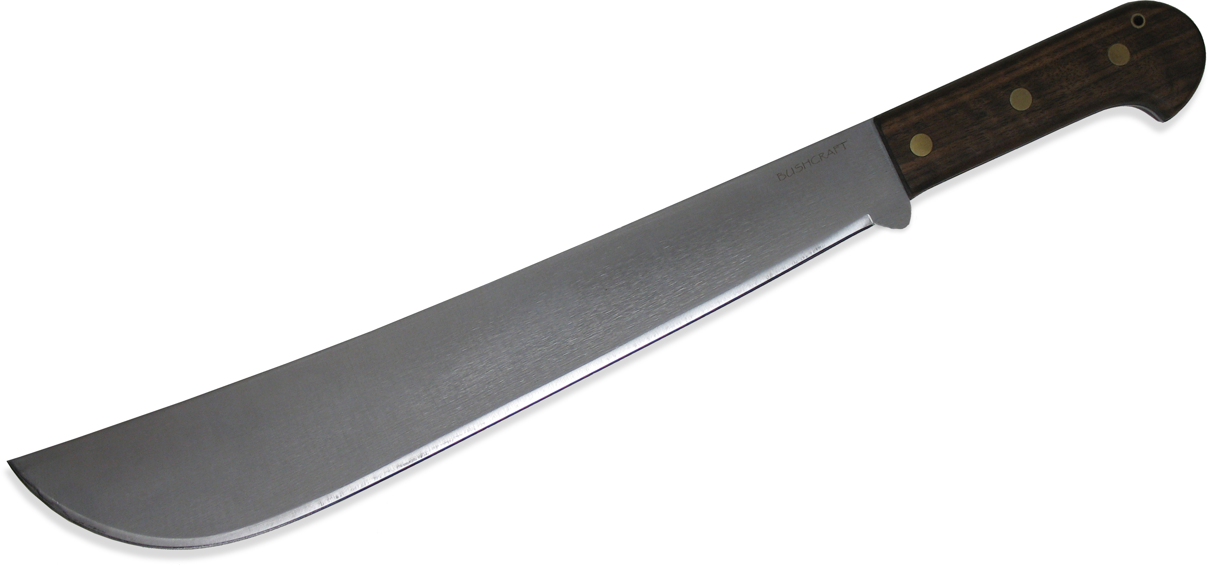
machete

Slide 3
overwhelm

Slide 4
wholesaler

Slide 5
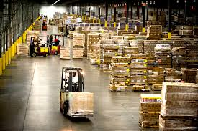
warehouse

Slide 6
chomp

Slide 7
lean

Slide 8
buddy

Slide 9
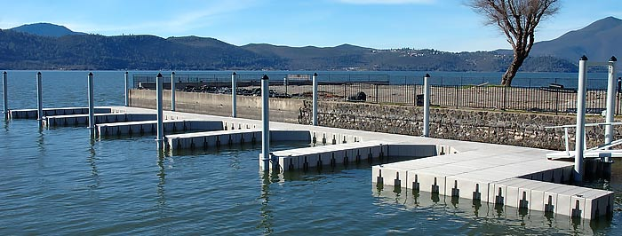
dock

Slide 10
dangle

Slide 11
roll

Slide 12
left?
right?
or

Slide 13
chomp

Slide 14
wholesaler

Slide 15
dock

Slide 16
lean

Slide 17
machete

Slide 18
overwhelm

Slide 19
warehouse

Slide 20
buddy

Slide 21
roll

Slide 22
dangle

Slide 33
Good Job!!

