Slide 1
VocabularY!

Slide 2
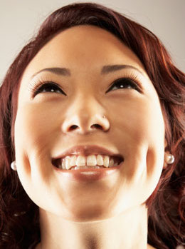
dimple

Slide 3
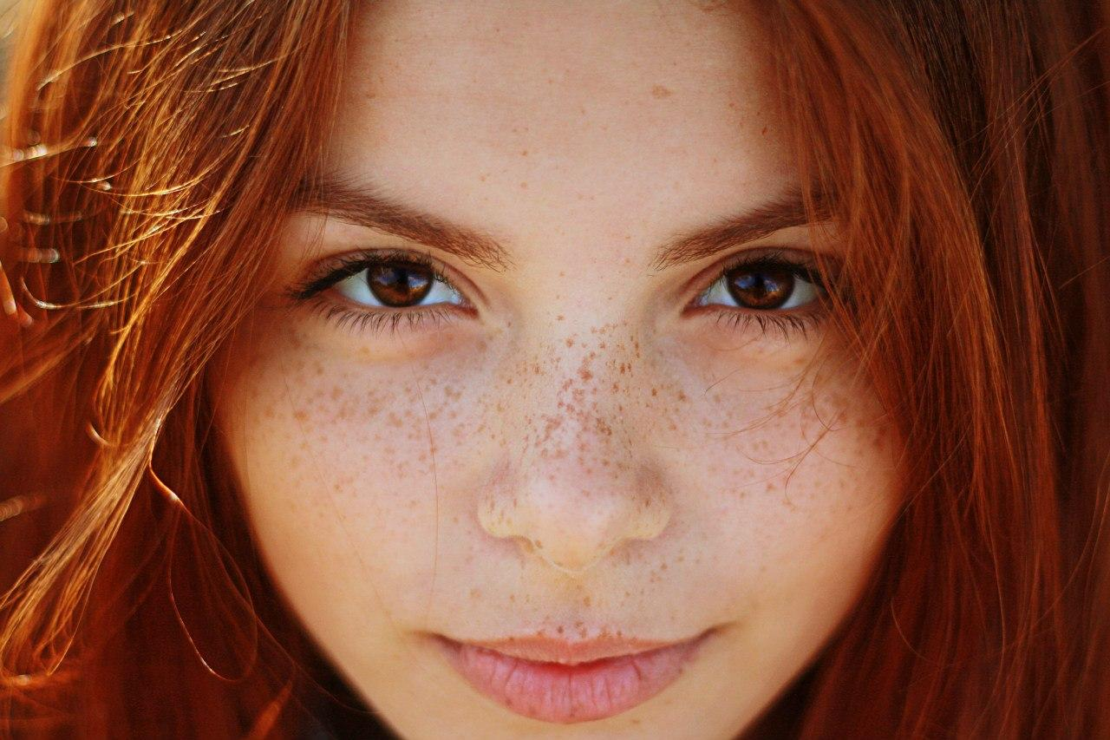
freckle

Slide 4
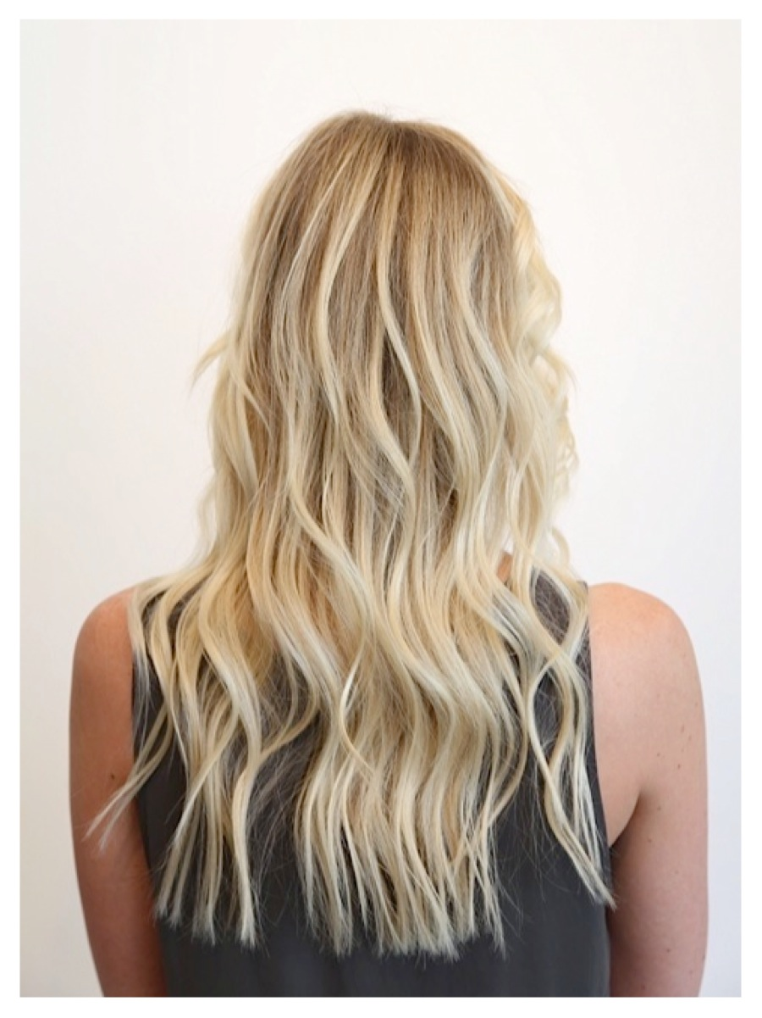
blonde

Slide 5
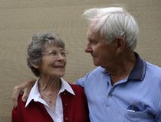
devoted

Slide 6
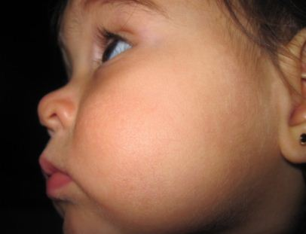
cheek

Slide 7
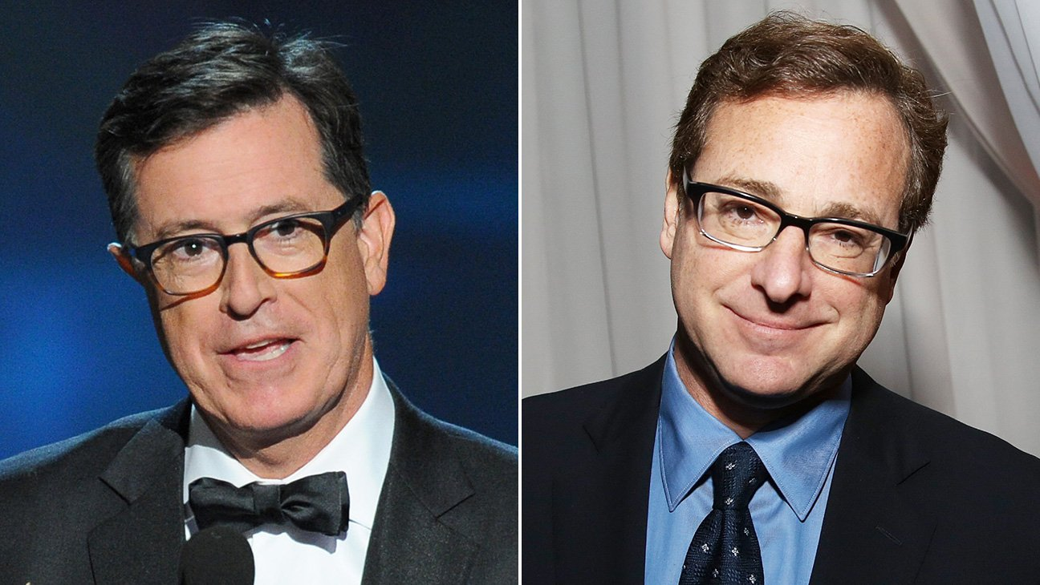
look alike

Slide 8
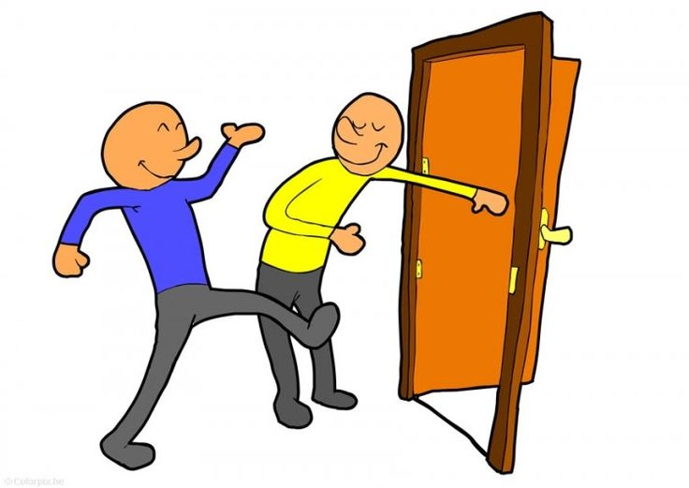
show somebody into

Slide 9
left?
right?
or

Slide 10
blonde

Slide 11
look alike

Slide 12
show somebody into

Slide 13
cheek

Slide 14
dimple

Slide 15
freckle

Slide 16
devoted

Slide 24
Good Job!!

