Slide 1
VocabularY!

Slide 2
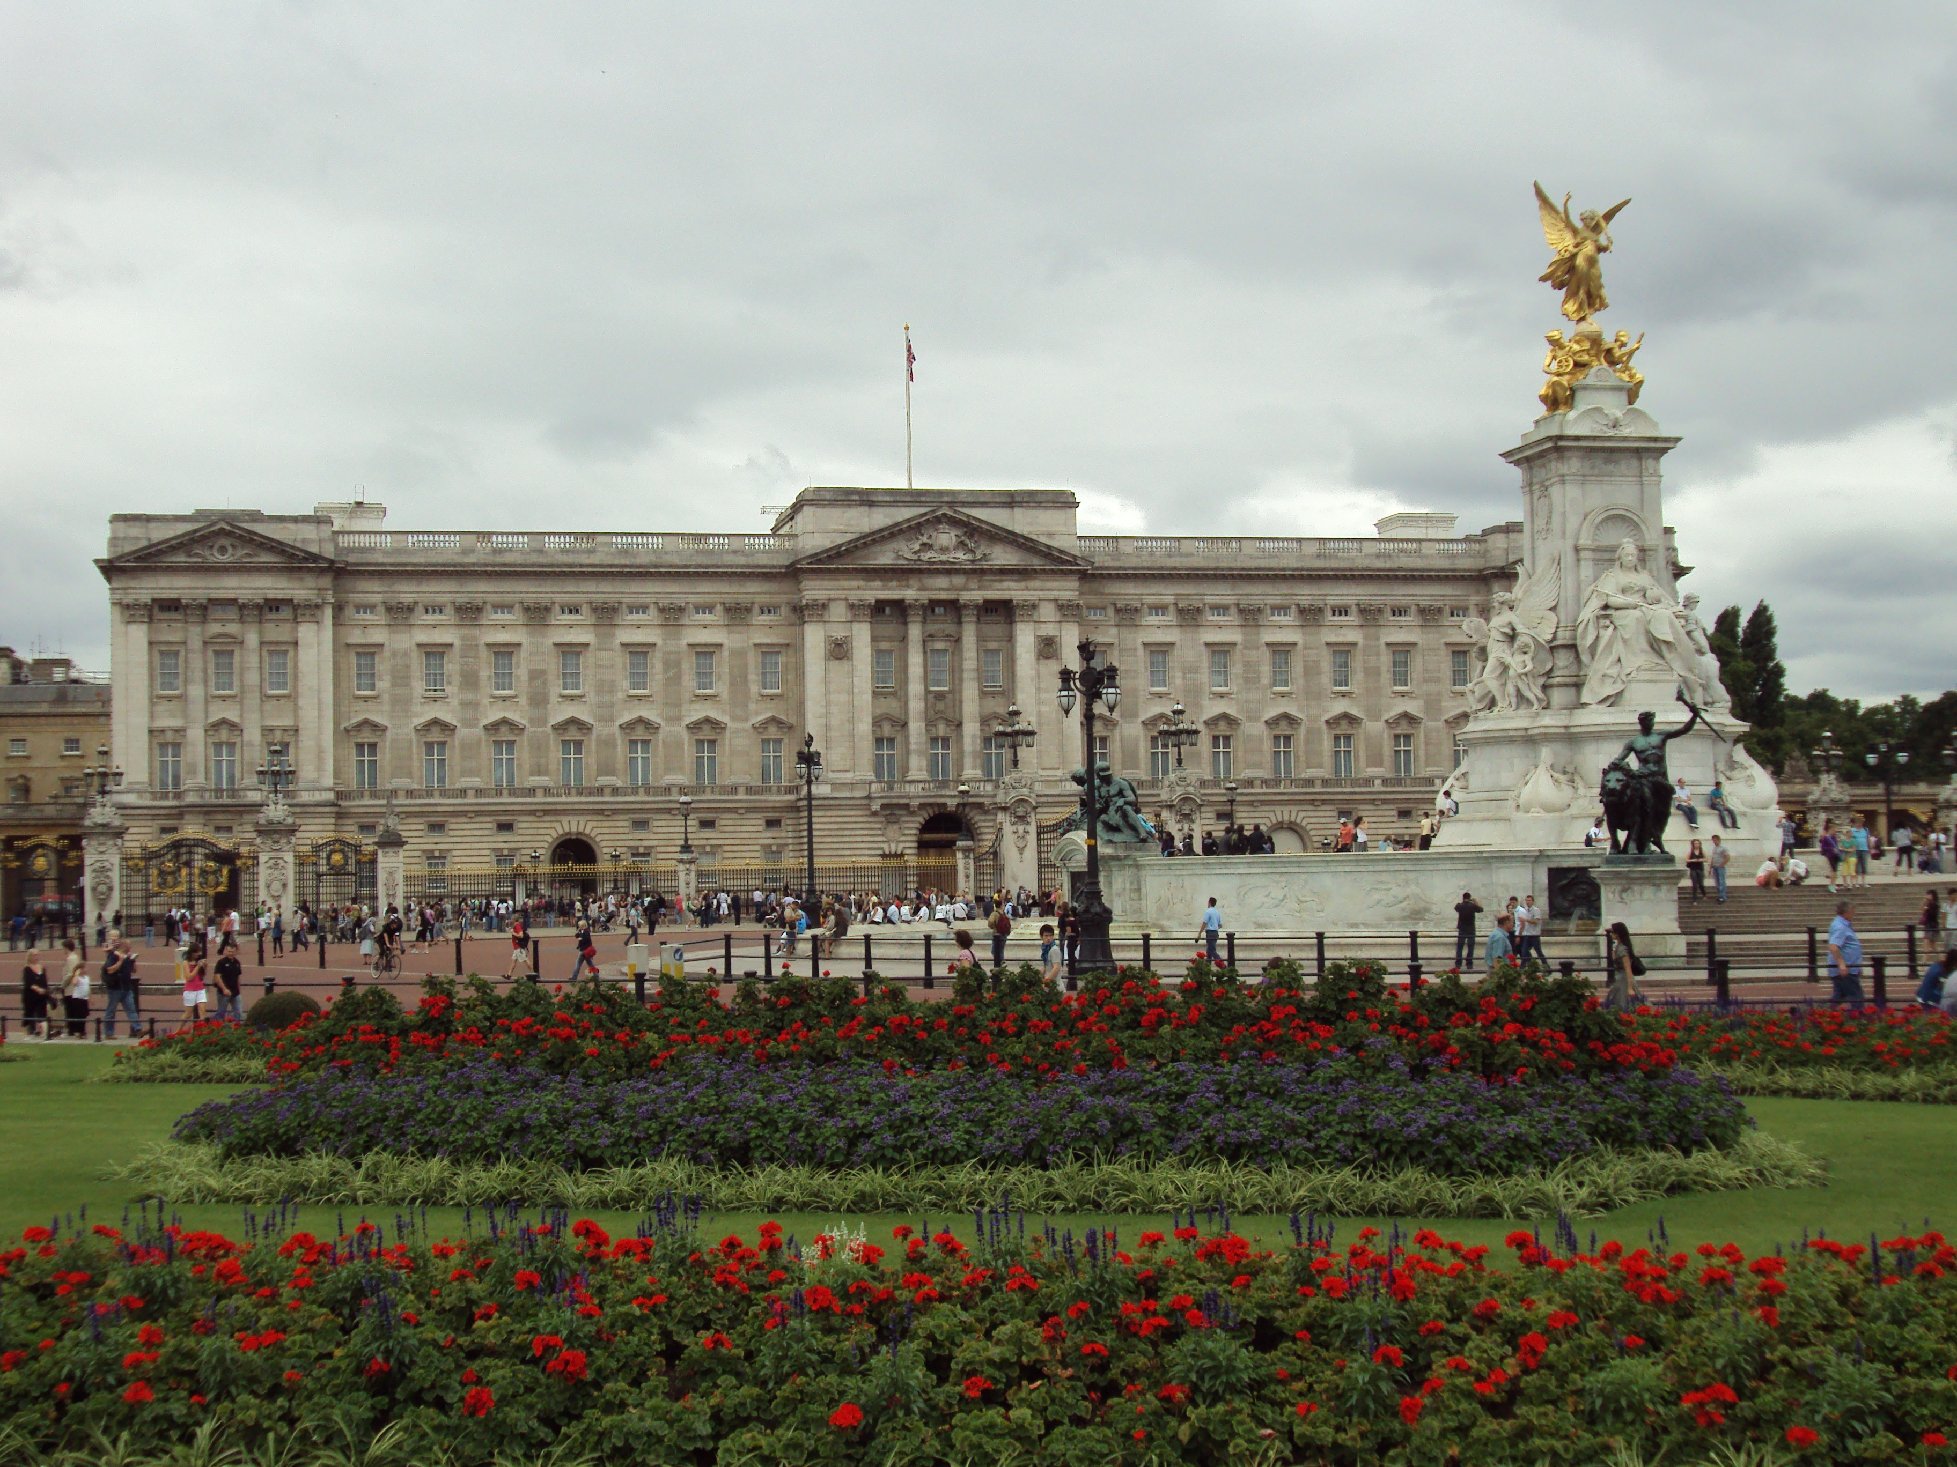
palace

Slide 3
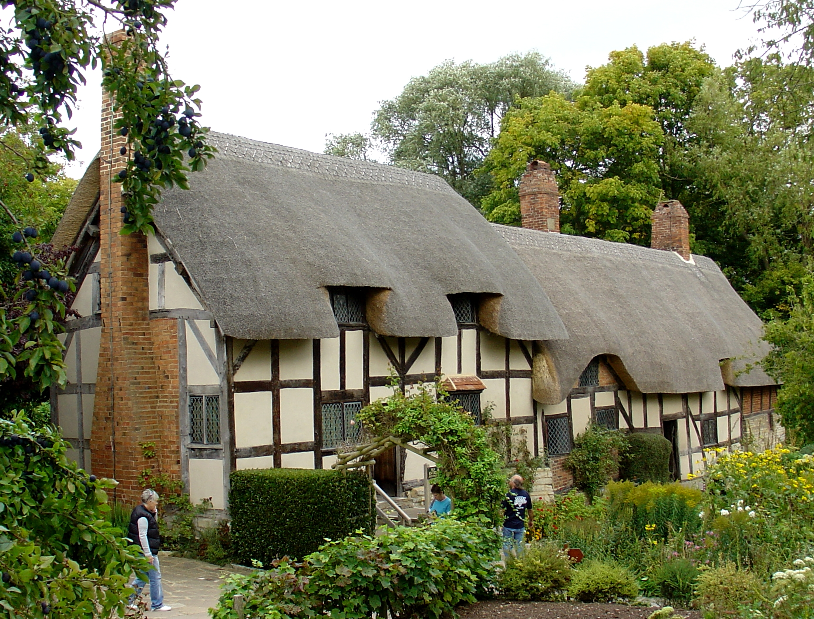
cottage

Slide 4
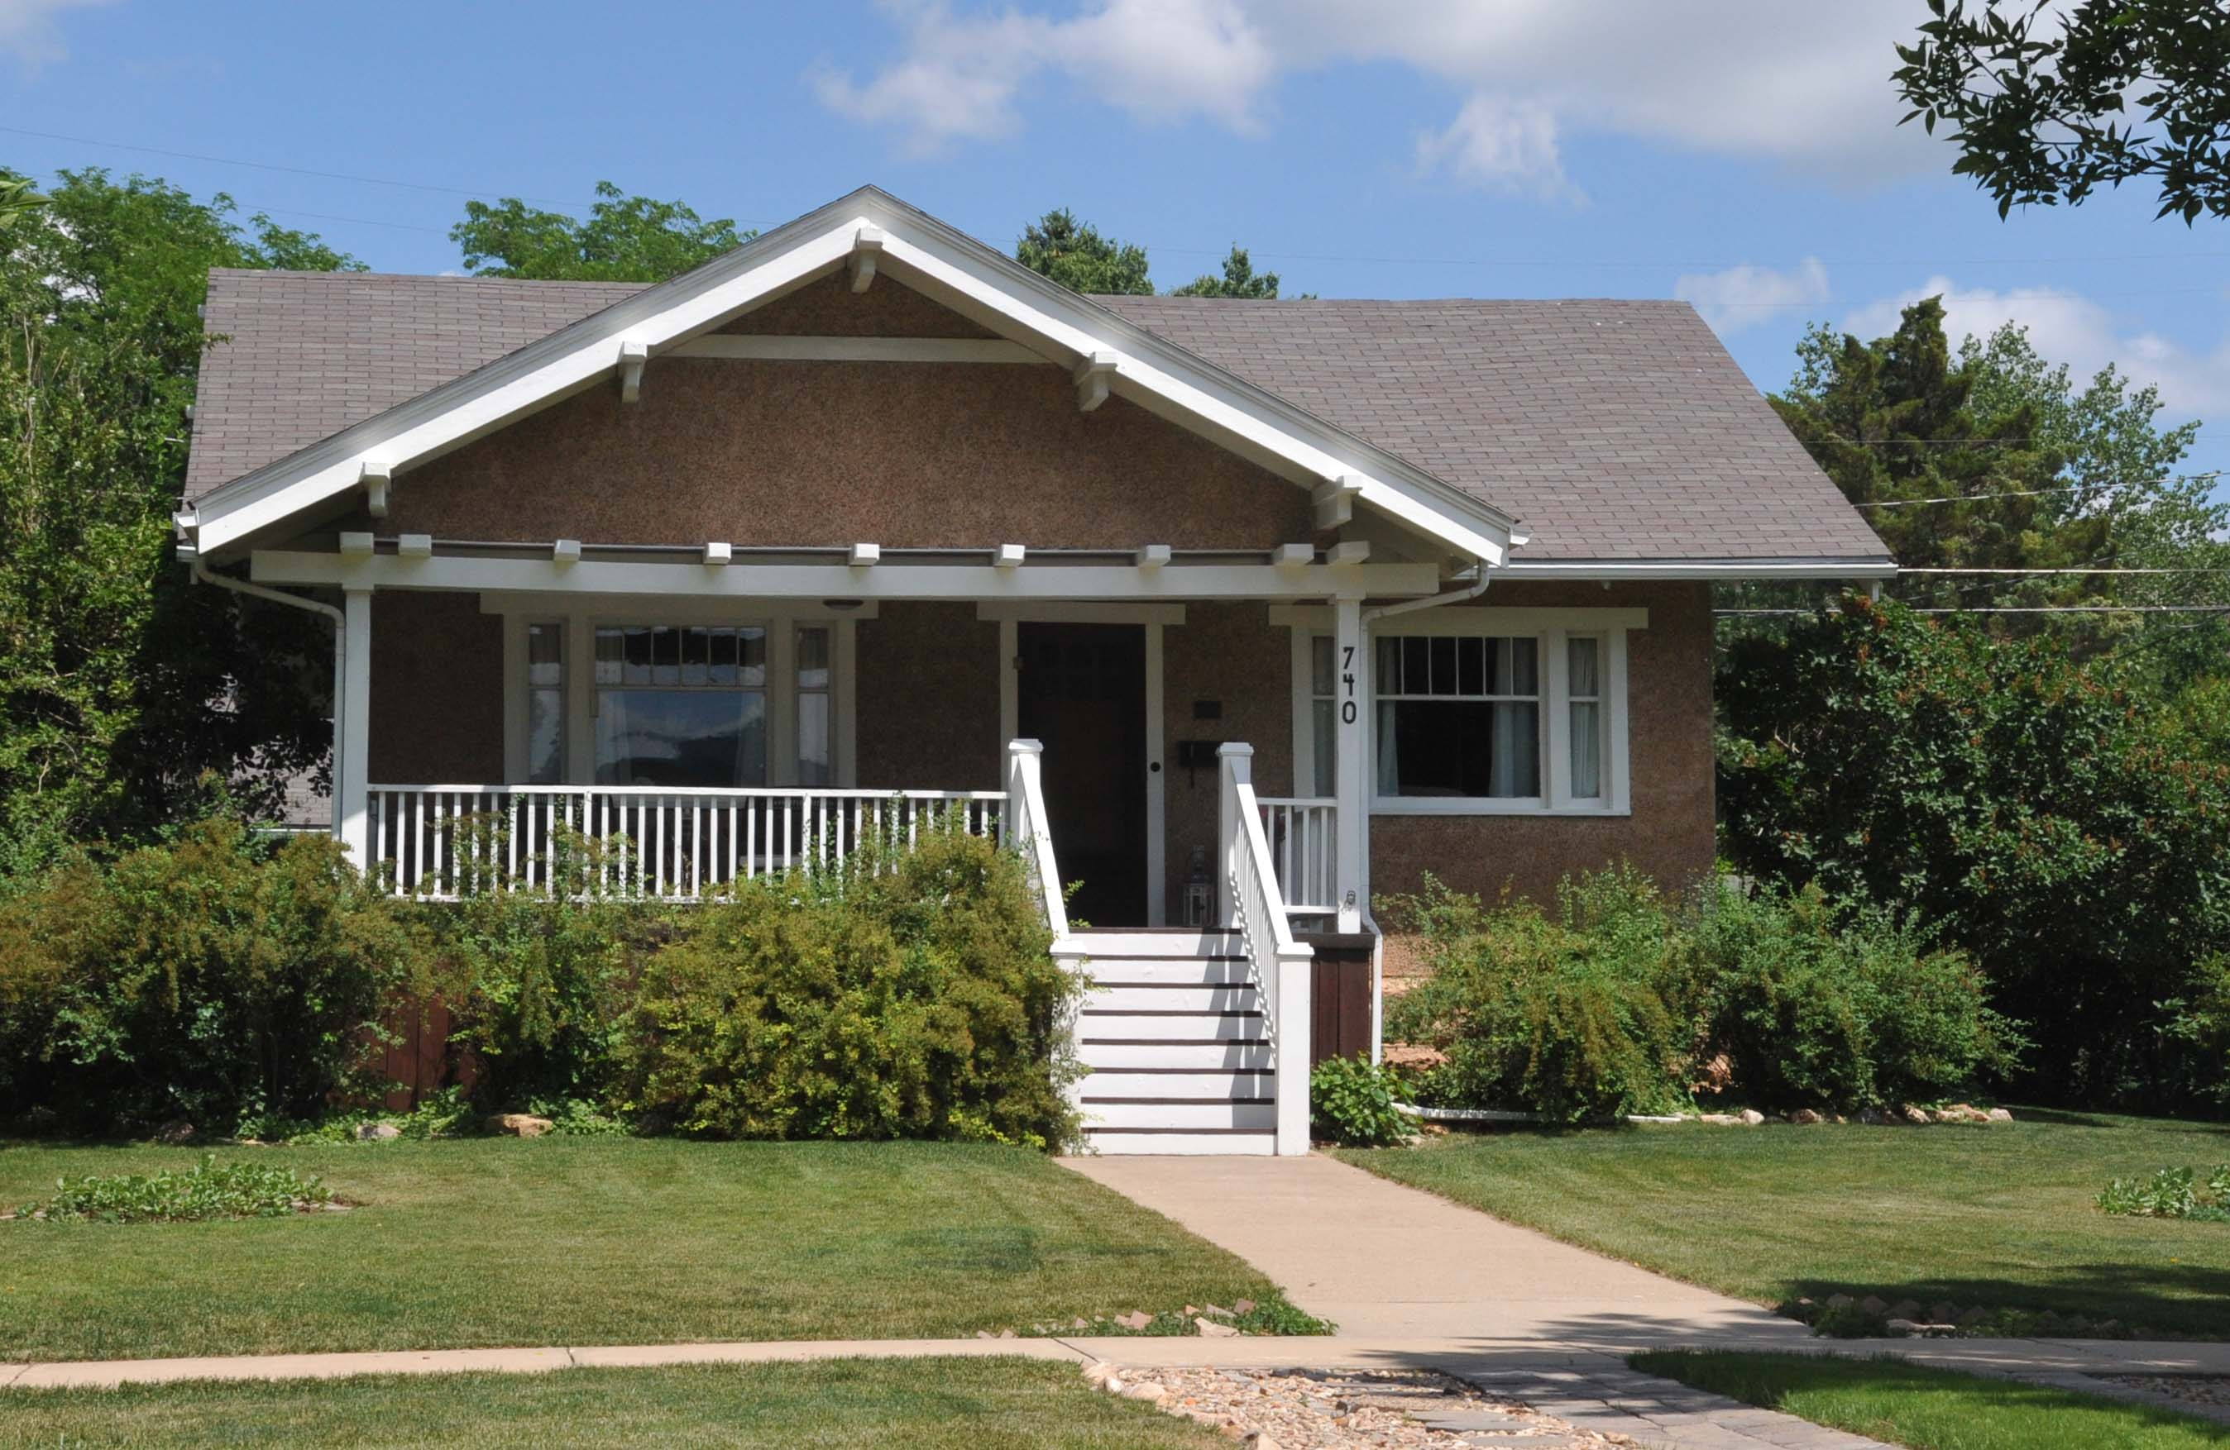
bungalow

Slide 5
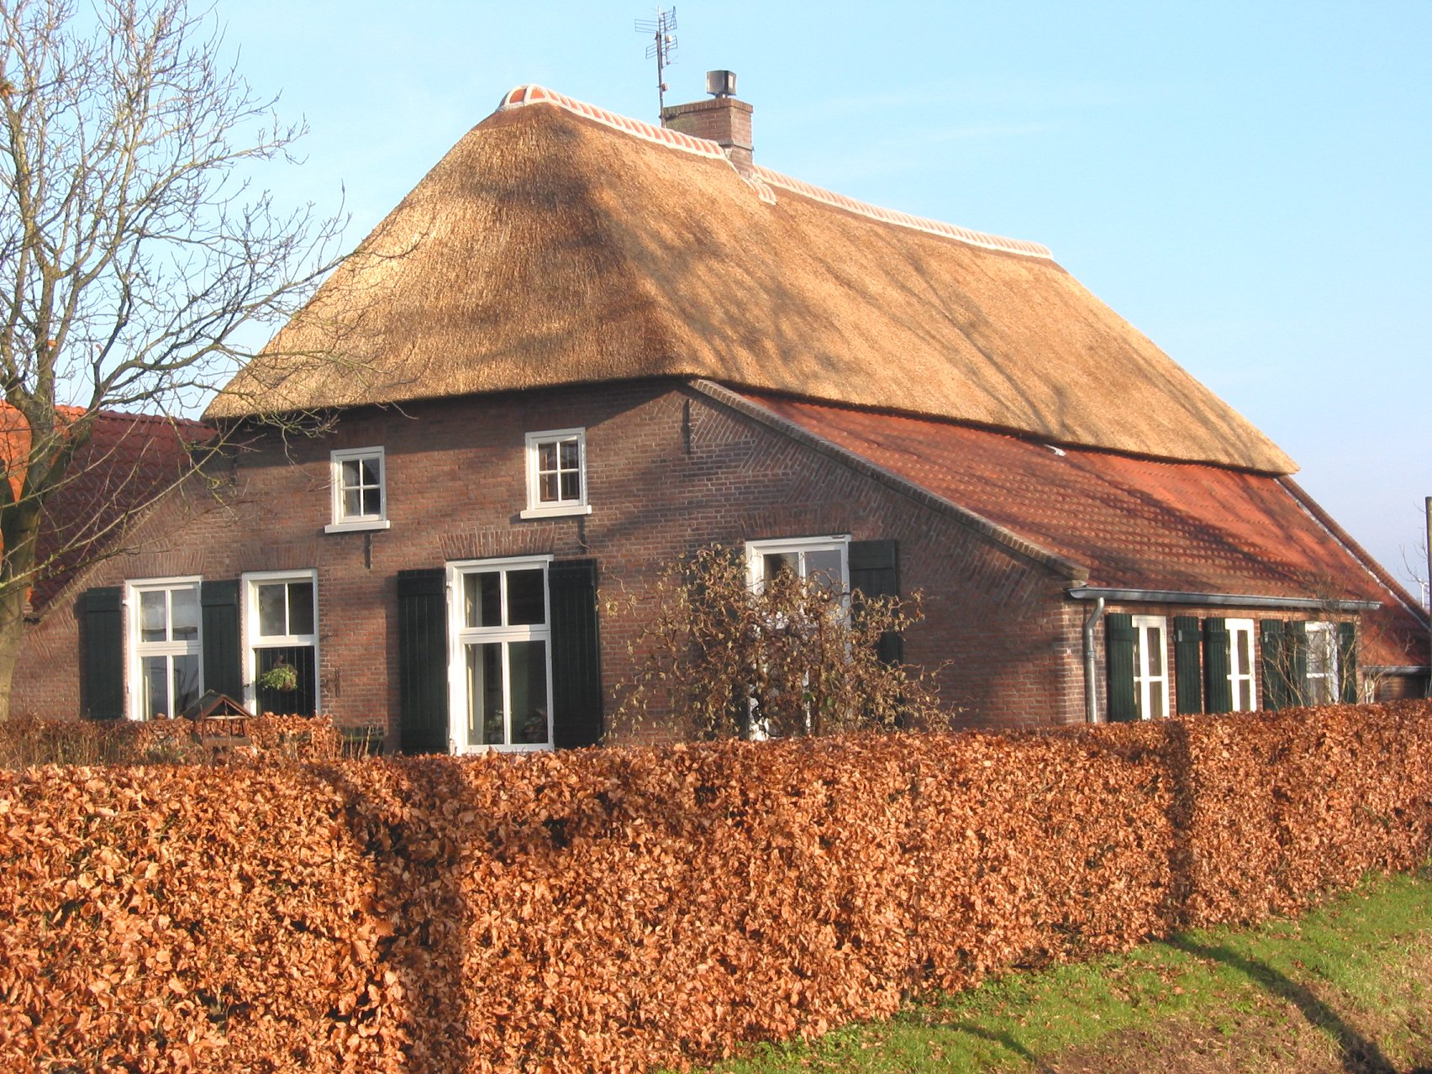
farmhouse

Slide 6
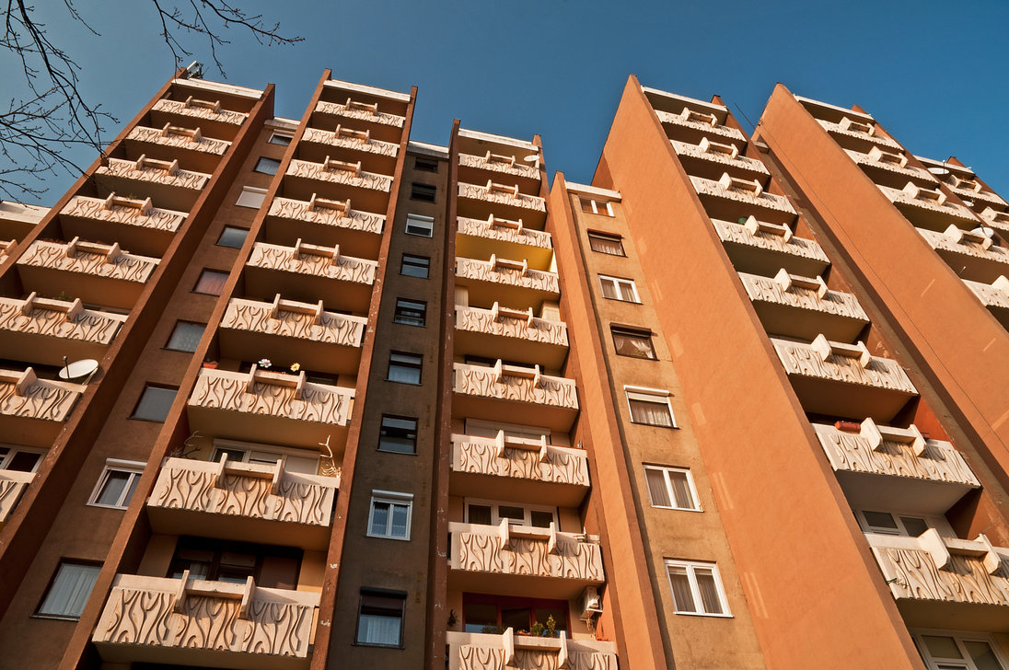
block of flats/apartments

Slide 7
left?
right?
or

Slide 8
bungalow

Slide 9
farmhouse

Slide 10
block of flats/apartments

Slide 11
cottage

Slide 12
palace

Slide 18
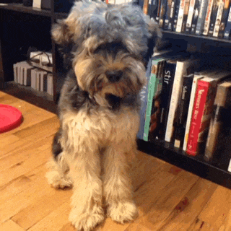
Good Job!!

