Slide 1
VocabularY!

Slide 2
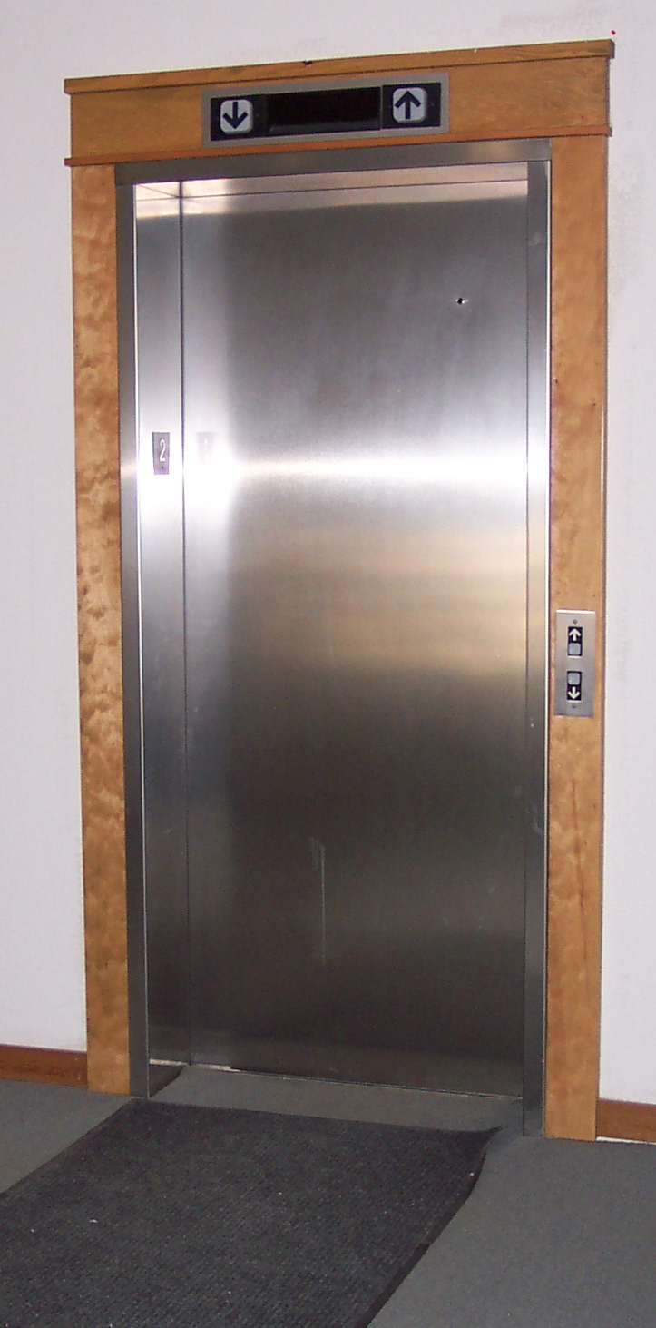
elevator

Slide 3
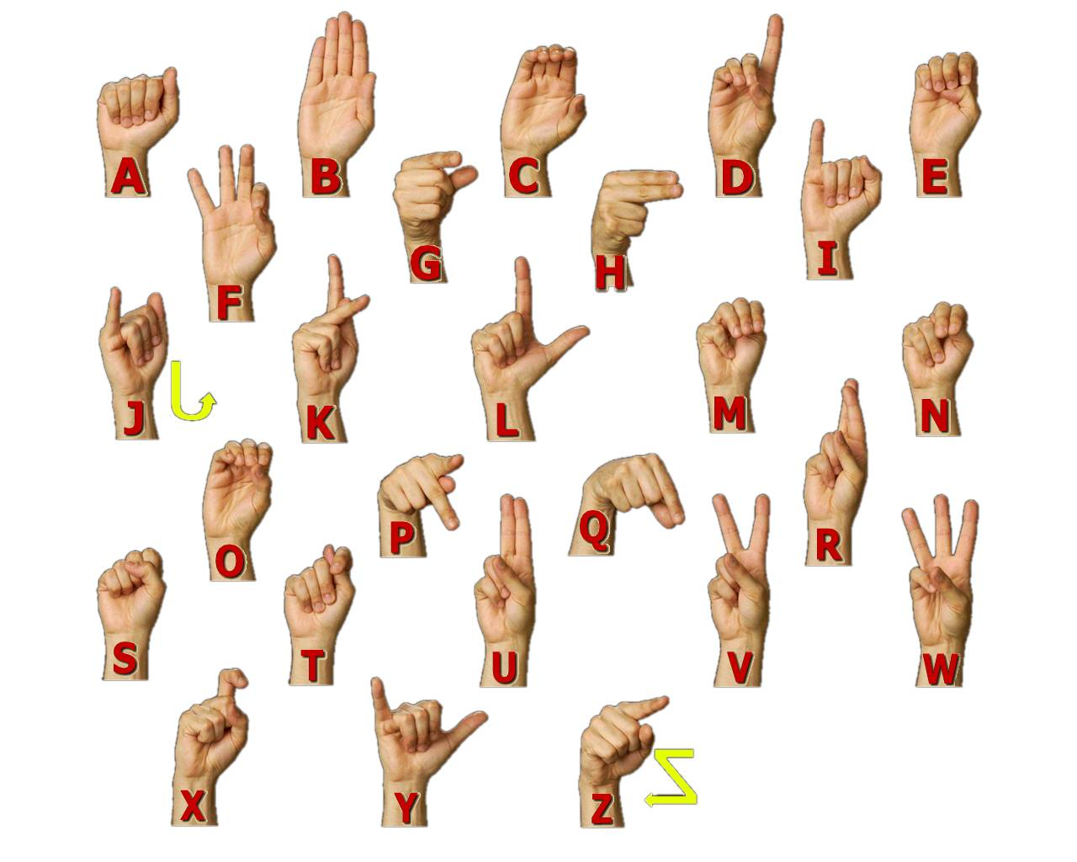
sign

Slide 4
excited

Slide 5
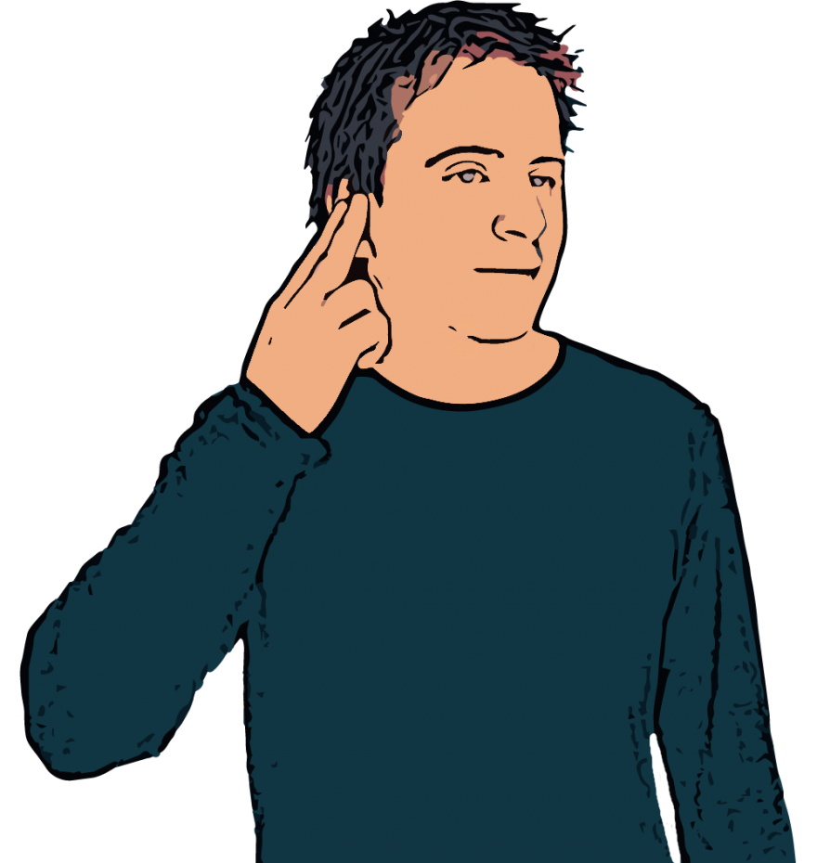
deaf

Slide 6
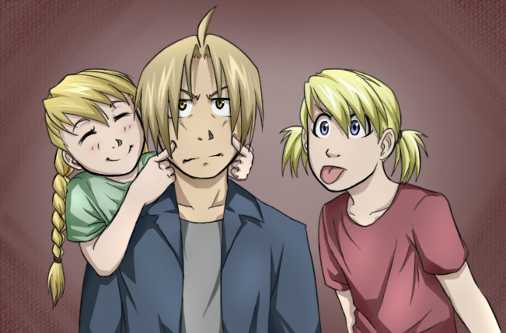
bother

Slide 7
find out

Slide 8
stop by

Slide 9
left?
right?
or

Slide 10
elevator

Slide 11
sign

Slide 12
deaf

Slide 13
bother

Slide 14
excited

Slide 15
stop by

Slide 16
find out

