Slide 1
VOCABULARY!

Slide 2
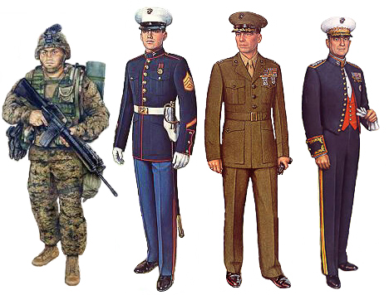
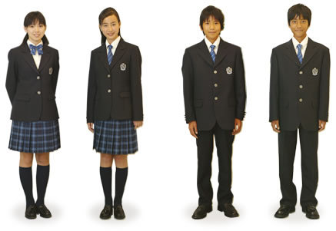
uniform

Slide 3
blazer
badge

Slide 4
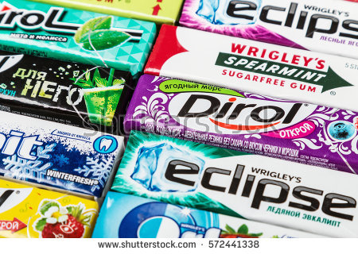
chewing gum

Slide 5
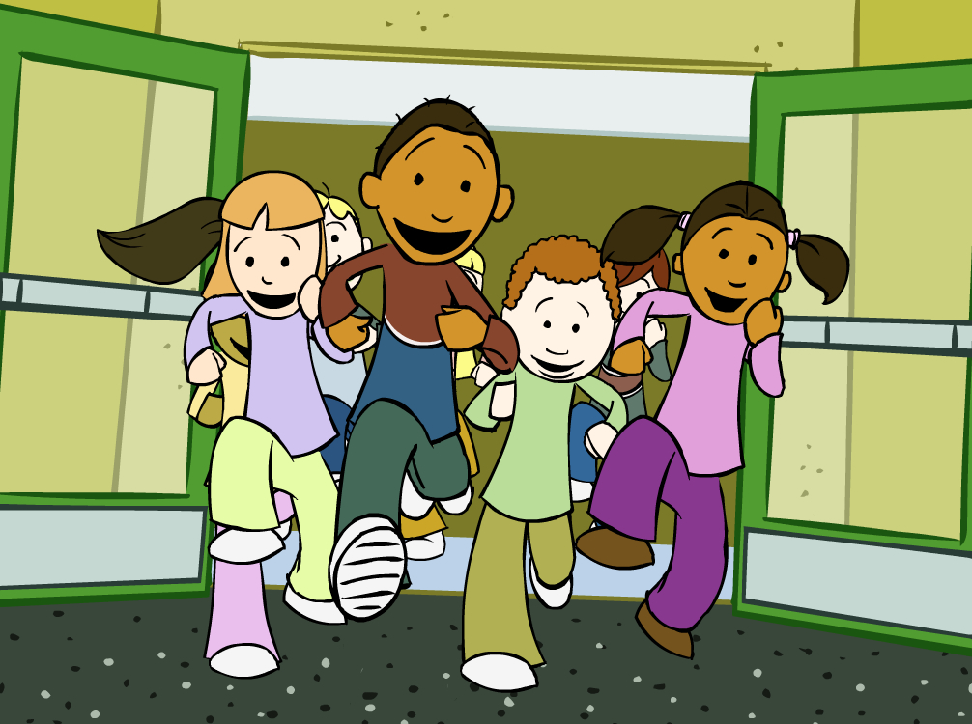
break

Slide 6
hand in

Slide 7
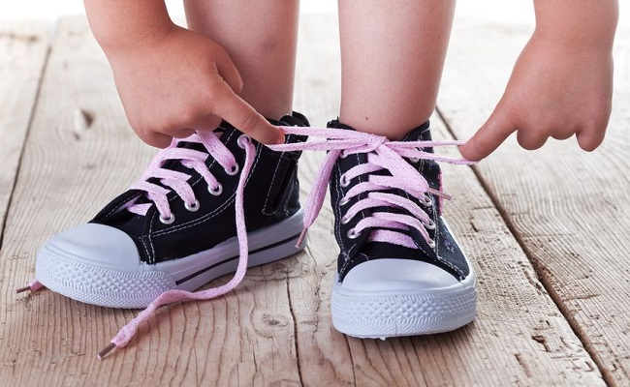
to tie

Slide 8
left?
right?
or

Slide 9
chewing gum

Slide 10
badge

Slide 11
uniform

Slide 12
hand in

Slide 13
blazer

Slide 14
to tie

Slide 15
break

Slide 18
uniform

Slide 23
