Slide 1
VocabularY!

Slide 2
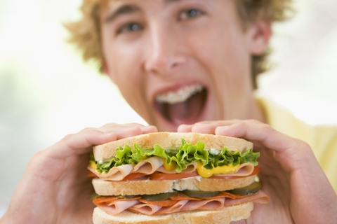
eat a sandwich

Slide 3
share news

Slide 4
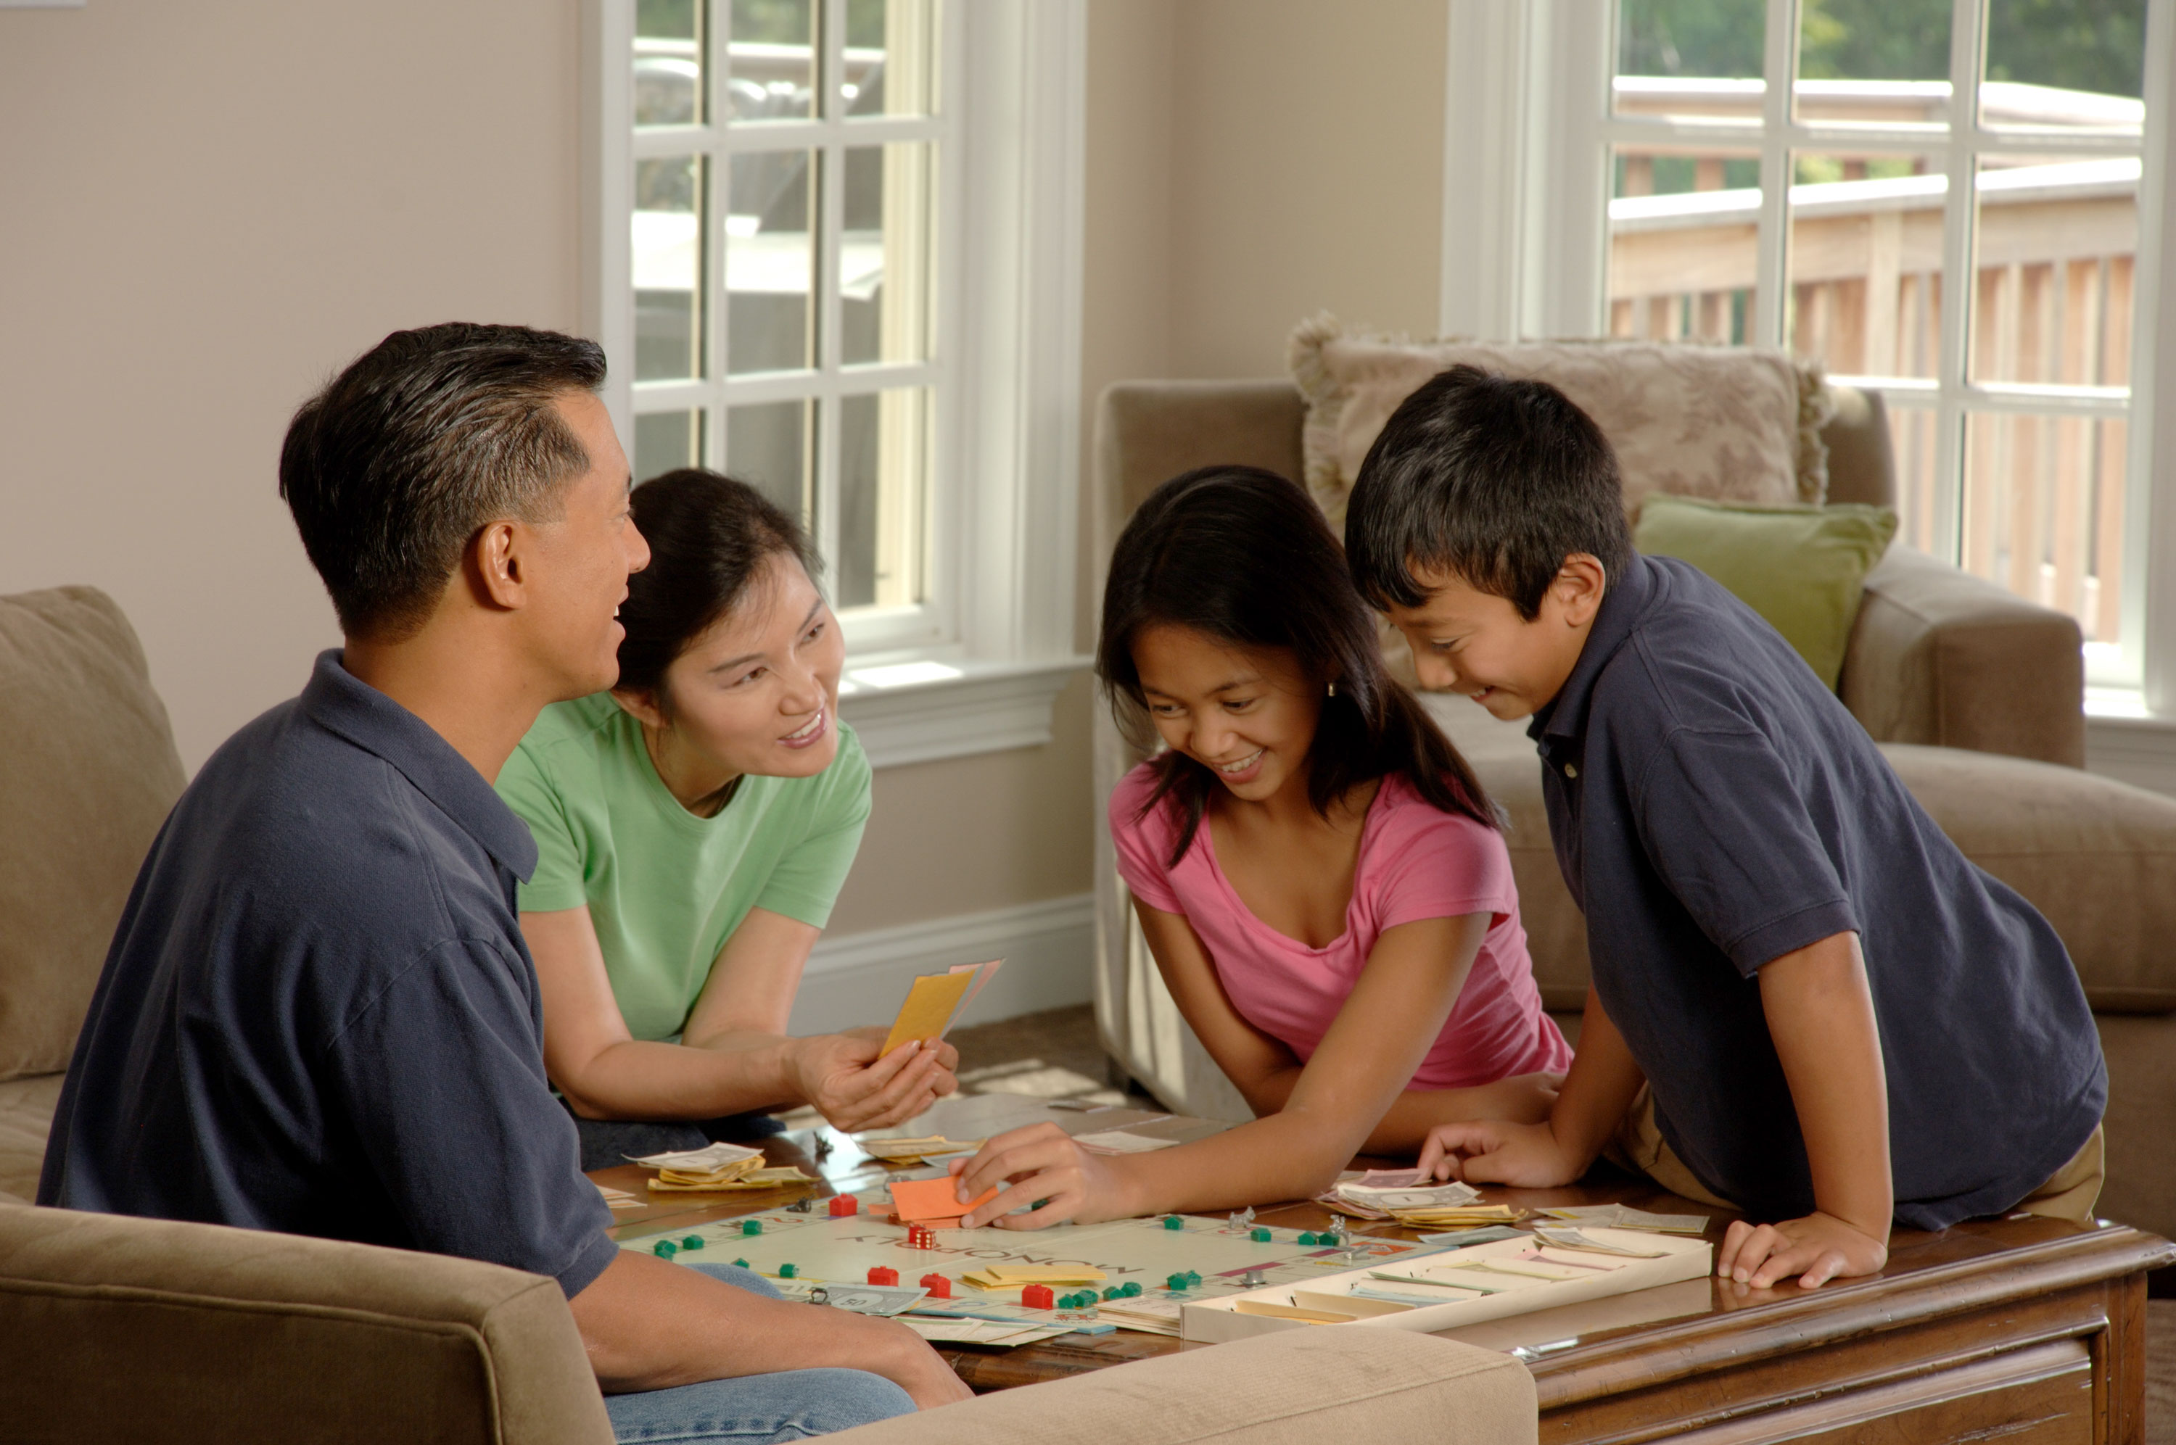
play games

Slide 5
draw pictures

Slide 6
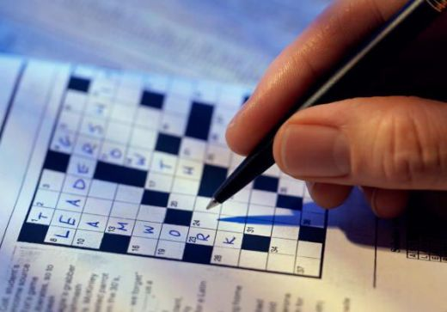
do crosswords

Slide 7
do sums

Slide 8
read texts

Slide 9
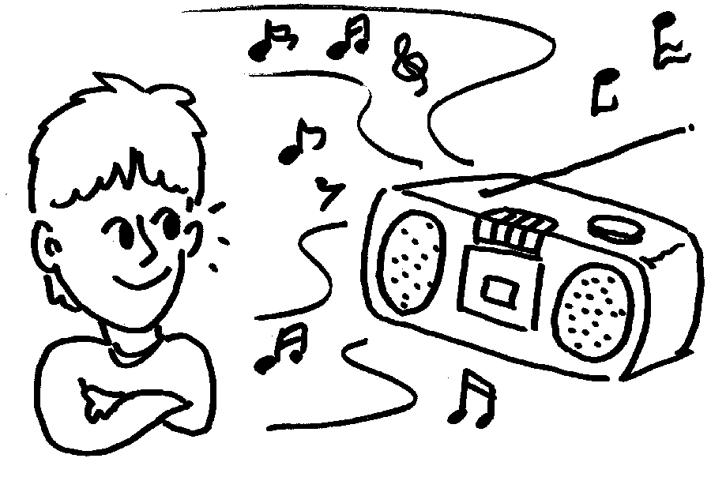
listen to music

Slide 10
do sports

Slide 11
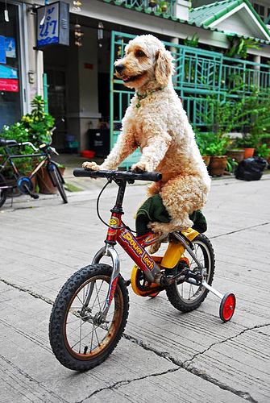
ride a bike

Slide 12
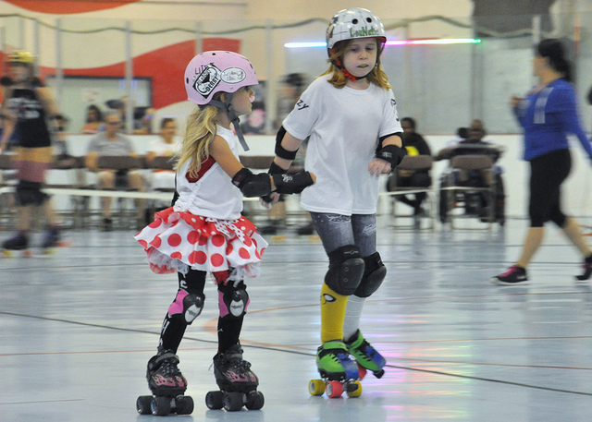
roller skate

Slide 13
text-message

Slide 14
left?
right?
or

Slide 15
share news

Slide 16
eat a sandwich

Slide 17
draw pictures

Slide 18
play games

Slide 19
do sums

Slide 20
do crosswords

Slide 21
read texts

Slide 22
do sports

Slide 23
ride a bike

Slide 24
roller skate

Slide 25
text-message

Slide 26
listen to music

