Slide 1
VocabularY!

Slide 2
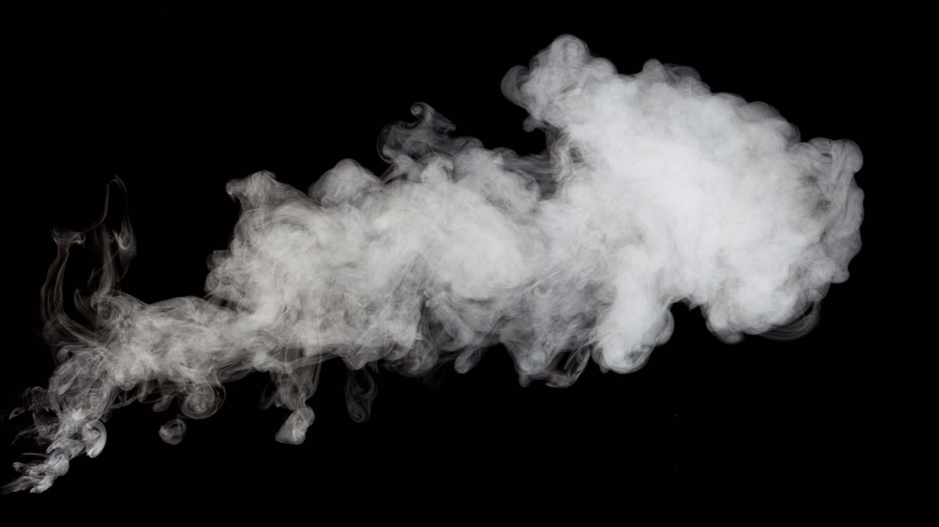
smoke

Slide 3
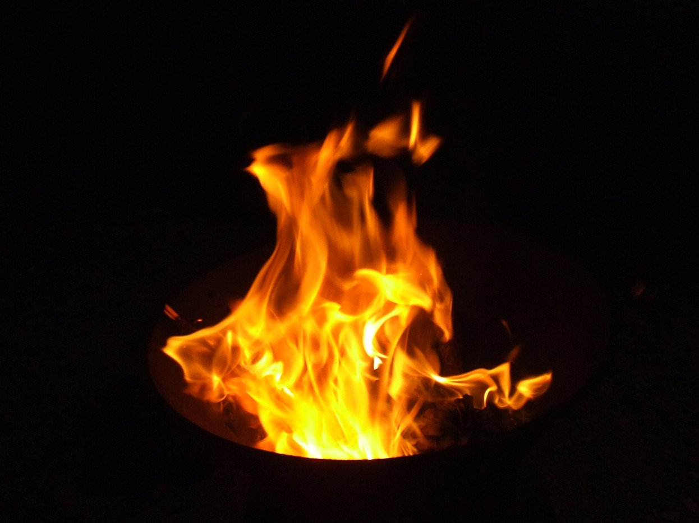
fire

Slide 4
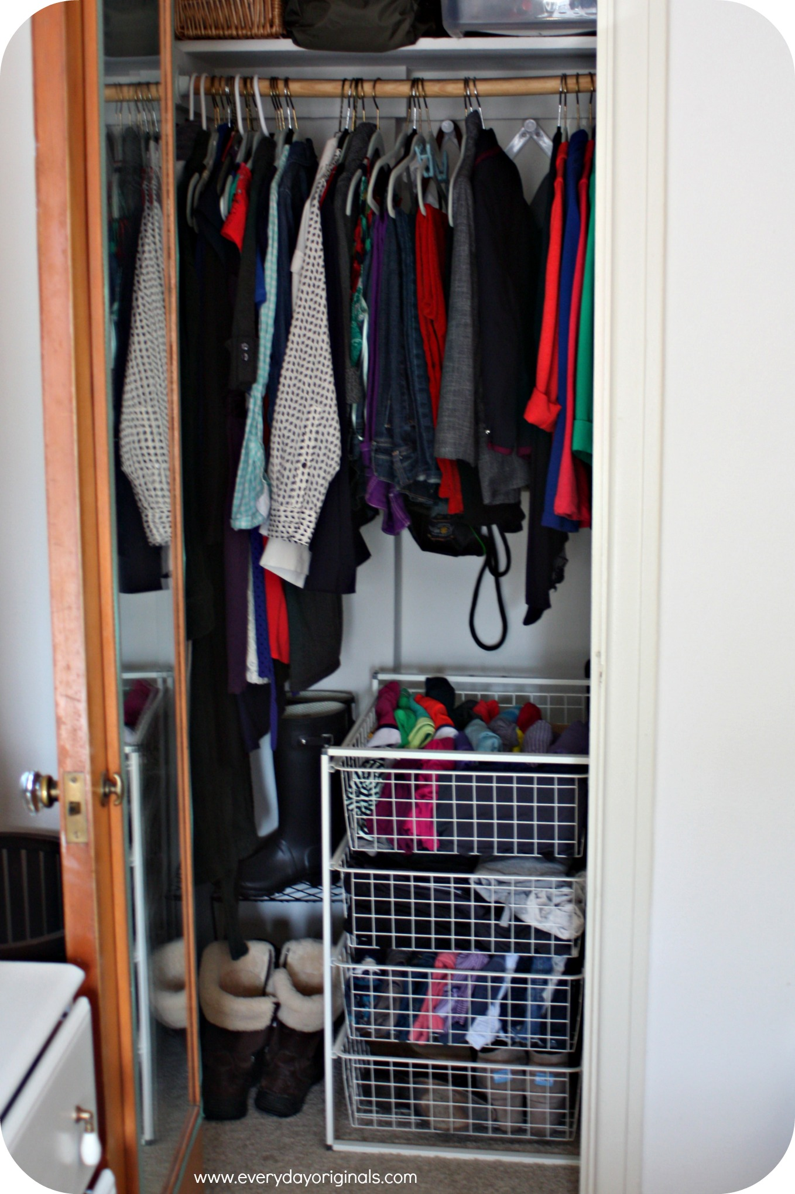
closet

Slide 5
fast

Slide 6
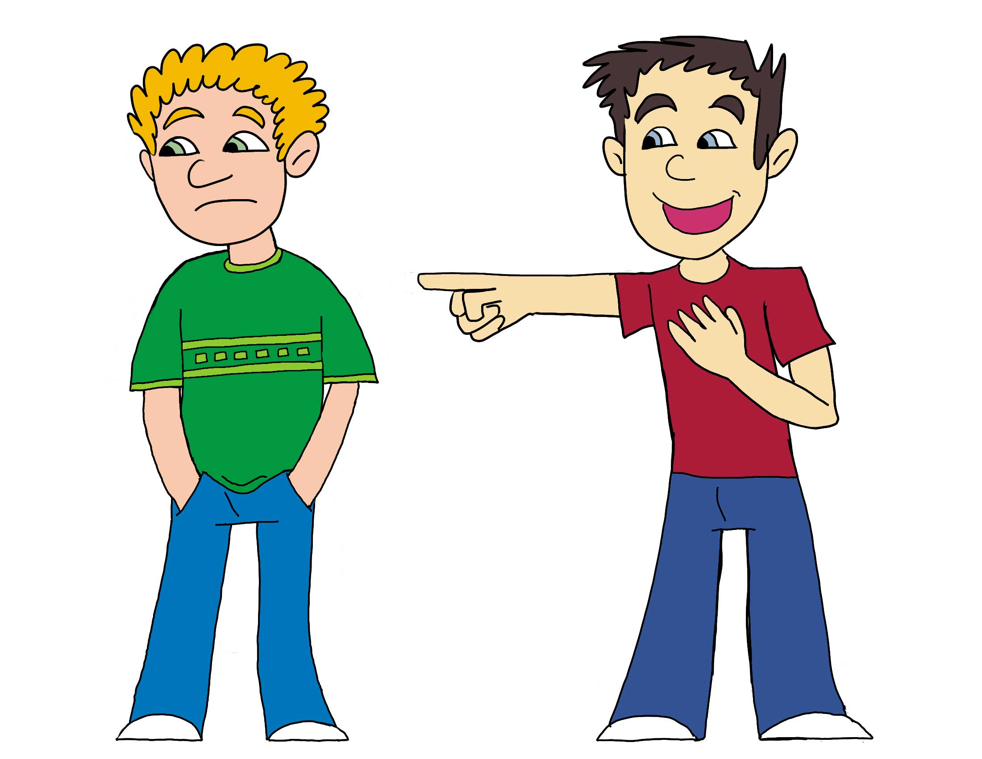
to make fun of

Slide 7
to point

Slide 8
to pour

Slide 9
left?
right?
or

Slide 10
fire

Slide 11
smoke

Slide 12
to point

Slide 13
fast

Slide 14
to pour

Slide 15
to make fun of

Slide 16
closet

Slide 24
Good Job!

