Slide 1
Weather adjectives!

Slide 2
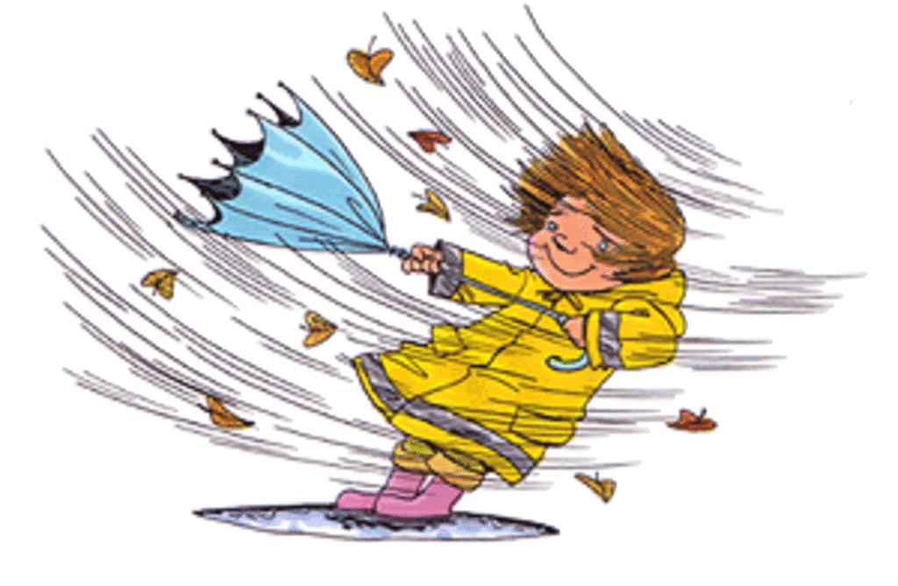
windy

Slide 3
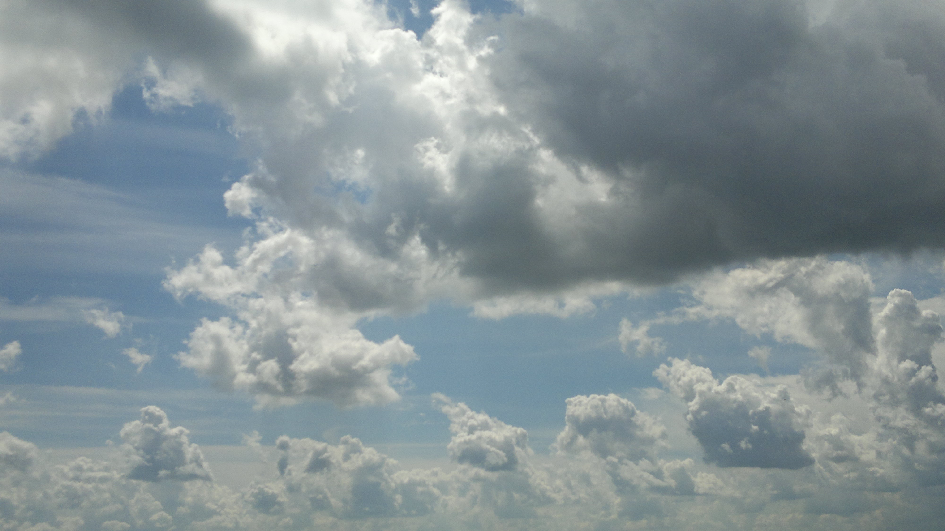
cloudy

Slide 4
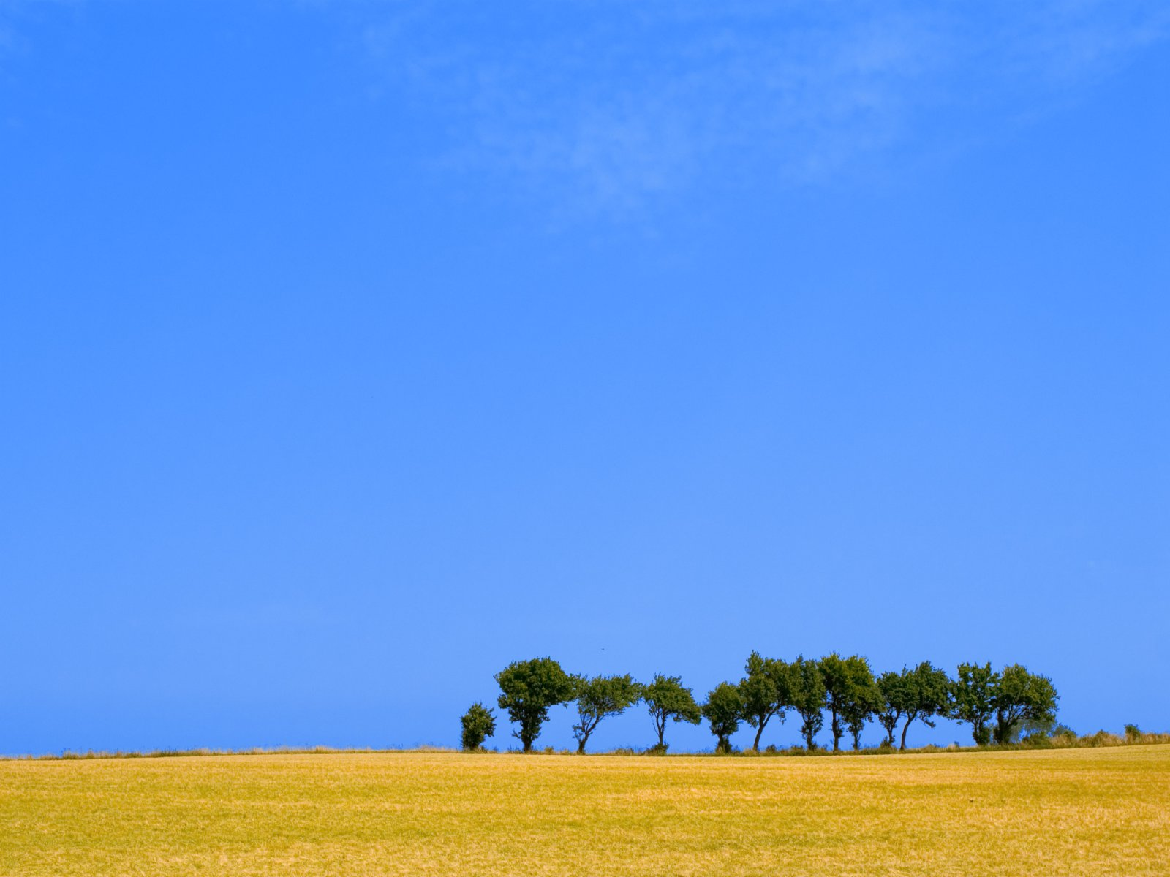
clear

Slide 5
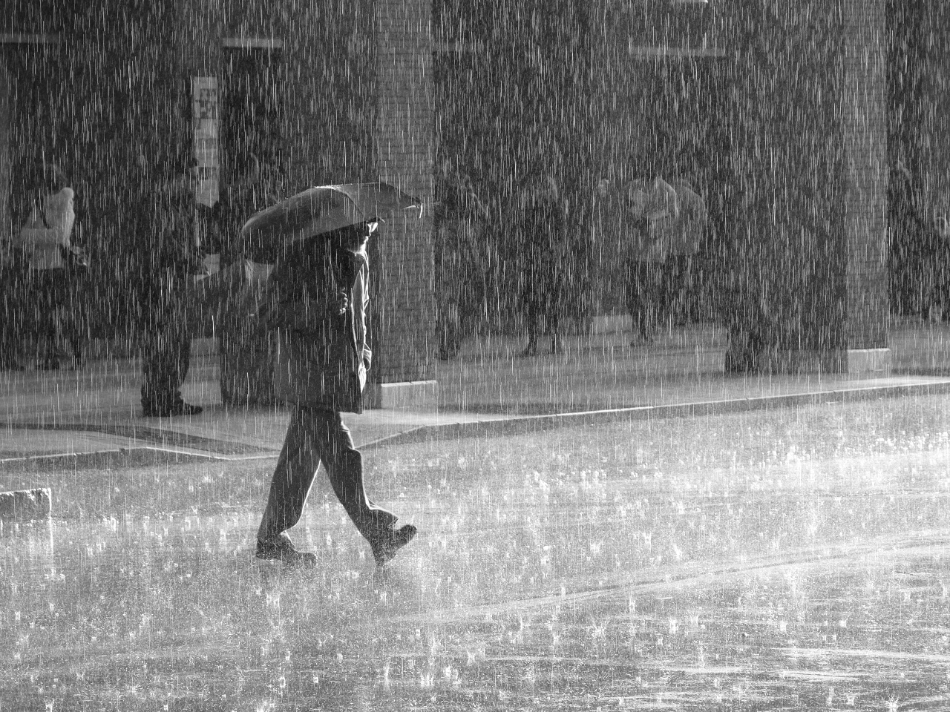
rainy

Slide 6
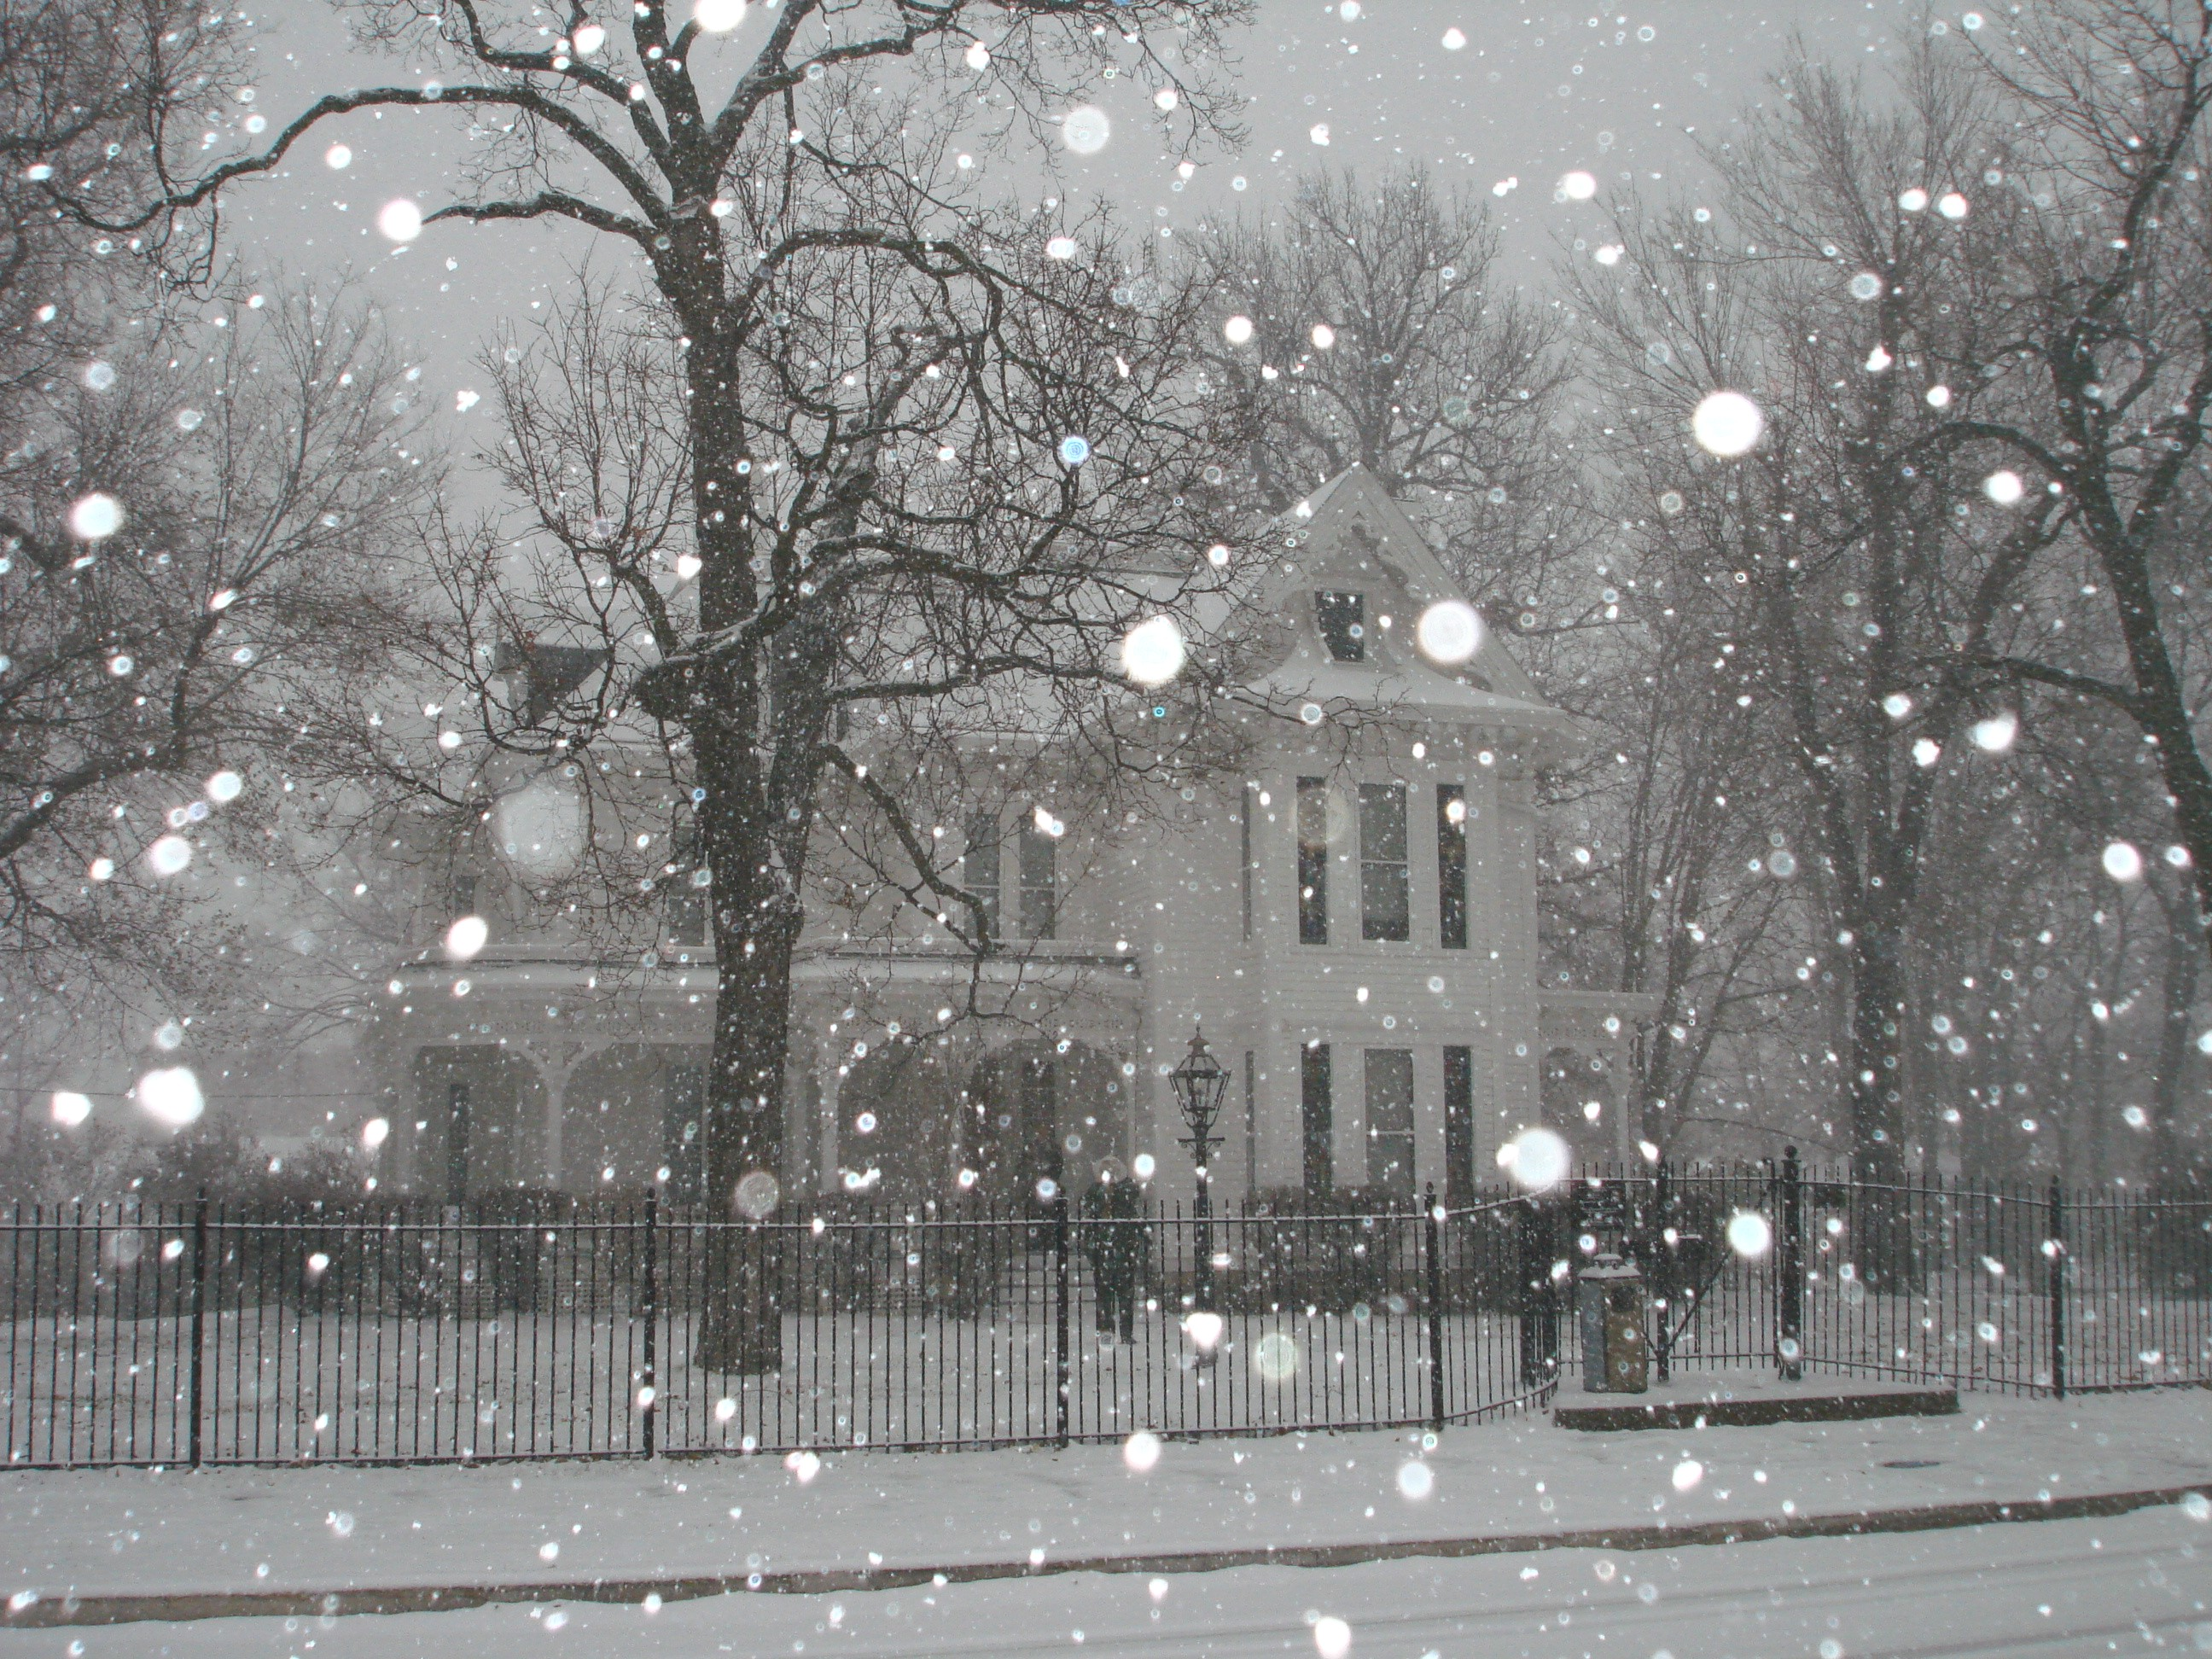
snowy

Slide 7
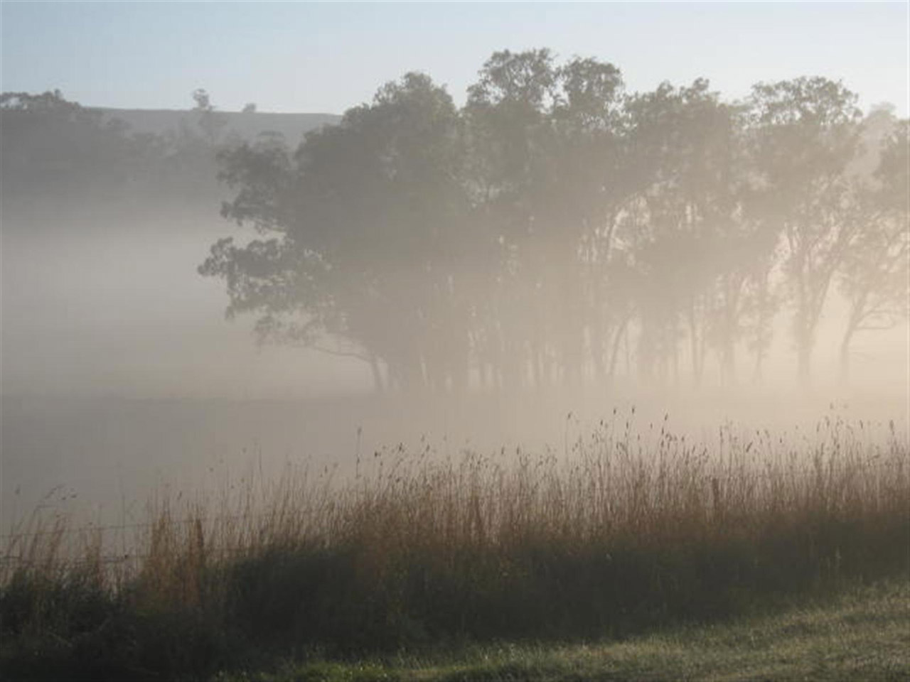
foggy

Slide 8
sunny

Slide 9
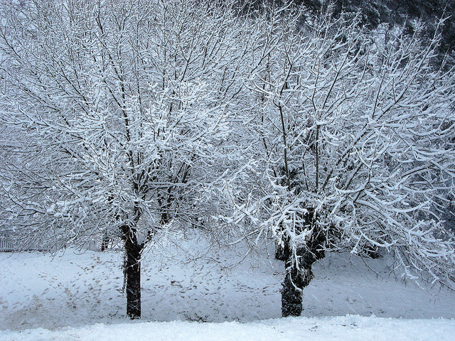
frosty

Slide 10
top?
or
bottom?

Slide 11
cloudy

Slide 12
clear

Slide 13
windy

Slide 14
snowy

Slide 15
rainy

Slide 16
frosty

Slide 17
foggy

Slide 18
sunny

