Slide 1
seasons!

Slide 2
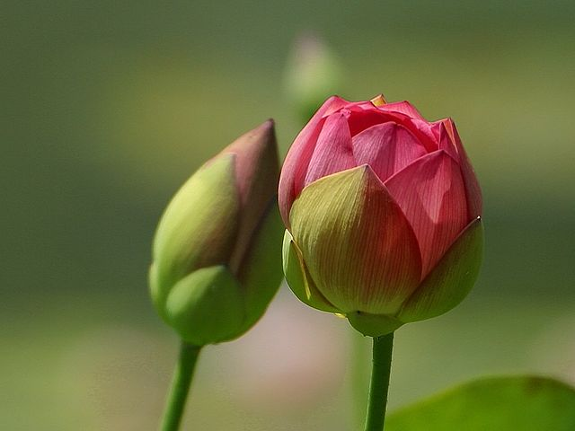
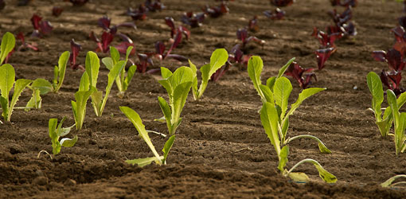
spring

Slide 3
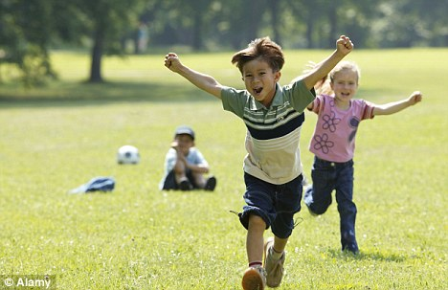
summer

Slide 4
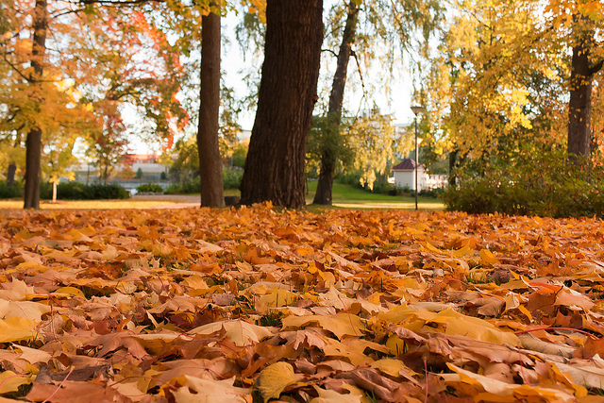
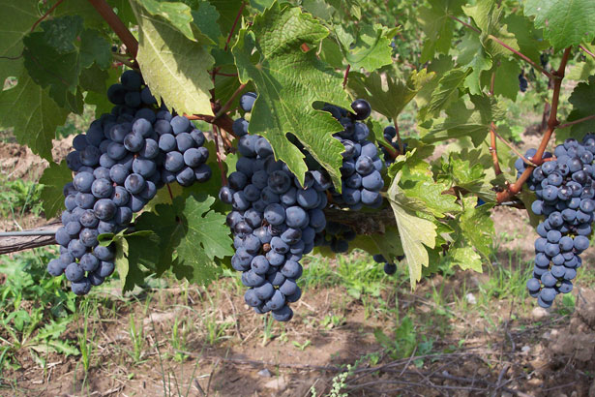
autumn

Slide 5
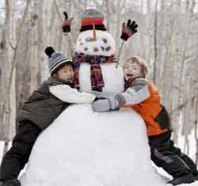
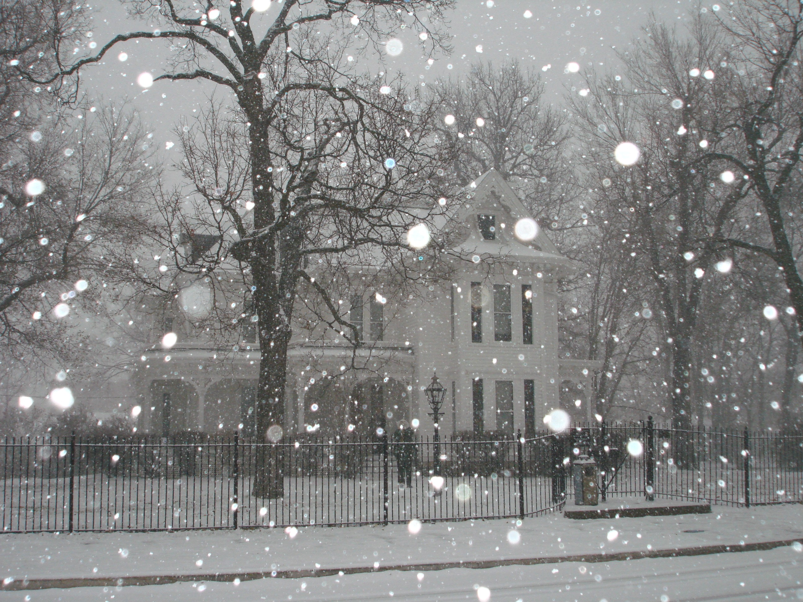
winter

Slide 6
vocabulary!

Slide 7
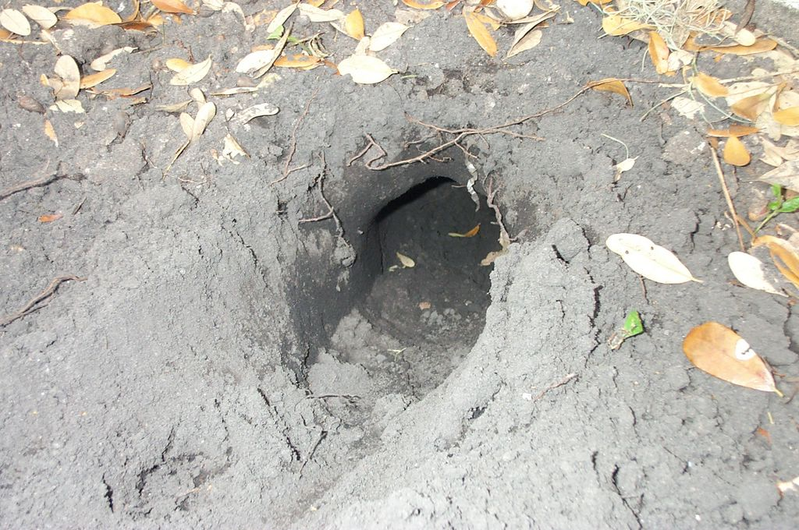
hole

Slide 8
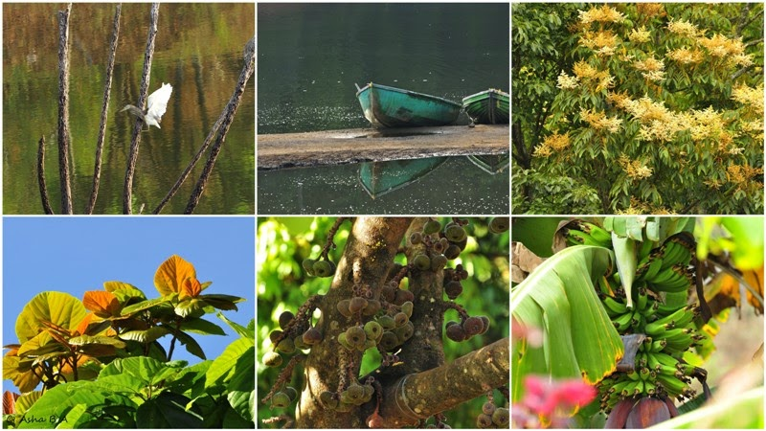
nature

Slide 9
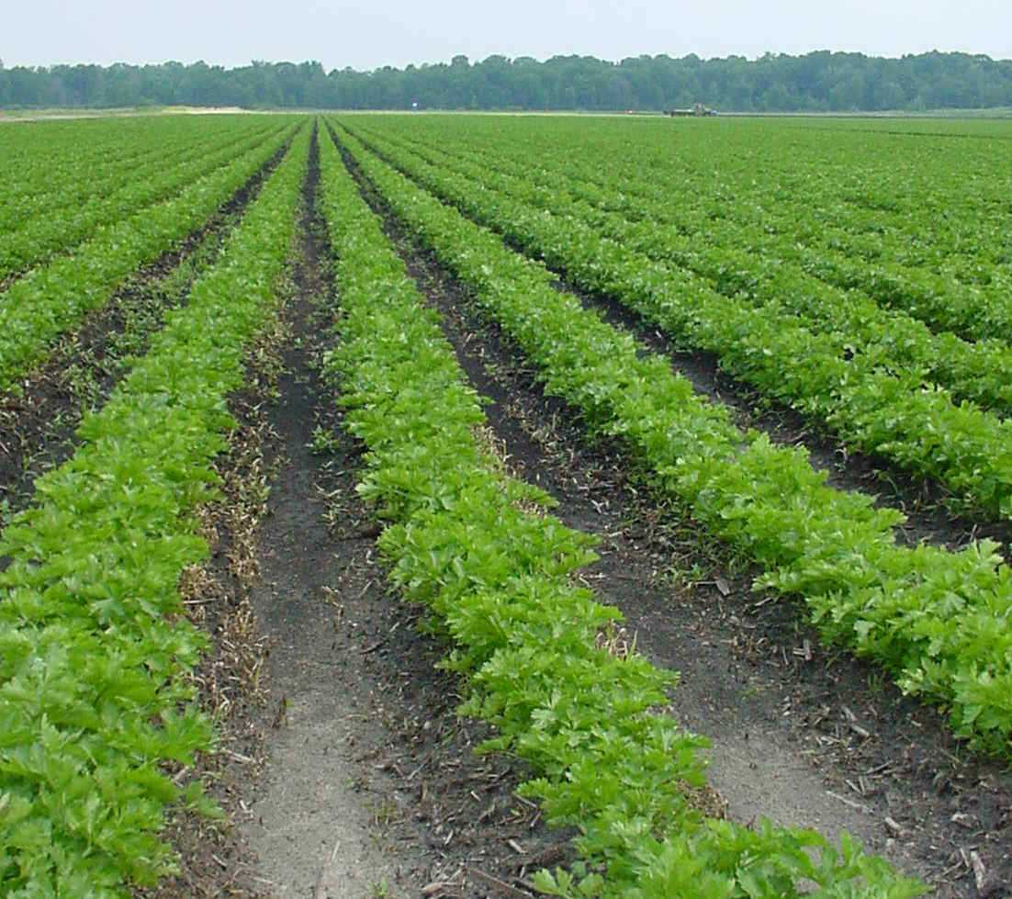
crops

Slide 10
top?
or
bottom?

Slide 11
autumn

Slide 12
spring

Slide 13
winter

Slide 14
summer

Slide 15
crops

Slide 16
nature

Slide 17
hole

Slide 25
