Slide 1
VocabULARY!

Slide 2
dictionary

Slide 3
librarian

Slide 4
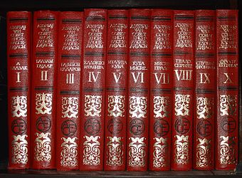
encyclopedia

Slide 5
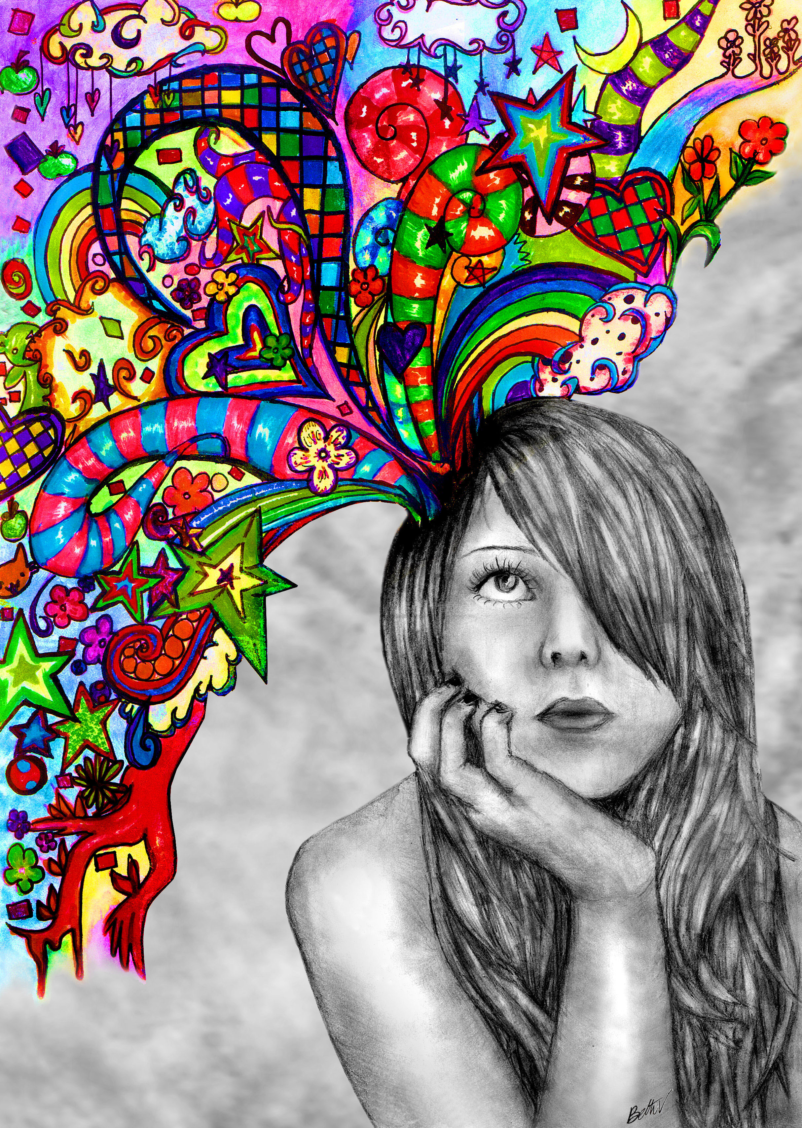
imagination

Slide 6
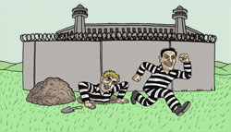
escape

Slide 7
information

Slide 8
top?
or
bottom?

Slide 9
librarian

Slide 10
dictionary

Slide 11
encyclopedia

Slide 12
imagination

Slide 13
escape

Slide 14
information

