Slide 1
VocabULARY!

Slide 2
adventure

Slide 3
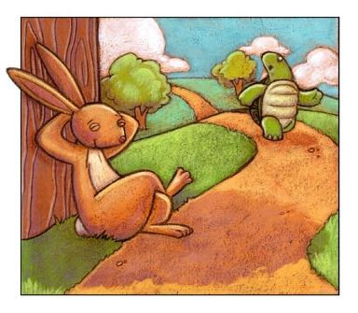
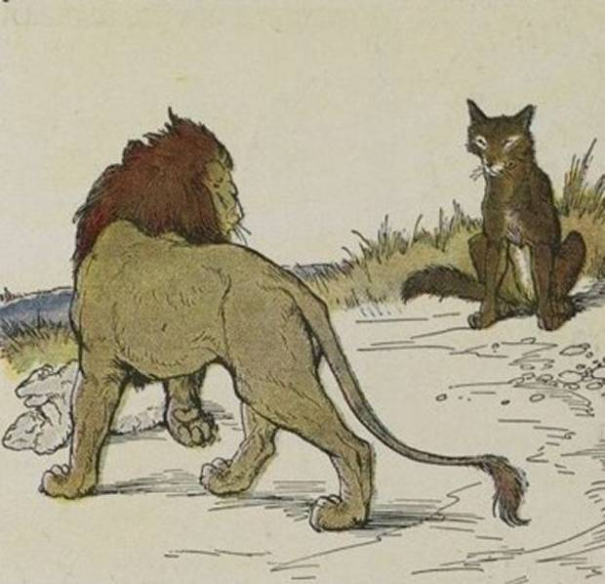
fable

Slide 4
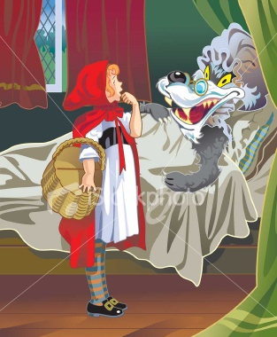
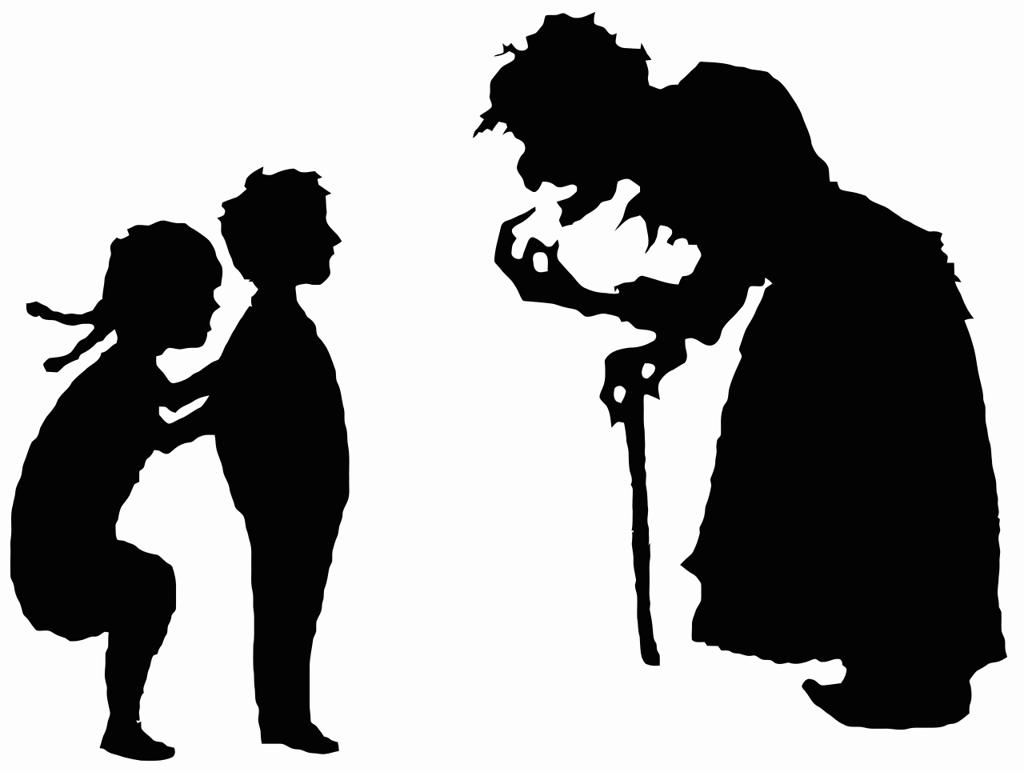
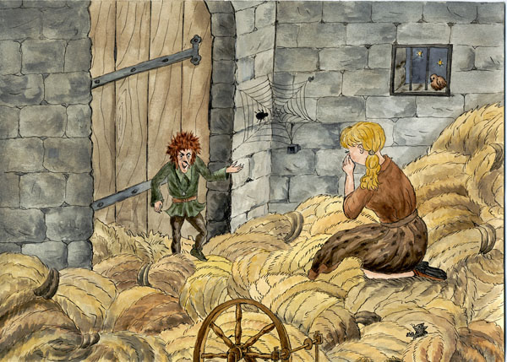
fairy tale

Slide 5
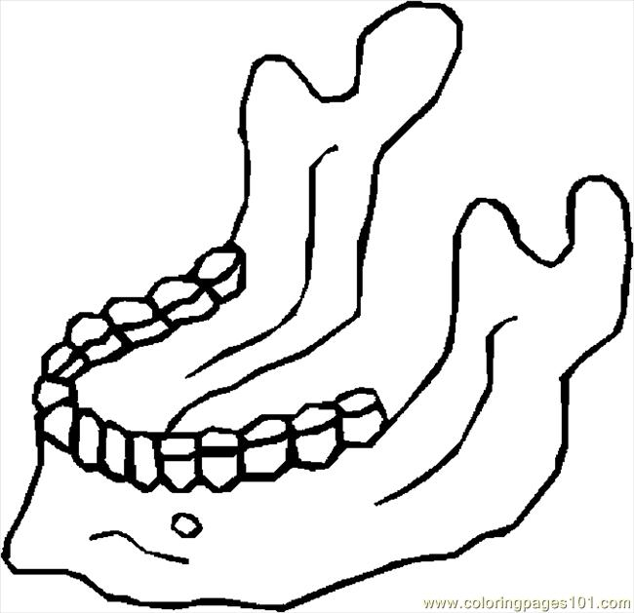
jaw

Slide 6
proverbs:
"Two wrongs don't make a right."
"The pen is mightier than the sword."
"People who live in glass houses should not throw stones."
"Better late than never."

Slide 7
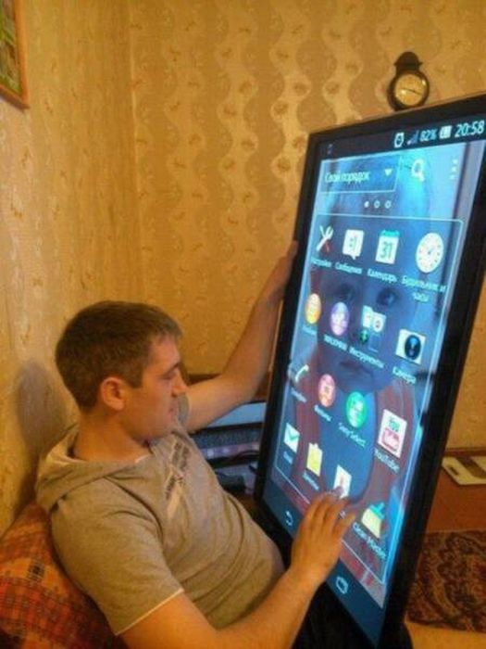
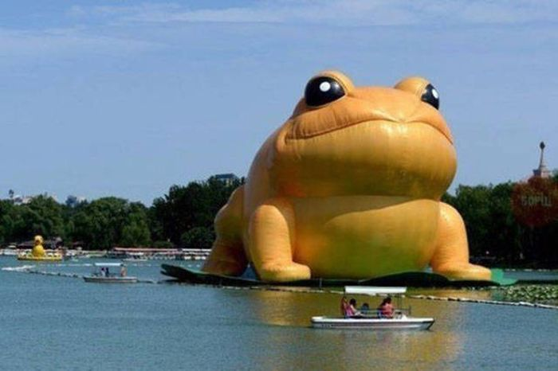
huge

Slide 8
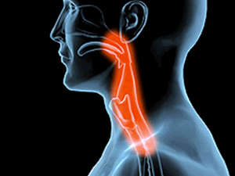
to swallow

Slide 9
left?
right?
or

Slide 10
fairy tale

Slide 11
jaw

Slide 12
fable

Slide 13
adventure

Slide 14
huge

Slide 15
proverbs
"Two wrongs don't make a right."
"The pen is mightier than the sword."
"People who live in glass houses should not throw stones."
"Better late than never."

Slide 16
to swallow

Slide 20
"Two wrongs don't make a right."
"The pen is mightier than the sword."
"People who live in glass houses should not throw stones."
"Better late than never."

Slide 24
