Slide 1
VocabULARY!

Slide 2
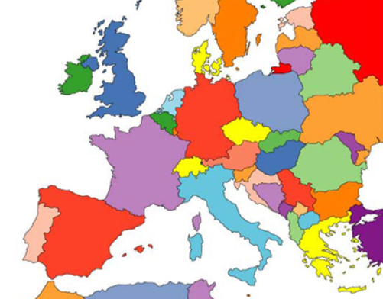
Europe

Slide 3
Russia
Ireland
Great Britain
Poland
Germany
Ukraine
Moldova!
France
Romania
Italy
Spain
Greece

Slide 4
?
?
?
?
?
?
?
?
?
?
?
?

Slide 5
GOOD JOB!

