Slide 1
CAPITALS AND MONUMENTS!

Slide 2
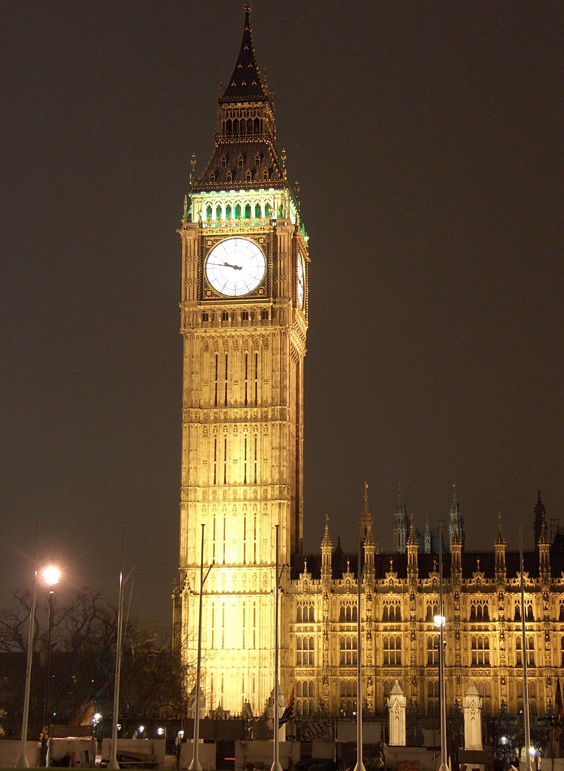
Big Ben
London, Great Britain

Slide 3
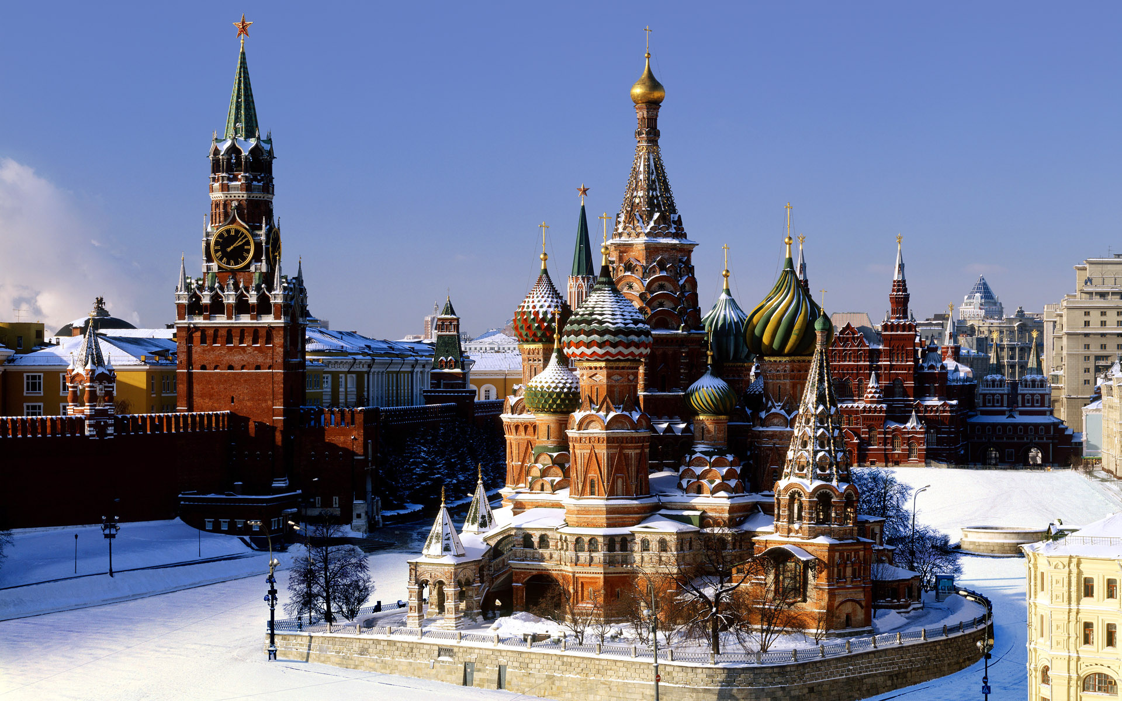
The Kremlin Moscow, Russia

Slide 4
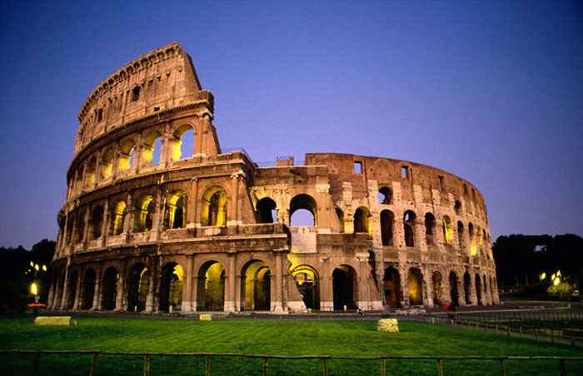
Colosseum Rome, Italy

Slide 5
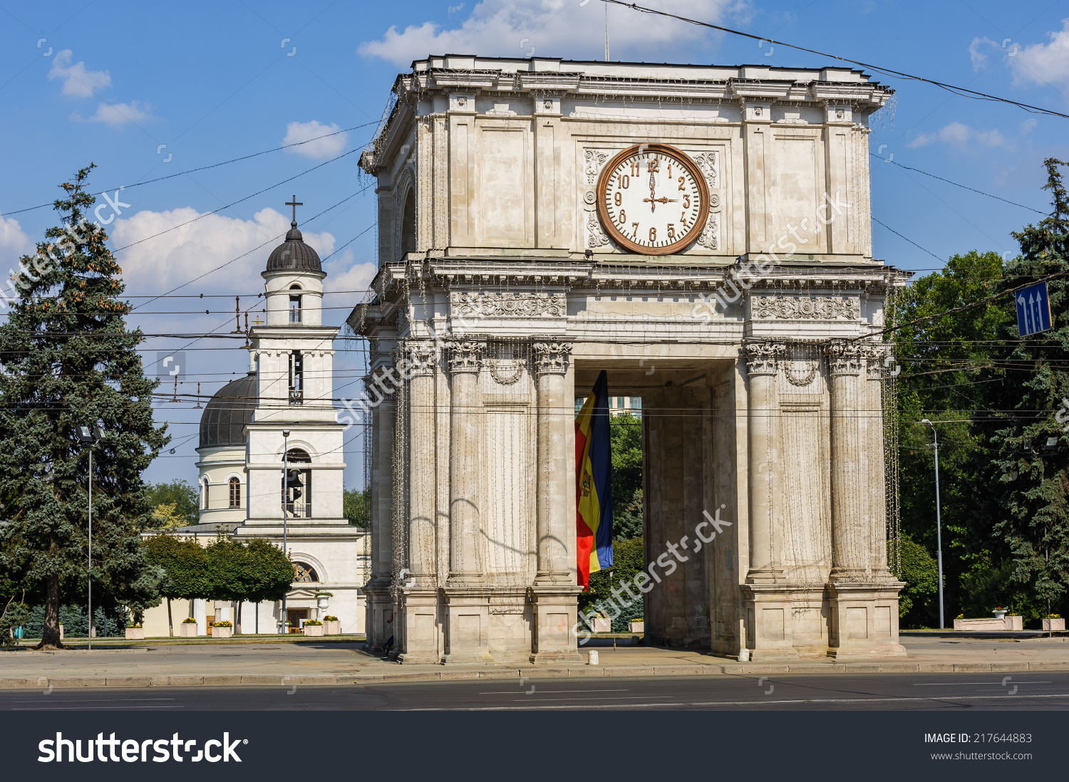
Victory Arch Chișinău, Moldova

Slide 6
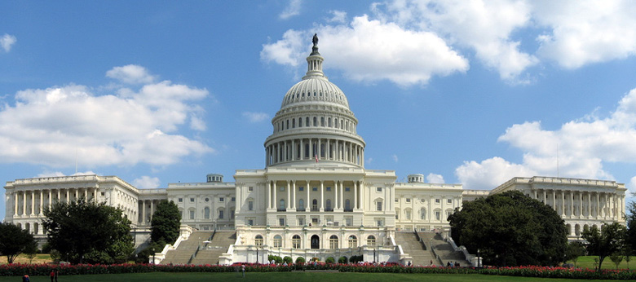
Capital
Washington DC, USA

Slide 7
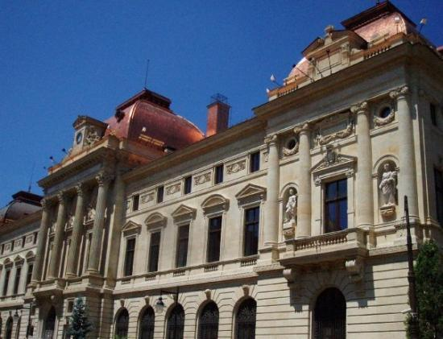
National Bank
București, Romania

Slide 8
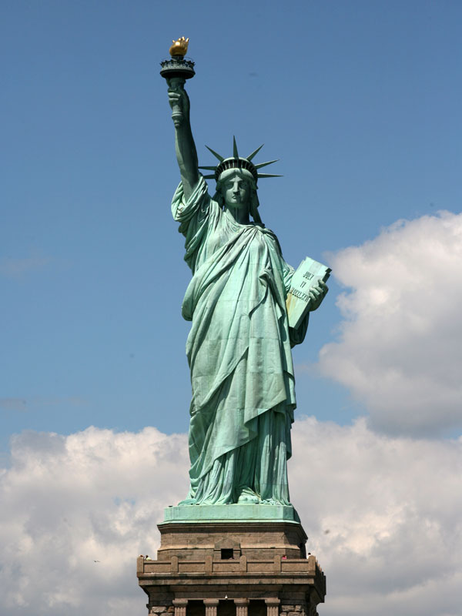
Statue of
Liberty
New York, USA

Slide 9
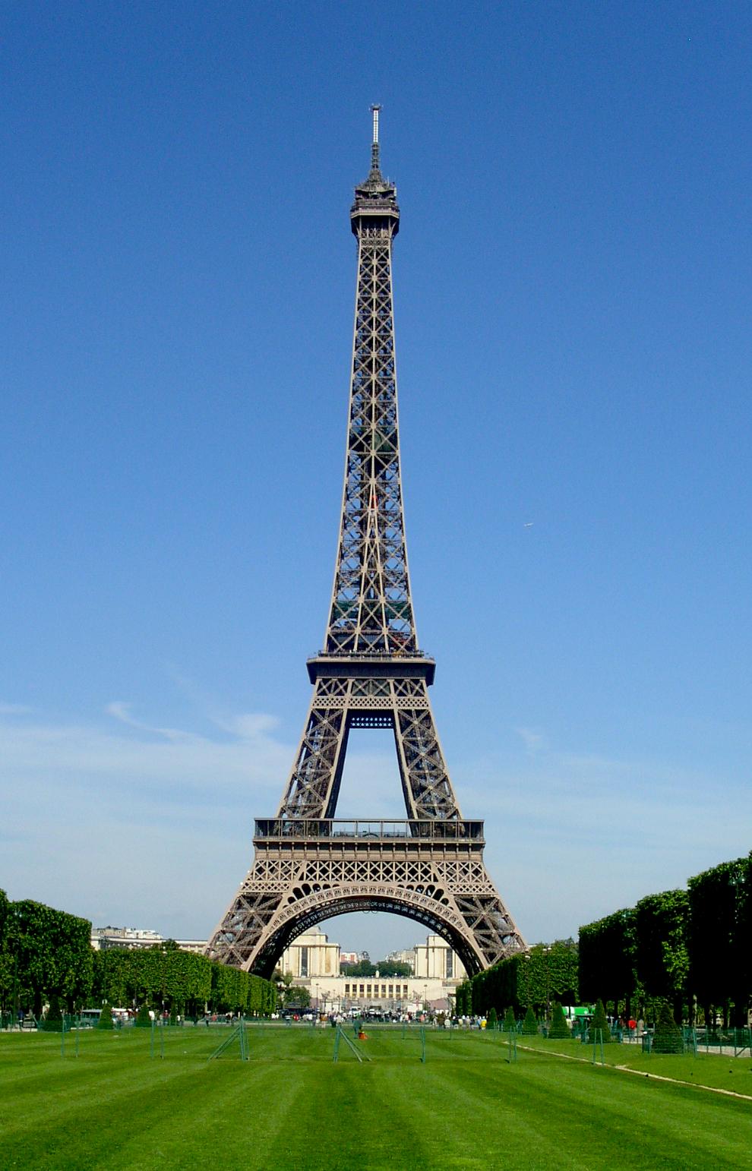
Eiffel Tower
Paris, France

Slide 10
The Kremlin Moscow, Russia

Slide 11
Colosseum Rome, Italy

Slide 12
Big Ben
London, Great Britain

Slide 13
Victory Arch Chișinău, Moldova

Slide 14
Statue of
Liberty
New York, USA

Slide 15
Eiffel Tower
Paris, France

Slide 16
Capital
Washington DC, USA

Slide 17
National Bank
București, Romania

Slide 18
