Slide 1
SIMPLE PAST TENSE

Slide 2
EXAMPLES:
It was fun.
We sang a song.
It was good.
We sang a beautiful song!

Slide 3
EXAMPLE:
It was great!
It was my birthday.
It was excellent!
I had a birthday party.

Slide 4
EXAMPLE:
It was sad.
My friend was sick.

Slide 5
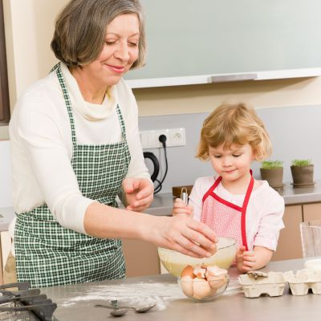
EXAMPLE:
It was great!
I baked with Granny.

Slide 6
EXAMPLES:
It was boring.
I did a lot of homework.
It was difficult.
I did a lot of homework.

