Slide 1
VocabULARY!

Slide 2
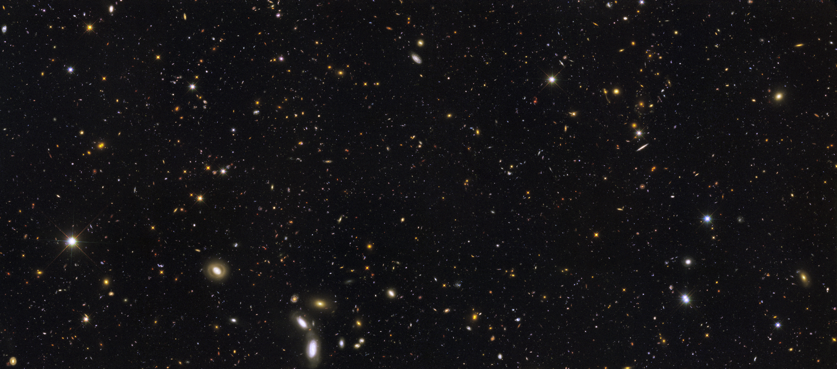
space

Slide 3
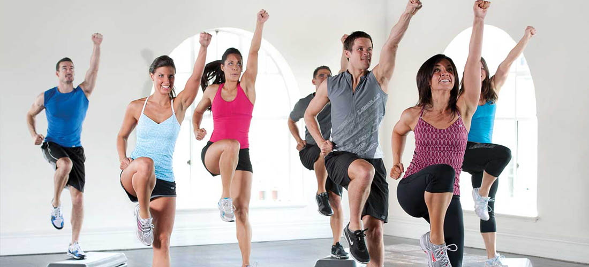
aerobics

Slide 4
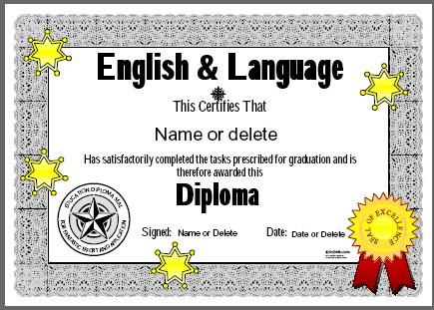
certificate

Slide 5
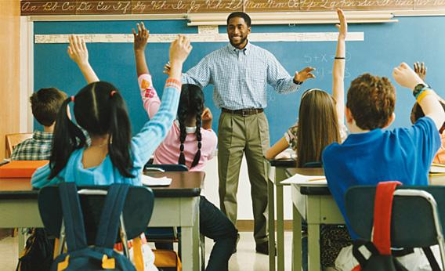
instructor

Slide 6
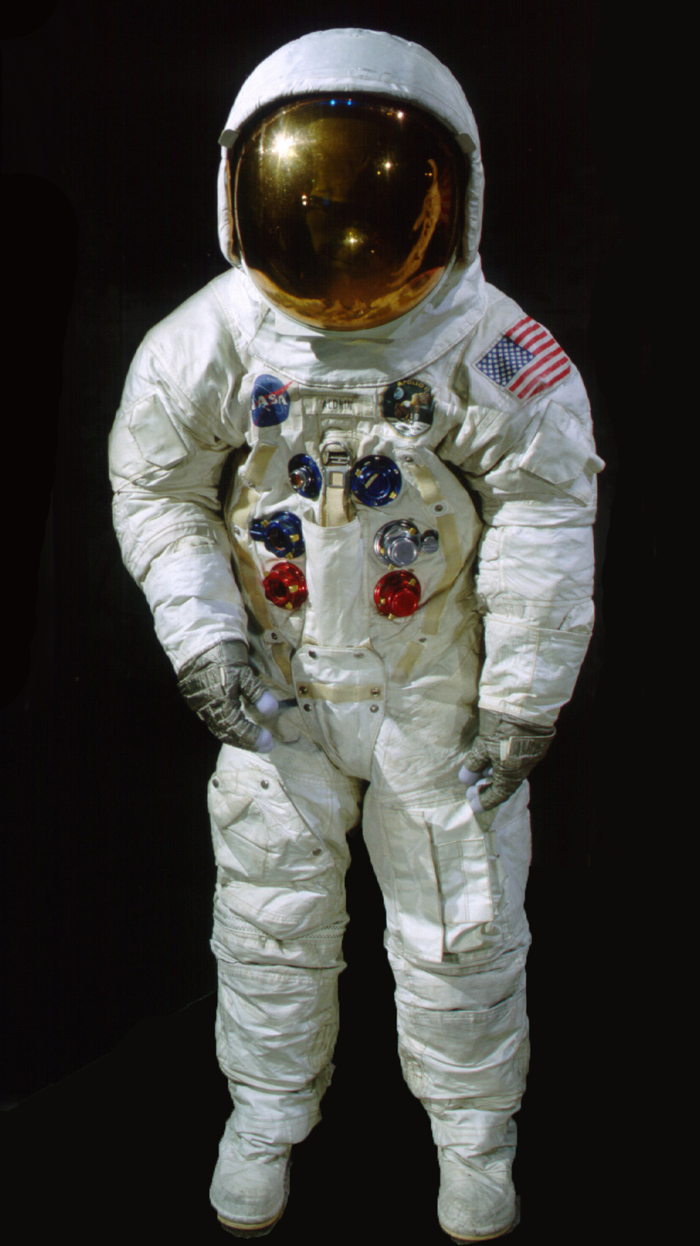
spacesuit

Slide 7
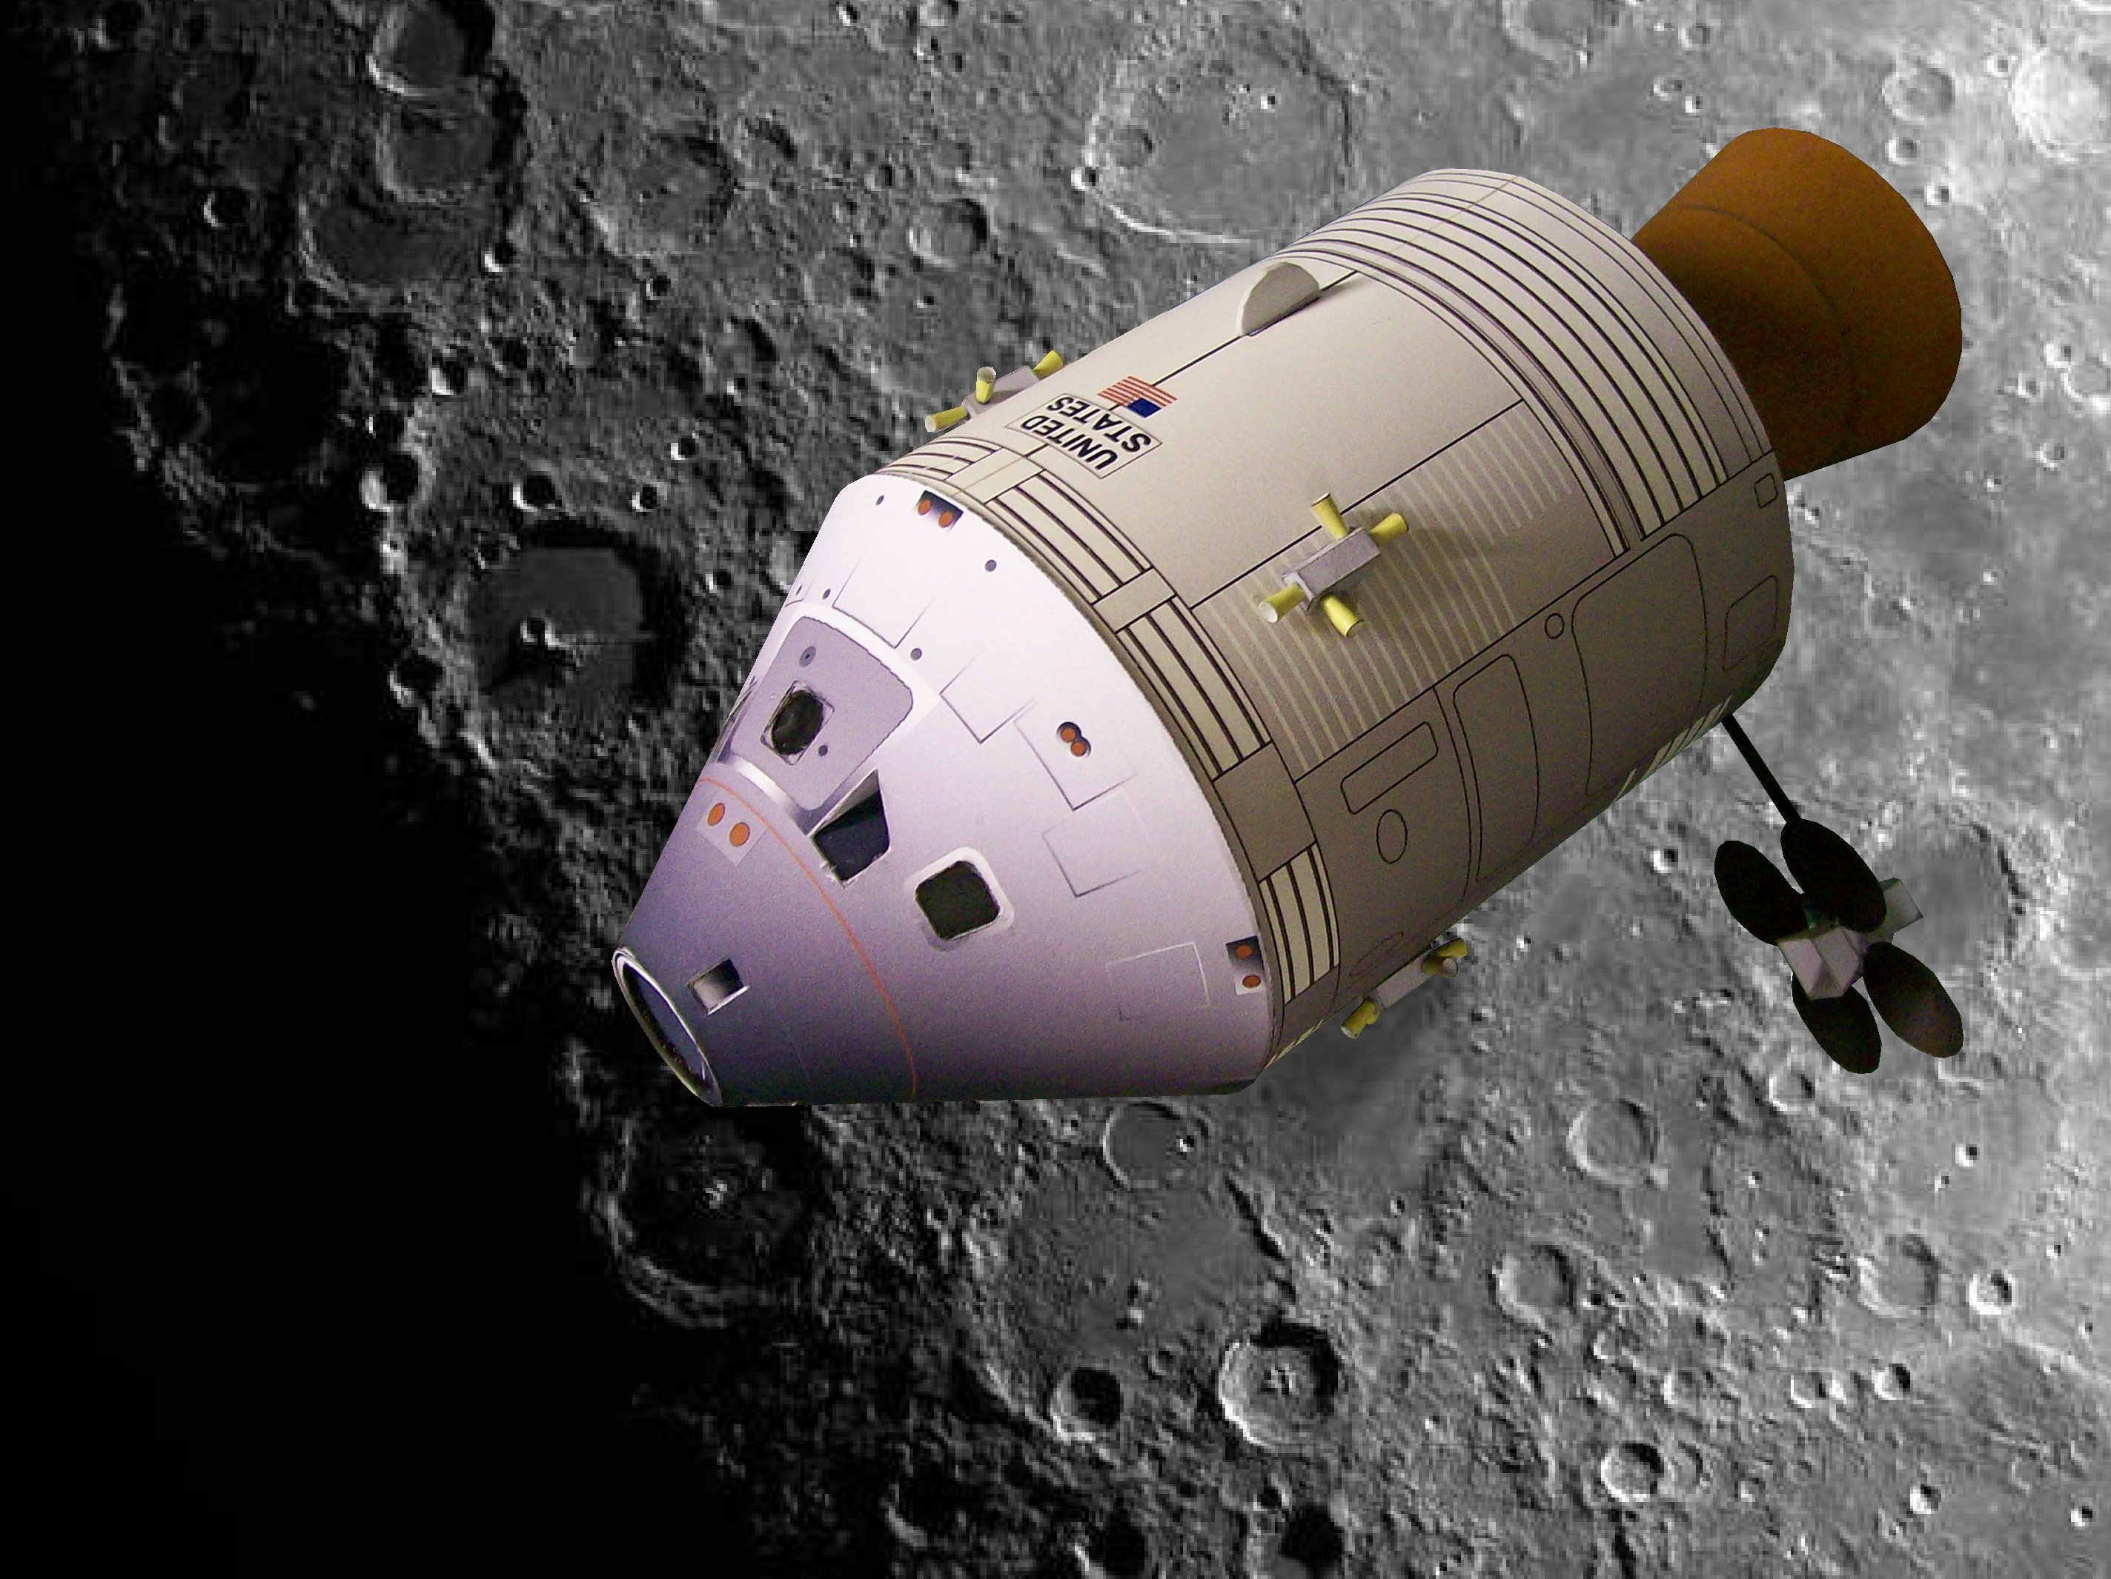
spaceship

Slide 8
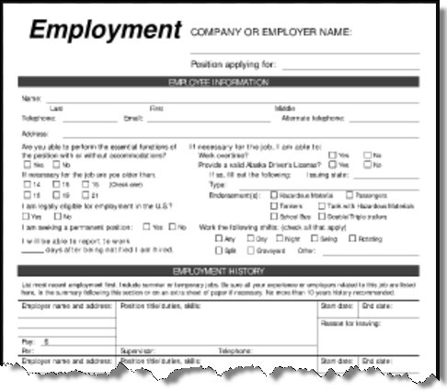
application

Slide 9
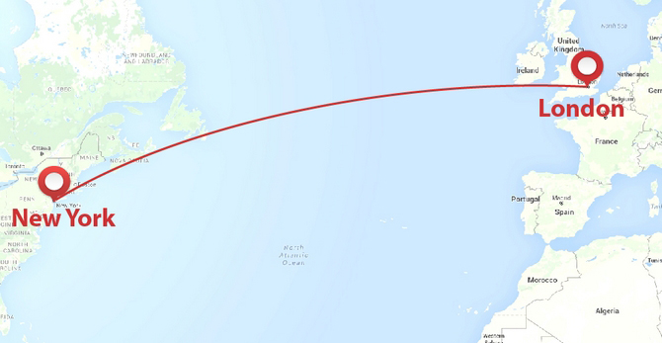
flight

Slide 10
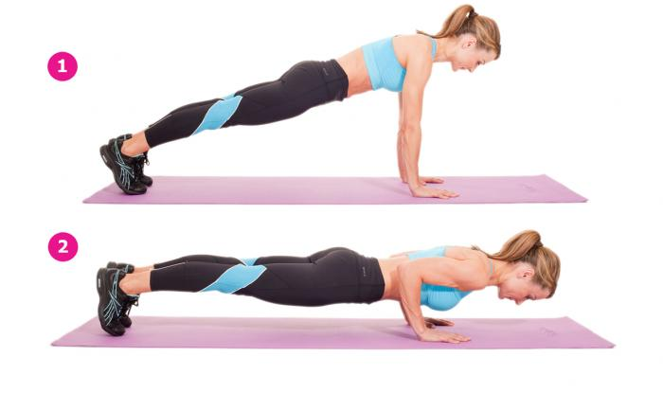
press-ups

Slide 11
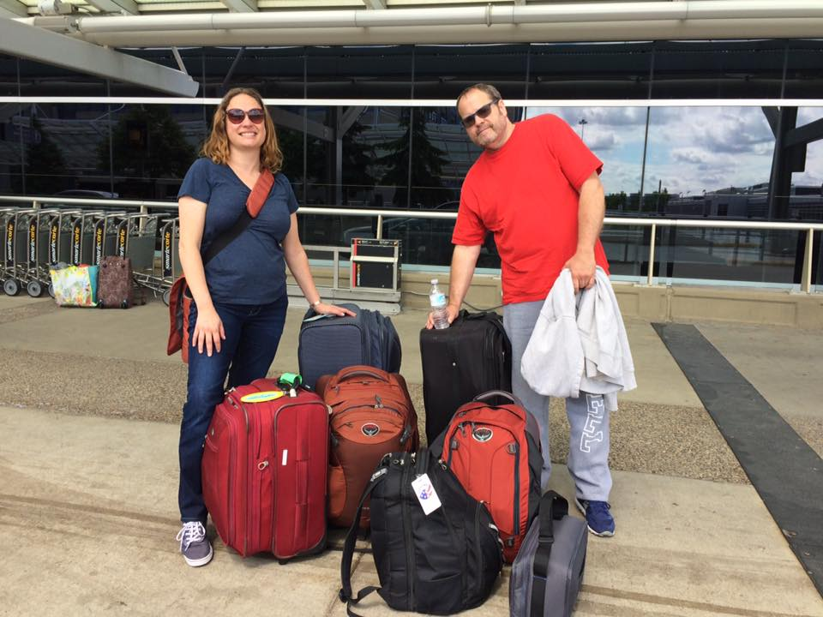
volunteer(s)

Slide 12
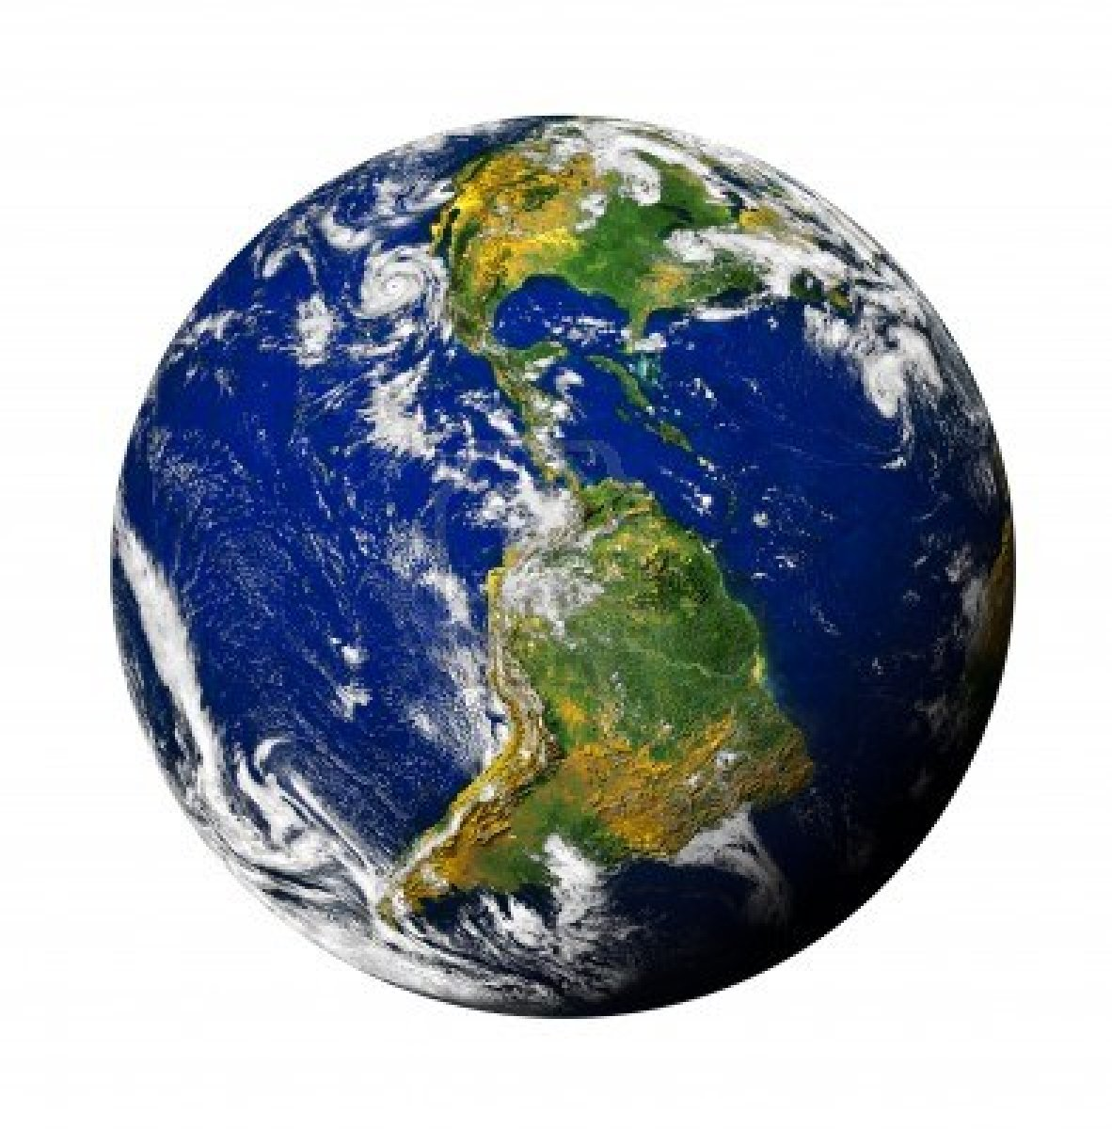
Earth

Slide 13
top?
or
bottom?

Slide 14
aerobics

Slide 15
instructor

Slide 16
space

Slide 17
certificate

Slide 18
spacesuit

Slide 19
application

Slide 20
press-ups

Slide 21
flight

Slide 22
volunteer(s)

Slide 23
Earth

Slide 24
spaceship

Slide 36
