Slide 1
VocabularY!

Slide 2
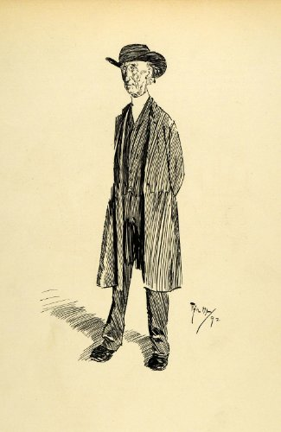
parson

Slide 3
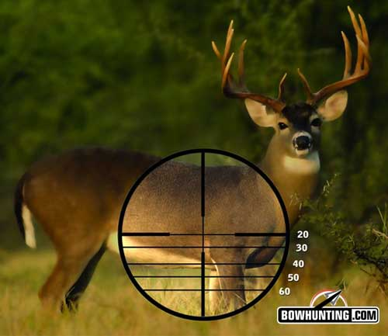
aim

Slide 4
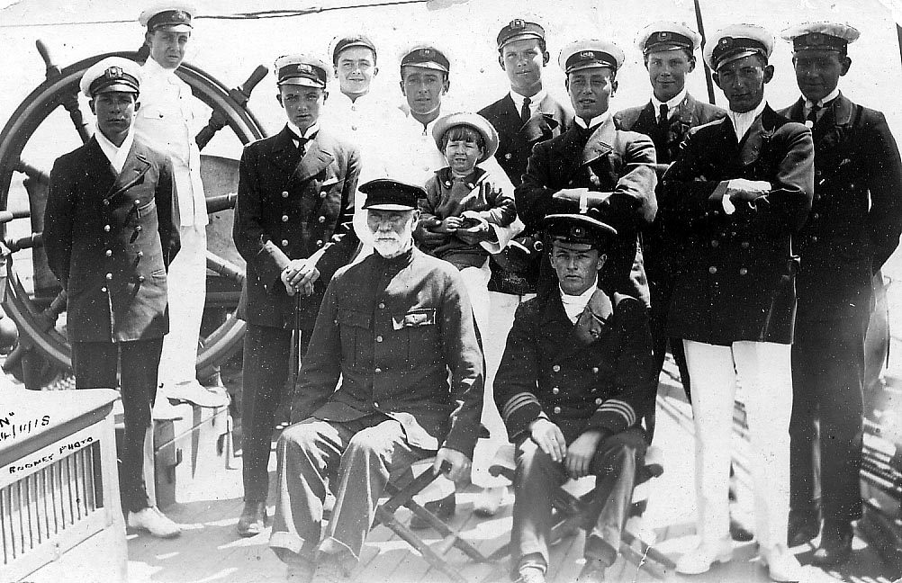
crew

Slide 5
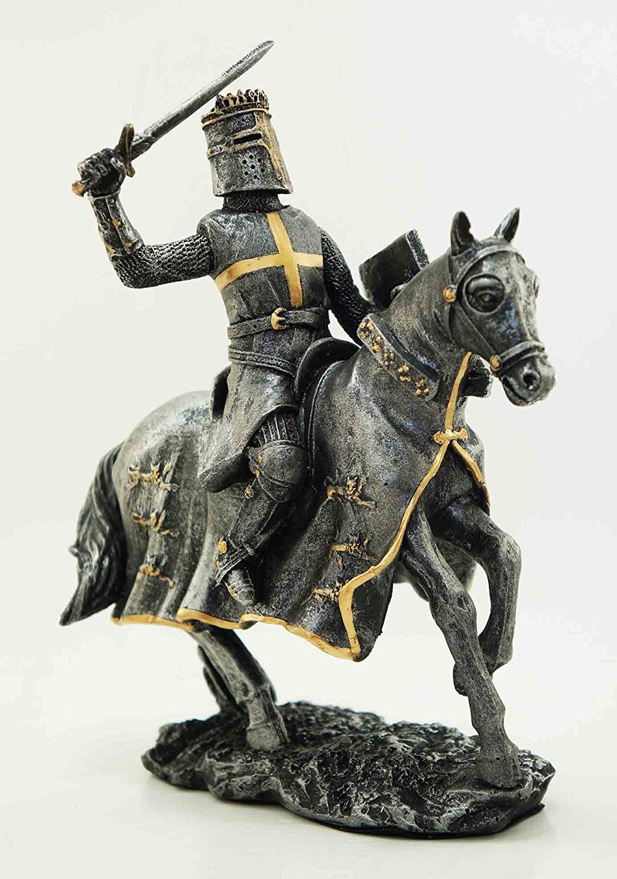
knight

Slide 6
explore

Slide 7
kneel

Slide 8
ignore

Slide 9
left?
right?
or

Slide 10
aim

Slide 11
crew

Slide 12
parson

Slide 13
ignore

Slide 14
knight

Slide 15
explore

Slide 16
kneel

Slide 24
Good Job!!

