Slide 1
Vocabulary!

Slide 2
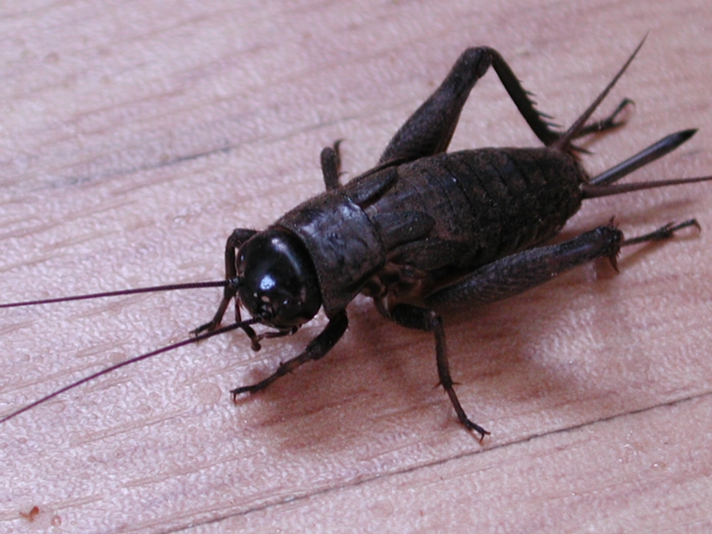
cricket

Slide 3
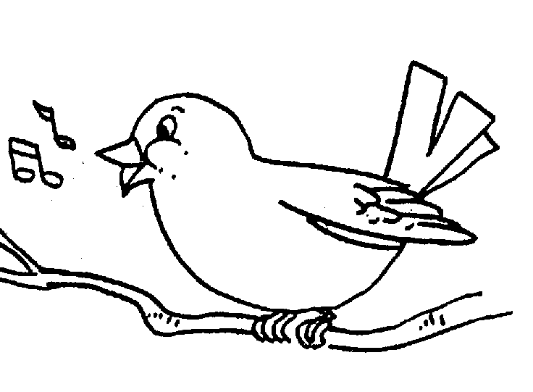
chirping

Slide 4
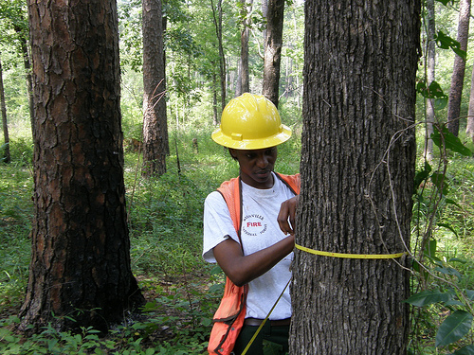
forester

Slide 5
sapling

Slide 6
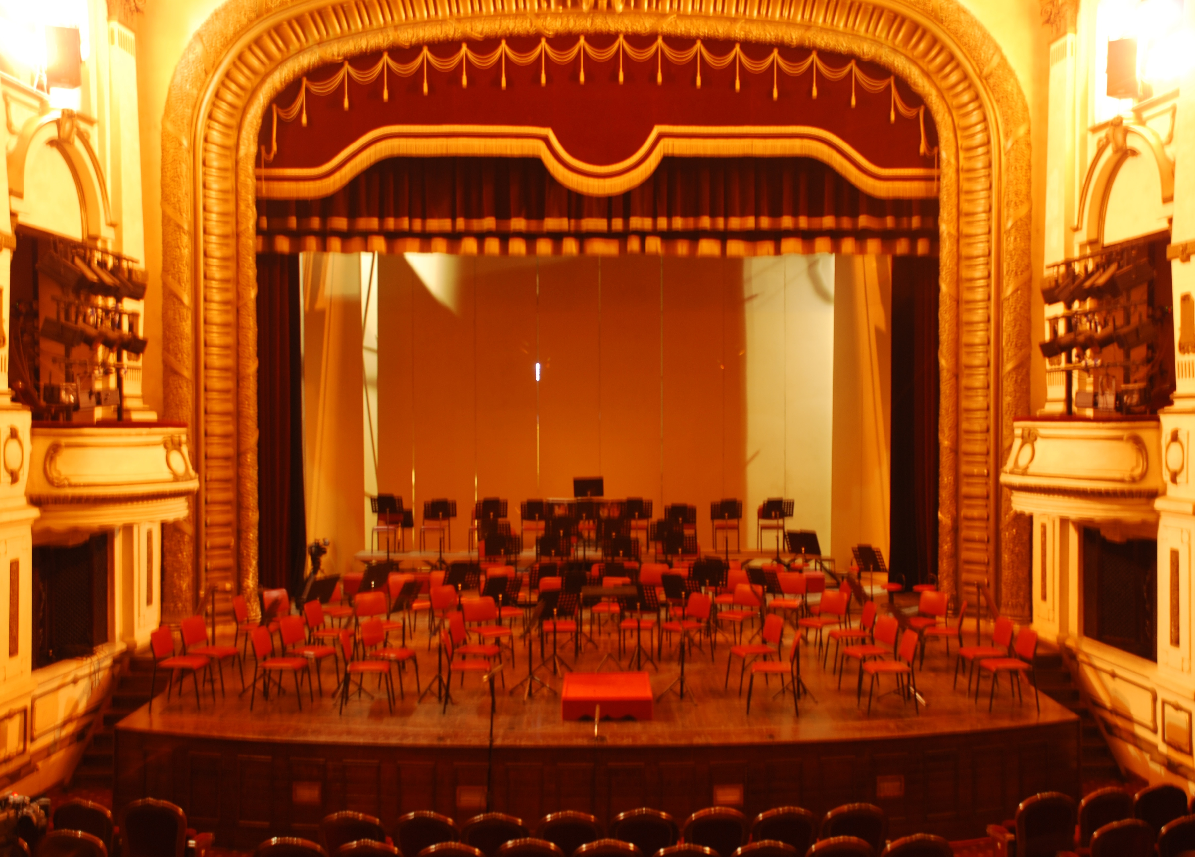
stage

Slide 7
award

Slide 8
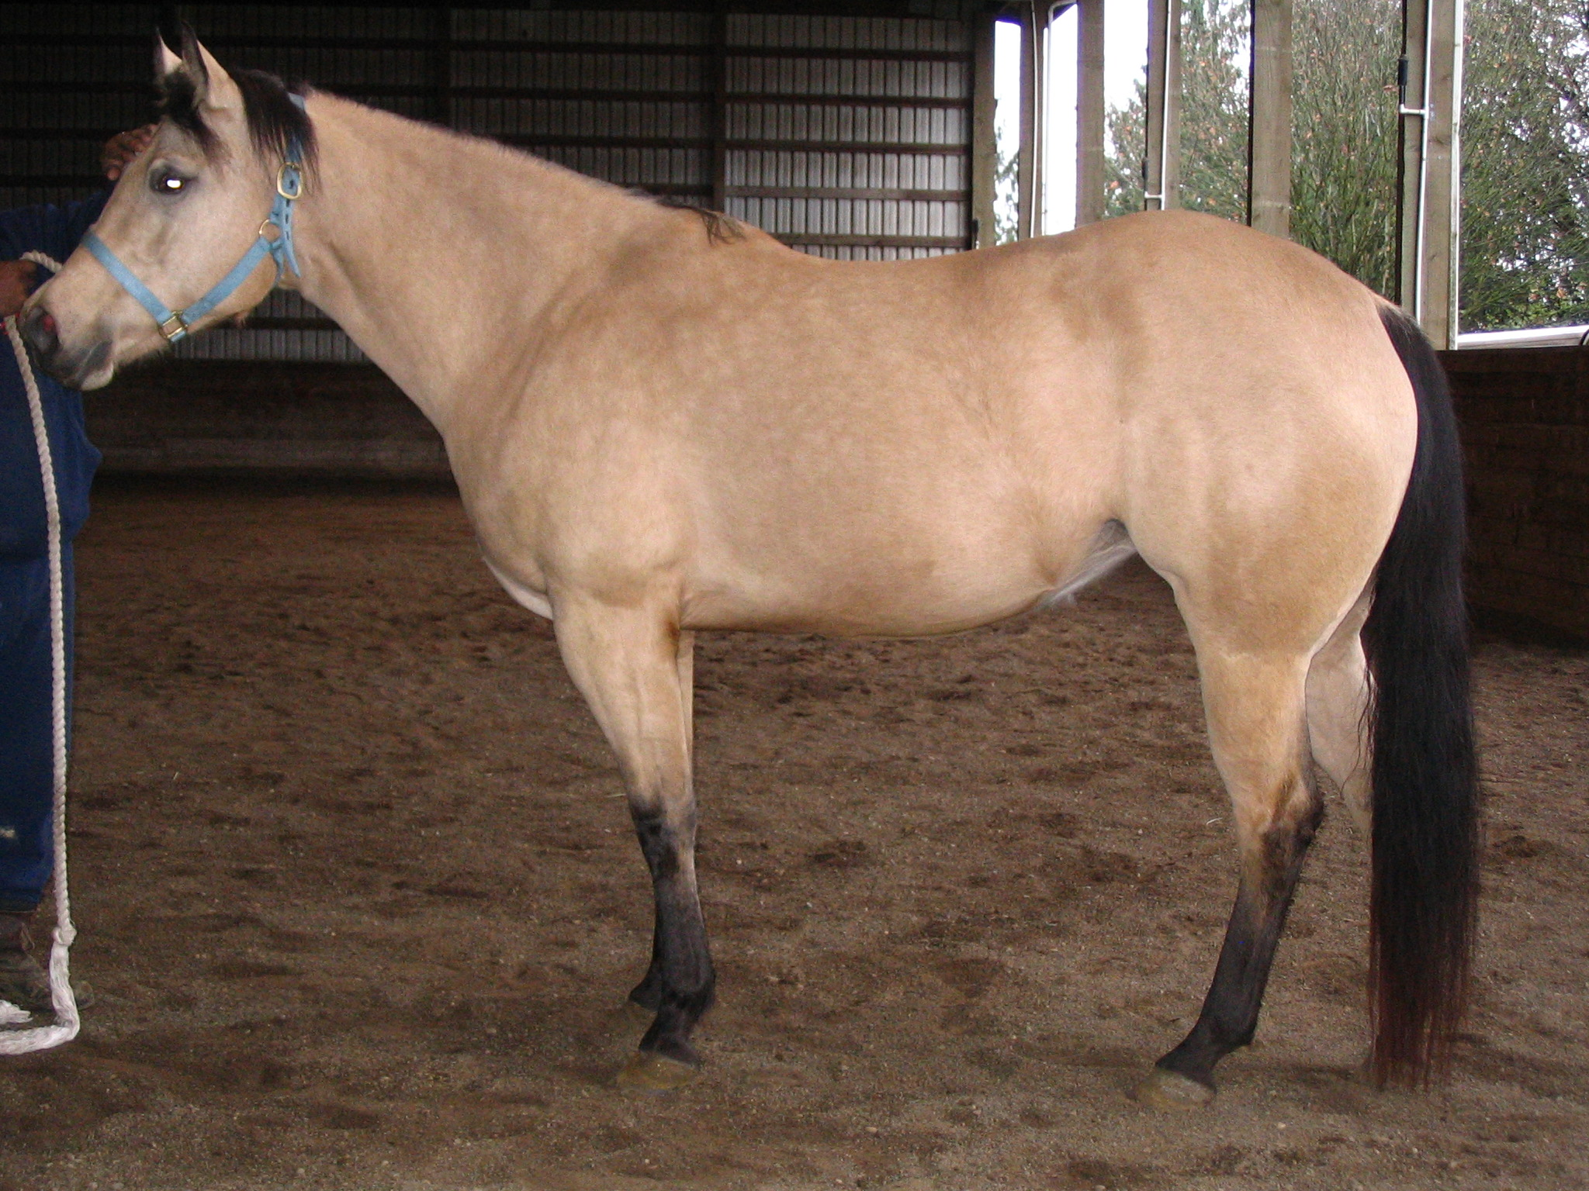
mare (female horse)

Slide 9
right?
left?
or

Slide 10
forester

Slide 11
cricket

Slide 12
chirping

Slide 13
award

Slide 14
mare

Slide 15
sapling

Slide 16
stage

Slide 24
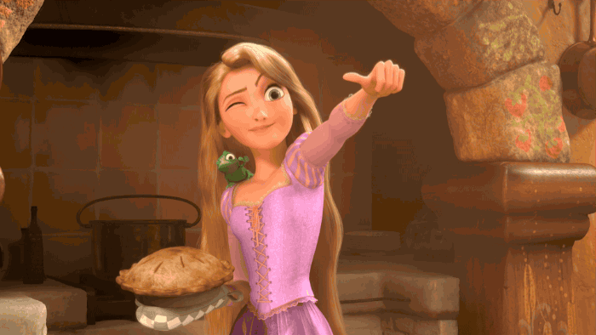
Good Job!!

