Slide 1
VocabularY!

Slide 2
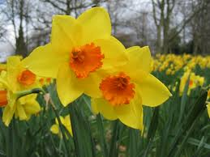
daffodil

Slide 3
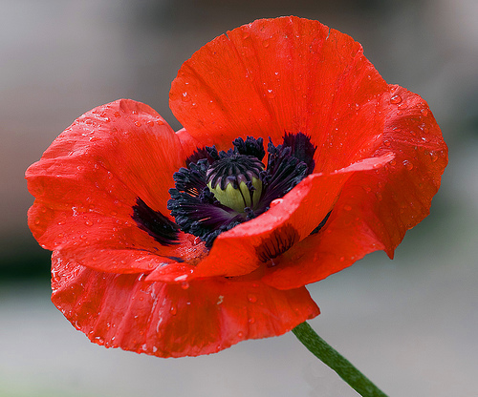
poppy

Slide 4
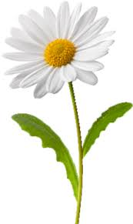
daisy

Slide 5
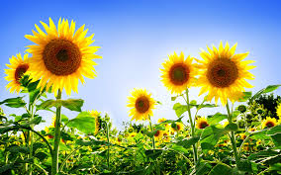
sunflower

Slide 6
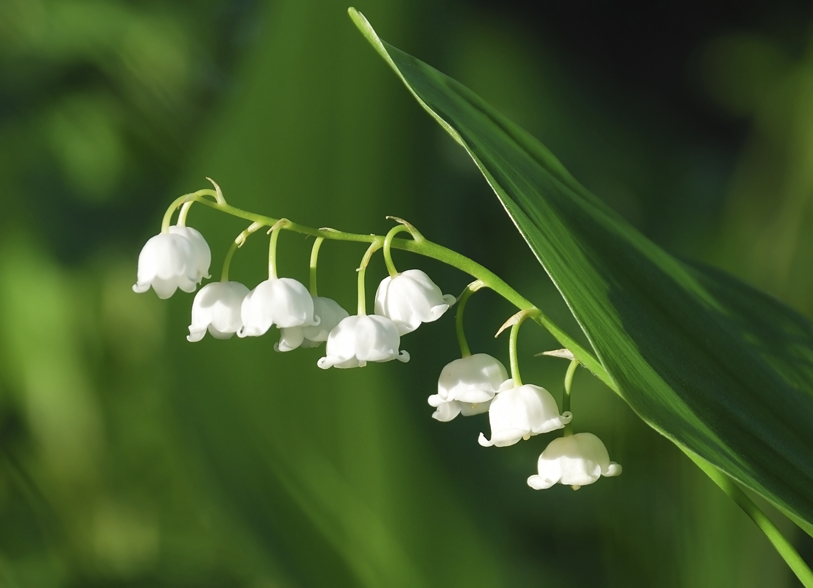
lily of the valley

Slide 7
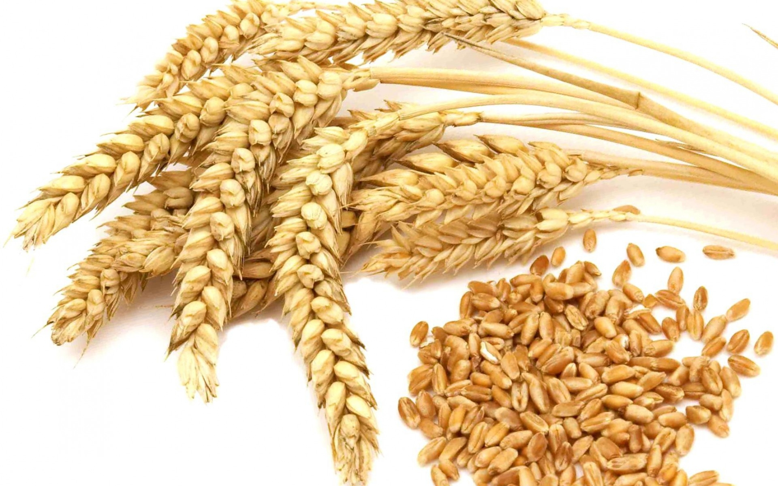
wheat

Slide 8
rust-coloured

Slide 9
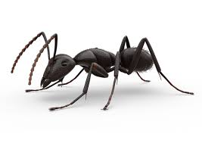
ant

Slide 10
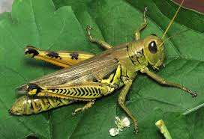
grasshopper

Slide 11
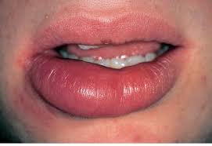
swelling

Slide 12
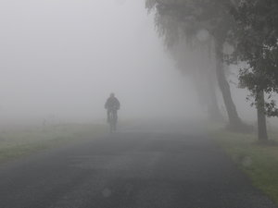
misty

Slide 13
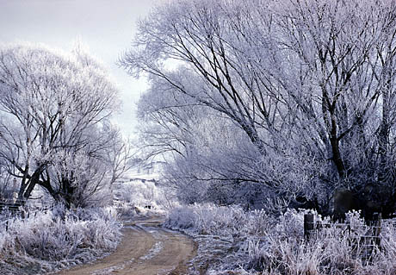
hoar-frost

Slide 14
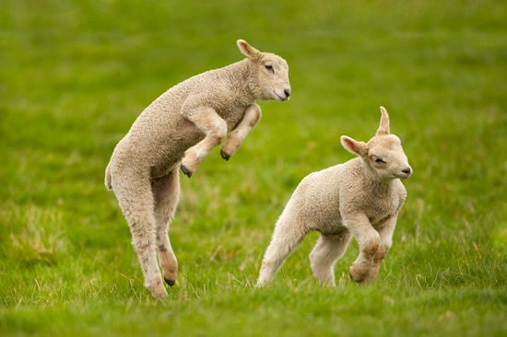
frolic

Slide 15
left?
right?
or

Slide 16
daisy

Slide 17
lily of the valley

Slide 18
sunflower

Slide 19
grasshopper

Slide 20
misty

Slide 21
wheat

Slide 22
hoar-frost

Slide 23
swelling

Slide 24
ant

Slide 25
poppy

Slide 26
frolic

Slide 27
rust-coloured

Slide 28
daffodil

Slide 42
Good Job!!

