Slide 1
VocabularY!

Slide 2
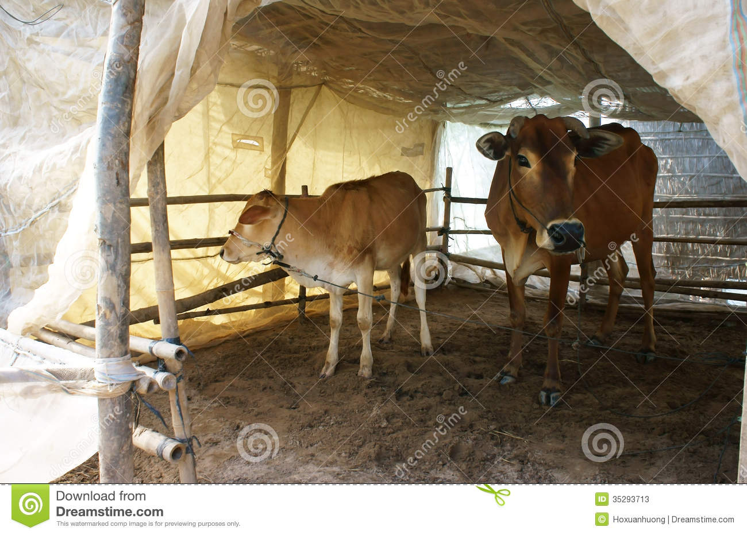
cowshed

Slide 3
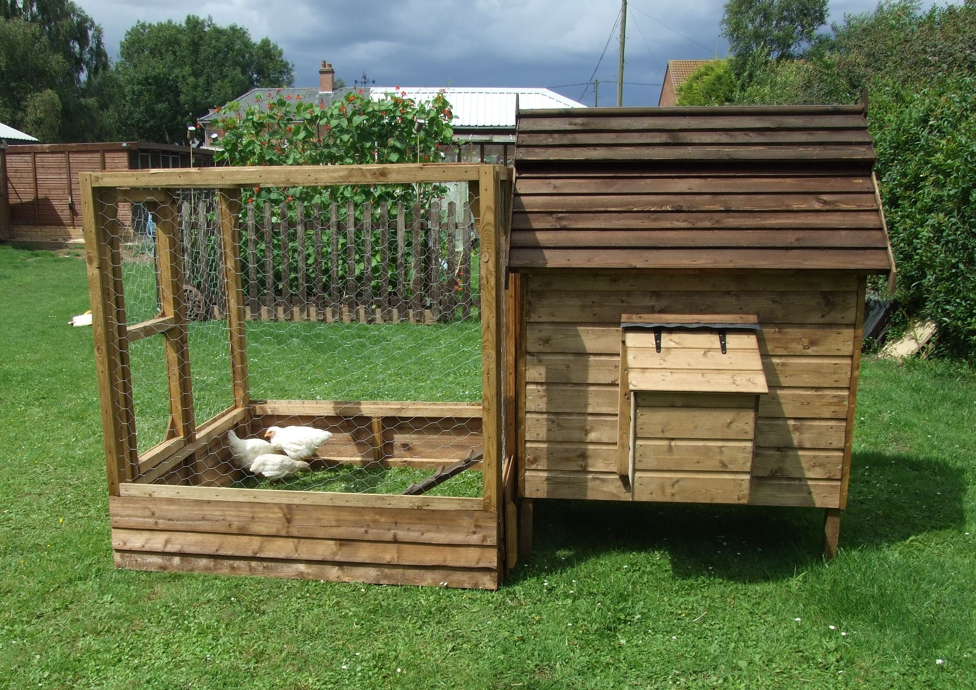
hen-house

Slide 4
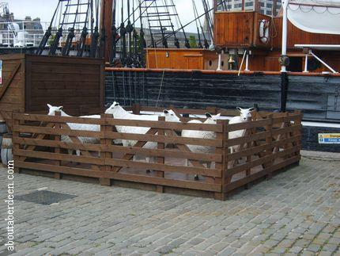
sheep-pen

Slide 5
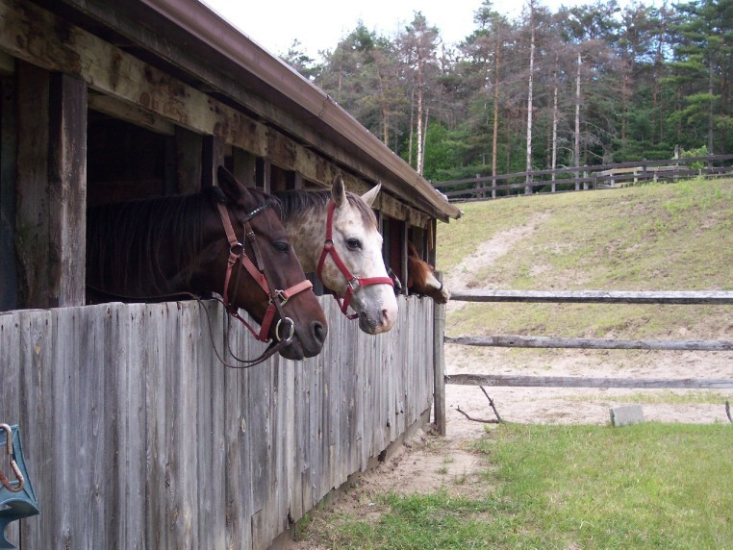
stable

Slide 6
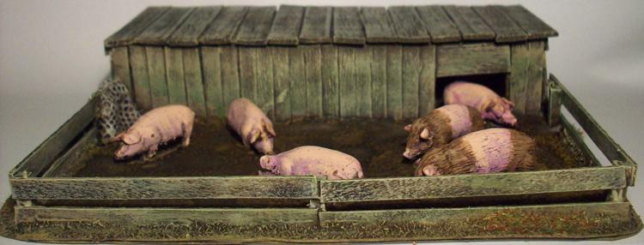
pigsty

Slide 7
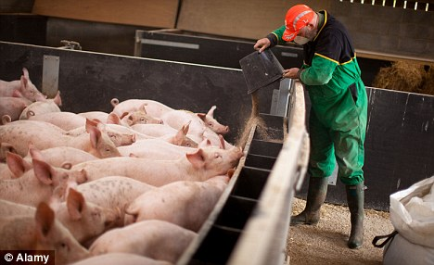
fatten

Slide 8
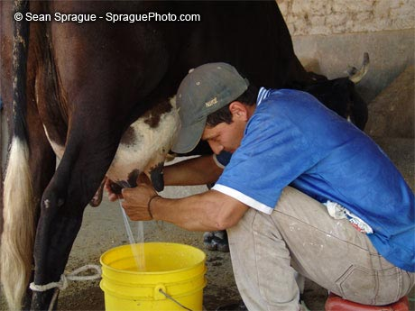
milk

Slide 9
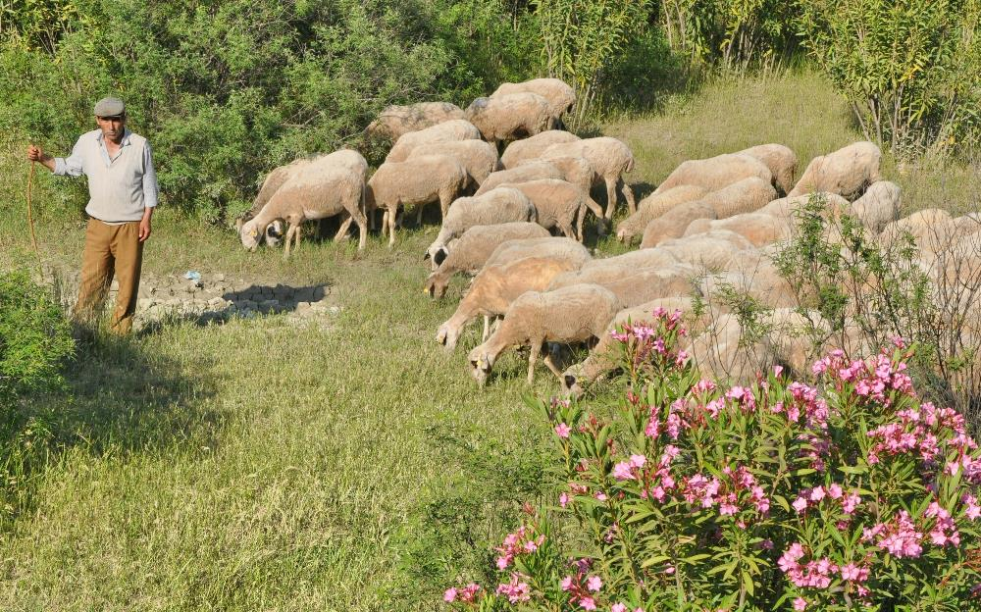
mind

Slide 10
left?
right?
or

Slide 11
hen-house

Slide 12
cowshed

Slide 13
stable

Slide 14
fatten

Slide 15
milk

Slide 16
pigsty

Slide 17
mind

Slide 18
sheep-pen

Slide 27
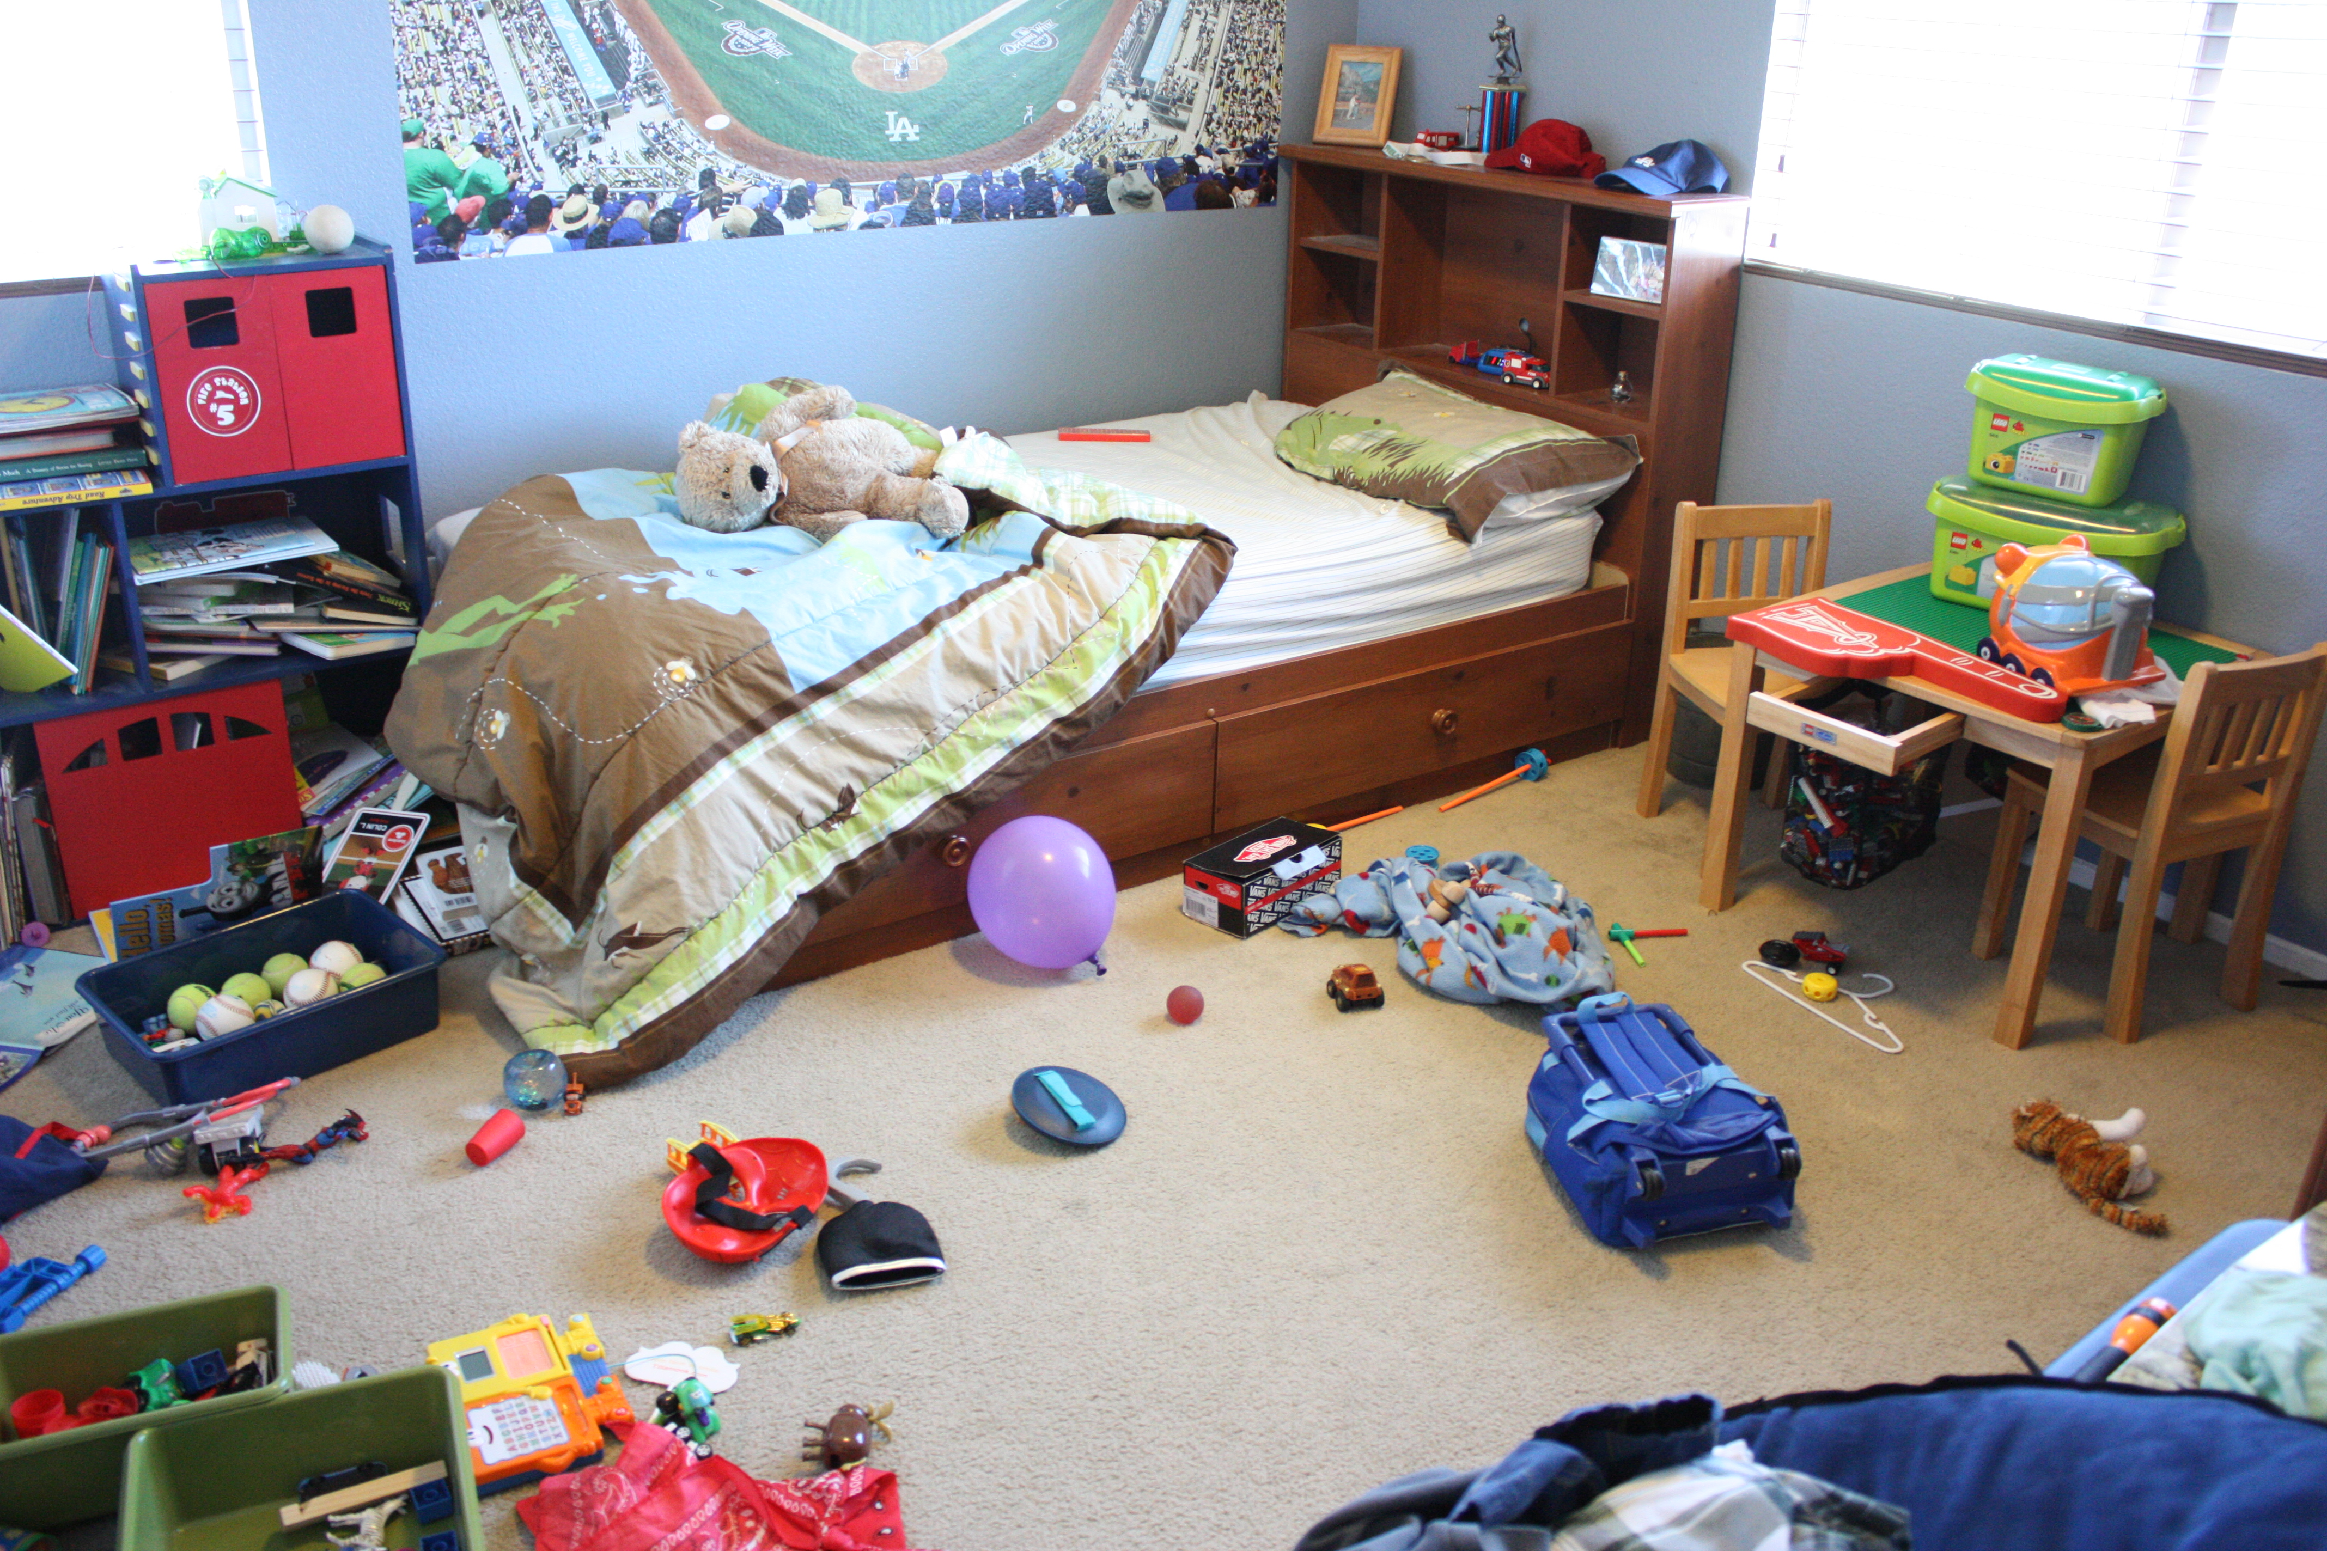

Slide 28
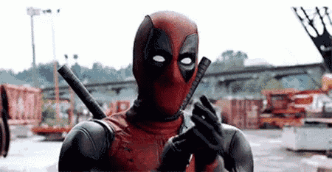
Good Job!!

