Slide 1
VocabularY!

Slide 2
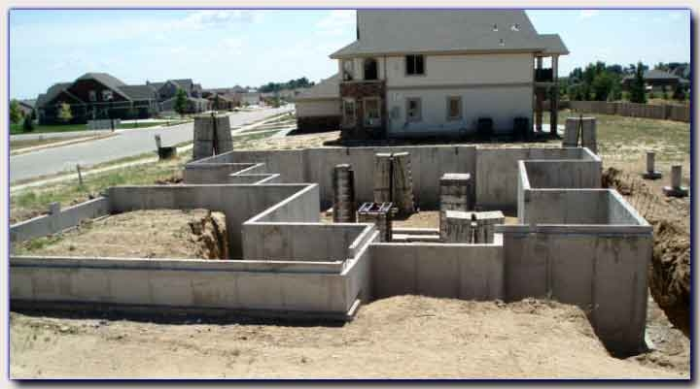
foundation

Slide 3
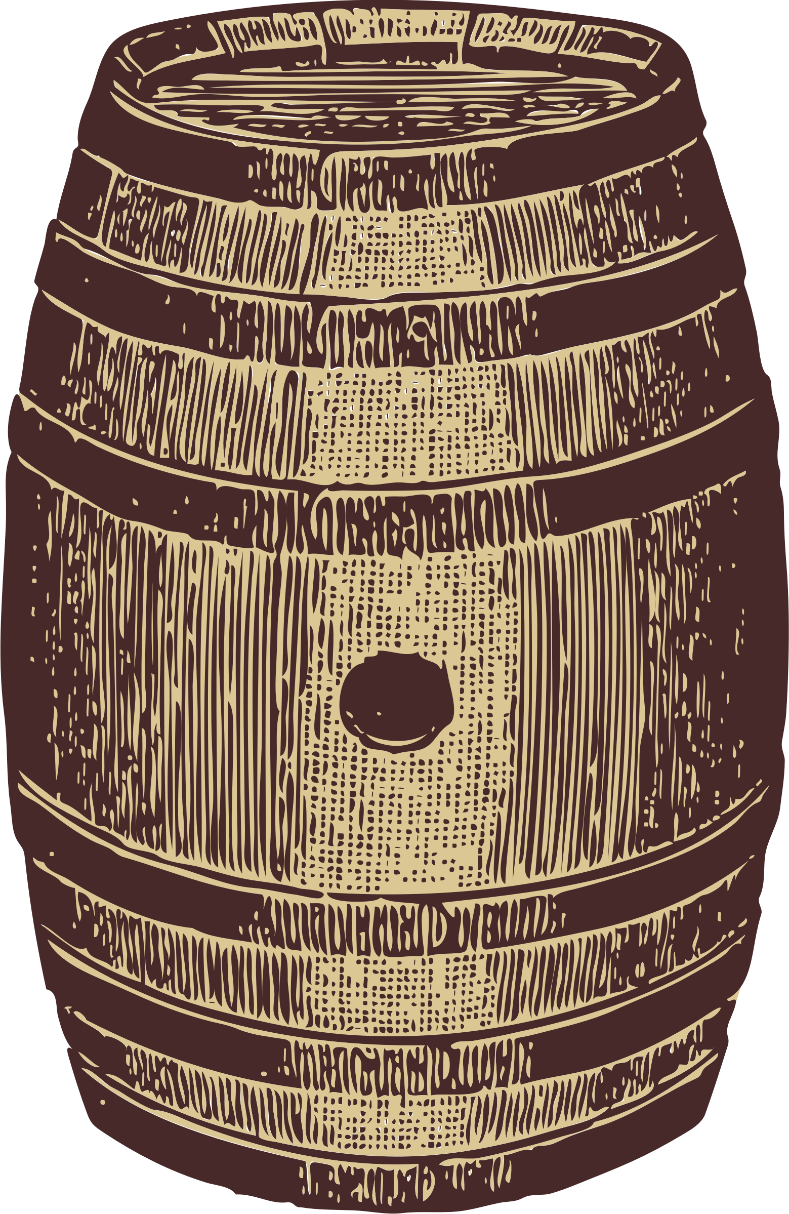
barrel

Slide 4
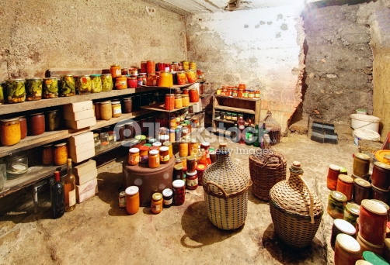
cellar

Slide 5
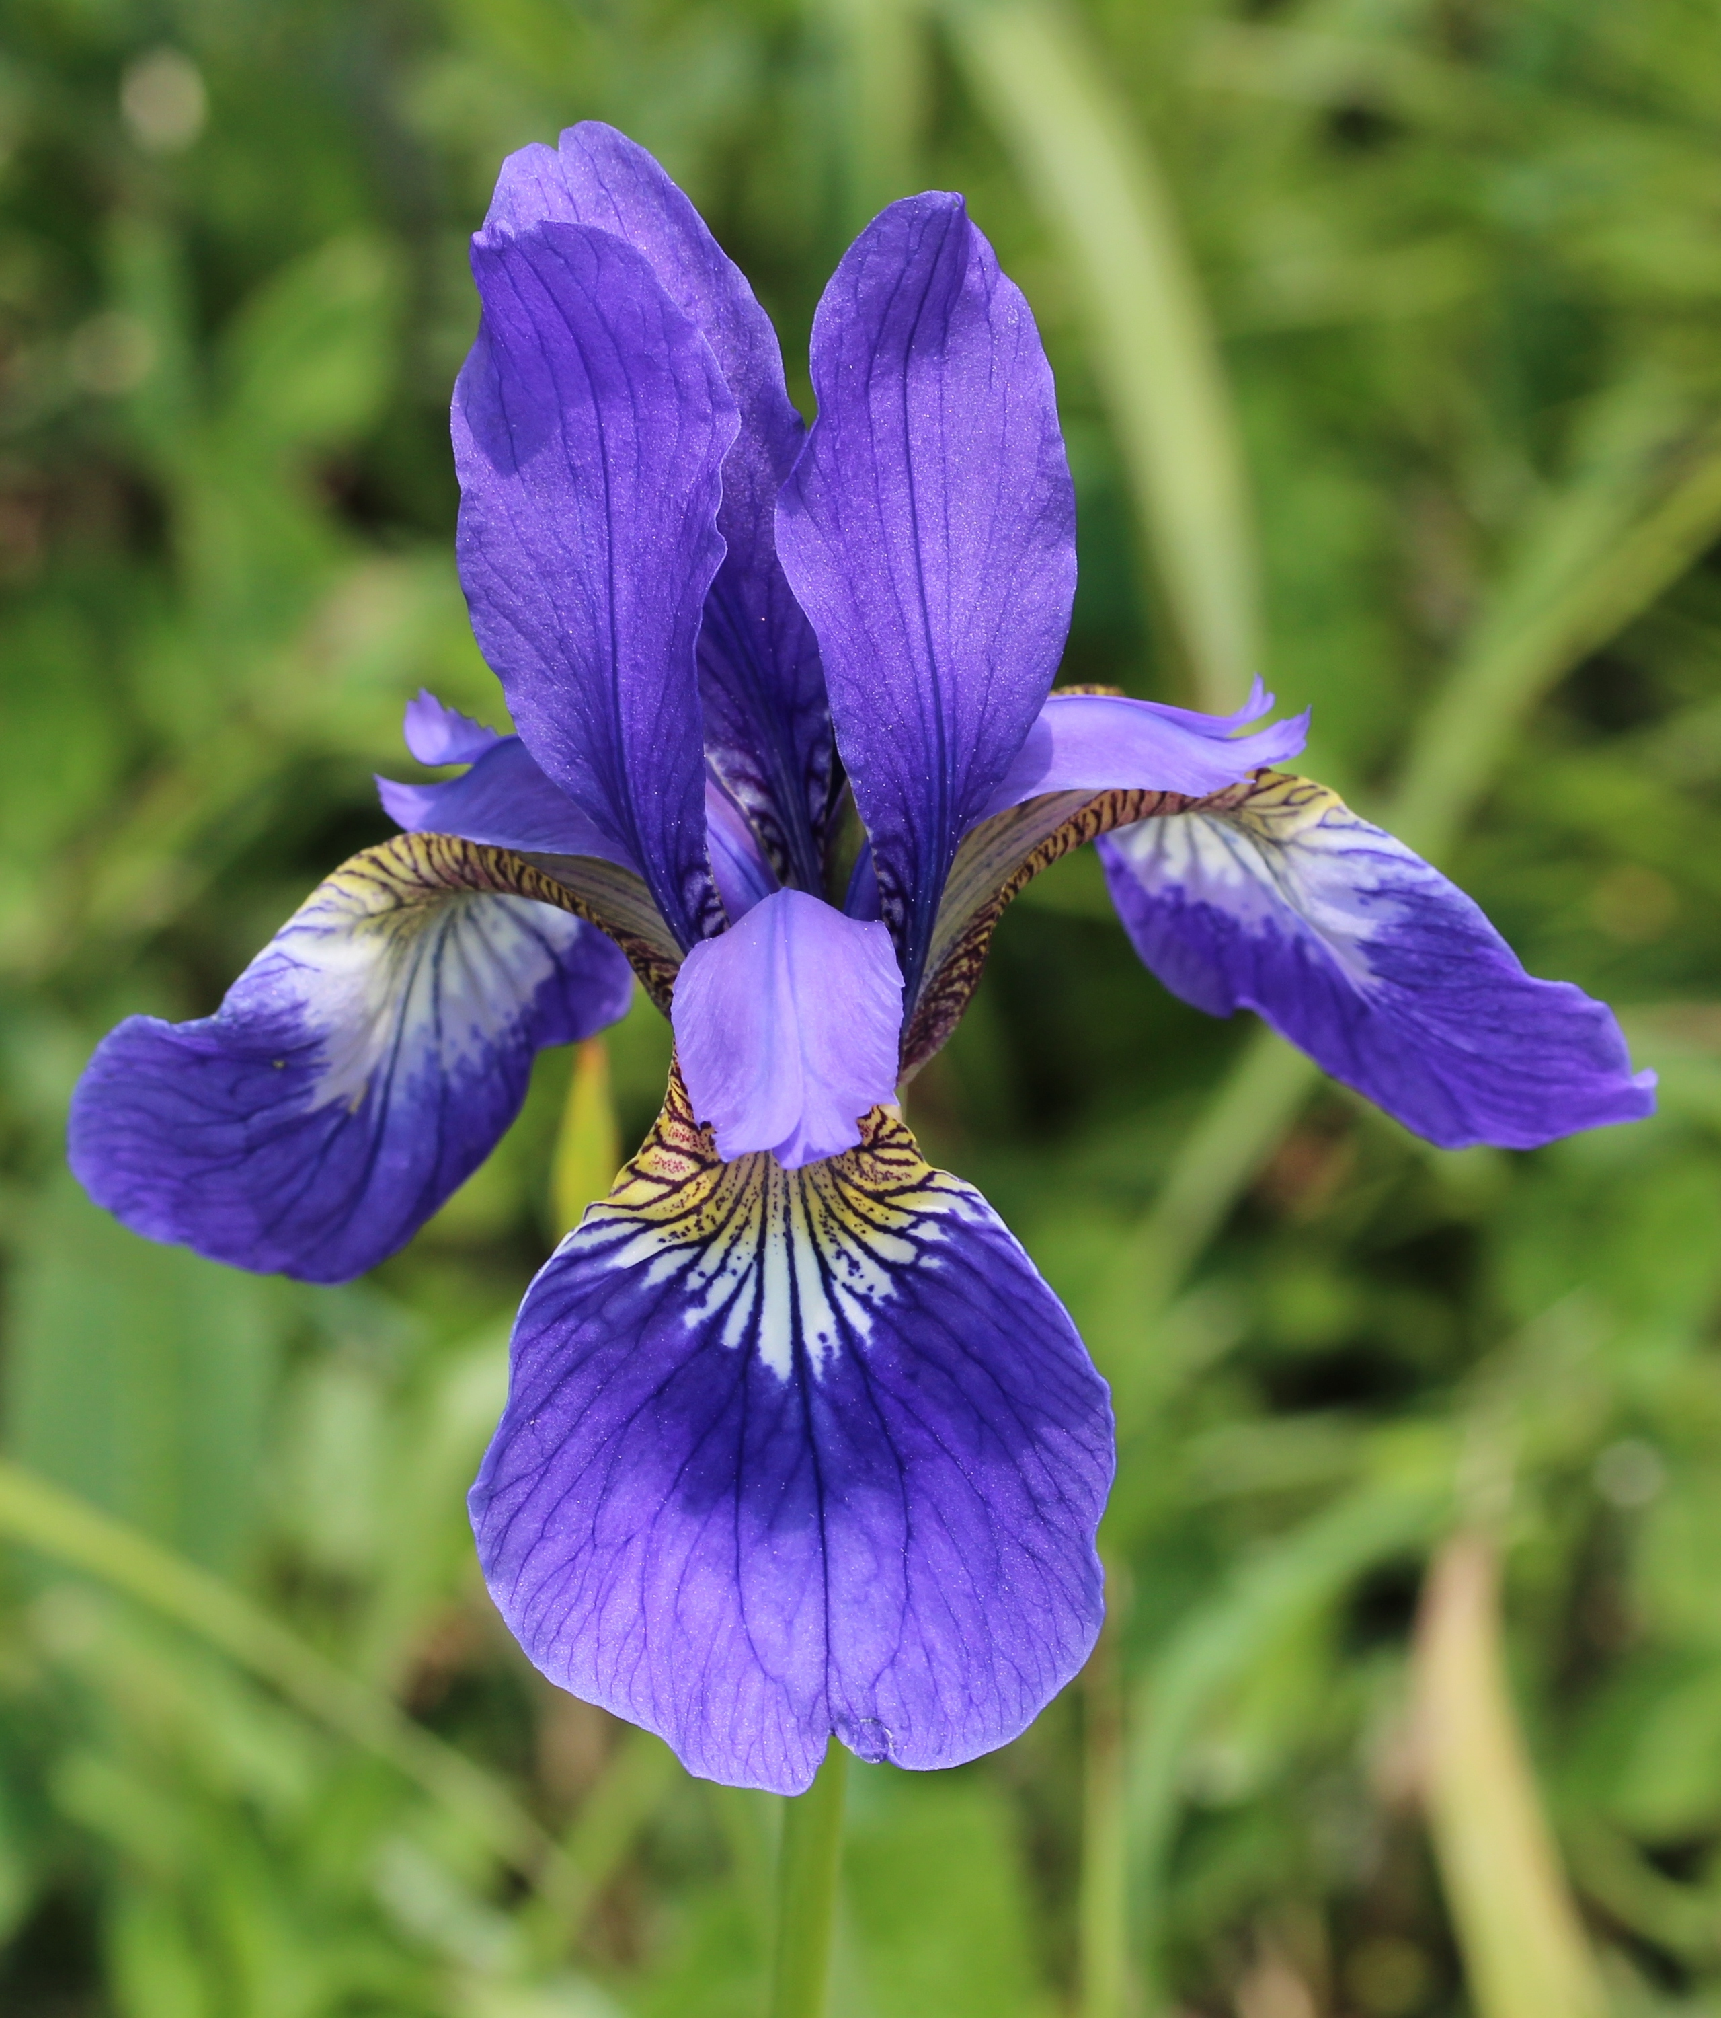
iris

Slide 6
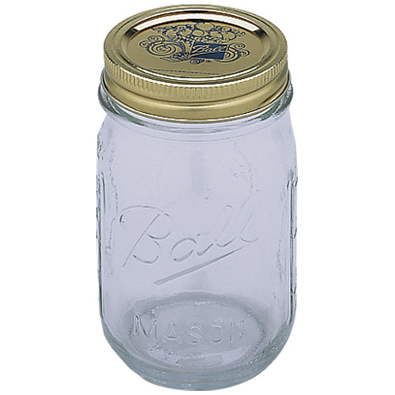
jar

Slide 7
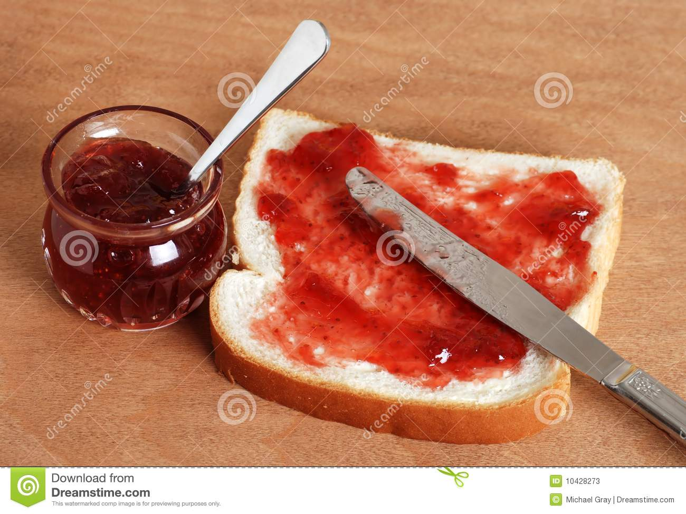
jelly

Slide 8
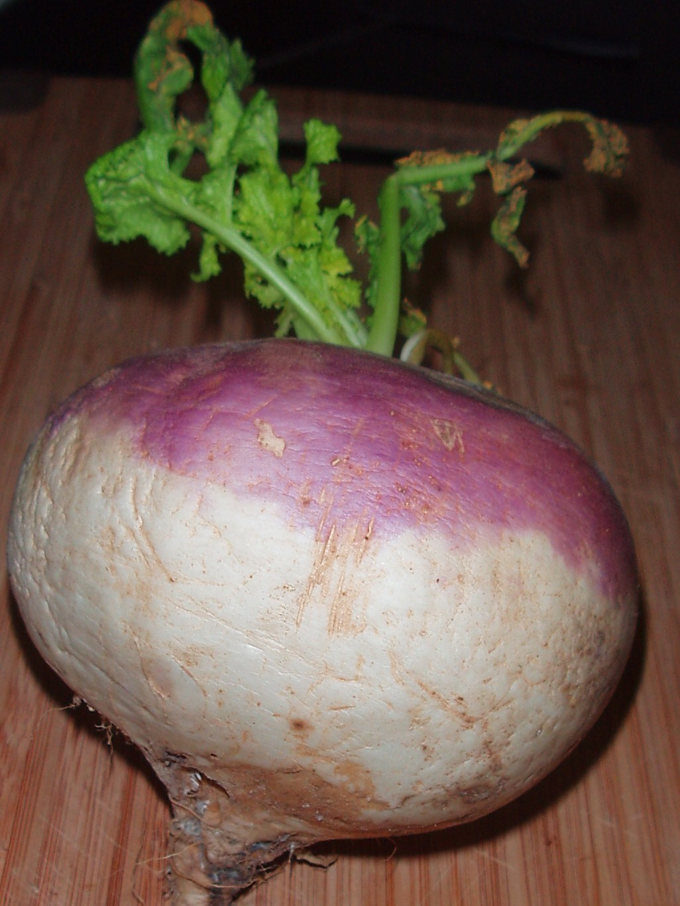
turnip

Slide 9
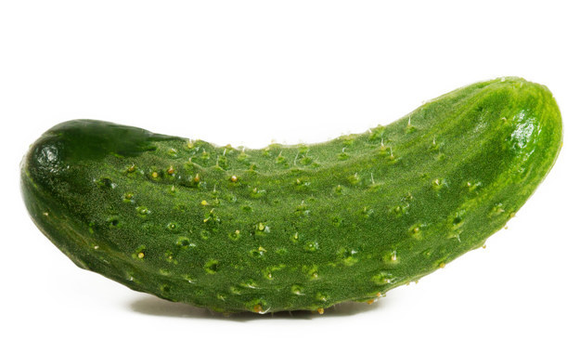
pickle

Slide 10
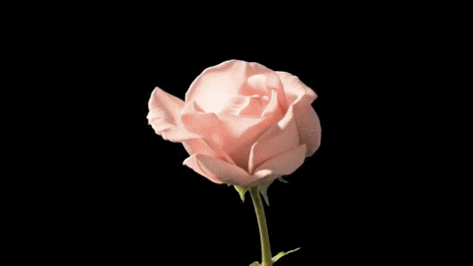
bloom

Slide 11
fragile

Slide 12
left?
right?
or

Slide 13
jar

Slide 14
iris

Slide 15
cellar

Slide 16
bloom

Slide 17
foundation

Slide 18
barrel

Slide 19
turnip

Slide 20
jelly

Slide 21
pickle

Slide 22
fragile

Slide 33
Good Job!!

