Slide 1
Vocabulary!

Slide 2
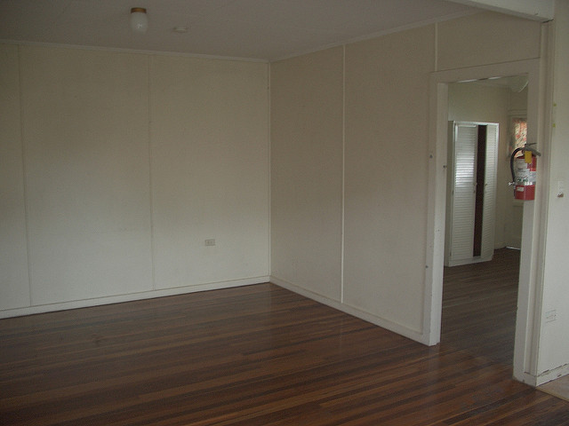
area

Slide 3
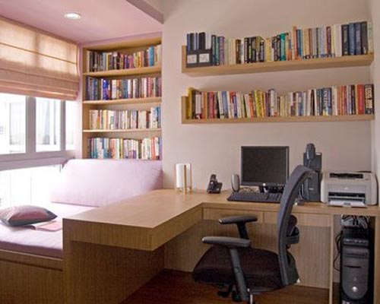
study

Slide 4
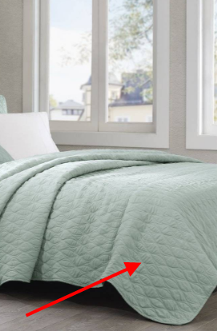
coverlet

Slide 5
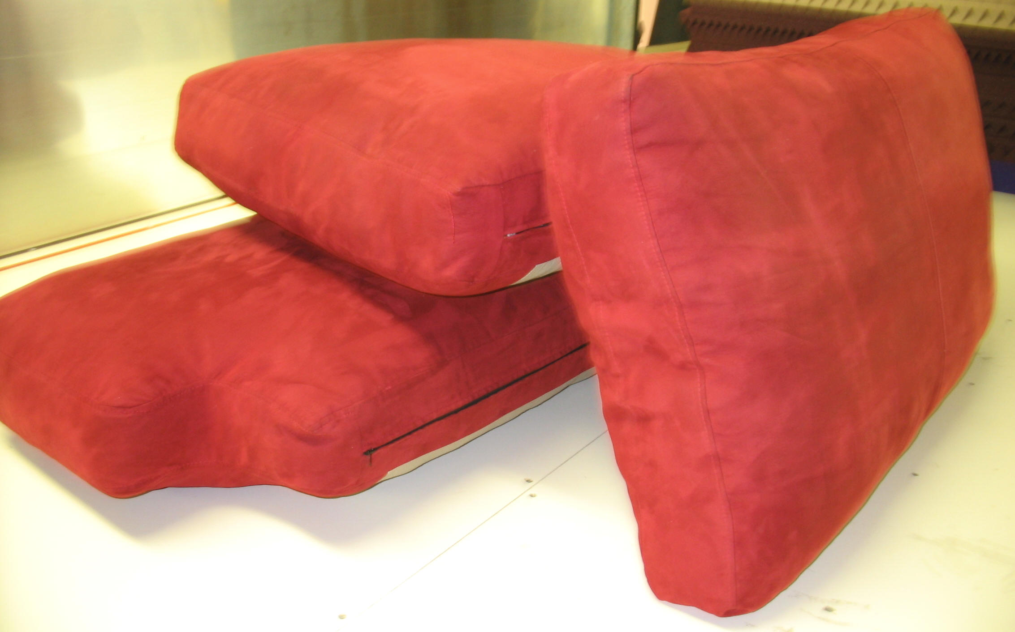
cushion

Slide 6
delicate

Slide 7
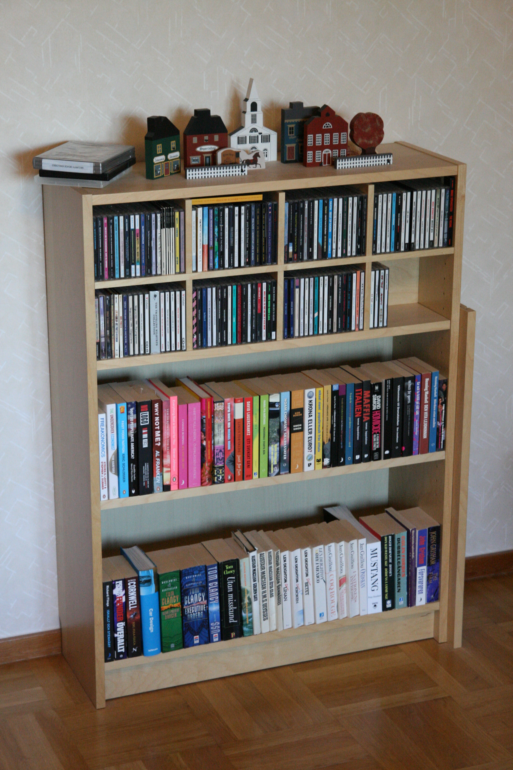
bookshelf

Slide 8
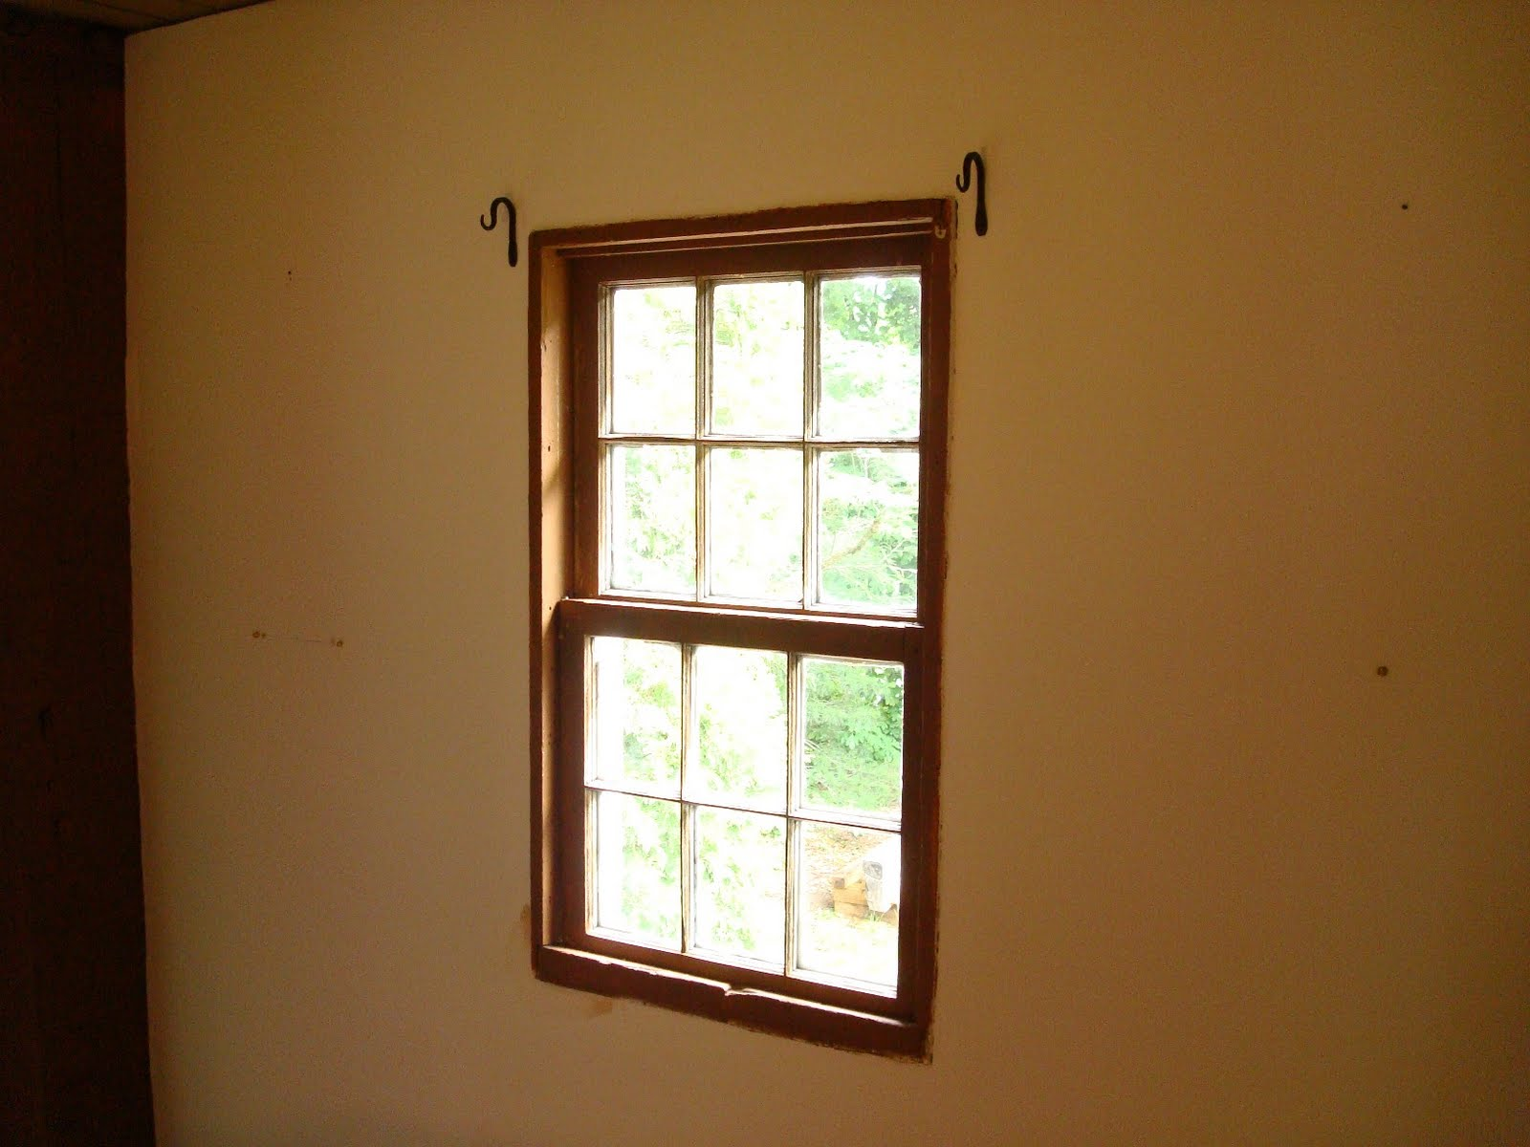
window

Slide 9
left?
right?
or

Slide 10
coverlet

Slide 11
area

Slide 12
study

Slide 13
cushion

Slide 14
delicate

Slide 15
bookshelf

Slide 16
window

