Slide 1
Vocab!

Slide 2
arrival

Slide 3
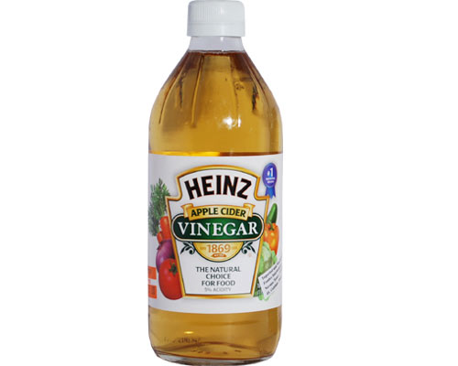
vinegar

Slide 4
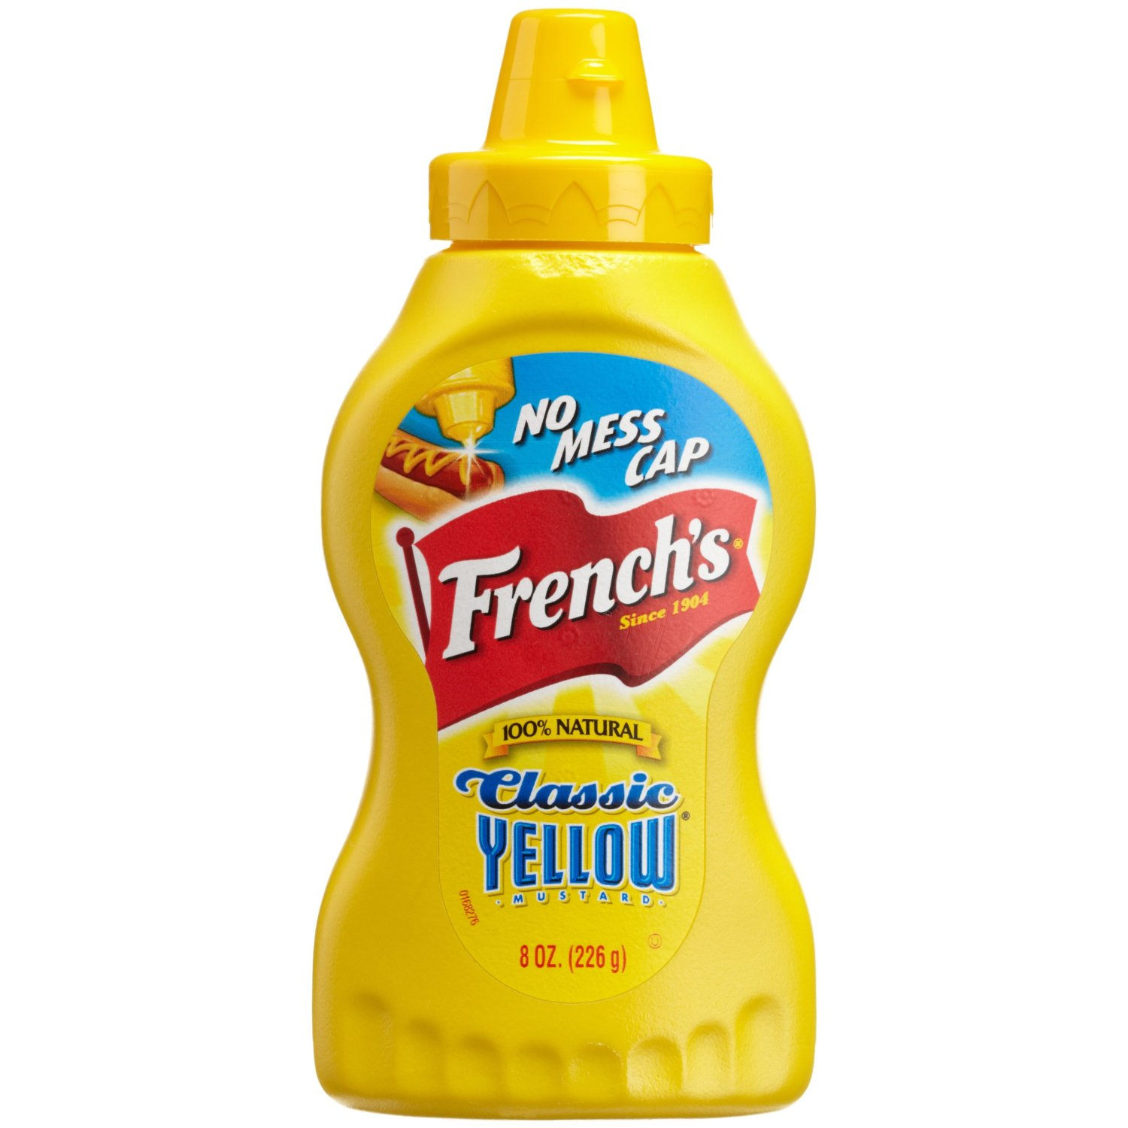
mustard

Slide 5
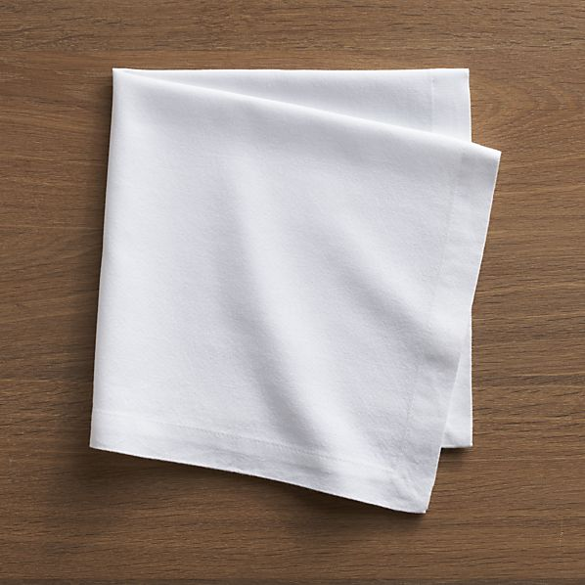
napkin

Slide 6
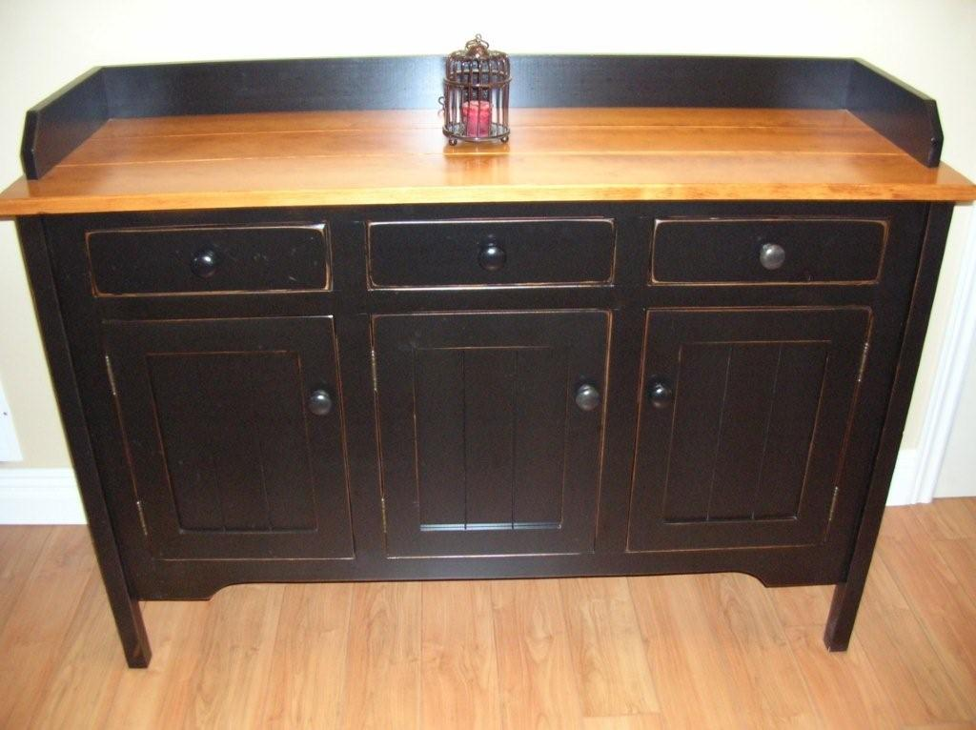
sideboard

Slide 7
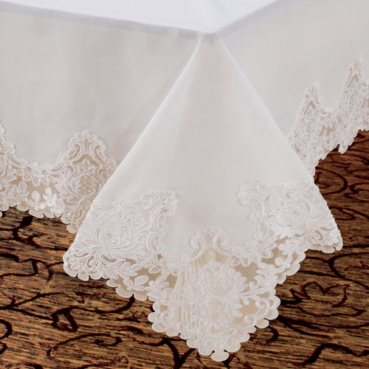
tablecloth

Slide 8
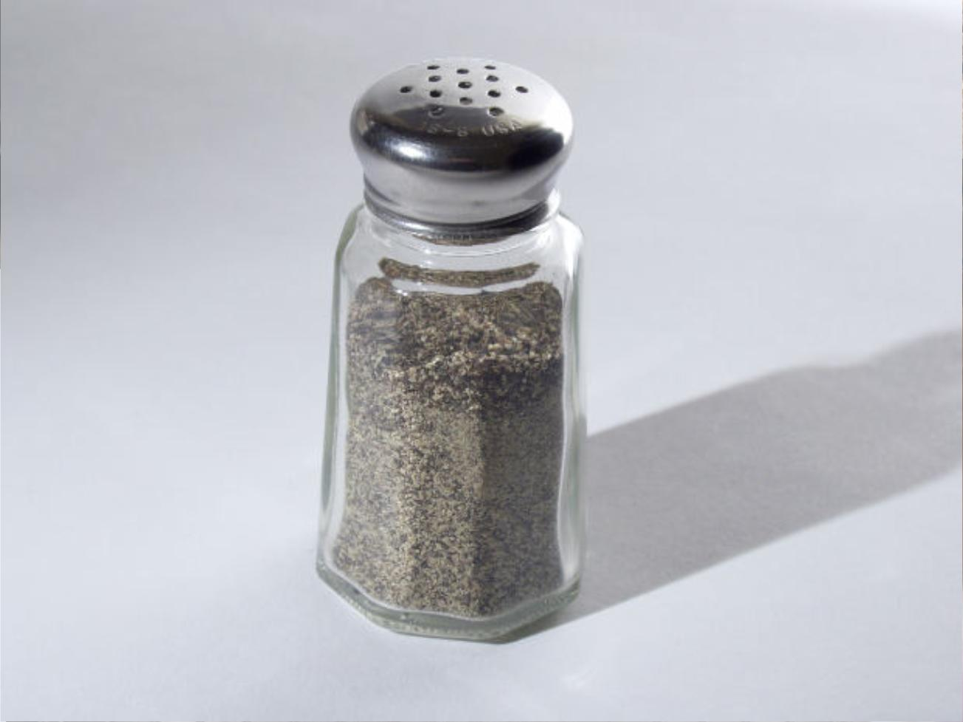
pepper

Slide 9
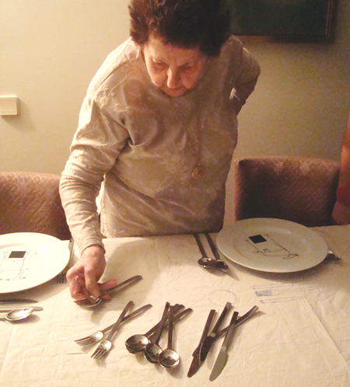
lay the table

Slide 10
left?
right?
or

Slide 11
mustard

Slide 12
arrival

Slide 13
vinegar

Slide 14
napkin

Slide 15
sideboard

Slide 16
pepper

Slide 17
tablecloth

Slide 18
lay the table

Slide 27
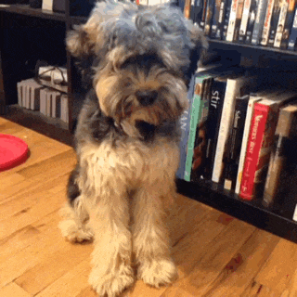
Good Job!

