Slide 1
VocabularY!

Slide 2
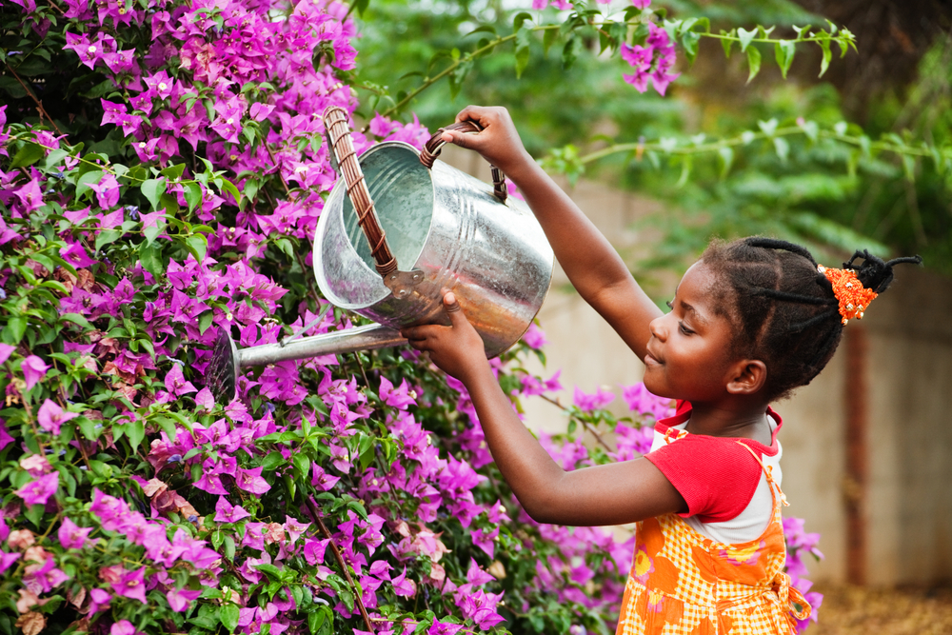
water the flowers

Slide 3
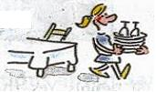
clear the table

Slide 4
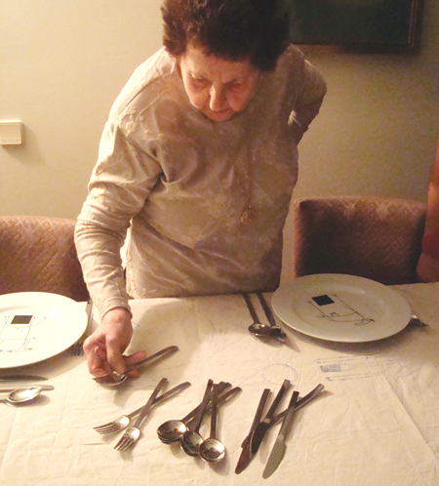
lay the table

Slide 5
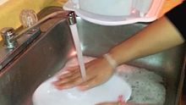
wash the dishes

Slide 6
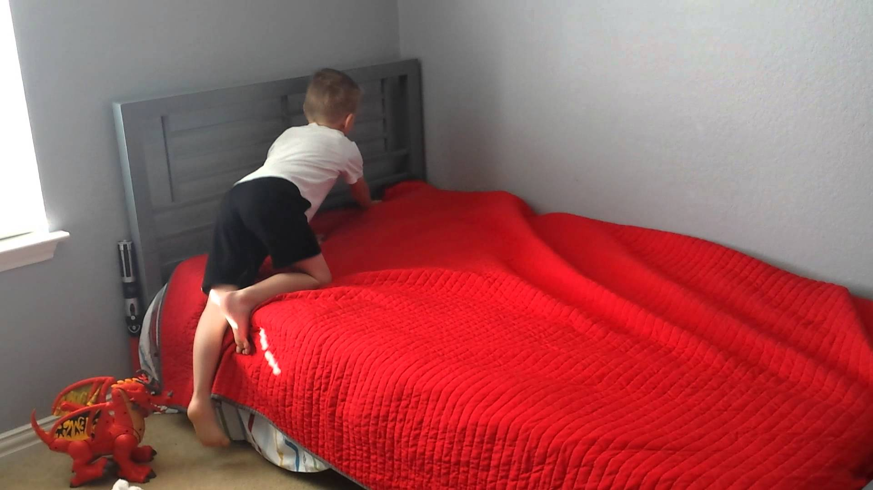
make the bed

Slide 7
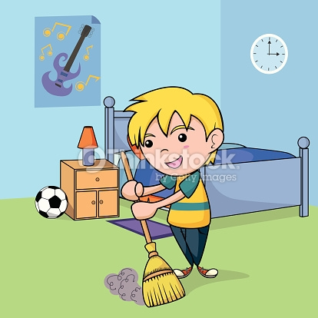
tidy the room

Slide 8
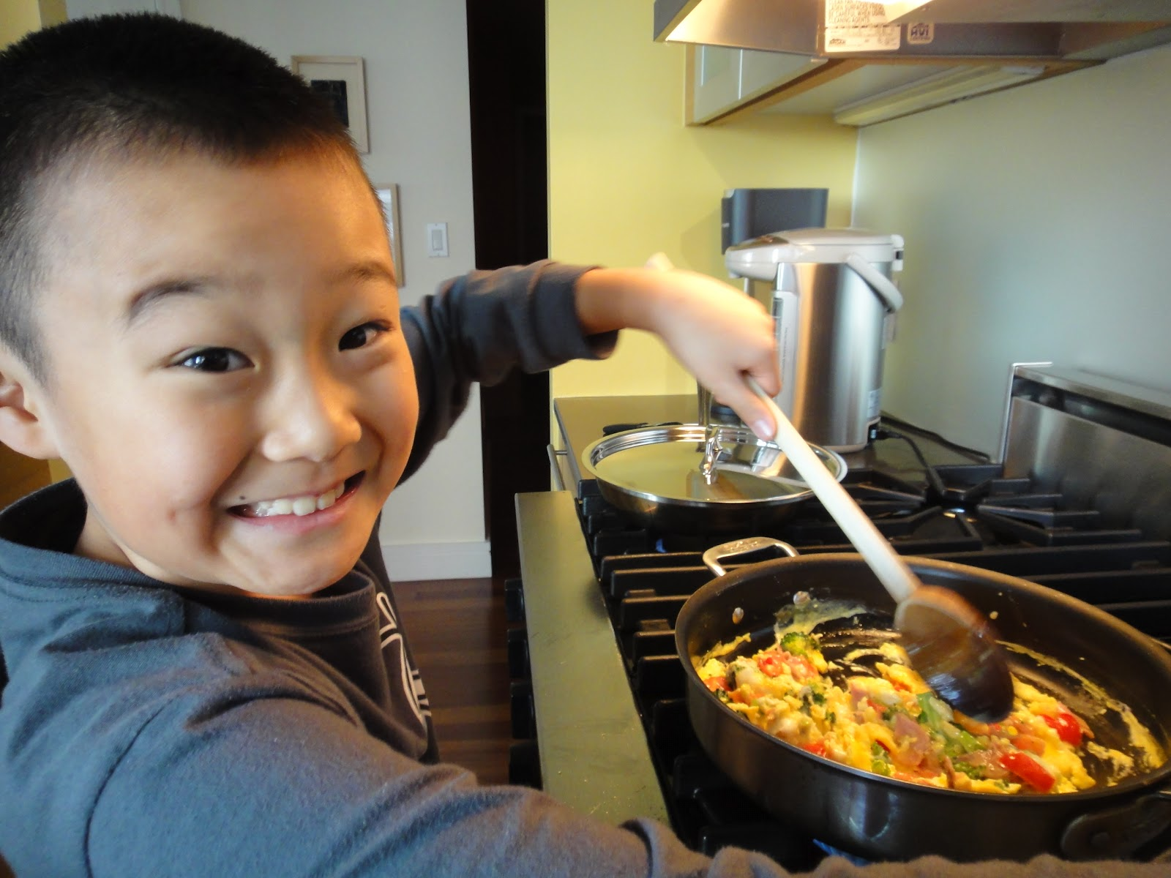
make breakfast

Slide 9
do the shopping

Slide 10
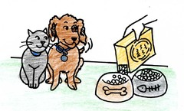
feed the pets

Slide 11
top?
or
bottom?

Slide 12
clear the table

Slide 13
lay the table

Slide 14
water the flowers

Slide 15
make the bed

Slide 16
wash the dishes

Slide 17
do the shopping

Slide 18
feed the pets

Slide 19
tidy the room

Slide 20
make breakfast

