Slide 1
Vocab!

Slide 2
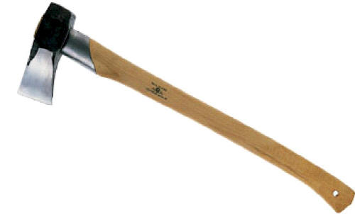
axe

Slide 3
to dive

Slide 4
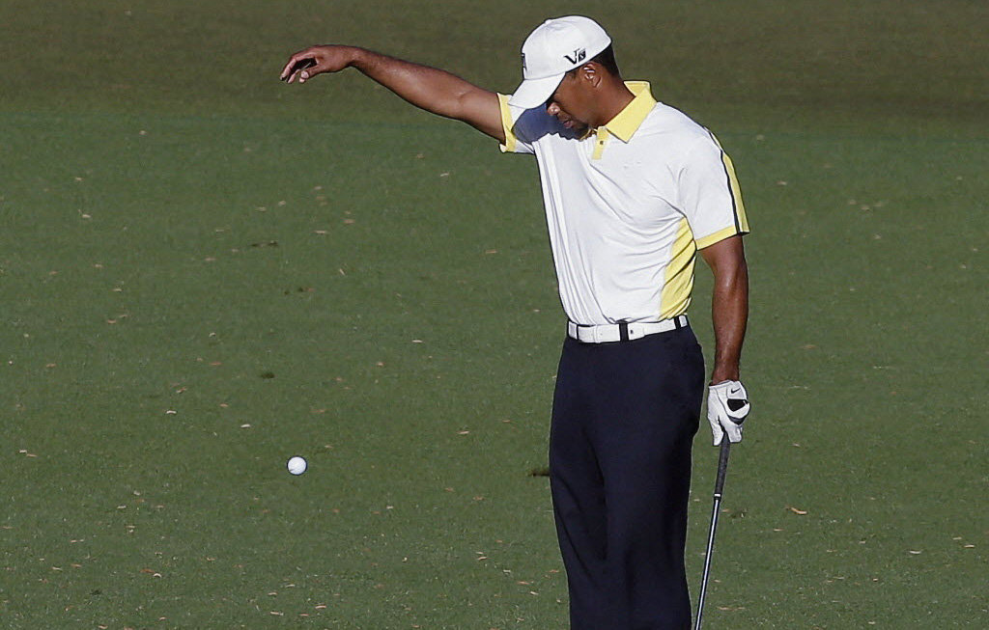
to drop

Slide 5
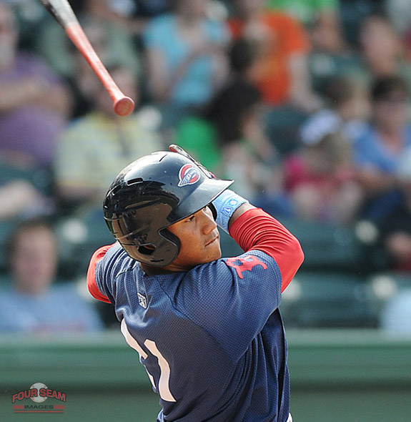
to slip

Slide 6
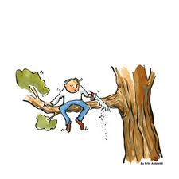
foolishly

Slide 7
left?
right?
or

Slide 8
to dive

Slide 9
axe

Slide 10
foolishly

Slide 11
to drop

Slide 12
to slip

Slide 18
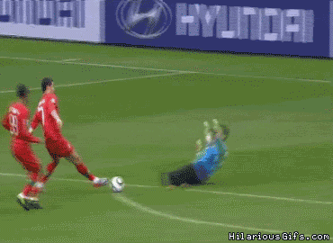
Good Job!

