Slide 1
VocabularY!

Slide 2
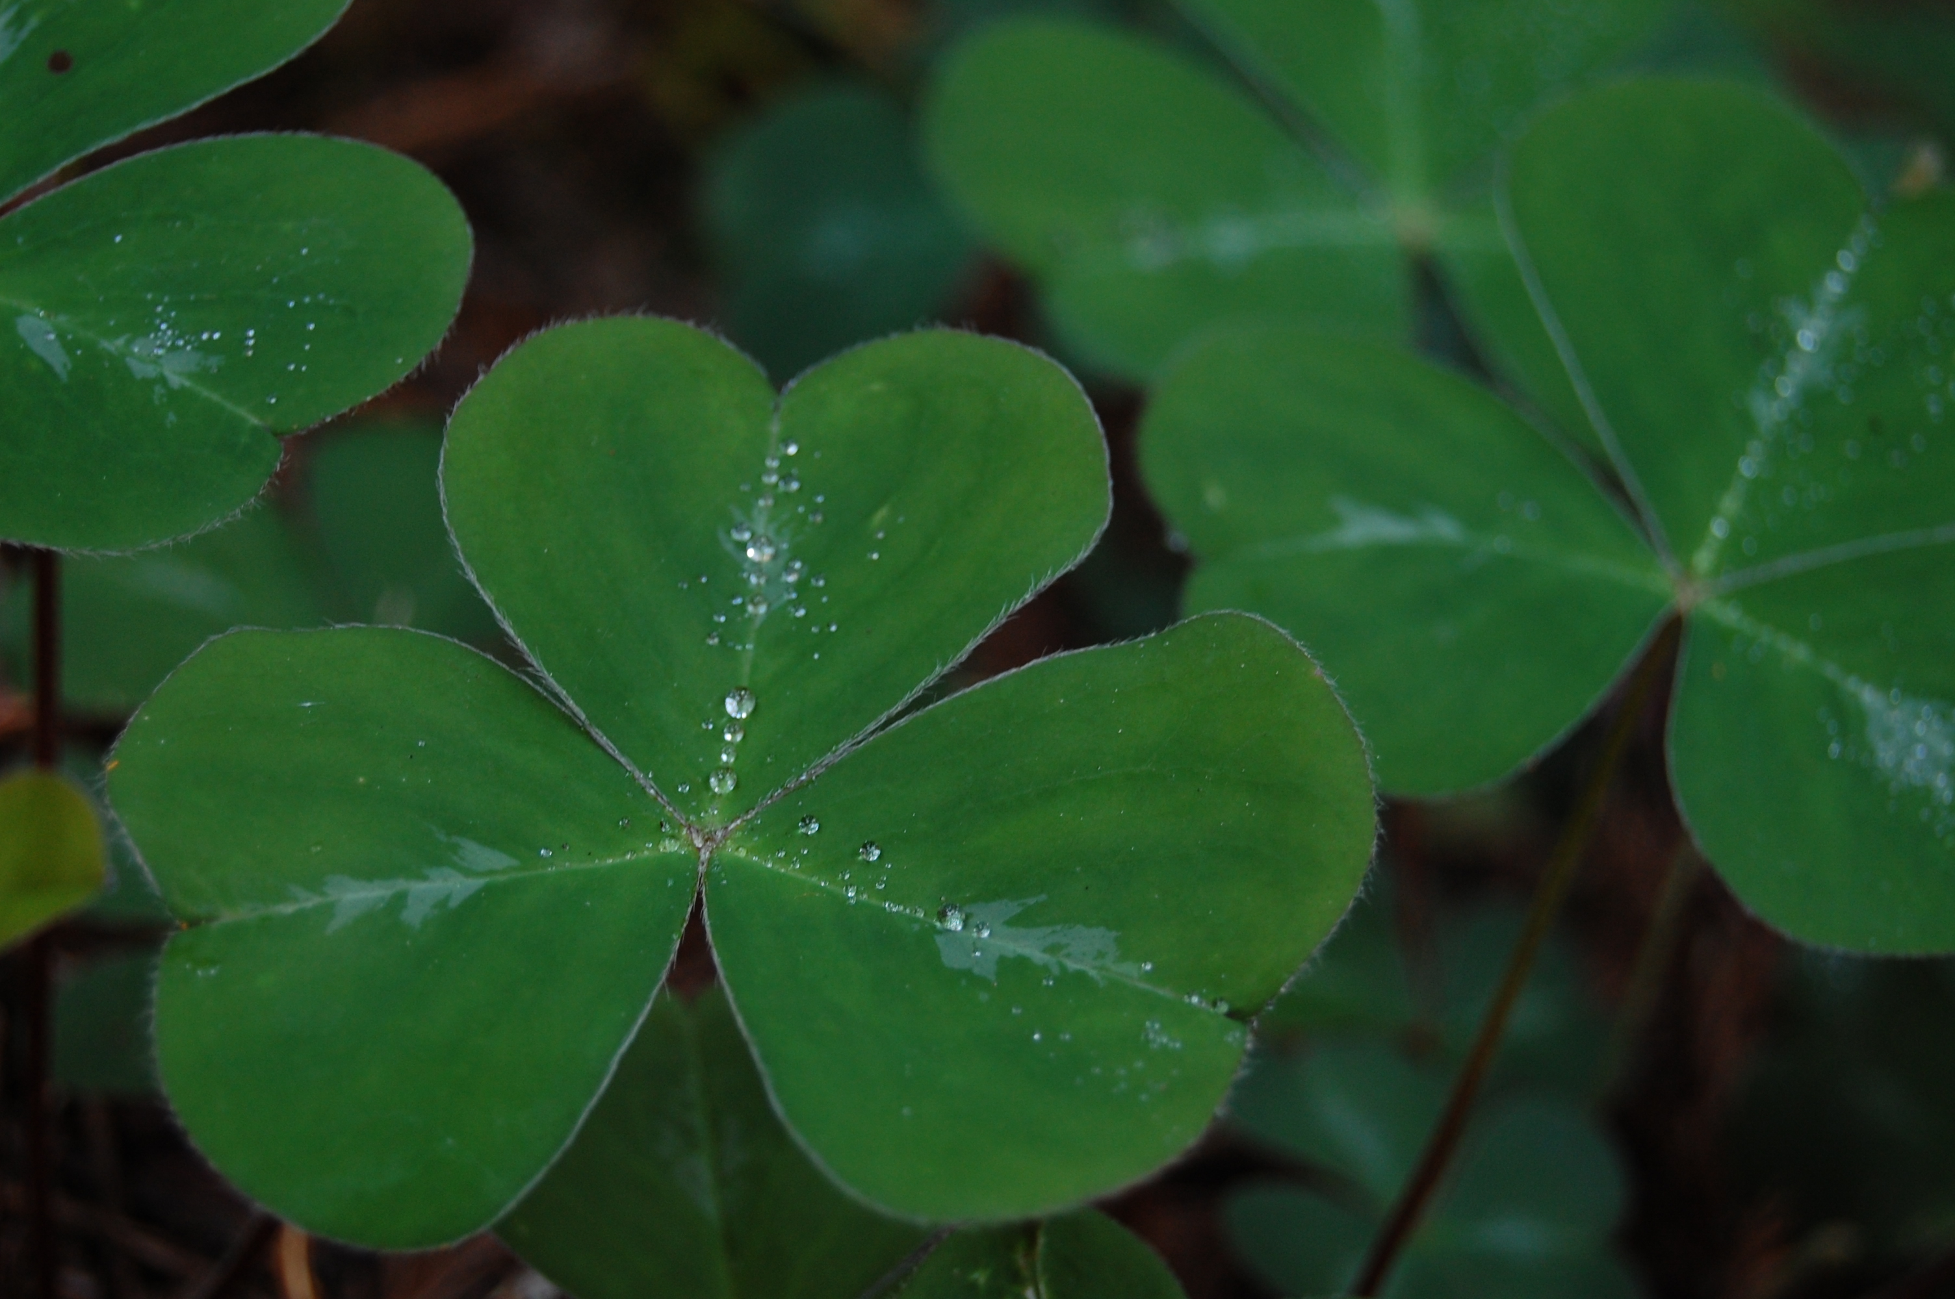
shamrock

Slide 3
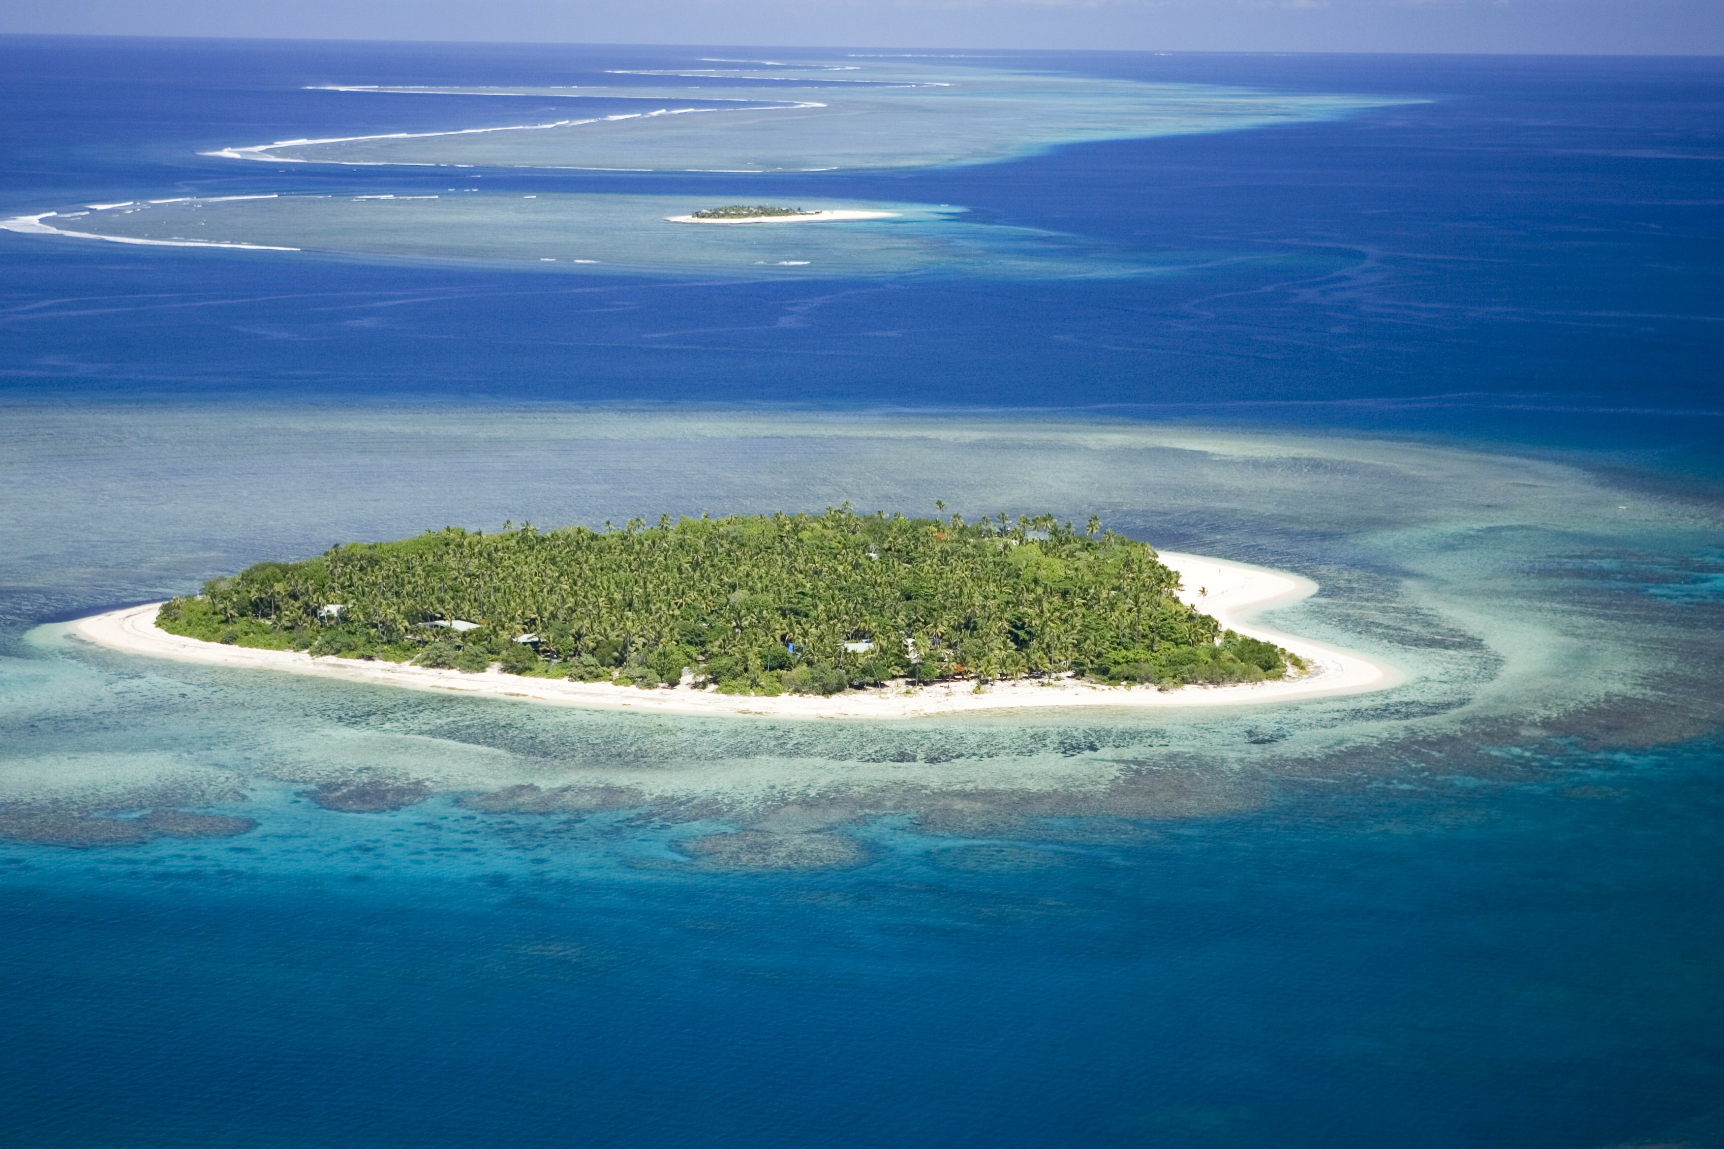
island

Slide 4
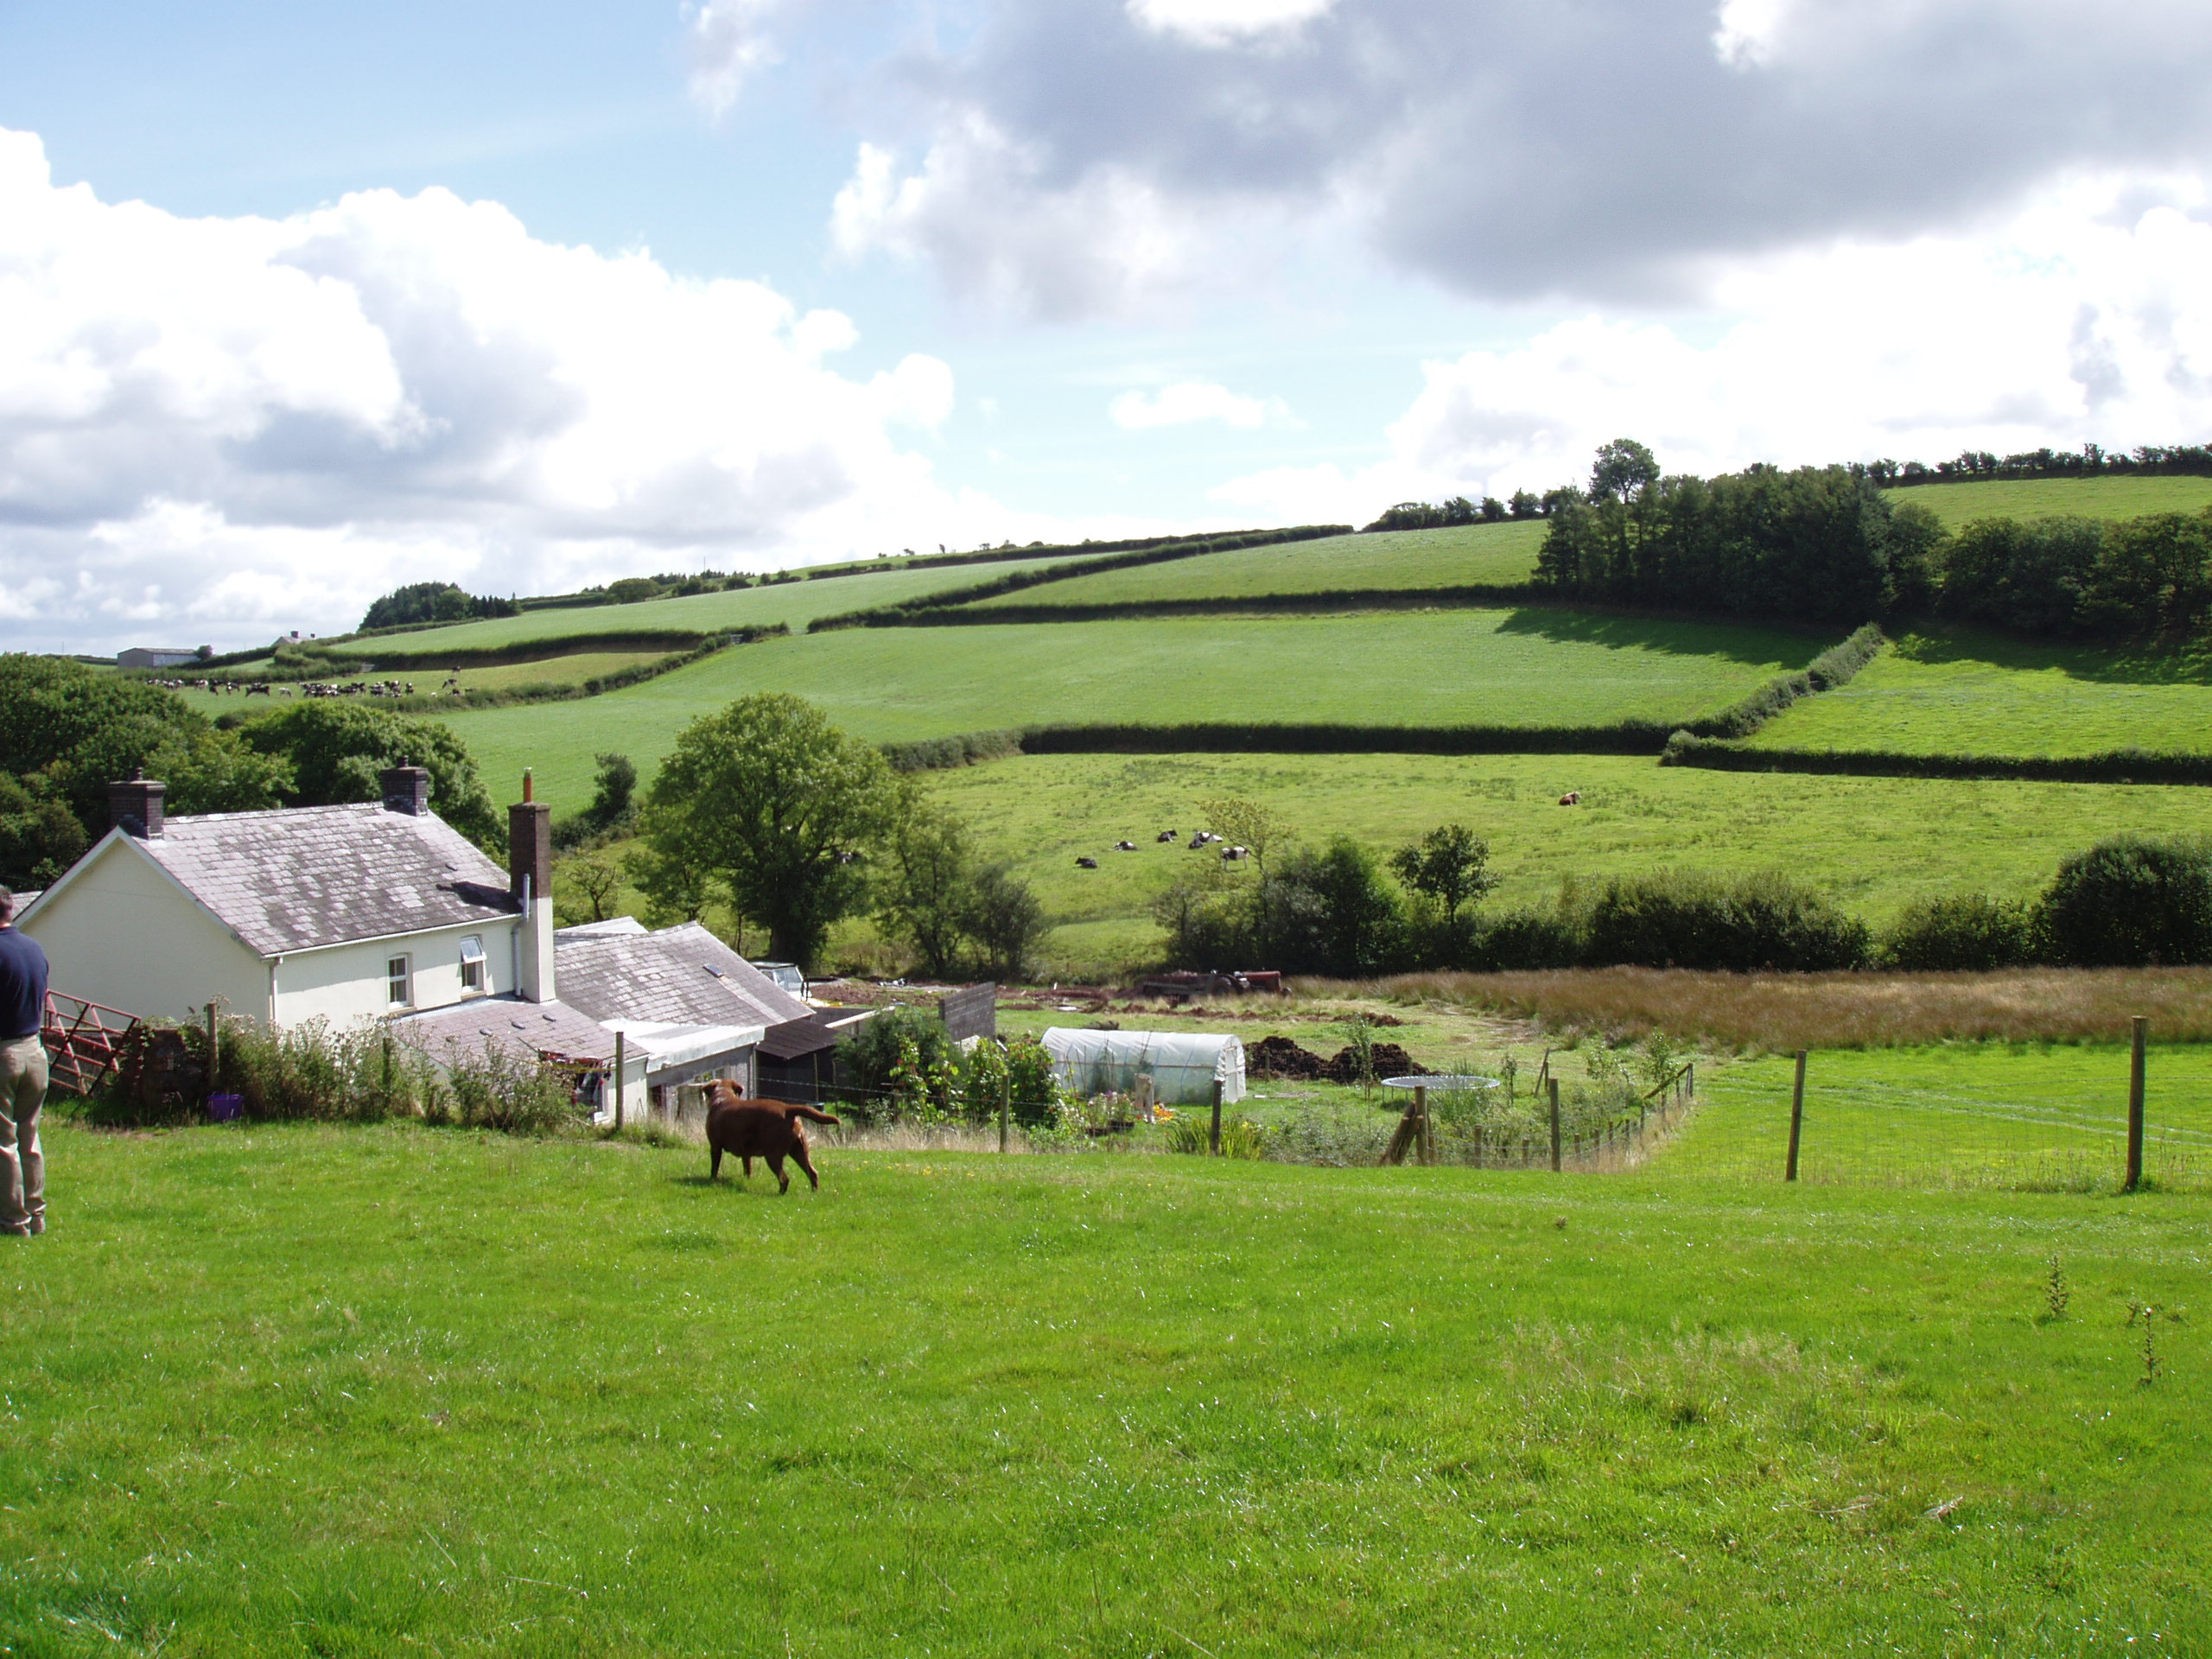
countryside

Slide 5
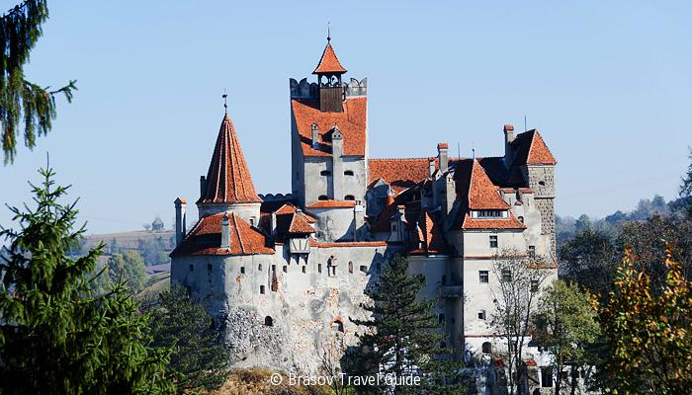
castle

Slide 6
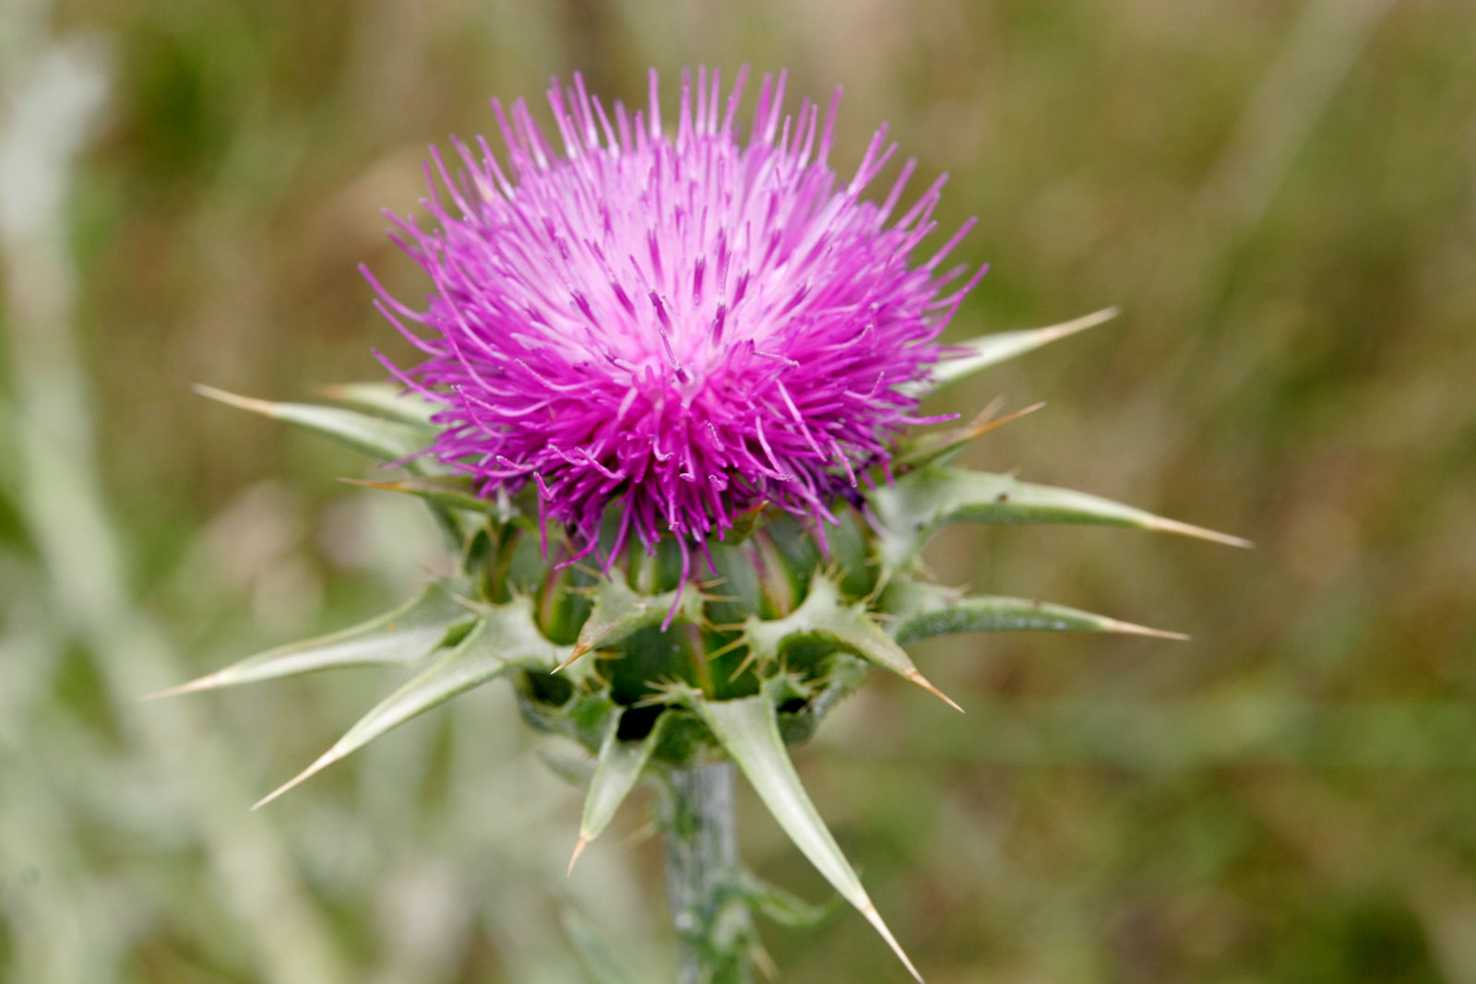
thistle

Slide 7
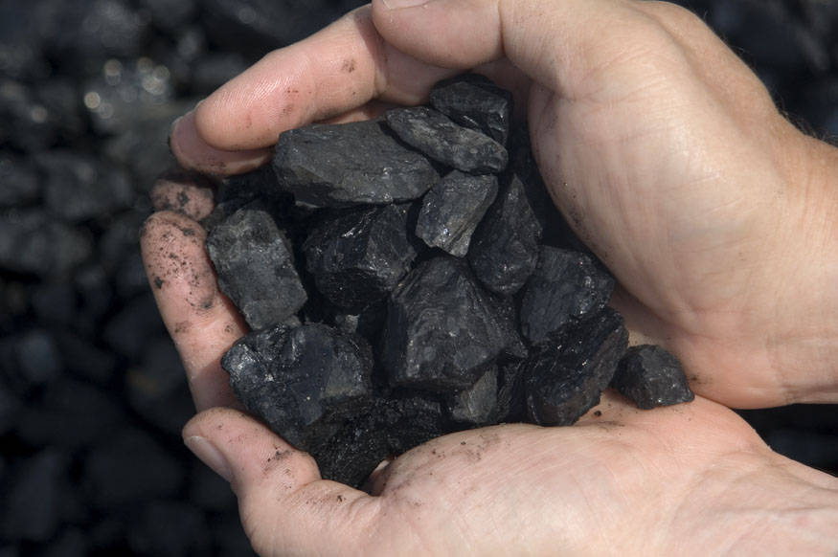
coal

Slide 8
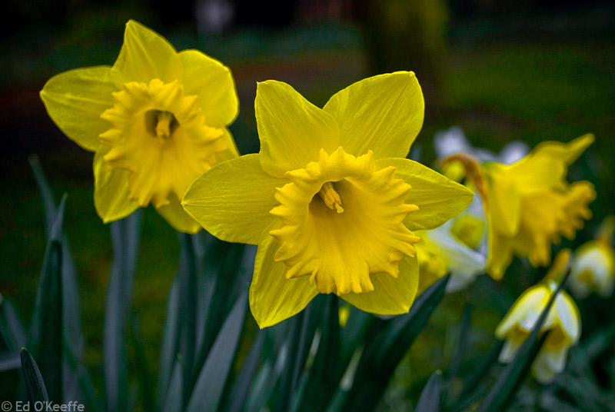
daffodil

Slide 9
top?
or
bottom?

Slide 10
island

Slide 11
countryside

Slide 12
shamrock

Slide 13
daffodil

Slide 14
castle

Slide 15
thistle

Slide 16
coal

