Slide 1
VocabularY!

Slide 2
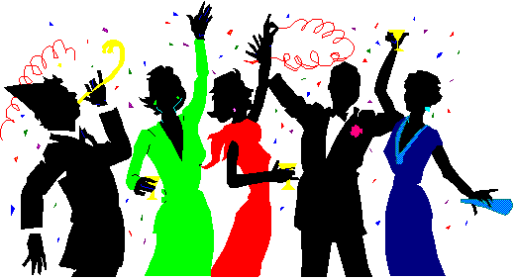
celebration

Slide 3
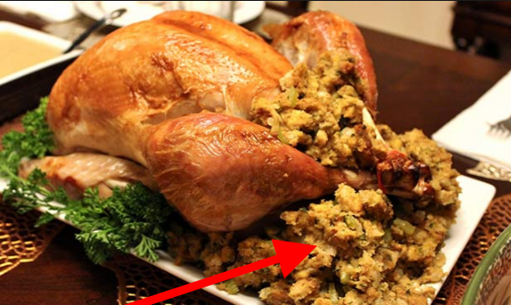
stuffing

Slide 4
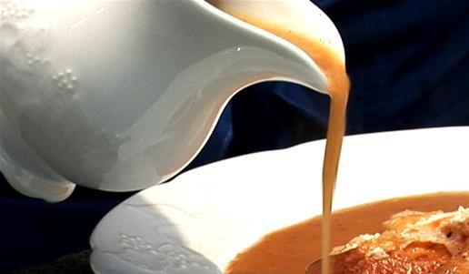
gravy

Slide 5
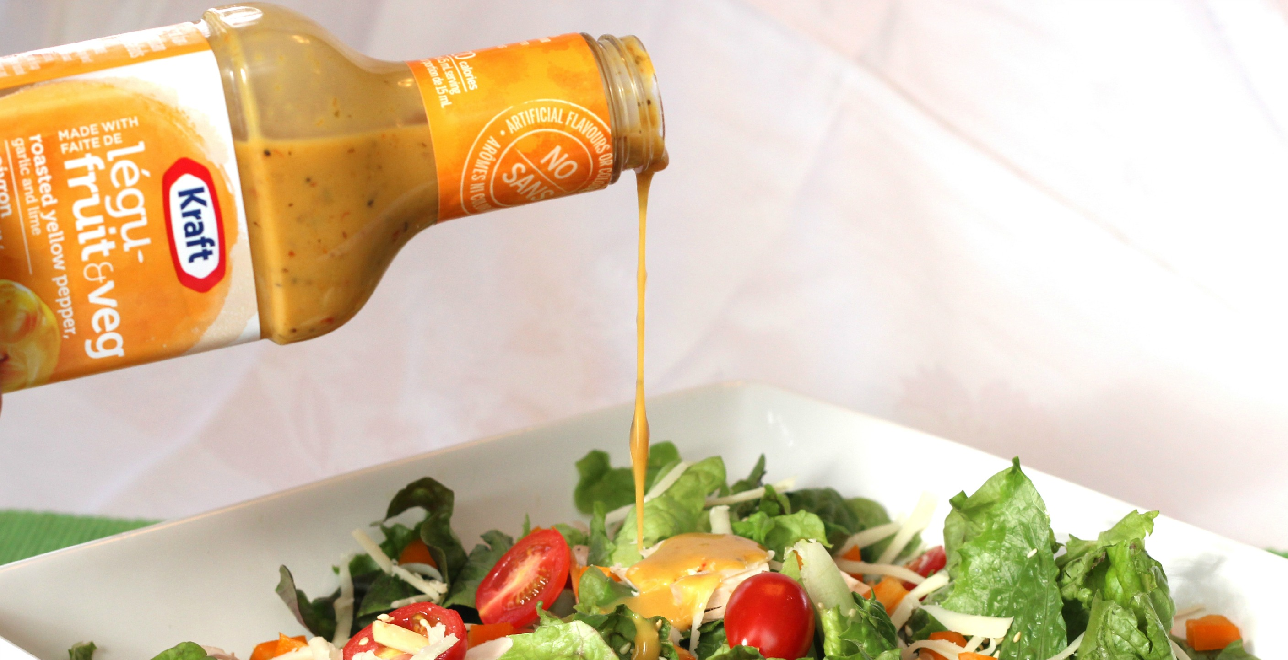
dressing

Slide 6
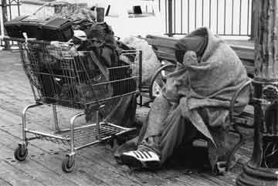
homeless

Slide 7
top?
or
bottom?

Slide 8
stuffing

Slide 9
celebration

Slide 10
gravy

Slide 11
dressing

Slide 12
homeless

