Slide 1
Vocab!

Slide 2
adult

Slide 3
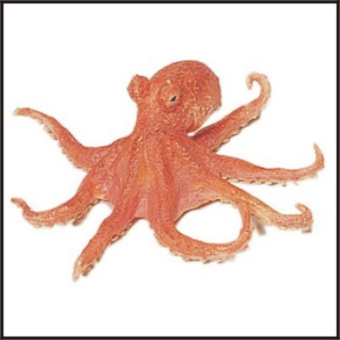
octopus

Slide 4
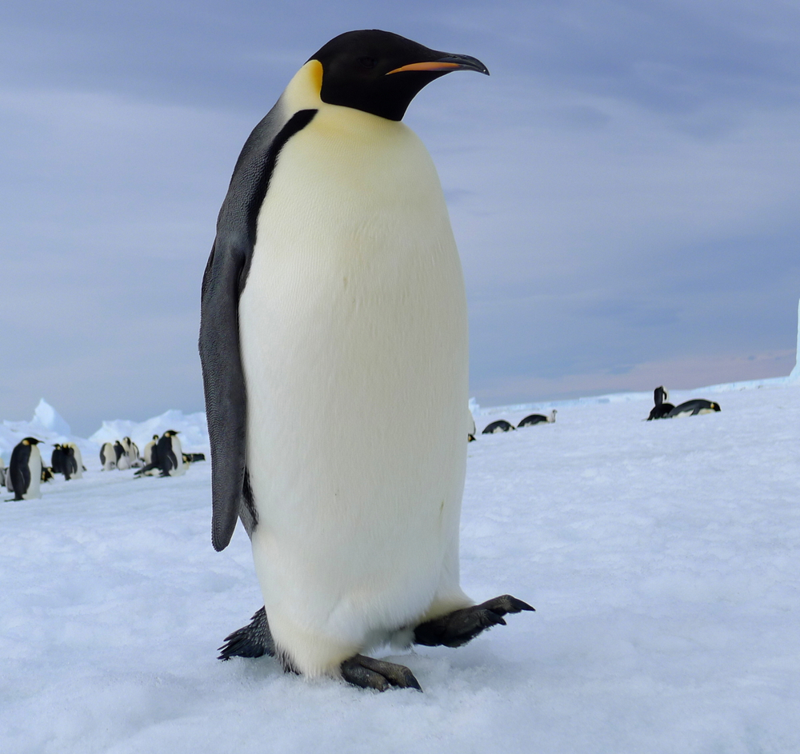
penguin

Slide 5
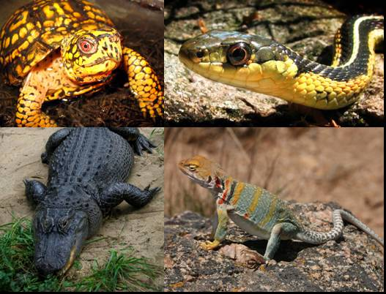
reptile

Slide 6
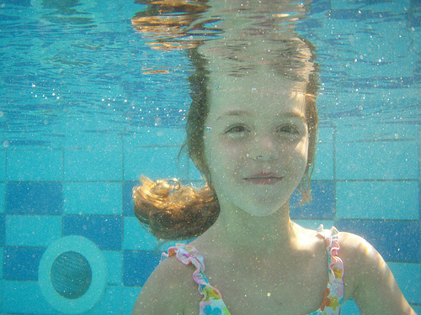
underwater

Slide 7
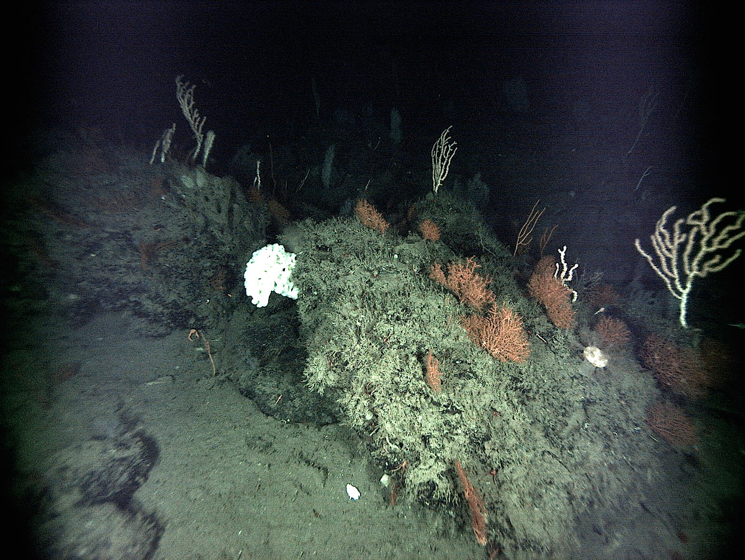
undersea

Slide 8
top?
or
bottom?

Slide 9
penguin

Slide 10
adult

Slide 11
reptile

Slide 12
octopus

Slide 13
undersea

Slide 14
underwater

