Slide 1
COMPUTER VocabULARY

Slide 2
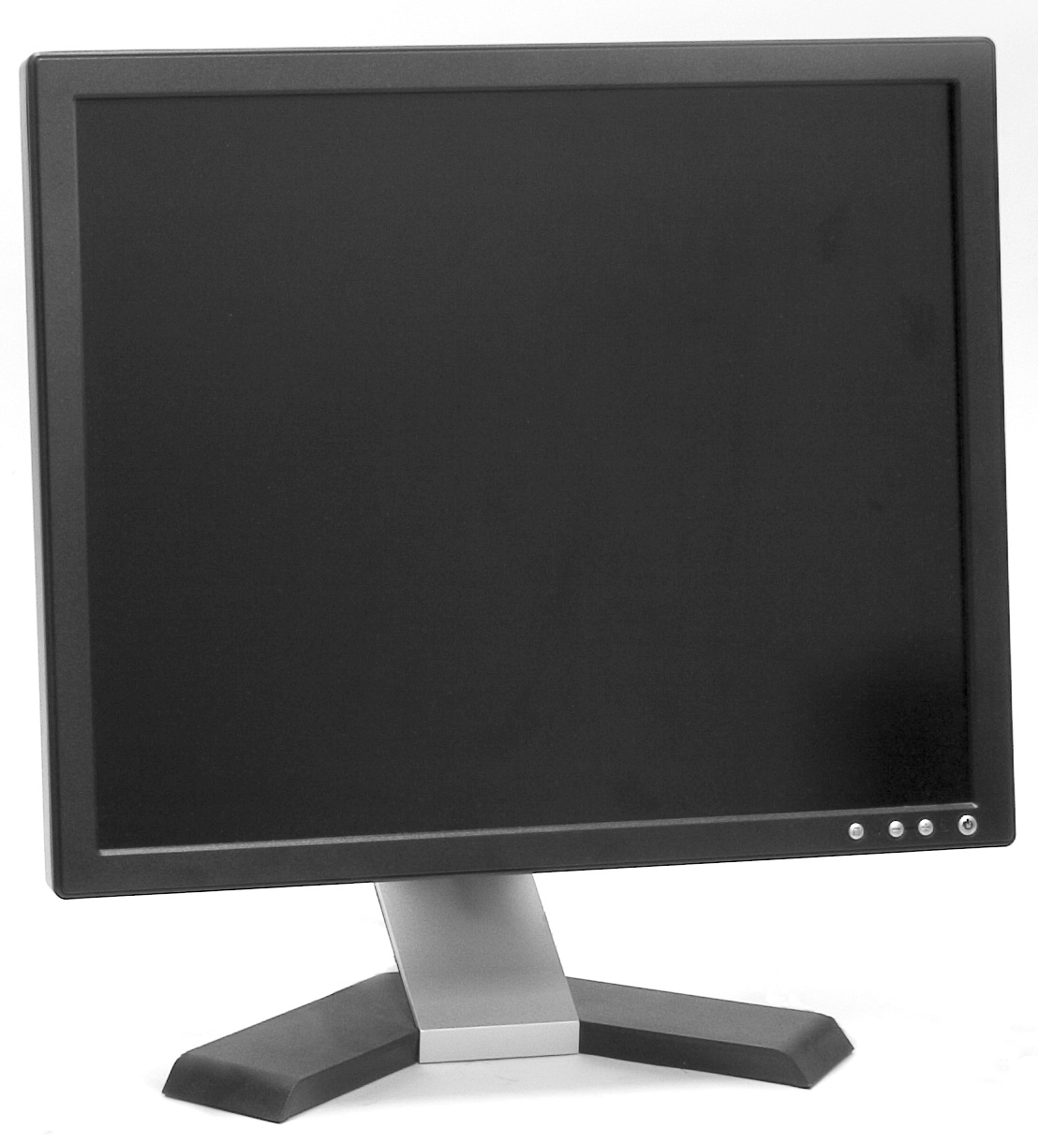
monitor

Slide 3
system unit

Slide 4
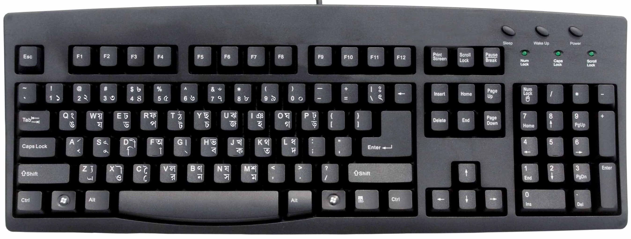
keyboard

Slide 5
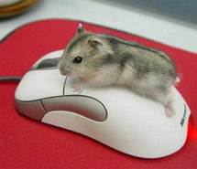
mouse

Slide 6
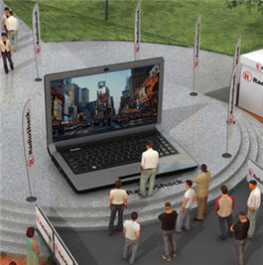
laptop

Slide 7
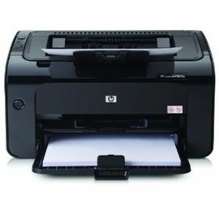
printer

Slide 8
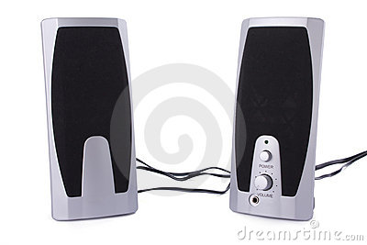
speakers

Slide 9
LEFT?
or
RIGHT?

Slide 10
keyboard

Slide 11
system unit

Slide 12
laptop

Slide 13
monitor

Slide 14
mouse

Slide 15
speakers

Slide 16
printer

