Slide 1
VocabULARY!

Slide 2
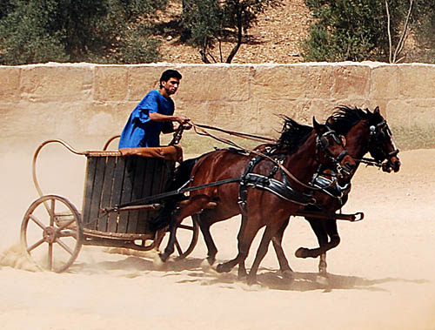
chariot

Slide 3
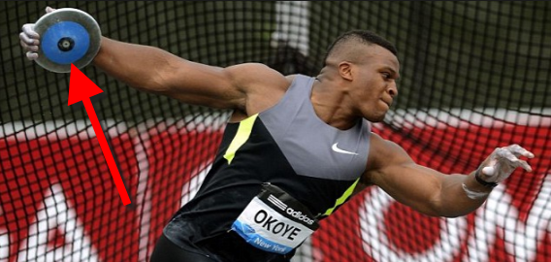
discus

Slide 4
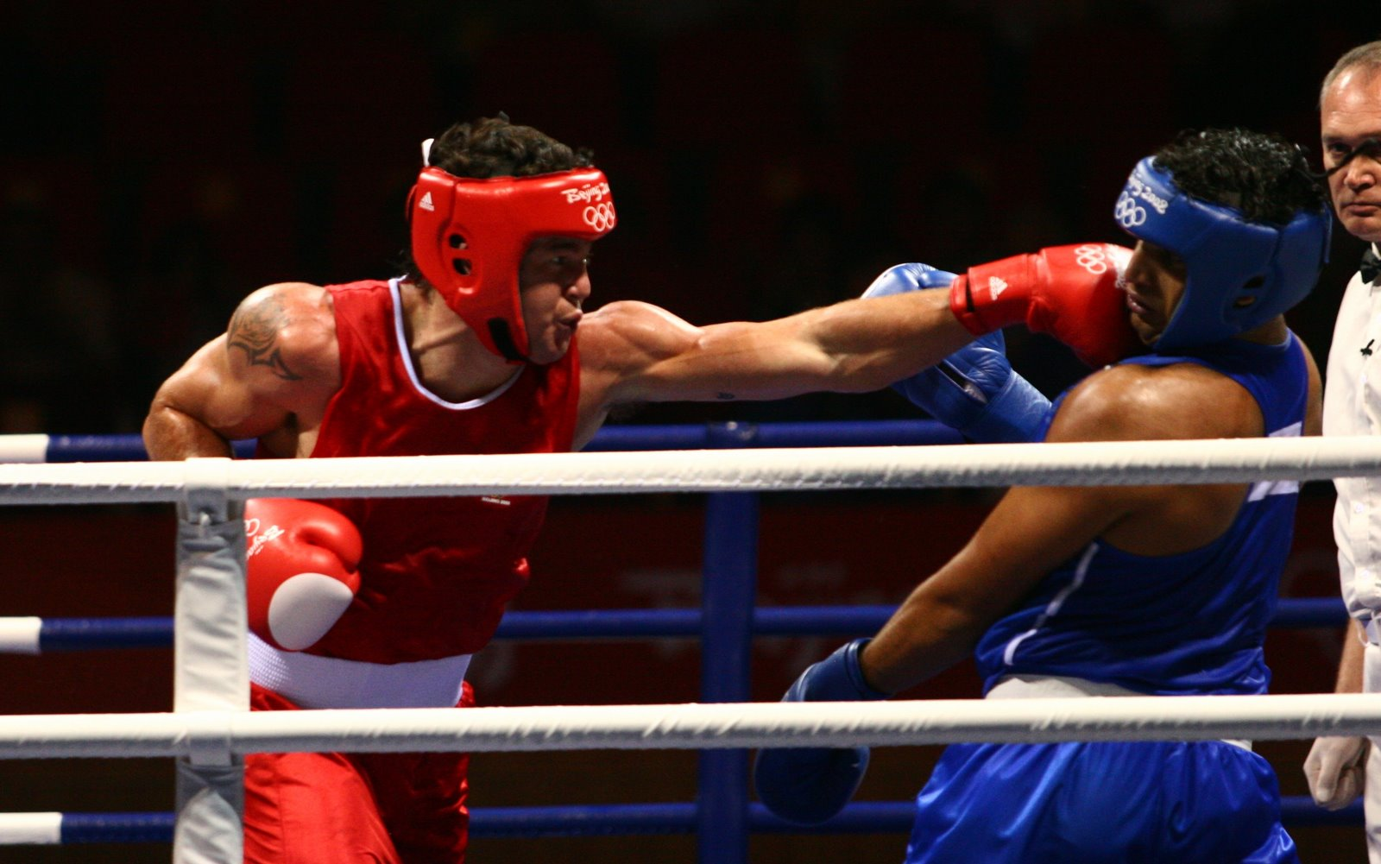
box

Slide 5
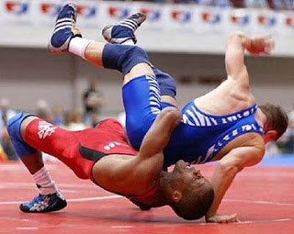
wrestle

Slide 6
leap year

Slide 7
TOP LEFT?
or
BOTTOM RIGHT?

Slide 8
discus

Slide 9
chariot

Slide 10
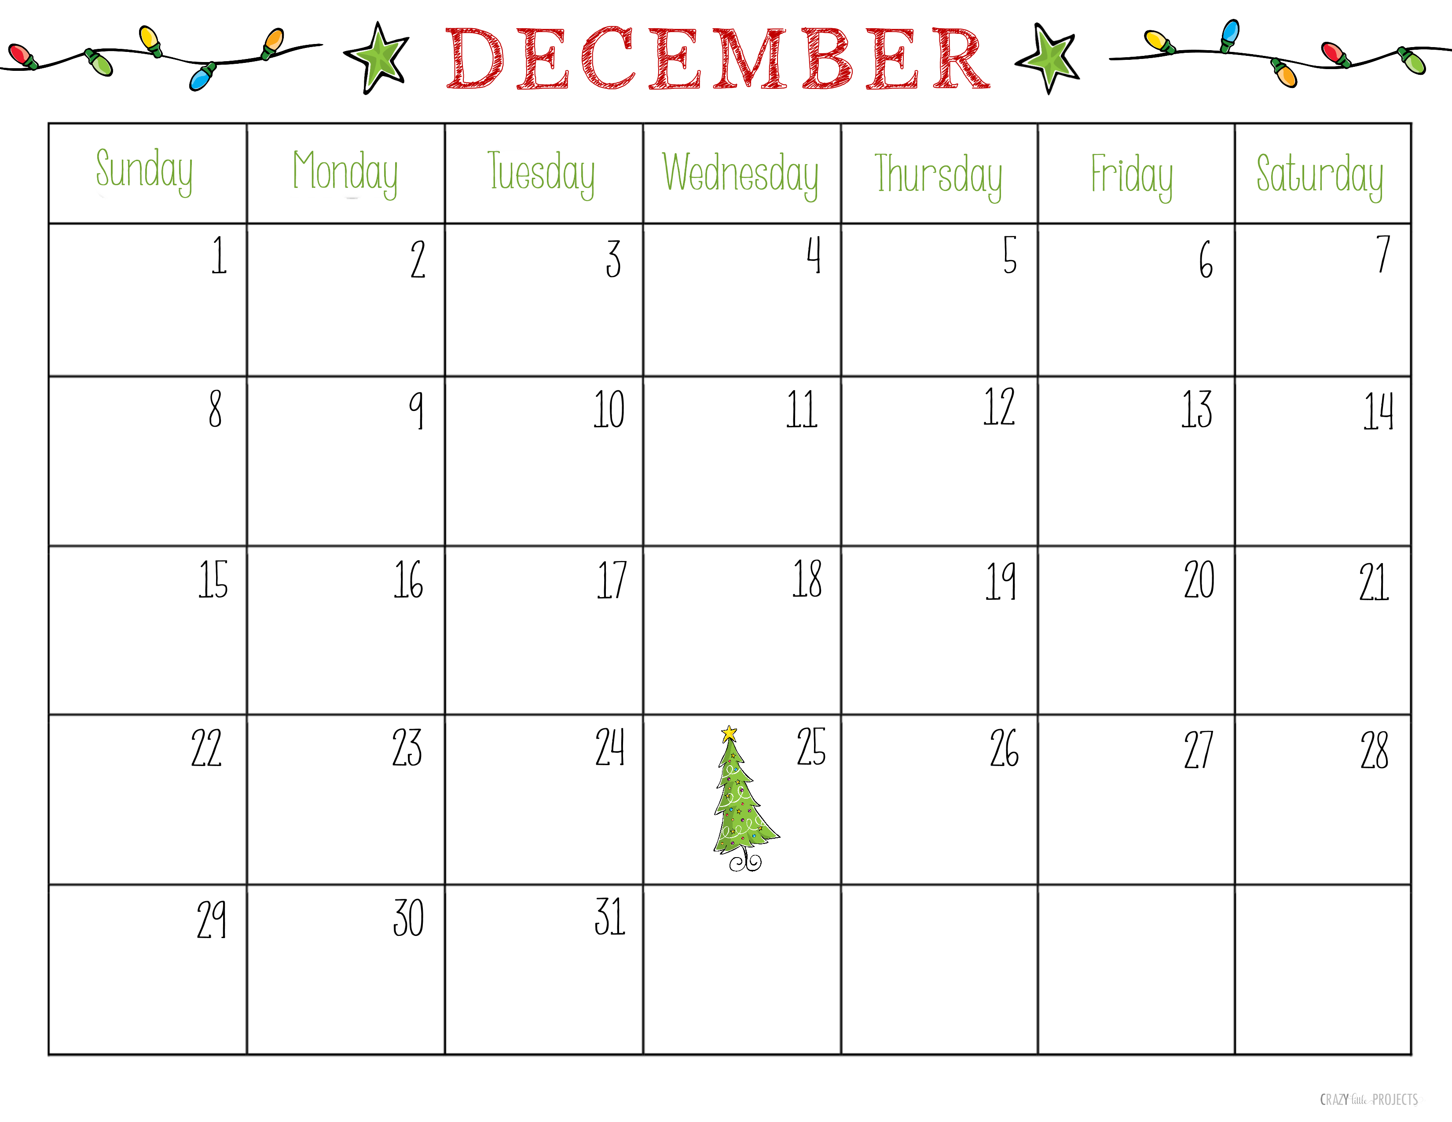
leap year

Slide 11
box

Slide 12
wrestle

Slide 18
