Slide 1
VocabularY!

Slide 2
try on

Slide 3
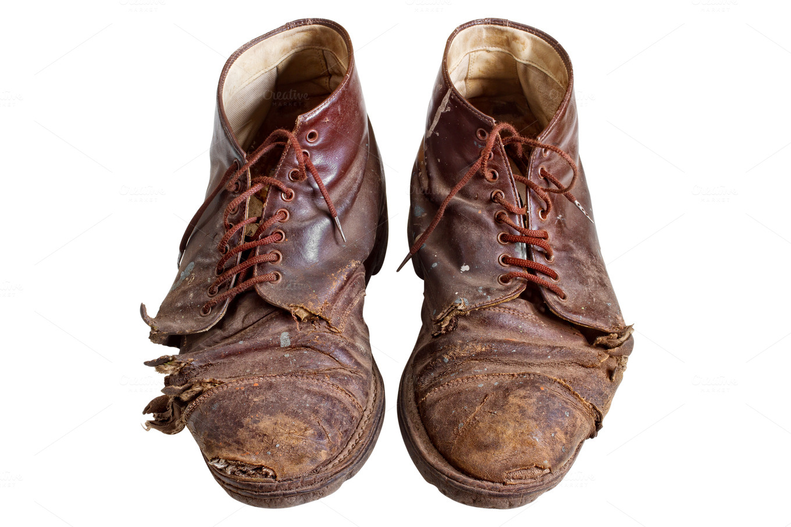
worn out

Slide 4
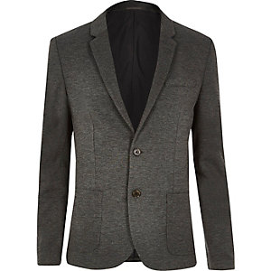
blazer

Slide 5
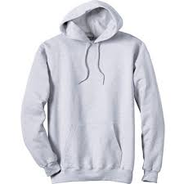
sweatshirt

Slide 6
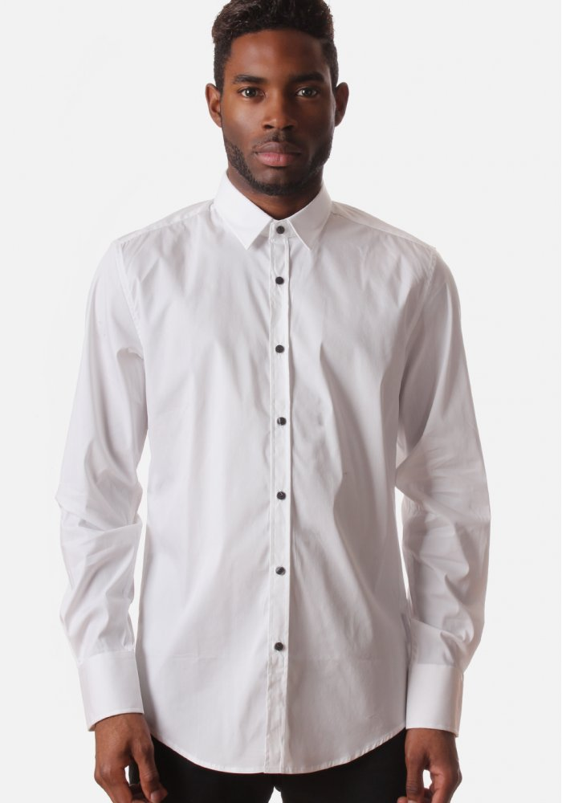
buttoned

Slide 7
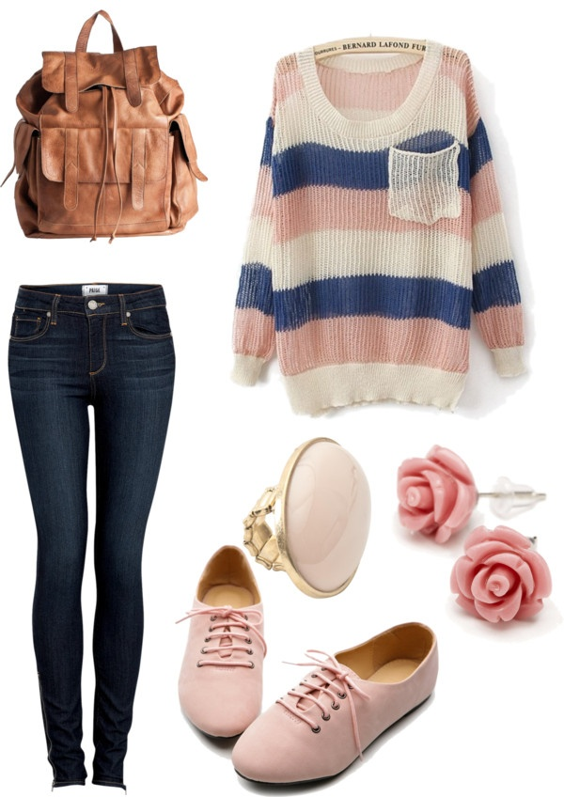
outfit

Slide 8
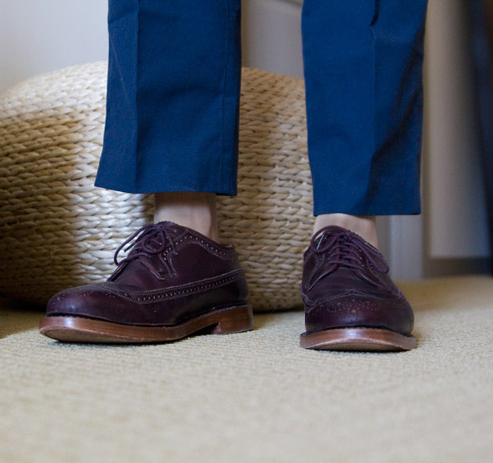
short

Slide 9
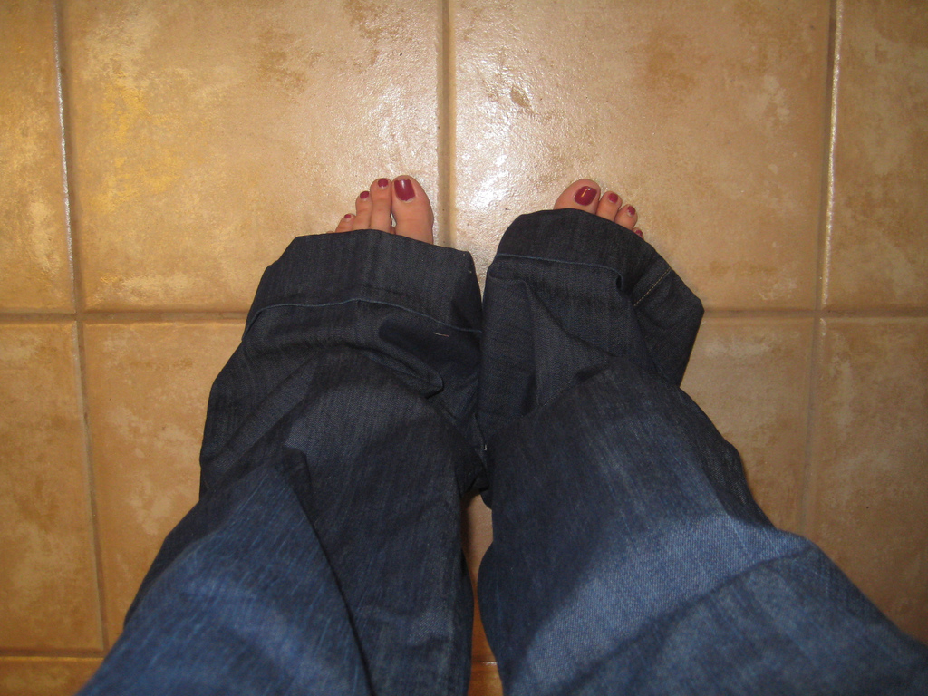
long

Slide 10
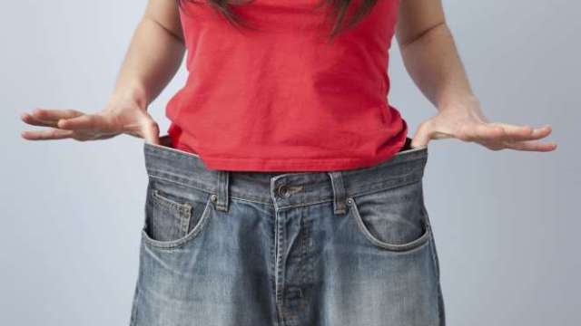
loose

Slide 11
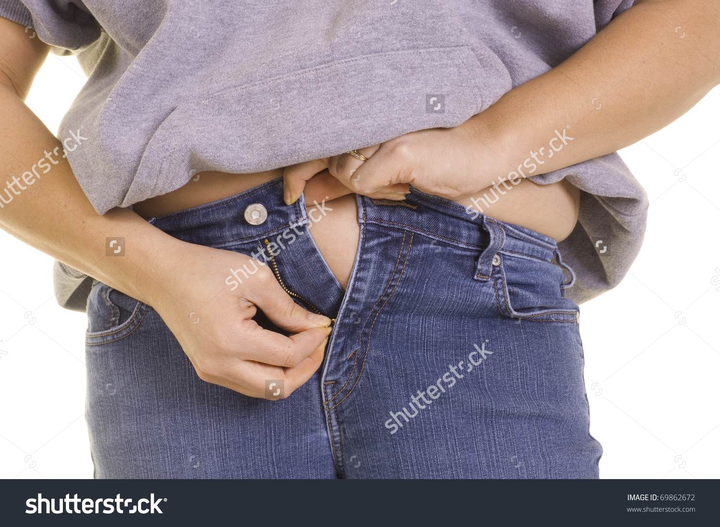
tight

Slide 12
left?
right?
or

Slide 13
sweatshirt

Slide 14
try on

Slide 15
short

Slide 16
tight

Slide 17
worn out

Slide 18
outfit

Slide 19
buttoned

Slide 20
blazer

Slide 21
loose

Slide 22
long

Slide 33
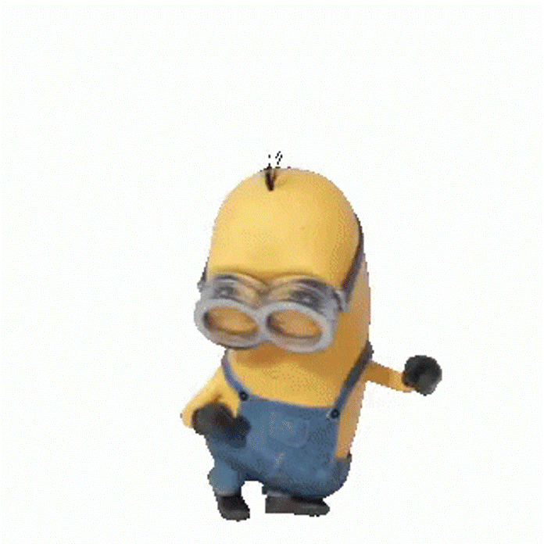
Good Job!

