Slide 1
VocabULARY!

Slide 2
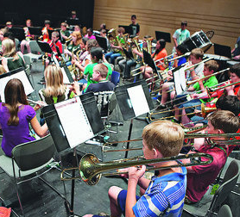
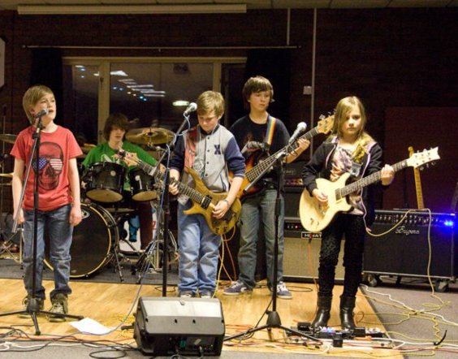
band

Slide 3
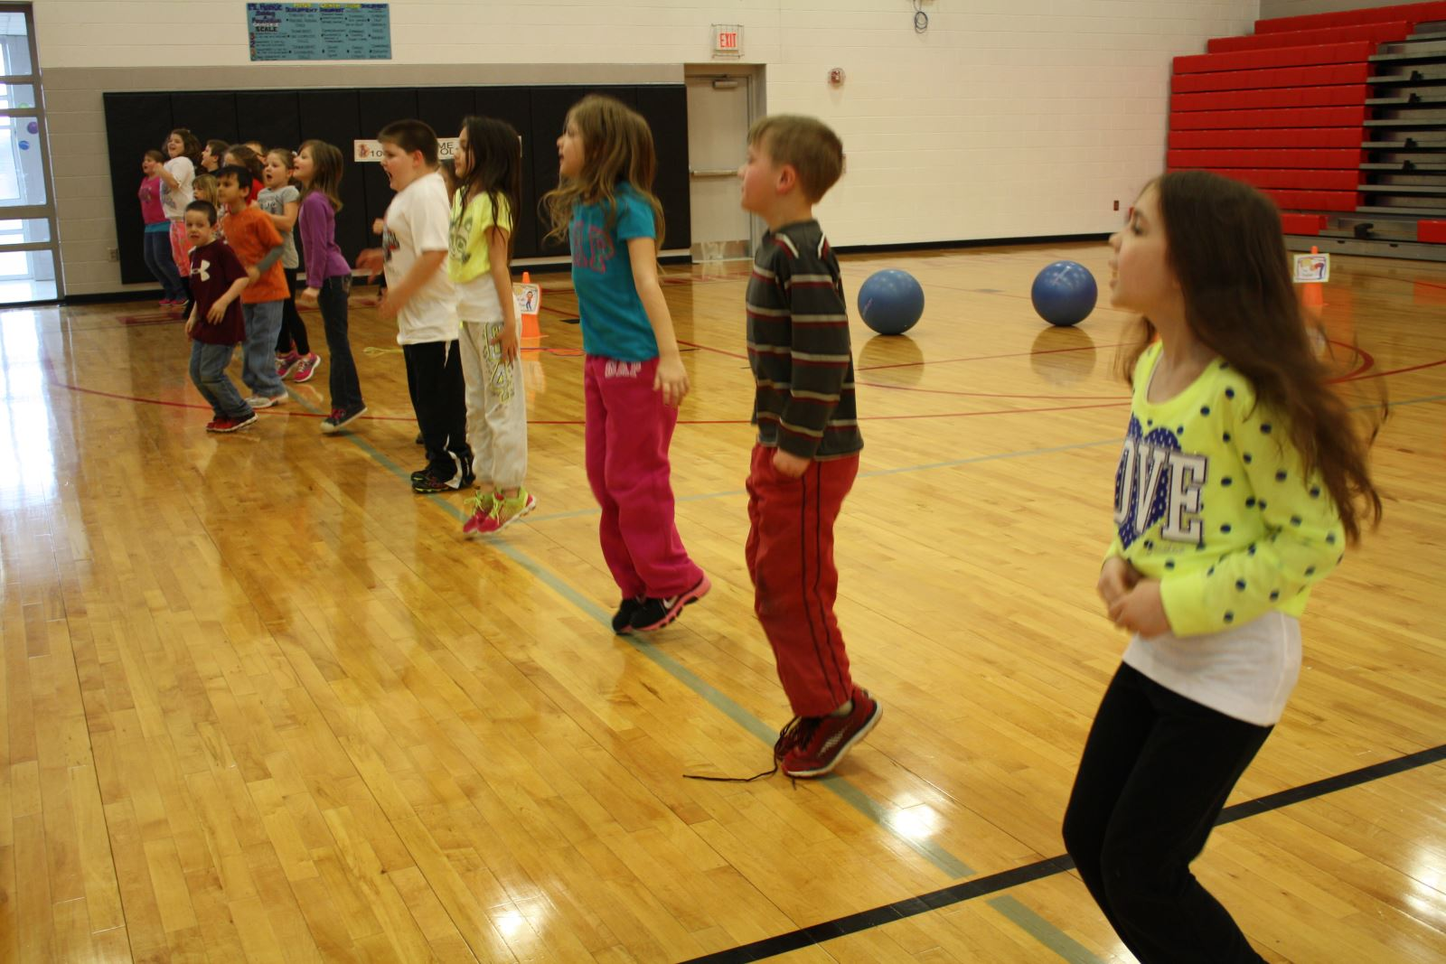
fitness

Slide 4
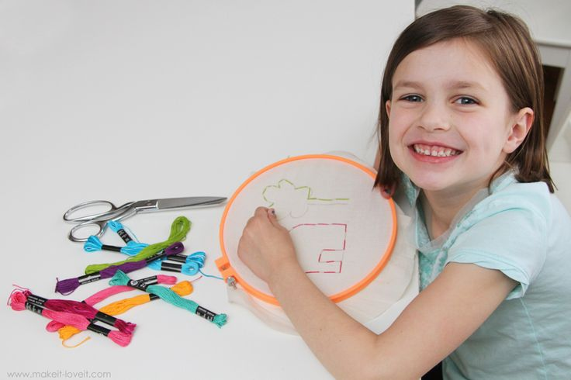
needlework

Slide 5
editor

Slide 6
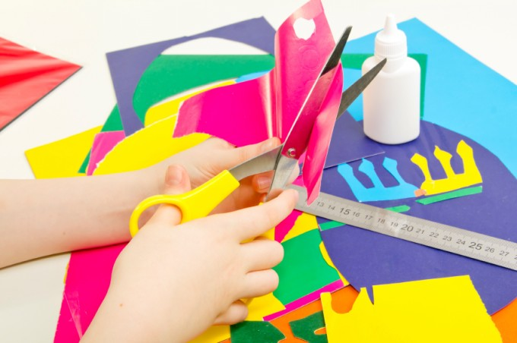
arts and crafts

Slide 7
TOP LEFT?
or
BOTTOM RIGHT?

Slide 8
fitness

Slide 9
band

Slide 10
needlework

Slide 11
arts and crafts

Slide 12
editor

Slide 18
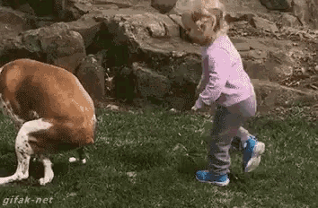
Good Job!

