Slide 1
Vocab!

Slide 2
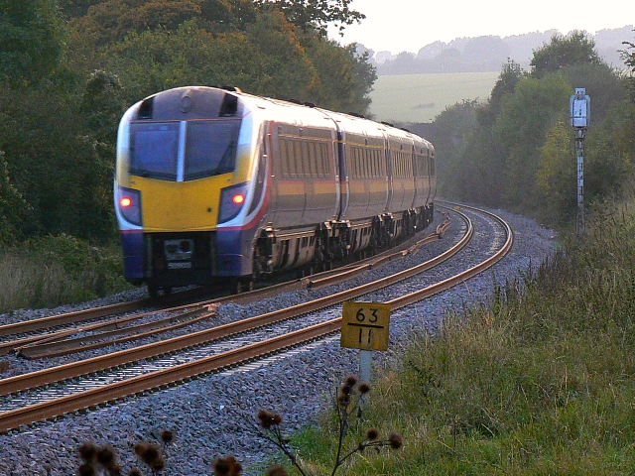
train

Slide 3
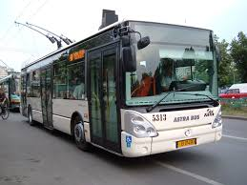
Trolley bus

Slide 4
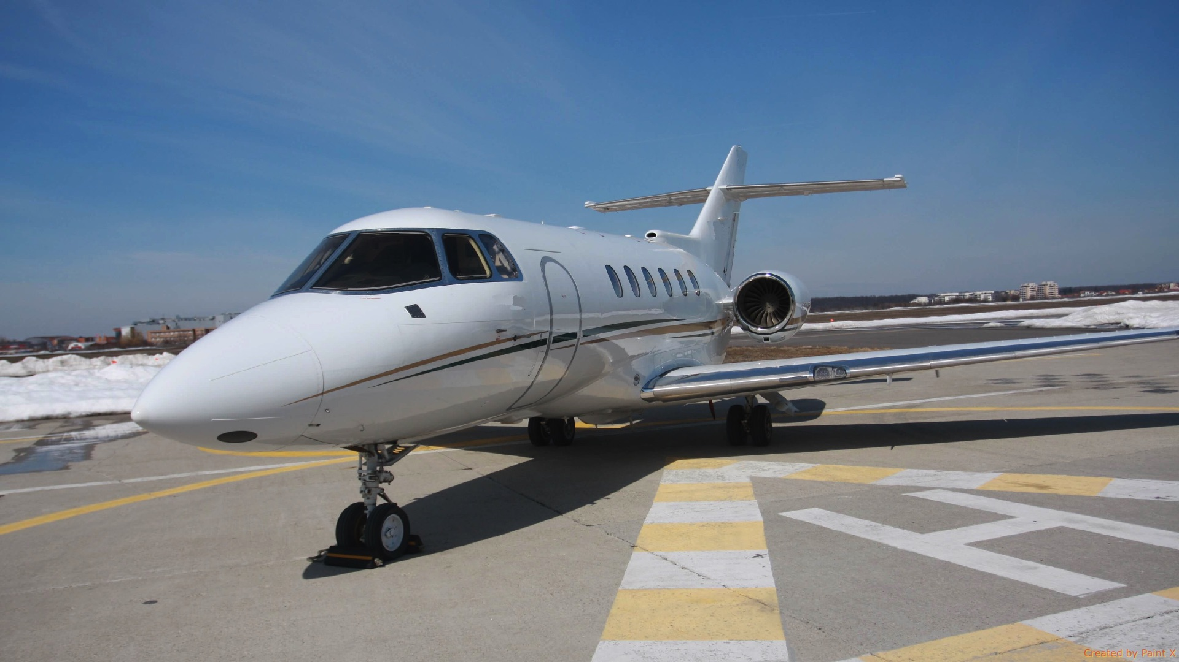
plane

Slide 5
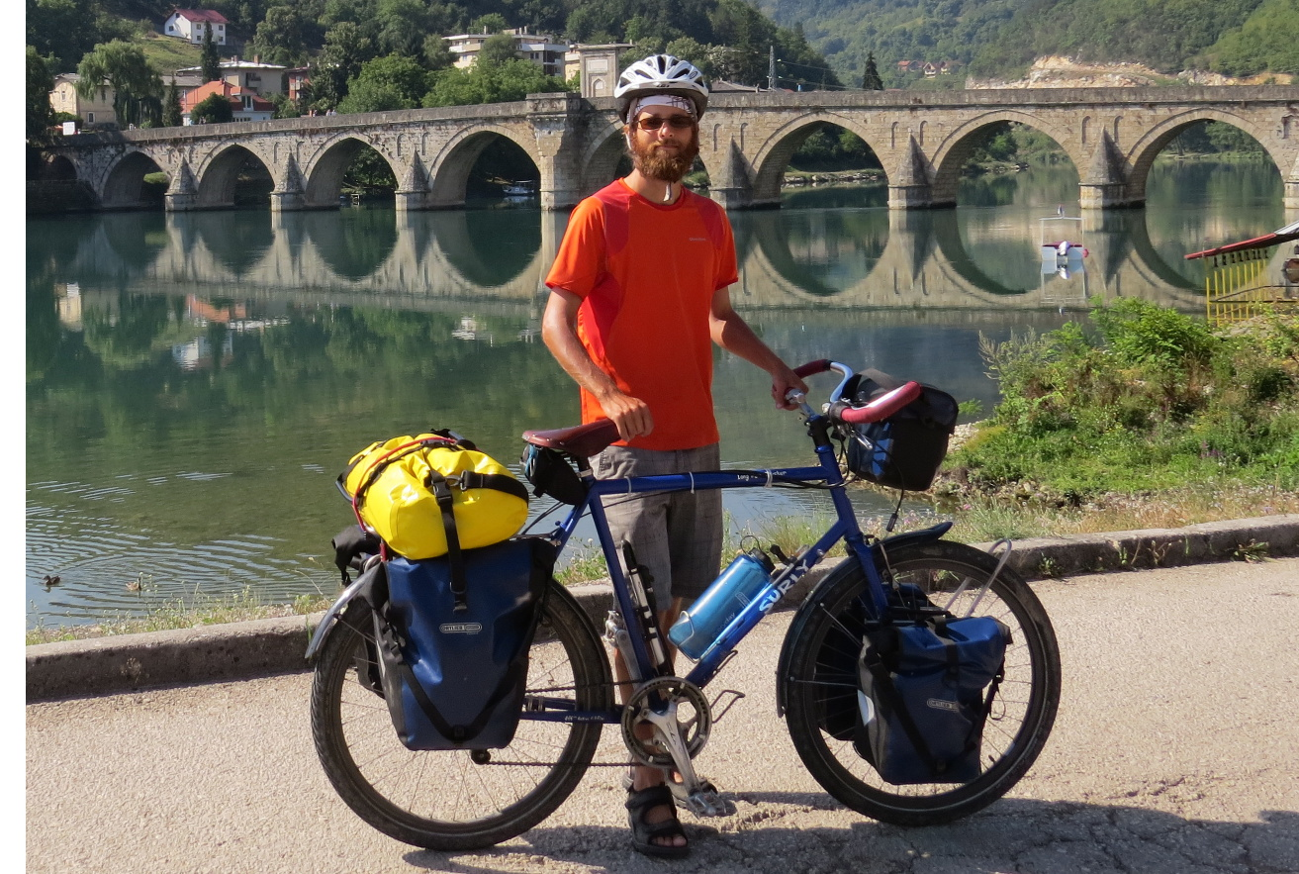
bicycle

Slide 6
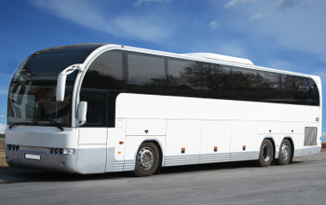
bus

Slide 7
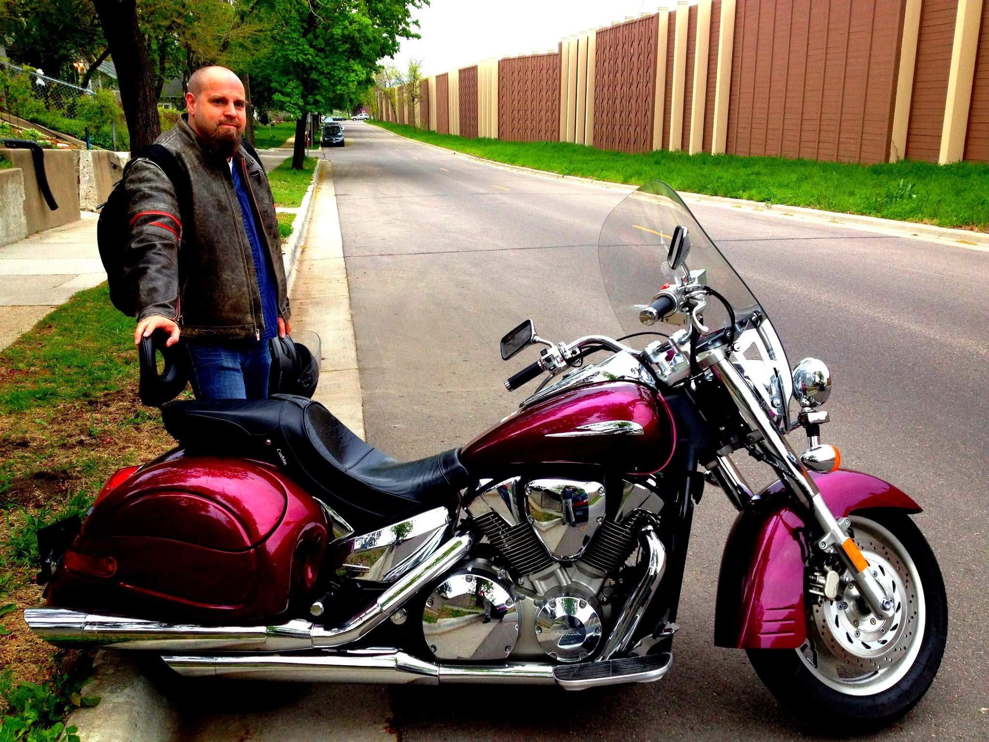
motorcycle

Slide 8
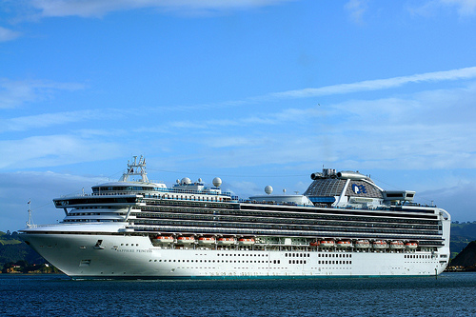
ship

Slide 9
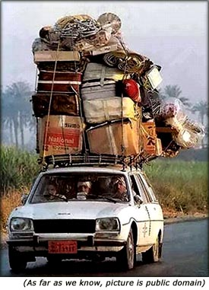
car

Slide 10
WORD BANK!

Slide 11
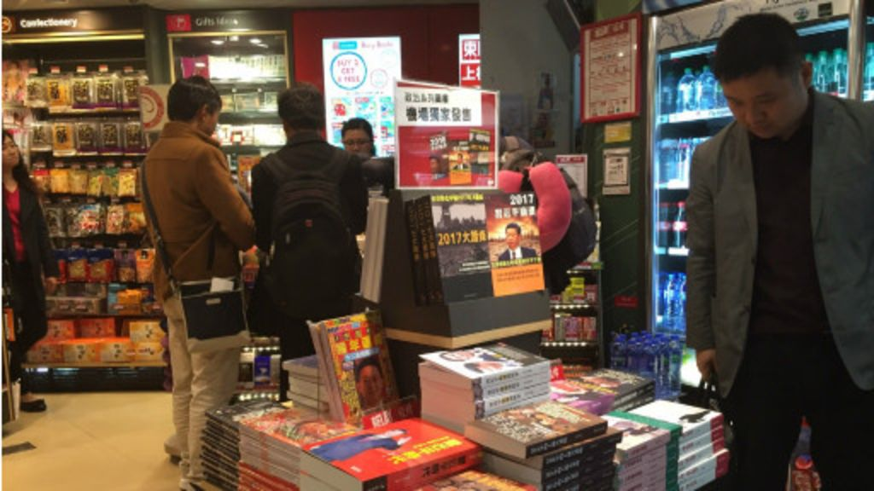
bookstall

Slide 12
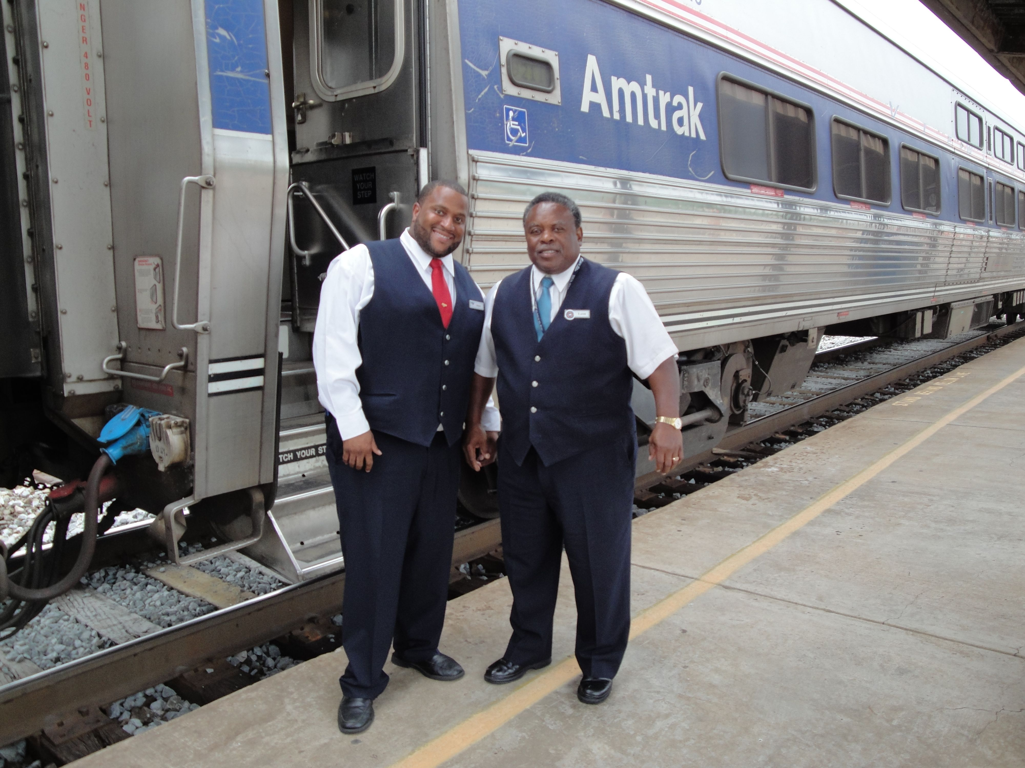
porter

Slide 13
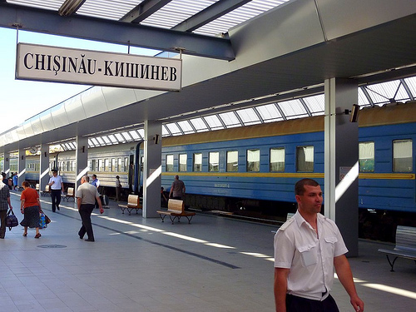
railway station

Slide 14
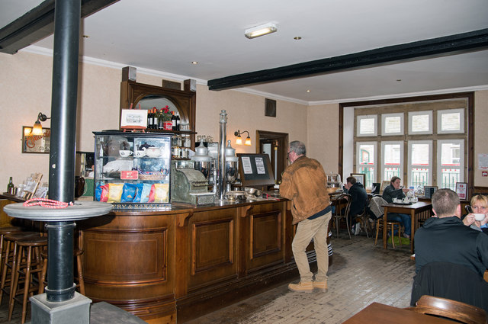
refreshment room

Slide 15
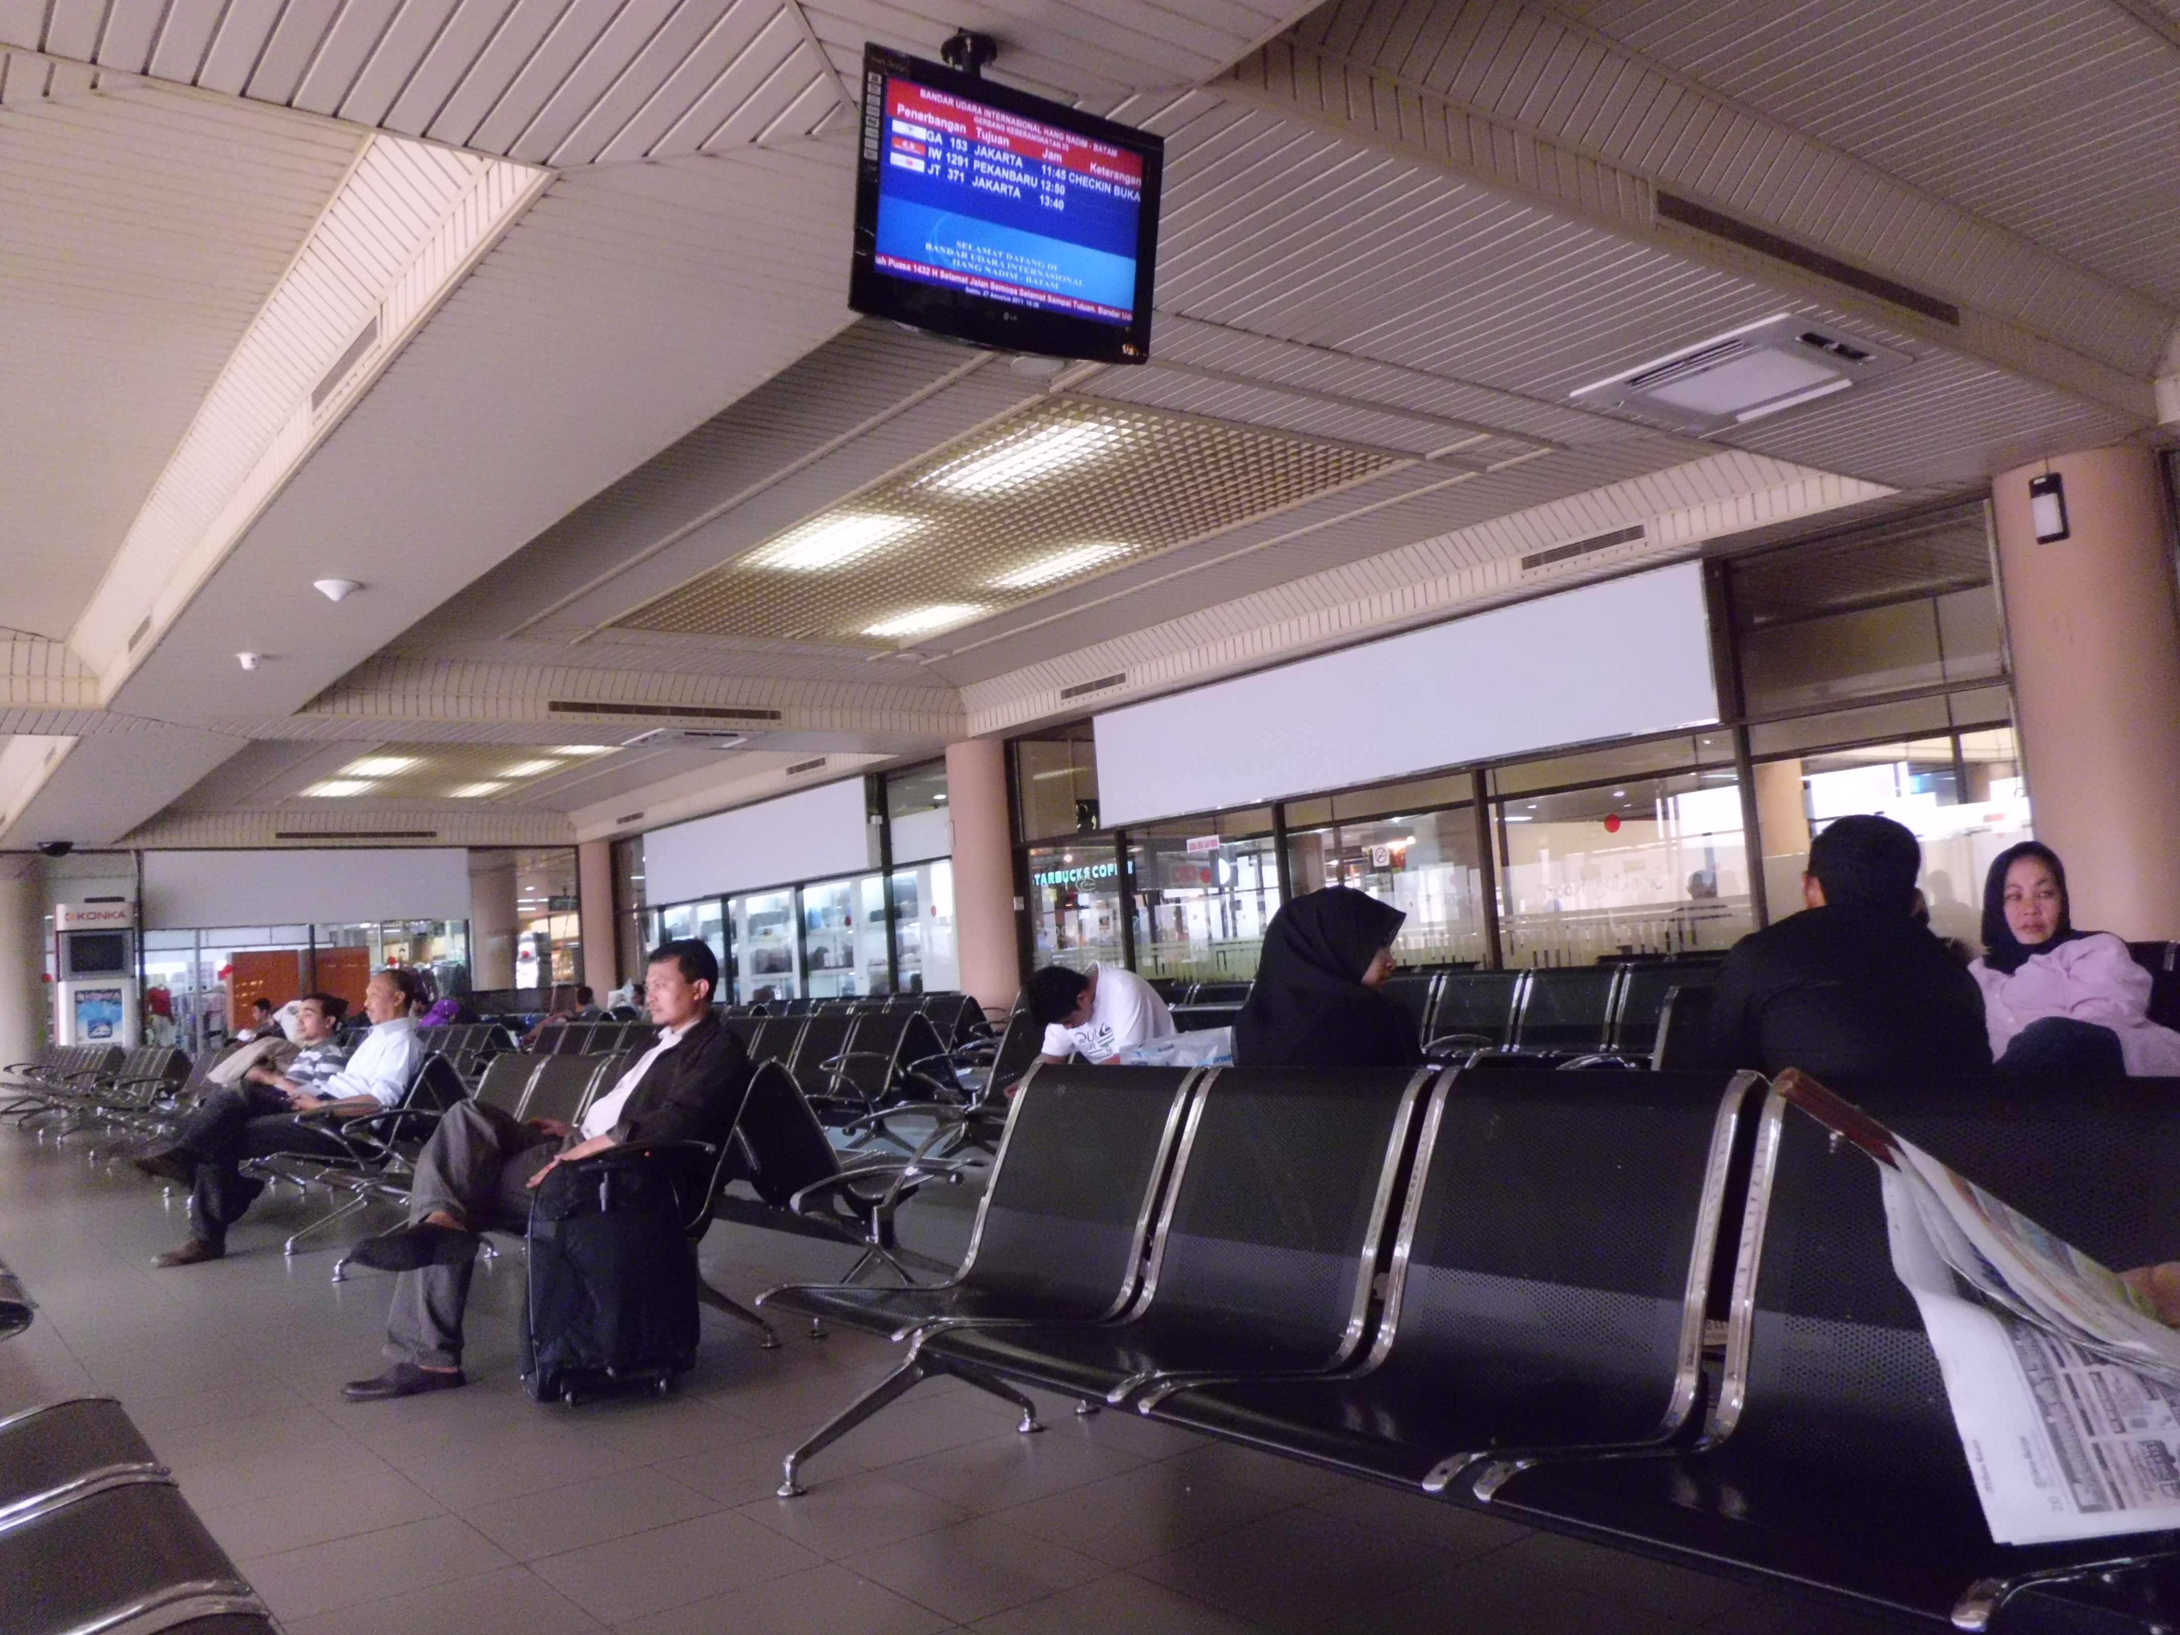
waiting-room

Slide 16
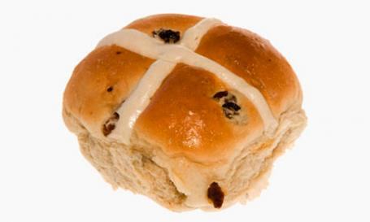
bun

Slide 17
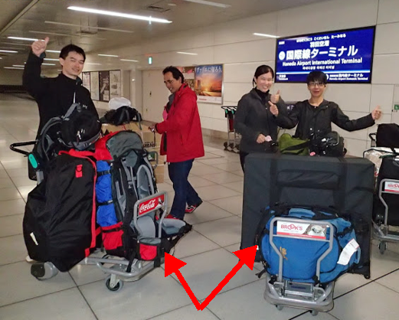
luggage

Slide 18
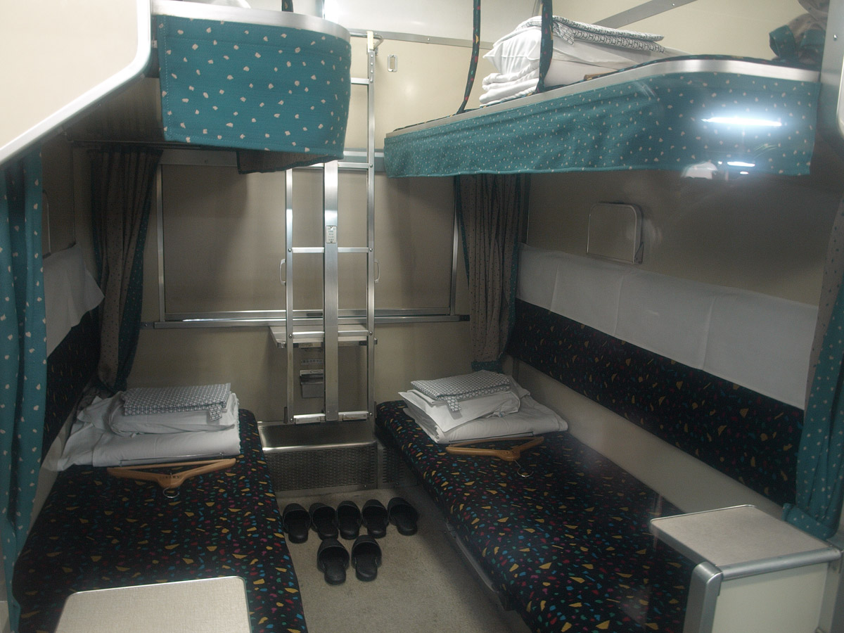
sleeper

Slide 19
top?
or
bottom?

Slide 20
railway station

Slide 21
bookstall

Slide 22
porter

Slide 23
refreshment room

Slide 24
waiting-room

Slide 25
sleeper

Slide 26
bun

Slide 27
luggage

Slide 36
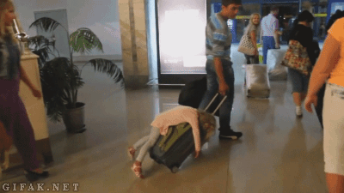
Good Job!

