Slide 1
Vocab revision!

Slide 2
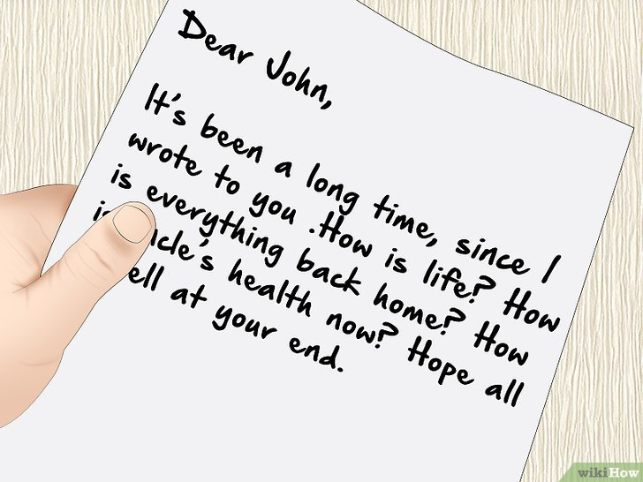

Slide 3
letter

Slide 5
envelope

Slide 6
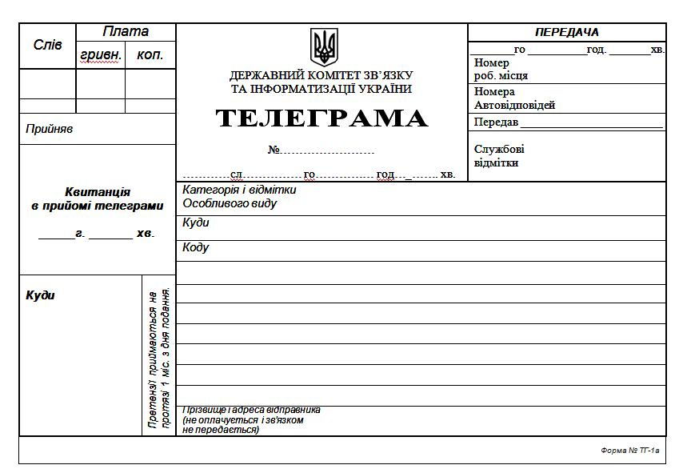

Slide 7
telegram

Slide 9
postcard

Slide 10
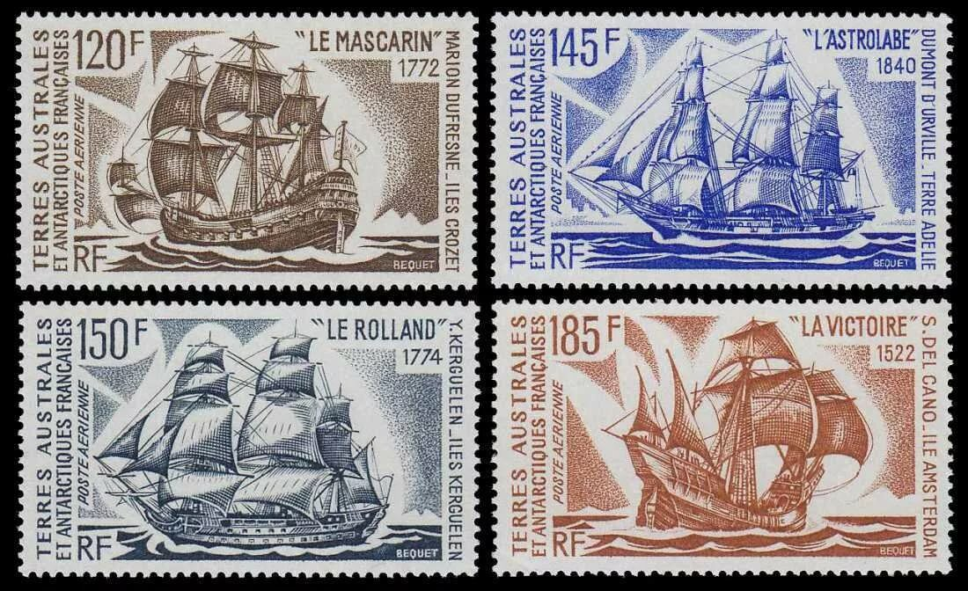

Slide 11
stamps

Slide 13
newspaper

Slide 15
magazine

Slide 16
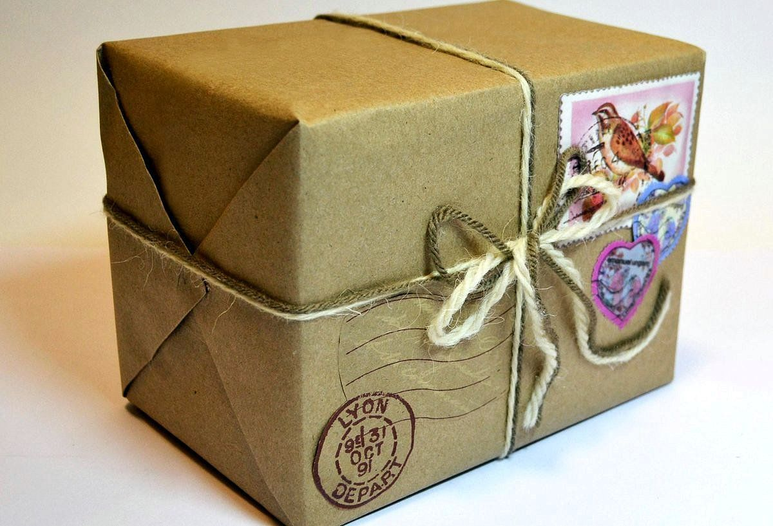

Slide 17
parcel

Slide 18
top?
or
bottom?

Slide 19
telegram

Slide 20
postcard

Slide 21
envelope

Slide 22
newspaper

Slide 23
magazine

Slide 24
letter

Slide 25
stamps

Slide 34
Word bank

Slide 35
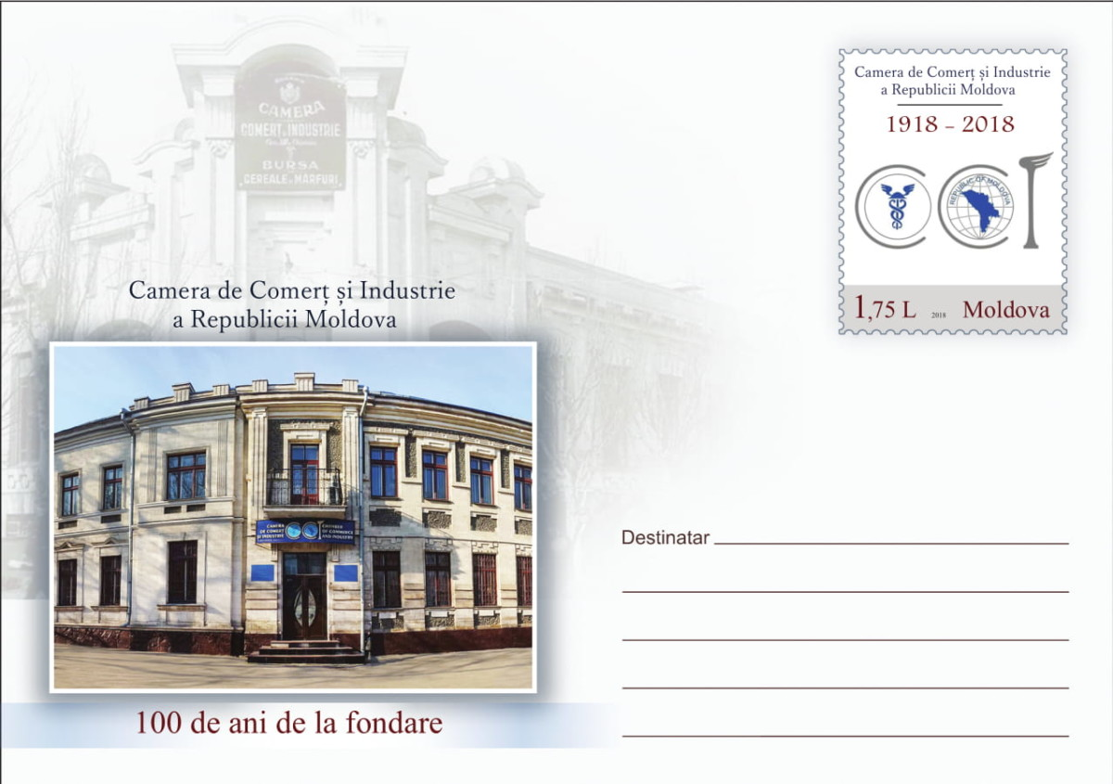
addressee

Slide 36
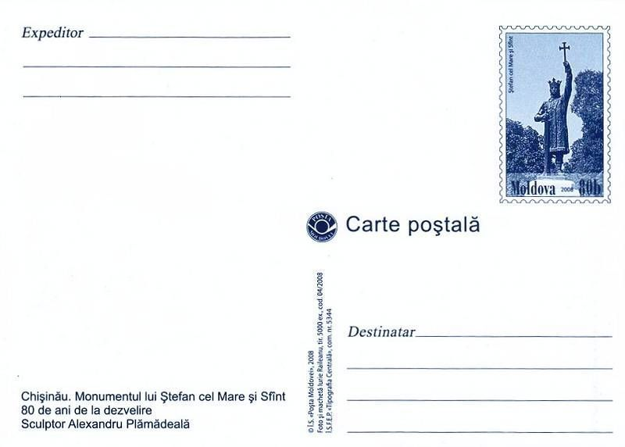
addresser

Slide 37
hand

Slide 38
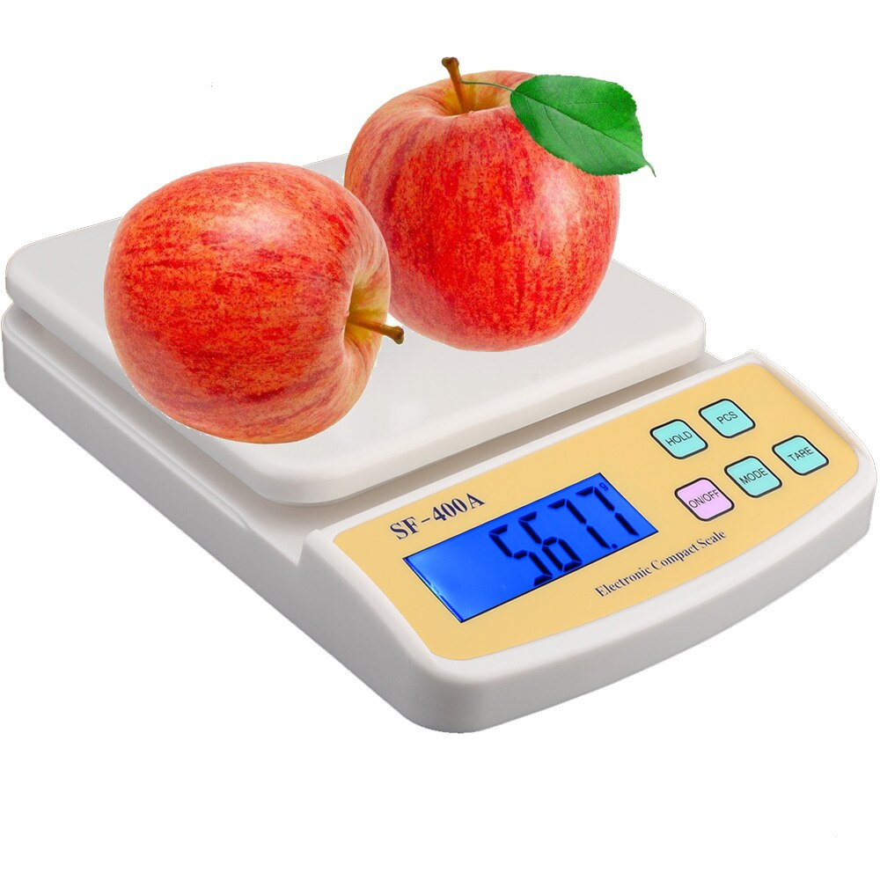
weigh

Slide 39
right?
left?
or

Slide 40
weigh

Slide 41
addresser

Slide 42
hand

Slide 43
addressee

Slide 44
Good Job!

Slide 45
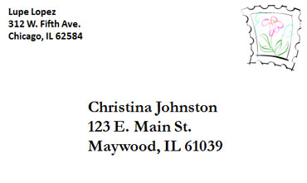
U.S.

Slide 46
Great Britain

Slide 47
Great Britain

Slide 48
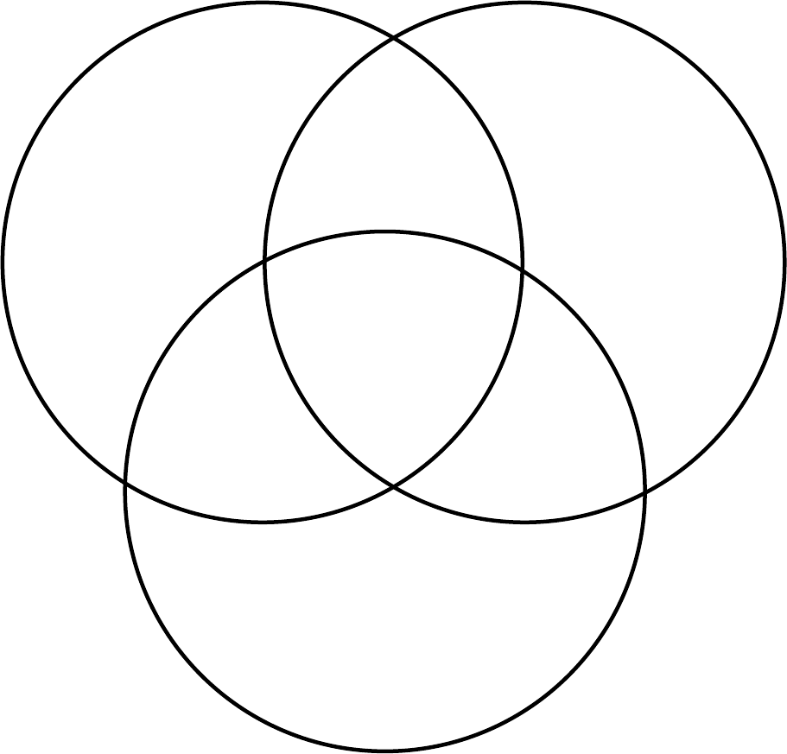
The USA
Great Britain
Moldova

Slide 49
The USA
Great Britain
The return address is written on the back side of the envelope.
Moldova

Slide 50
The USA
Great Britain
The addressee and the addresser’s addresses are both written on the back side of the envelope.
The return address is written on the back side of the envelope.
Moldova

Slide 51
The USA
Great Britain
The addressee and the addresser’s addresses are both written on the back side of the envelope.
All the envelopes have stamps on.
The return address is written on the back side of the envelope.
Moldova

