Slide 1
VocabULARY!

Slide 2
customer

Slide 3
mail

Slide 4
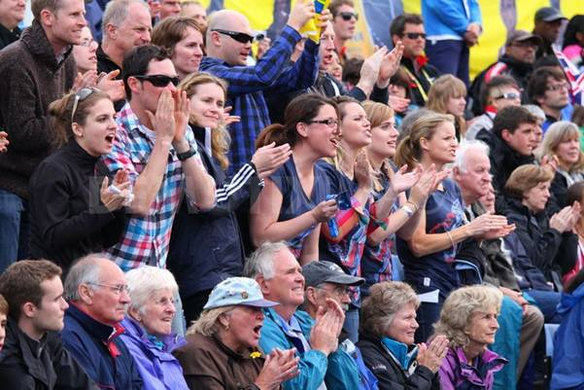
spectator(s)

Slide 5
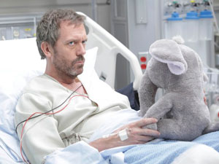
patient

Slide 6
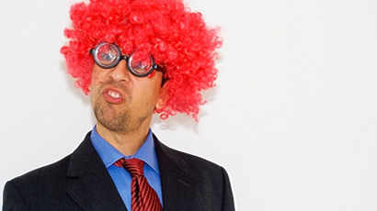
foolish

Slide 7
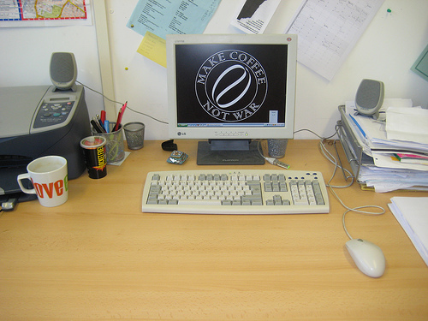
neat/tidy

Slide 8
to type

Slide 9
top?
or
bottom?

Slide 10
spectator(s)

Slide 11
mail

Slide 12
customer

Slide 13
patient

Slide 14
type

Slide 15
foolish

Slide 16
tidy/neat

