Slide 1
Vocabulary!

Slide 2
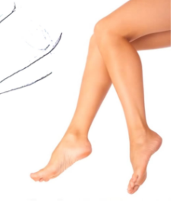
thigh
knee
shin
calf
ankle
toe
heel
sole
arch

Slide 3
thigh
knee
shin
calf
ankle
toe
heel
sole
arch

Slide 4
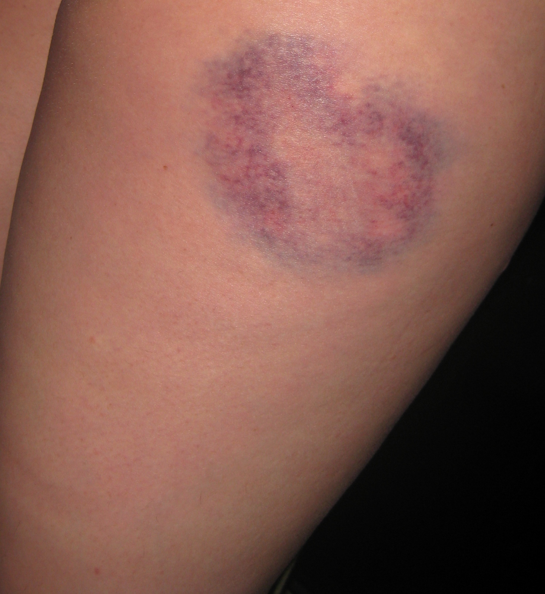
noun: a bruise
verb: to bruise

Slide 5
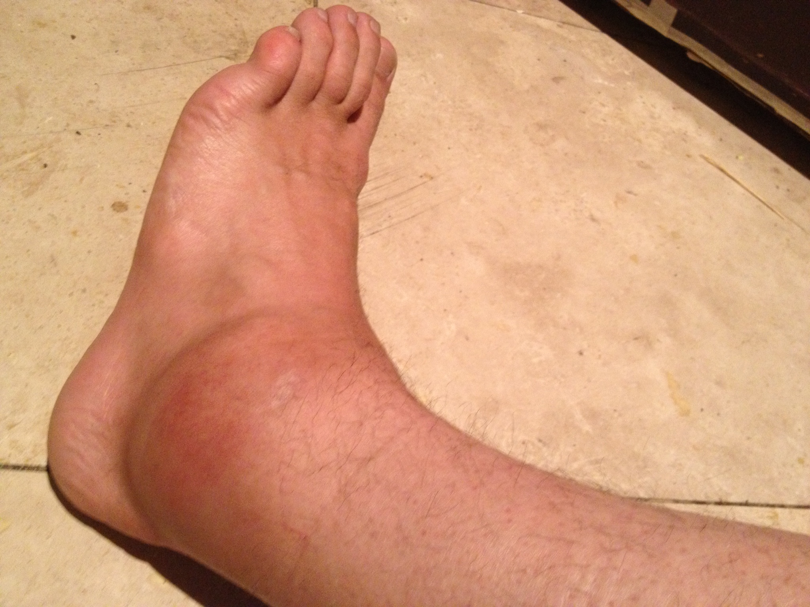
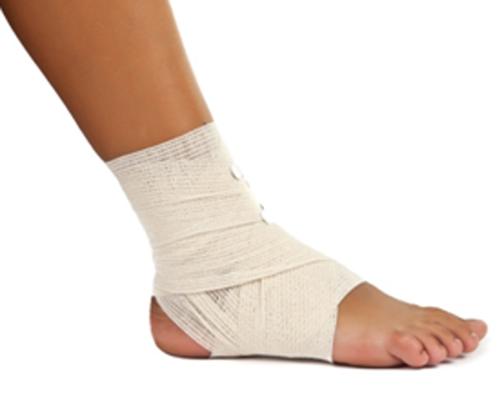
noun: a sprain
verb: to sprain

Slide 6
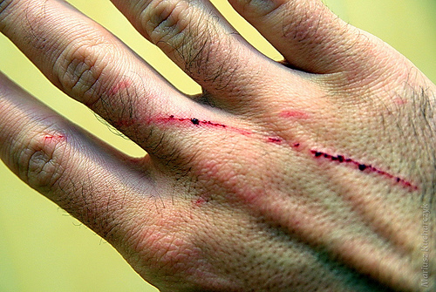
noun: a scratch
verb: to scratch

Slide 7
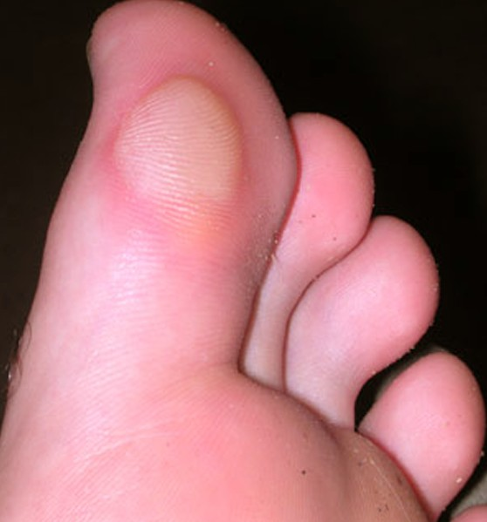
blister

Slide 8
to tear

Slide 9
right?
left?
or

Slide 10
scratch

Slide 11
sprain

Slide 12
bruise

Slide 13
tear

Slide 14
blister

Slide 20
thigh
knee
shin
calf
ankle
toe
heel
sole
arch

Slide 21
Good Job!!

