Slide 1
VocabularY!

Slide 2
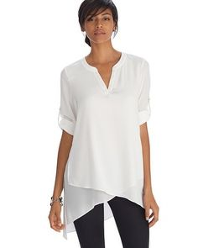
tunic

Slide 3
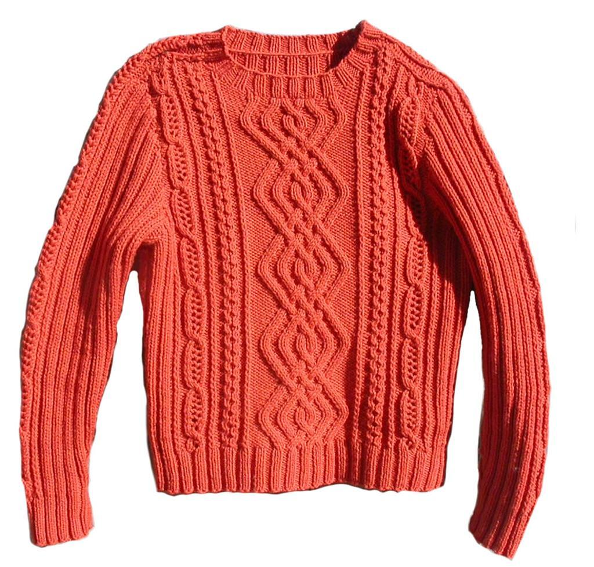
sweater

Slide 4
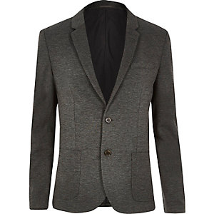
blazer

Slide 5
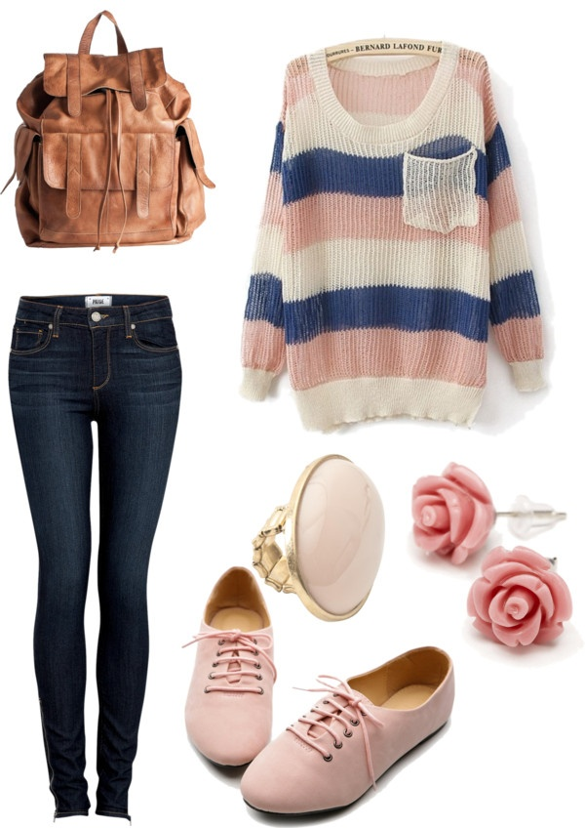
outfit

Slide 6
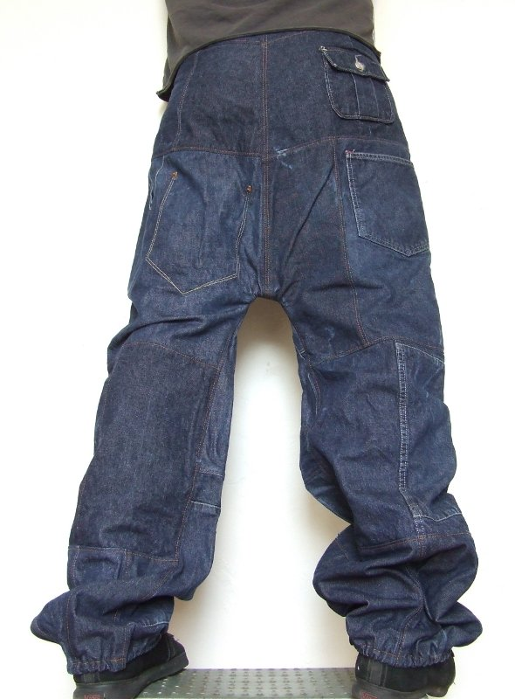
Baggy jeans

Slide 7
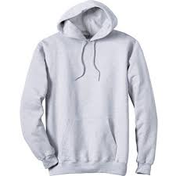
Hooded sweatshirt

Slide 8
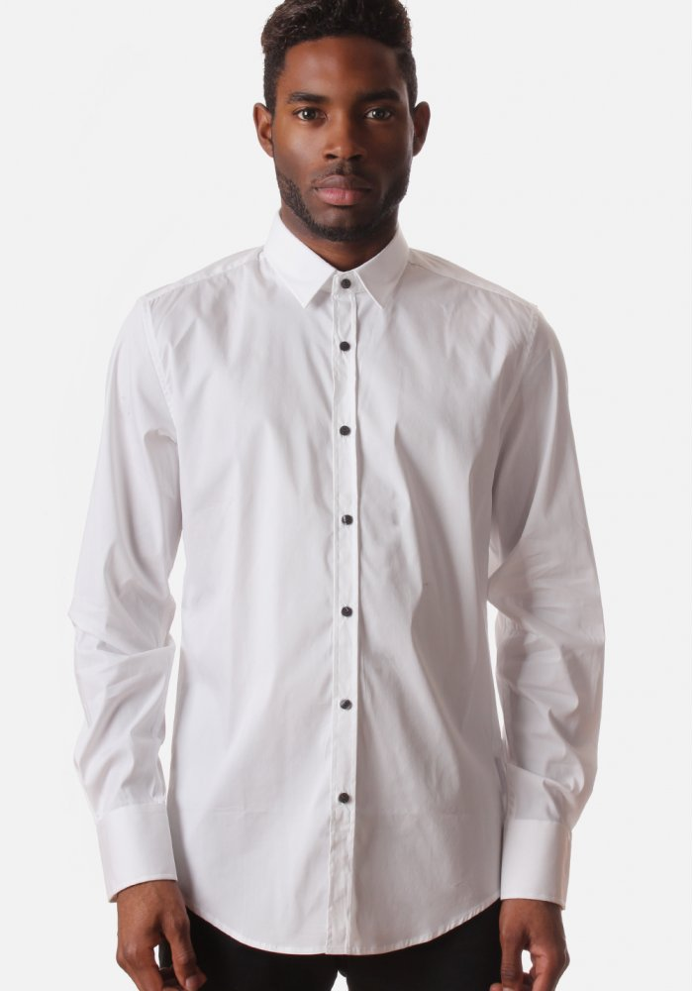
Buttoned shirt

Slide 9
try on

Slide 10
left?
right?
or

Slide 11
sweatshirt

Slide 12
sweater

Slide 13
outfit

Slide 14
Buttoned shirt

Slide 15
blazer

Slide 16
tunic

Slide 23
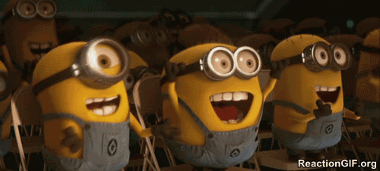
Good Job!!

