Slide 1
VocabularY!

Slide 2
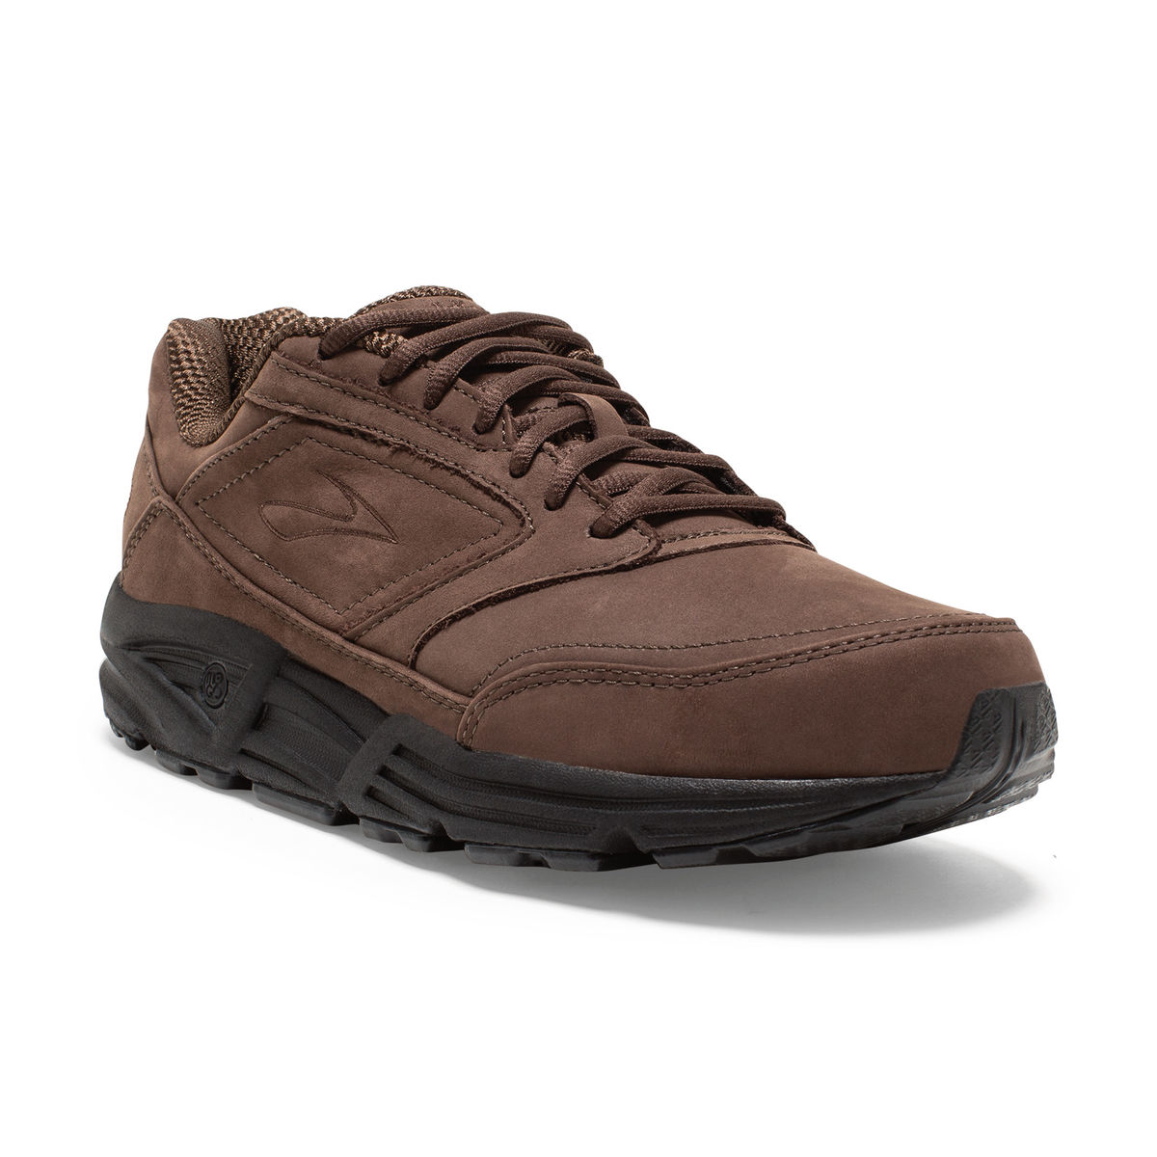
walking shoes

Slide 3
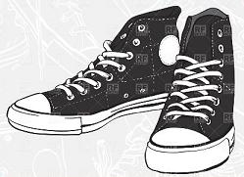
gym shoes

Slide 4
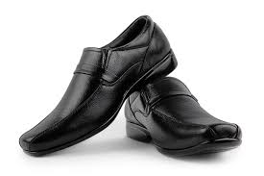
leather shoes

Slide 5
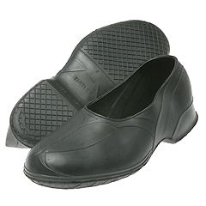
rubbers

Slide 6
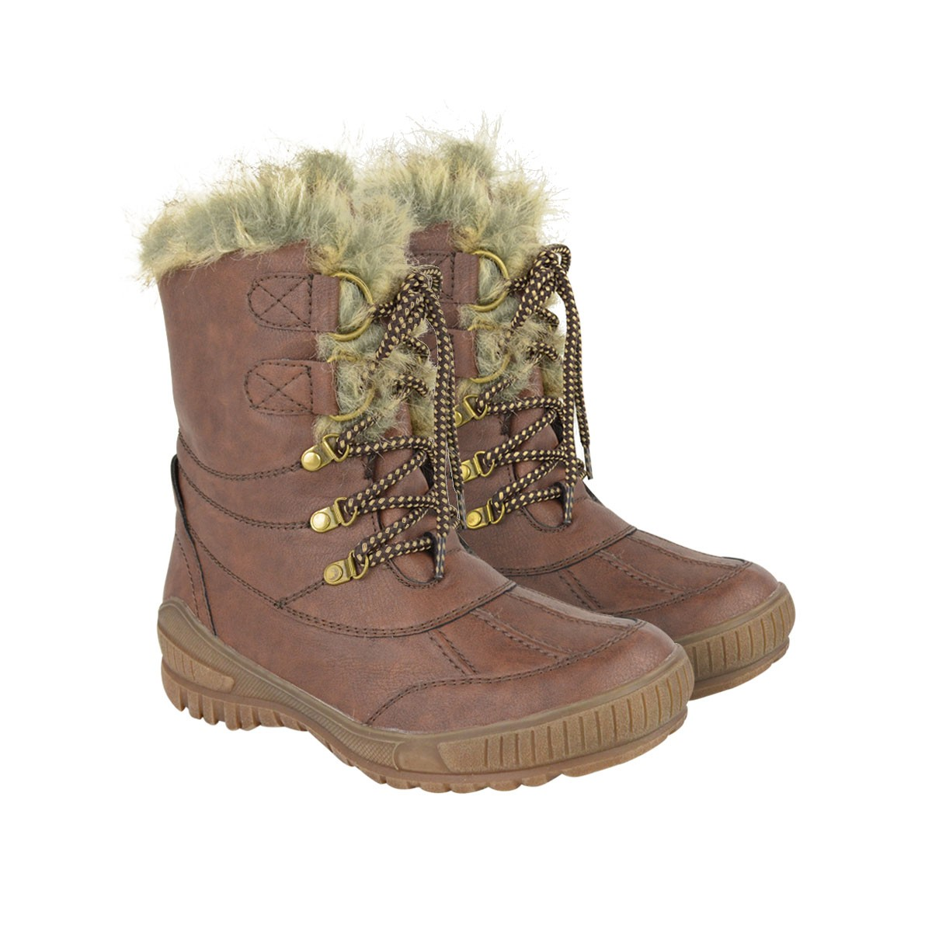
fur lined boots

Slide 7
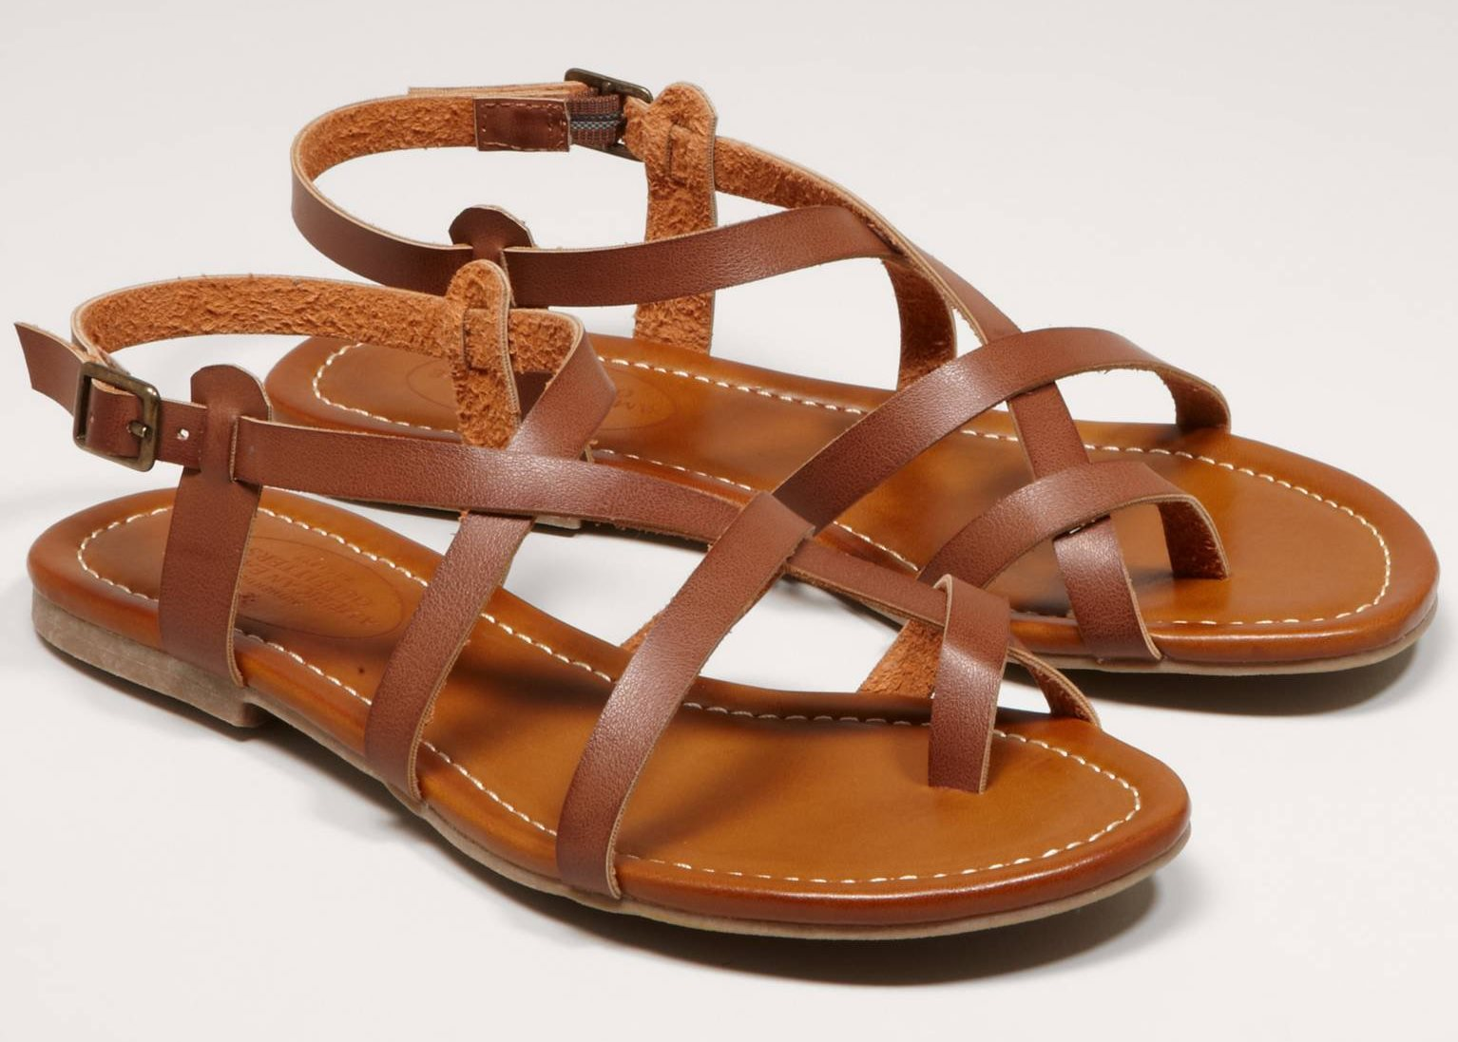
sandals

Slide 8
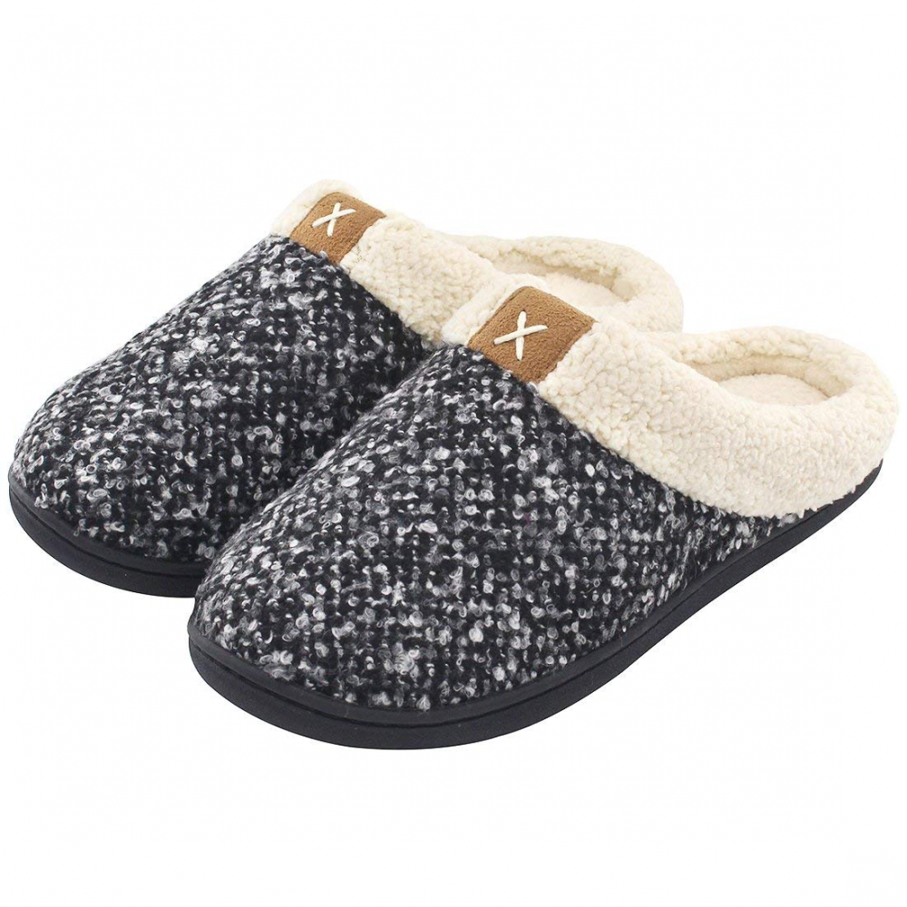
slippers

Slide 9
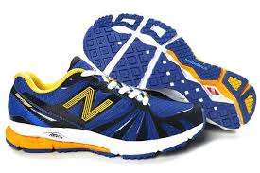
trainers / sneakers

Slide 10
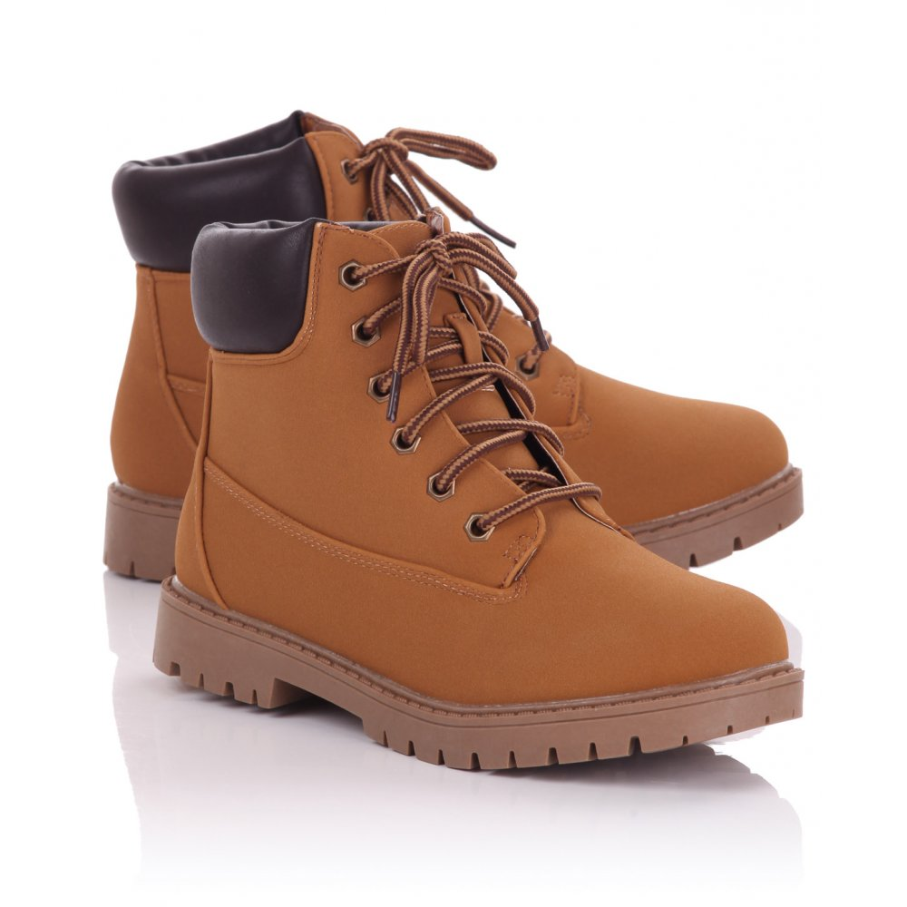
boots

Slide 11
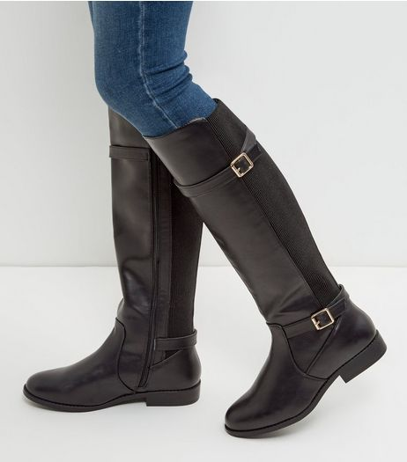
high boots

Slide 12
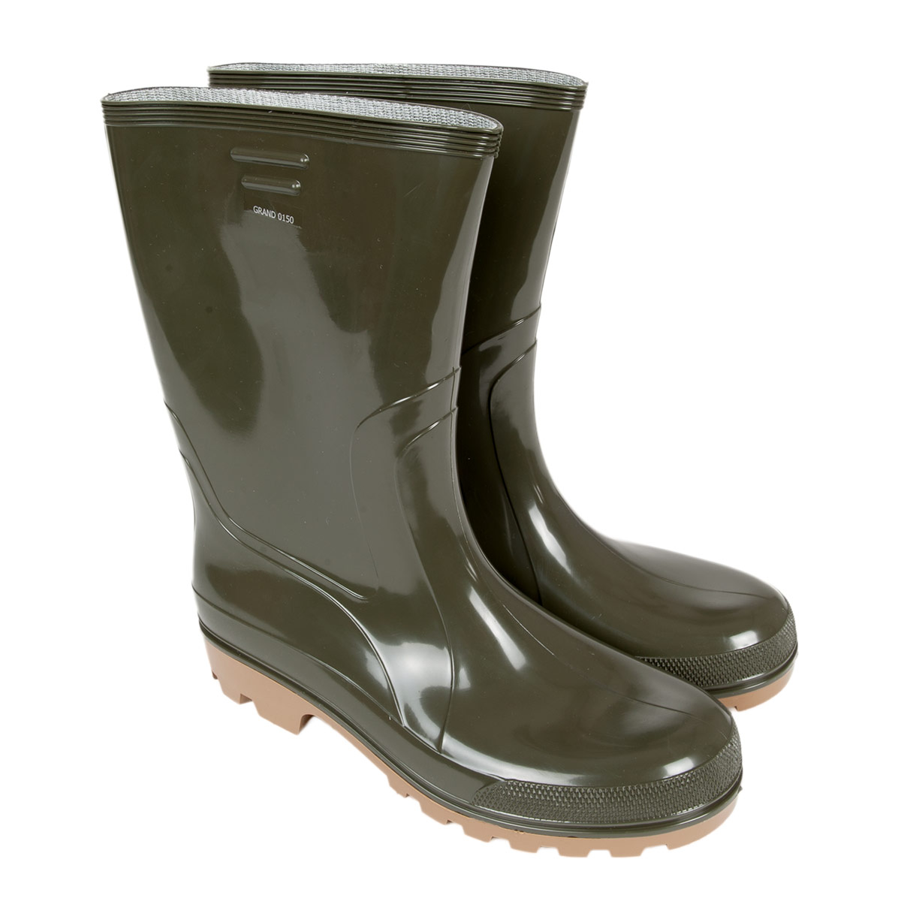
rubber boots

Slide 13
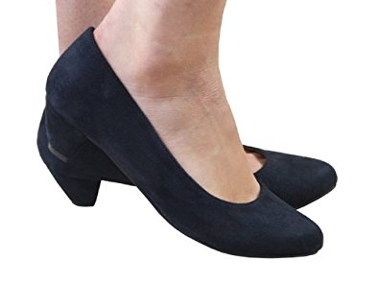
low heeled shoes

Slide 14
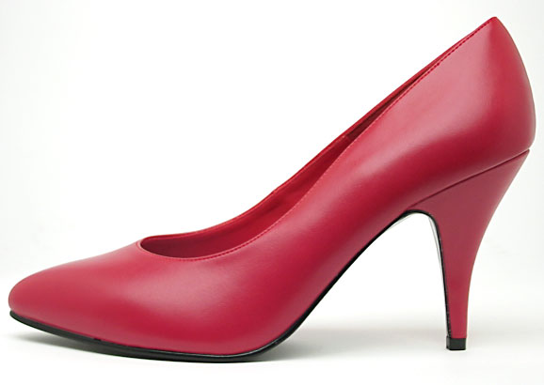
high heeled shoes

Slide 15
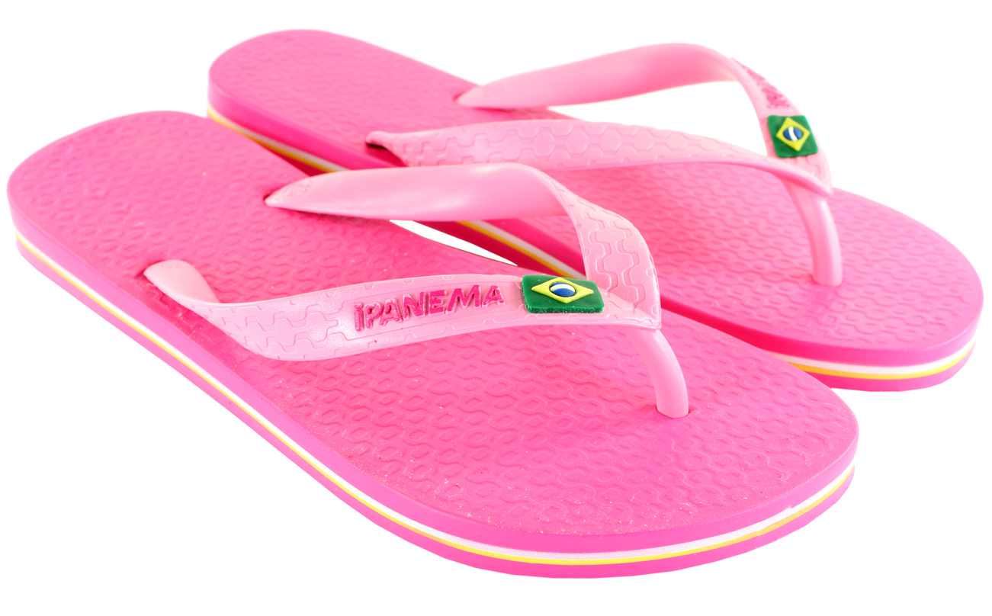
flip flops

Slide 16
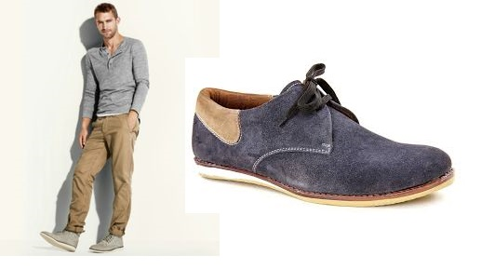
casual

Slide 17
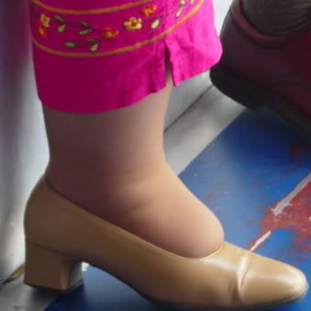
too tight

Slide 18
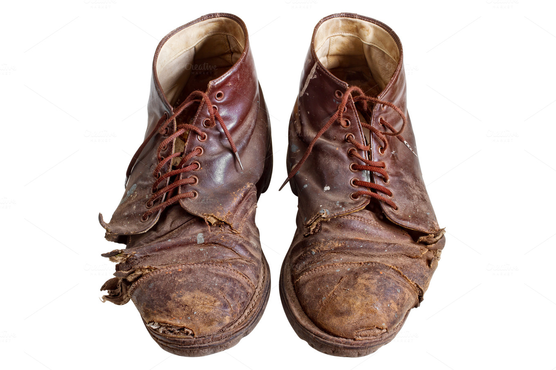
worn out

Slide 19
left?
right?
or

Slide 20
gym shoes

Slide 21
boots

Slide 22
high boots

Slide 23
low heeled shoes

Slide 24
rubber boots

Slide 25
rubbers

Slide 26
leather shoes

Slide 27
too tight

Slide 28
high heeled shoes

Slide 29
slippers

Slide 30
casual

Slide 31
walking shoes

Slide 32
sandals

Slide 33
fur lined boots

Slide 34
trainers/sneakers

Slide 35
worn out

Slide 36
flip flops

Slide 37
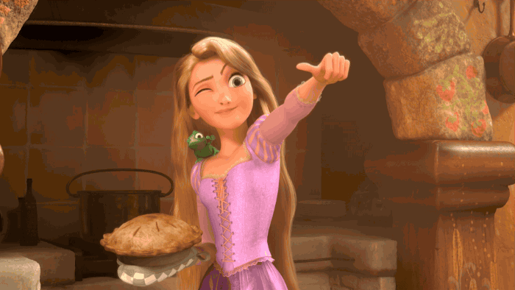
Good Job!!

