Slide 1
VocabularY!

Slide 2
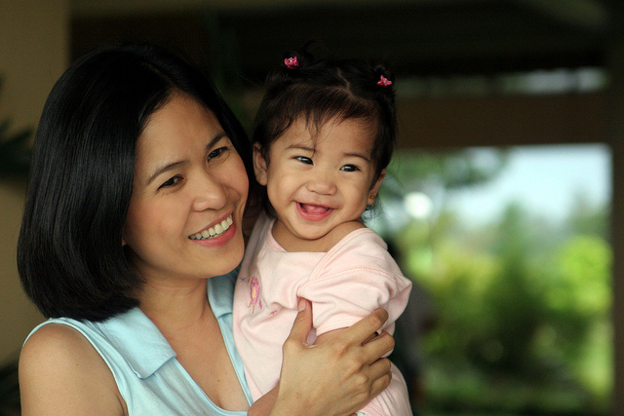
mother

Slide 3
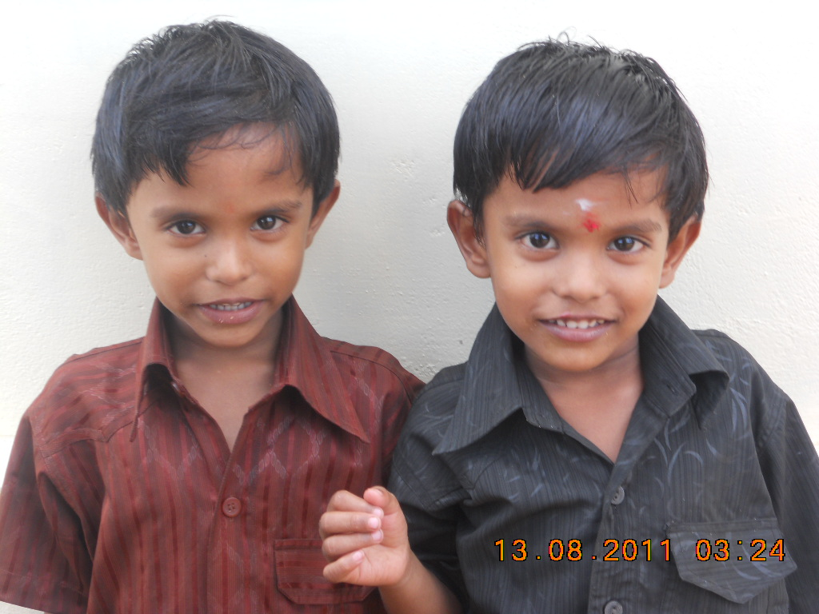
twins

Slide 4
daughter

Slide 5
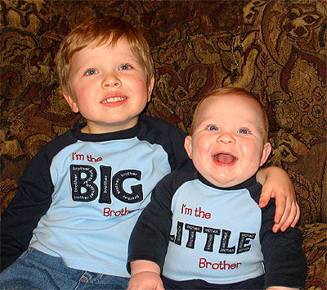
brother

Slide 6
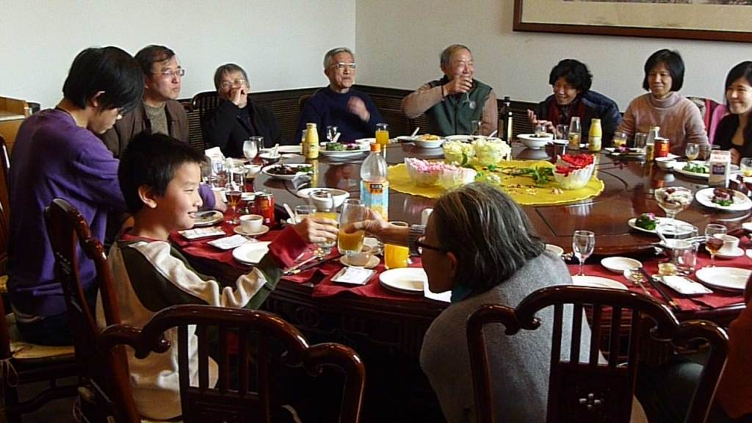
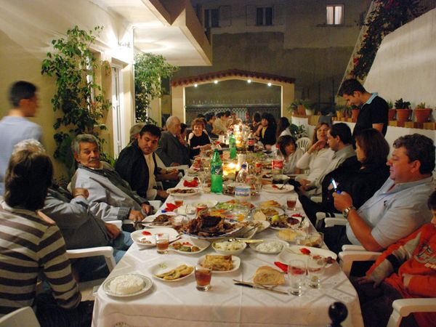
relatives

Slide 7
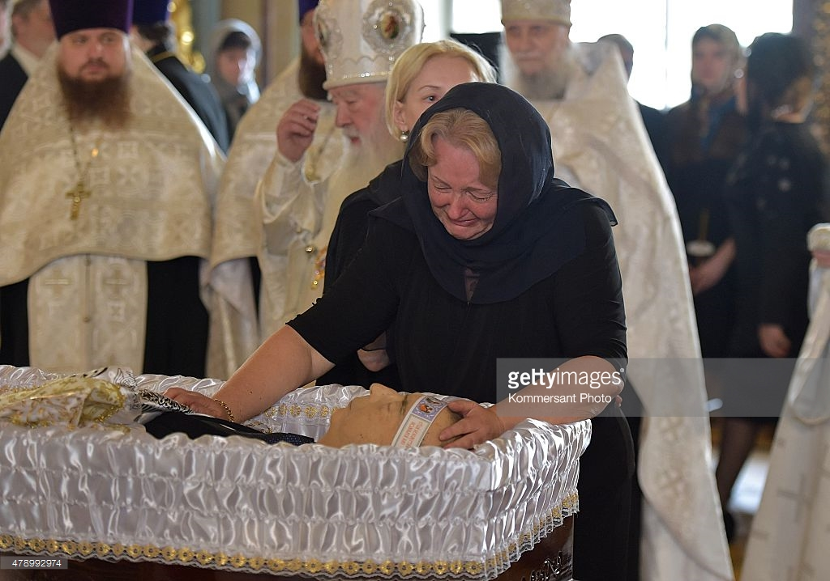
widow

Slide 8
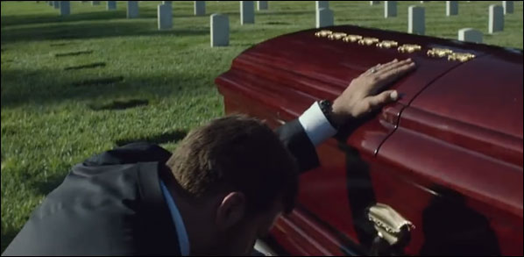
widower

Slide 9
spouse

Slide 10
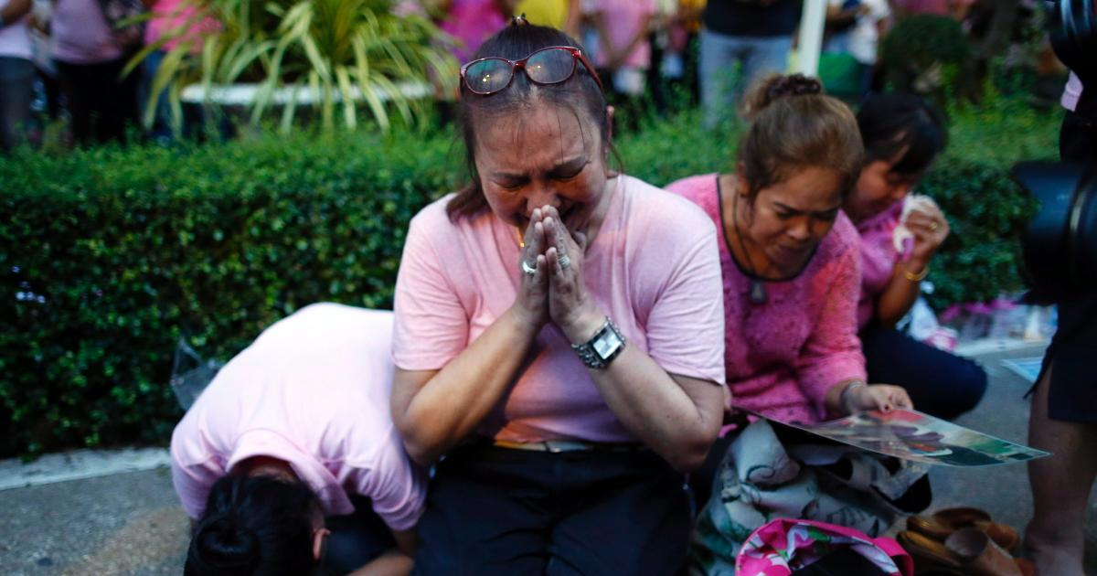
grieve

Slide 11
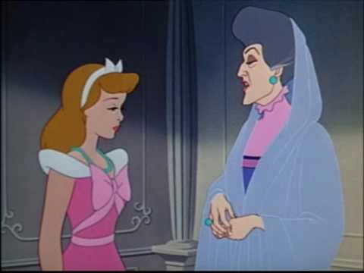
step-mother

Slide 12
watch over/
care for

Slide 13
left?
right?
or

Slide 14
twins

Slide 15
mother

Slide 16
relatives

Slide 17
brother

Slide 18
daughter

Slide 19
widow

Slide 20
step-mother

Slide 21
grieve

Slide 22
watch over/care for

Slide 23
widower

Slide 24
spouse

