Slide 1
VOCAB!

Slide 2
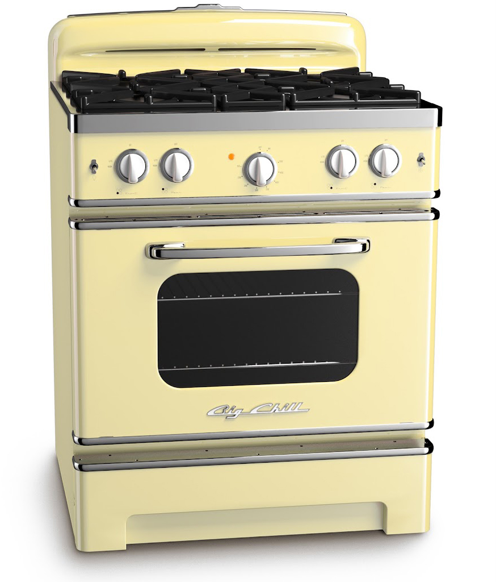
oven

Slide 3
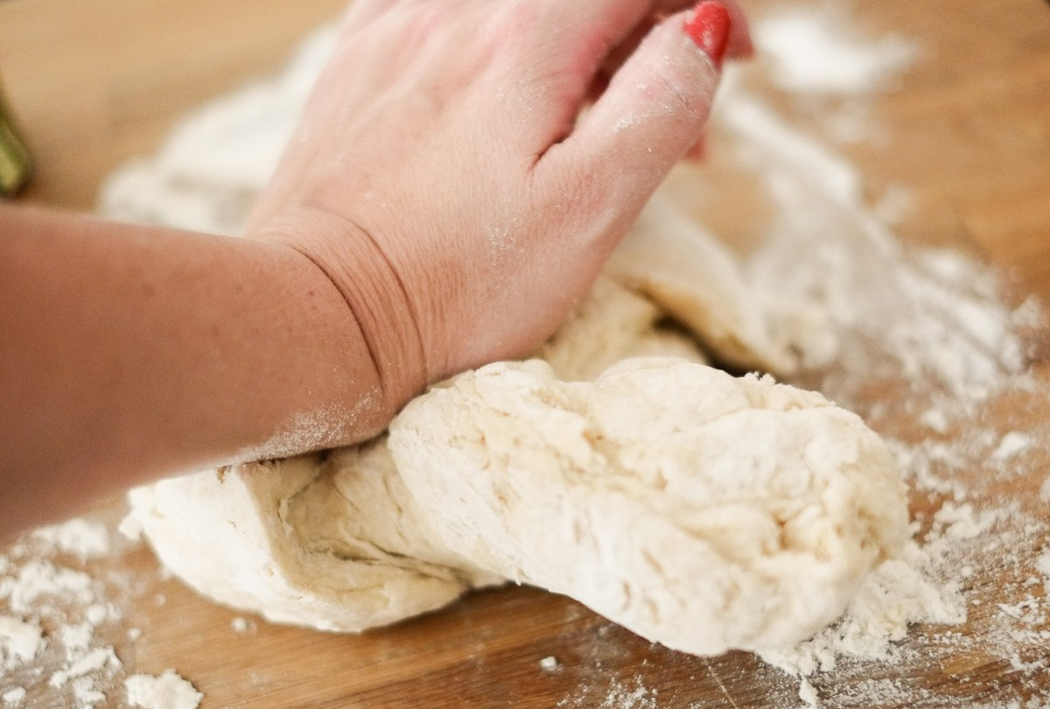
dough

Slide 4
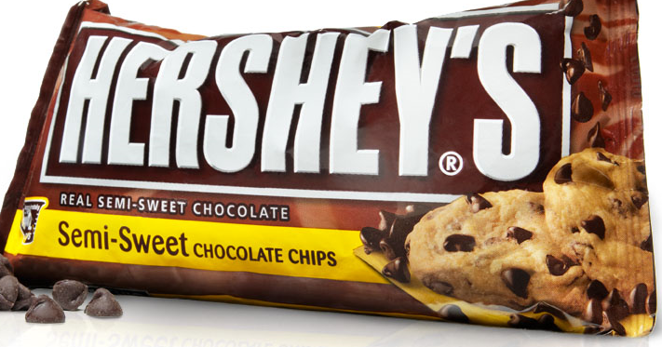
chocolate chips

Slide 5
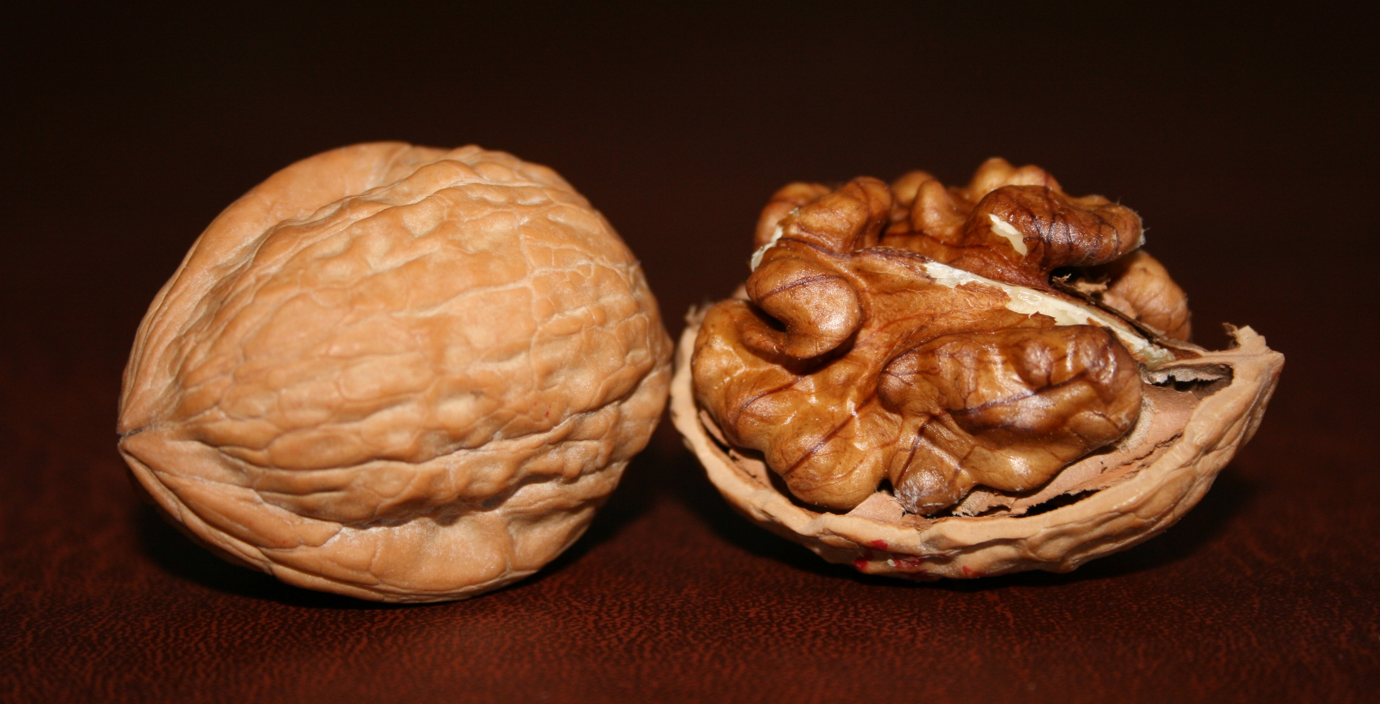
walnut

Slide 6
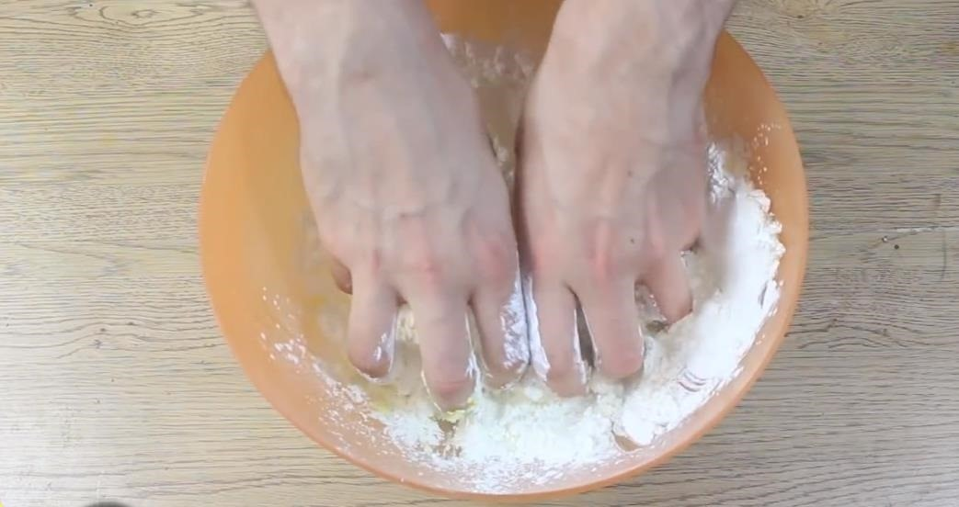
to mix

Slide 7
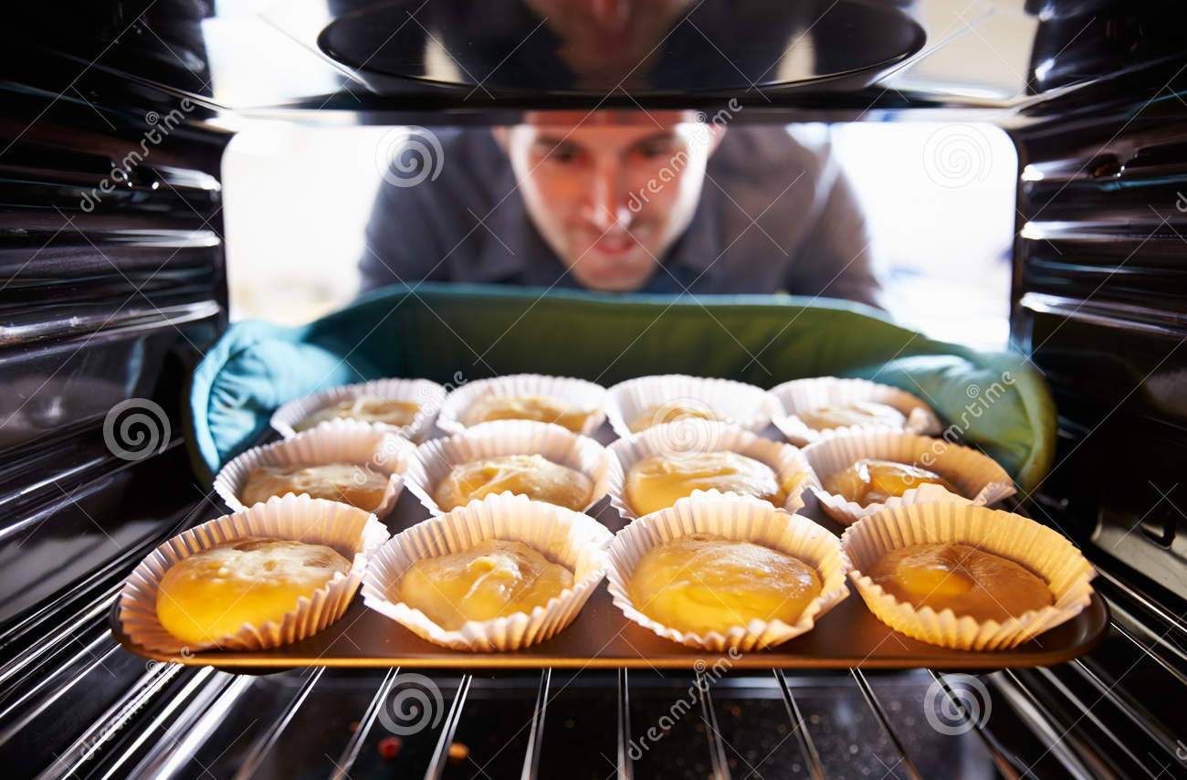
to bake

Slide 8
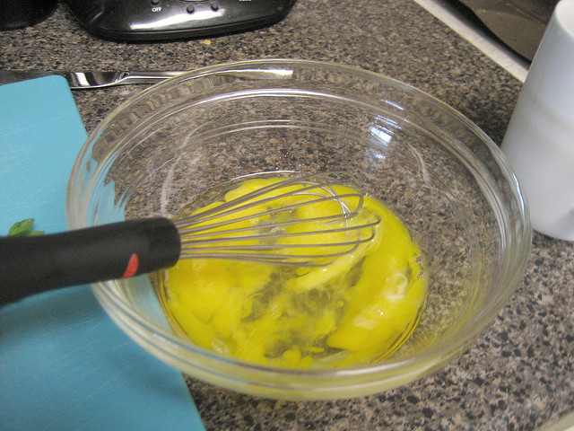
to beat

Slide 9
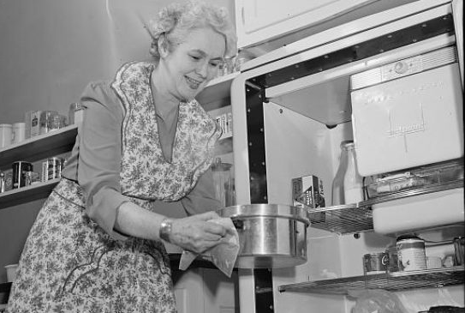
to refrigerate

Slide 10
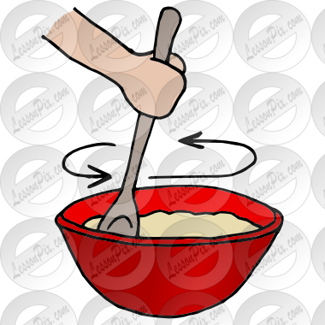
to stir

Slide 11
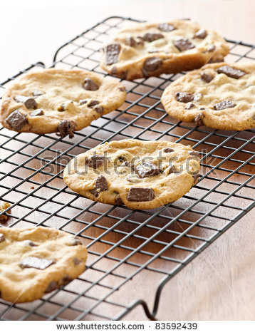
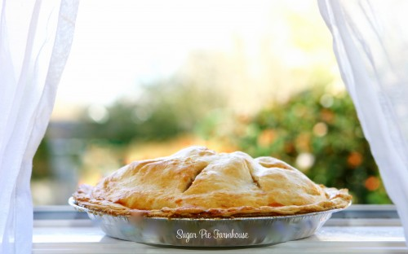
to cool

Slide 12
top?
or
bottom?

Slide 13
walnut

Slide 14
dough

Slide 15
oven

Slide 16
to refrigerate

Slide 17
to stir

Slide 18
chocolate chips

Slide 19
to beat

Slide 20
to mix

Slide 21
to cool

Slide 22
to bake

