Slide 1
Royal family

Slide 2
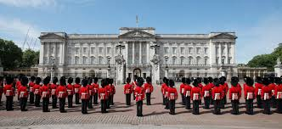
Buckingham Palace

Slide 3
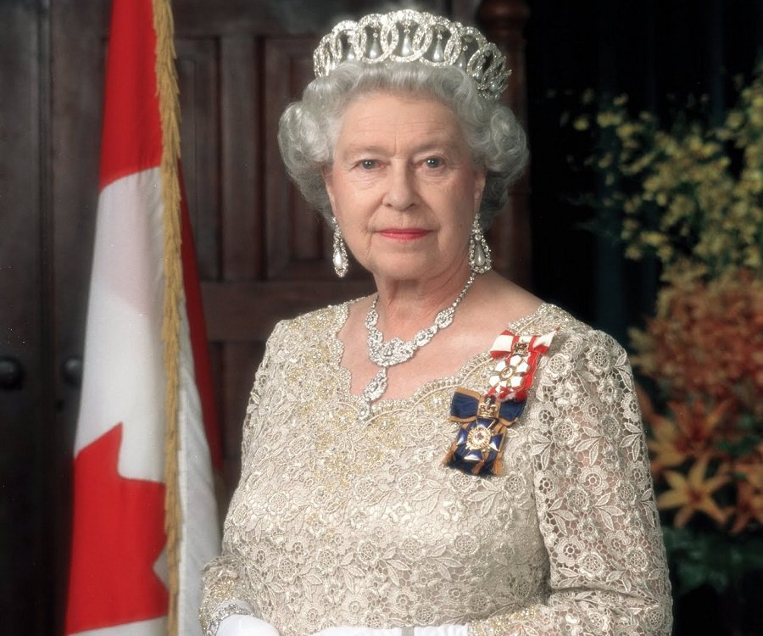
Queen Elizabeth II

Slide 4
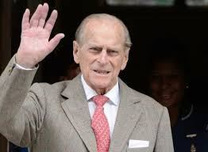
Prince Phillip – Duke of Edinburgh

Slide 5
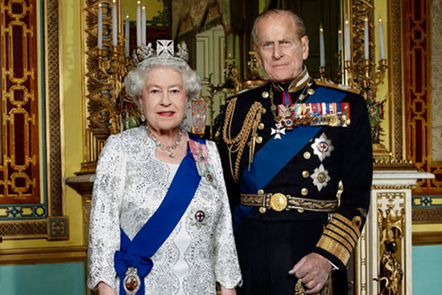
Queen Elizabeth and Phillip

Slide 6
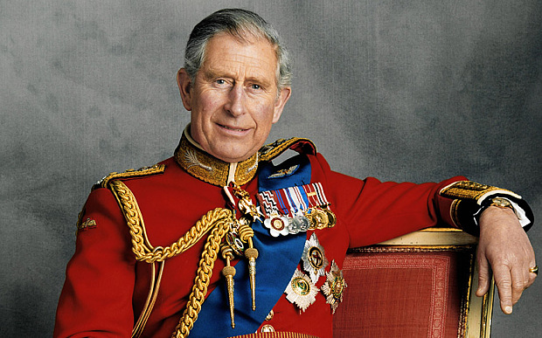
Prince Charles

Slide 7
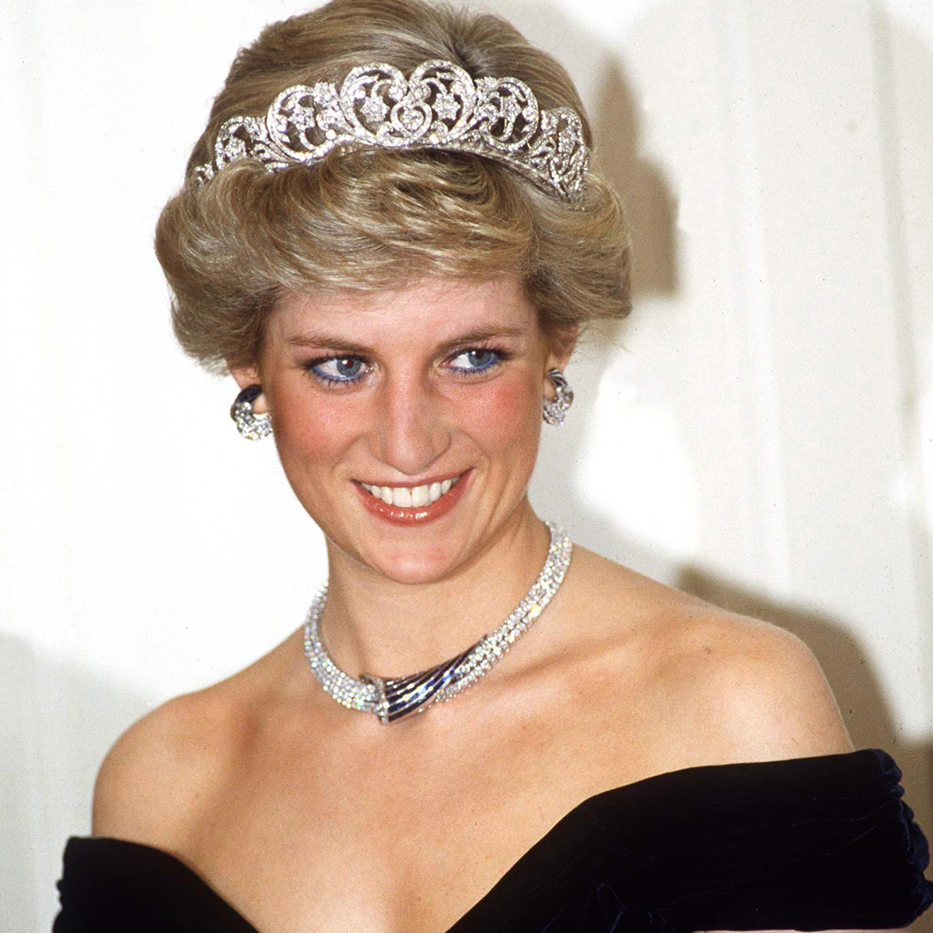
Princess Diana

Slide 8
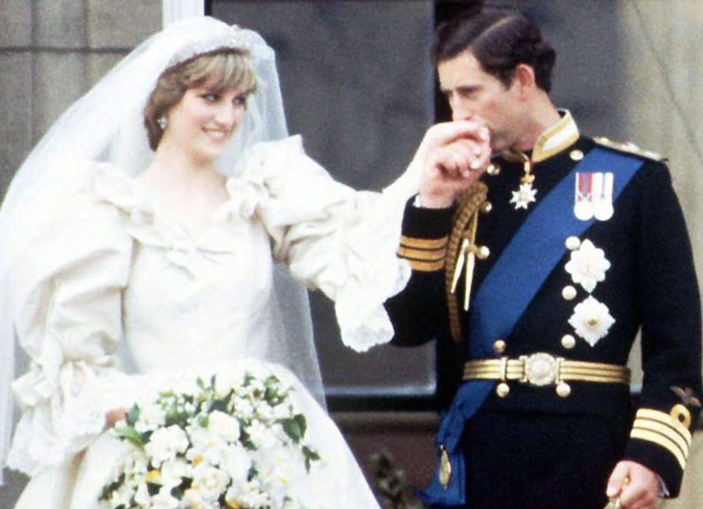
Prince Charles and Diana

Slide 9
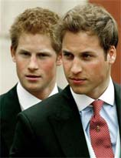
Princes William and Harry

Slide 10
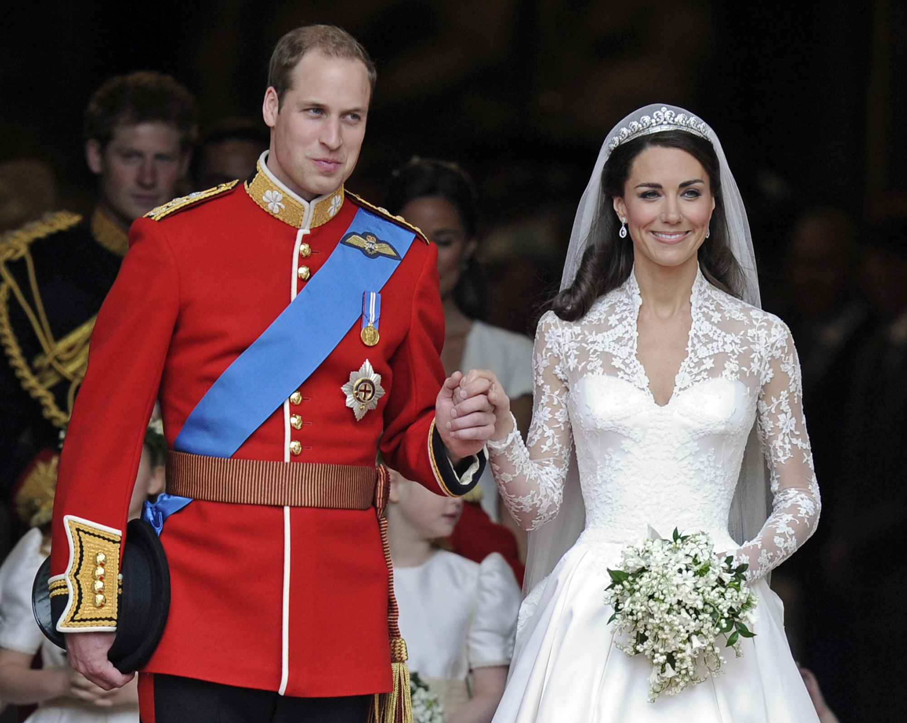
Prince William and Catherine (Kate)

Slide 11
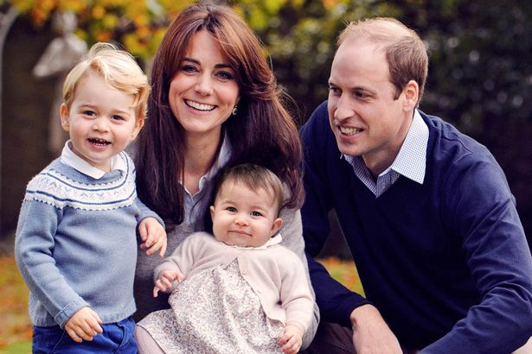
William and Kate with family

Slide 12
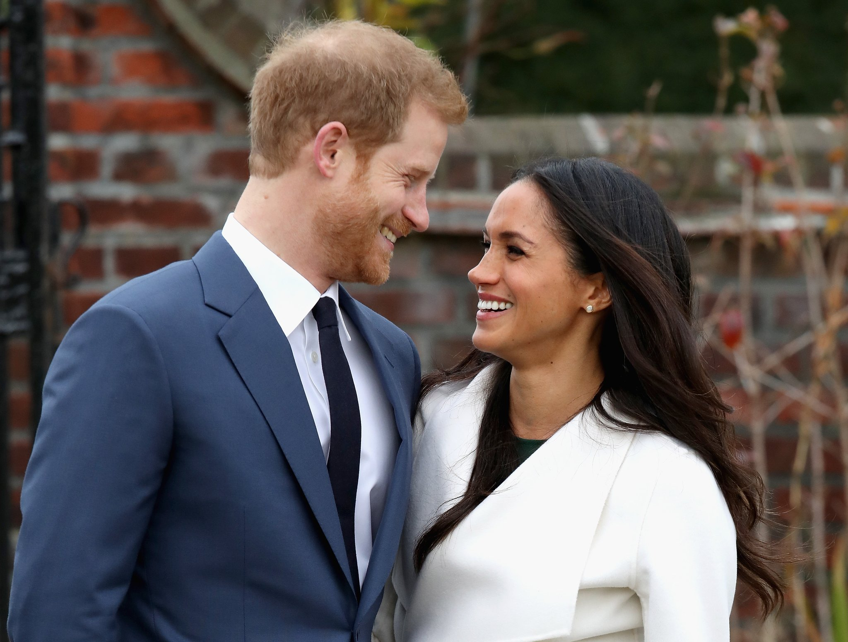
Harry and fiancée, Meghan Markle

Slide 13
Prince William’s father is ___________.
Who is Queen Elizabeth’s husband?
Princess Anne is Prince Harry’s _____.
__________ is Princess Beatrice’s sister.
Prince Andrew is Lady Louise’s ______.
Prince Charles
Prince Phillip
aunt
Princess Eugenie
uncle

Slide 14
6. Prince Charles’ brothers are ______ and ______.
7. ____________ is Prince George’s grandfather.
8. Princess Eugenie is Princess Anne’s _________.
9. Lady Louise is Princess Eugenie’s ___________.
10. Who is Princess Charlotte’s great- grandmother?
Andrew
Edward
Prince Charles
niece
cousin
Queen Elizabeth

