Slide 1
The United Kingdom
KNOW | WANT TO KNOW | LEARNED

Slide 2
Vocabulary

Slide 3
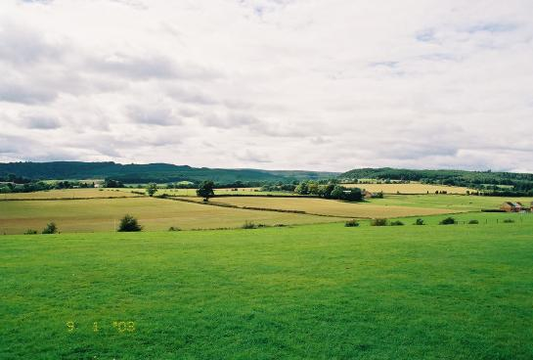
lowland

Slide 4
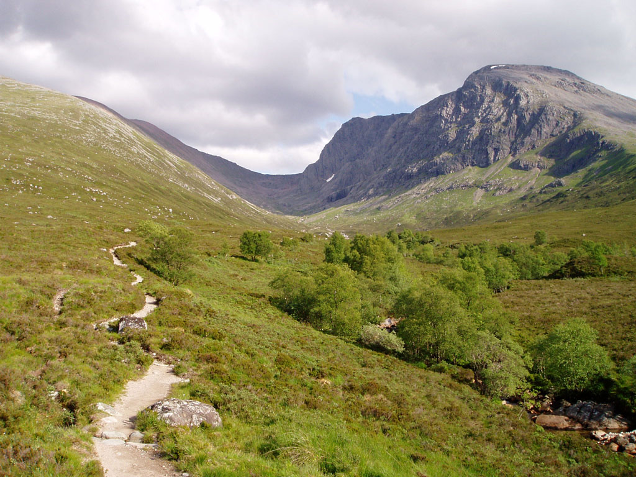
highland

Slide 5
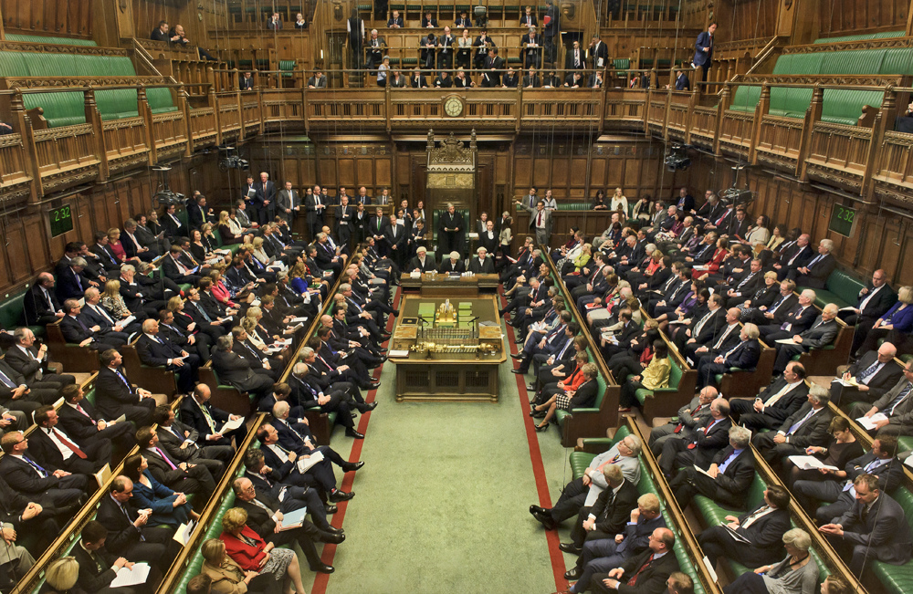
House of commons

Slide 6
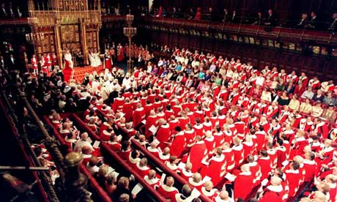
House of lords

Slide 7
To elect

Slide 8
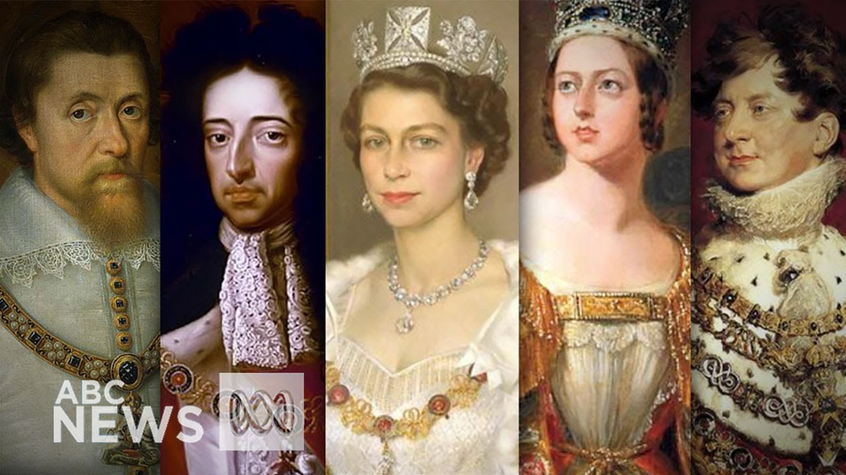
monarch

Slide 9
to surround

Slide 10
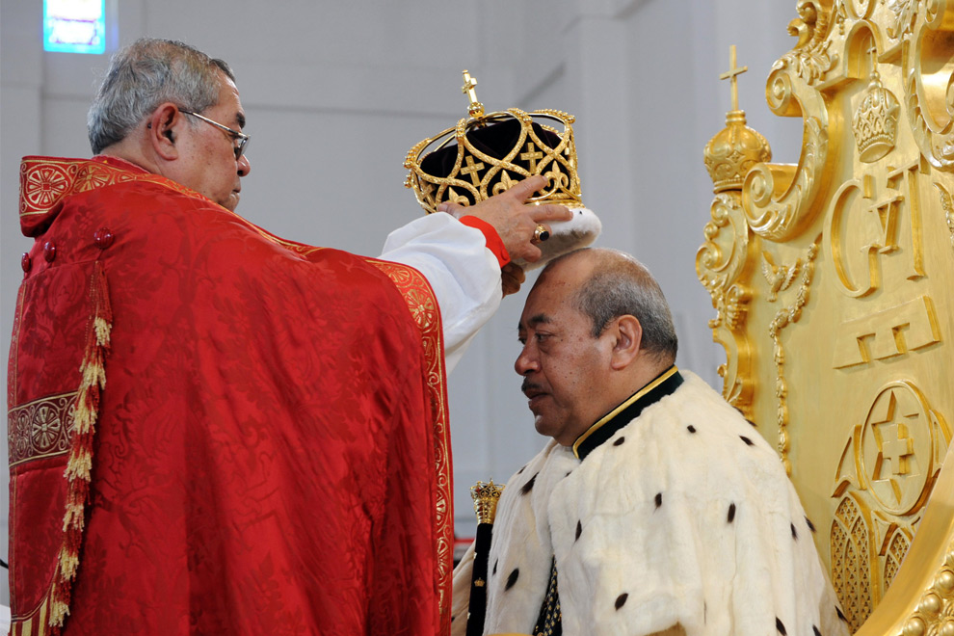
to crown

Slide 11
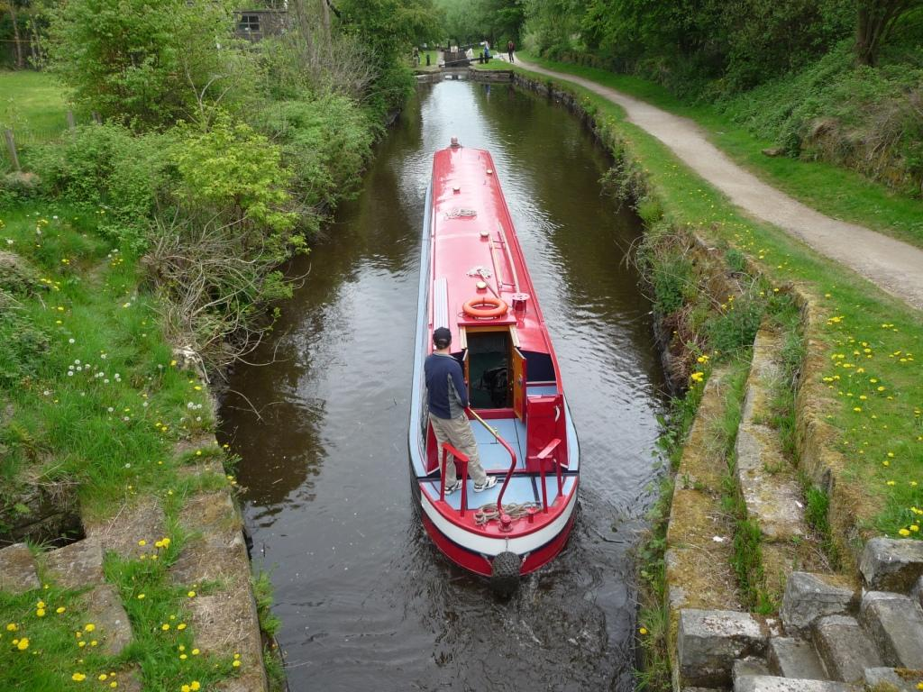
navigable

Slide 12
left?
right?
or

Slide 13
lowland

Slide 14
highland

Slide 15
house of commons

Slide 16
house of lords

Slide 17
to surround

Slide 18
monarch

Slide 19
navigable

Slide 20
to crown

Slide 30
Good Job!!

Slide 31
Select from the text:
Group 1 FORMS OF RELIEF | Group 2 GEOGRAPHICAL NAMES
Group 3 CITIES AND SEAPORTS | Group 4 NUMBERS WITH THEIR REFERENCES

Slide 32
Say True or False:
The English Channel separates Great Britain from the European continent.
The Strait of Dover is widest part of the English Channel.
The population of the UK is 66.2 million people.
The largest country in the UK is Scotland with a population of over 53 million people.
The Thames is the longest river in England.
The Thames is not navigable.
London is the capital of the UK and one of the most important seaports in the world.

Slide 33
Answer the questions about the text:
What is the official name of the UK?
What countries make up Great Britain?
What countries make up the UK?
What are some of the most important cities from England?
What is Northern England famous for?
What is the birthplace of William Shakespeare?
What two cities are famous for their universities?

Slide 34
The United Kingdom
SIMILARITIES | DIFFERENCES | NEW FACTS

Slide 35
The United Kingdom
KNOW | WANT TO KNOW | LEARNED

Slide 36
Goodbye!!!

