Slide 1
Vocab!

Slide 2
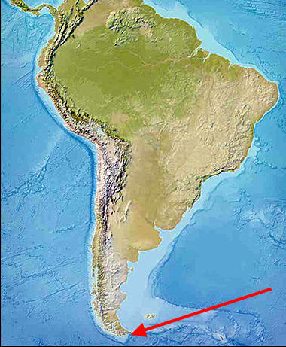
tip

Slide 3
gateway

Slide 4
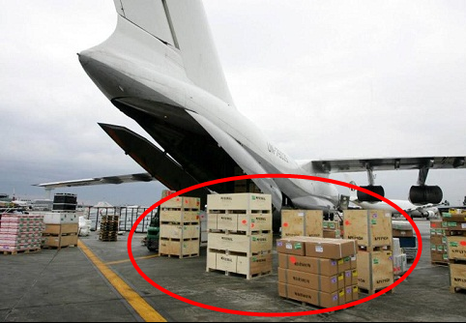
cargo

Slide 5
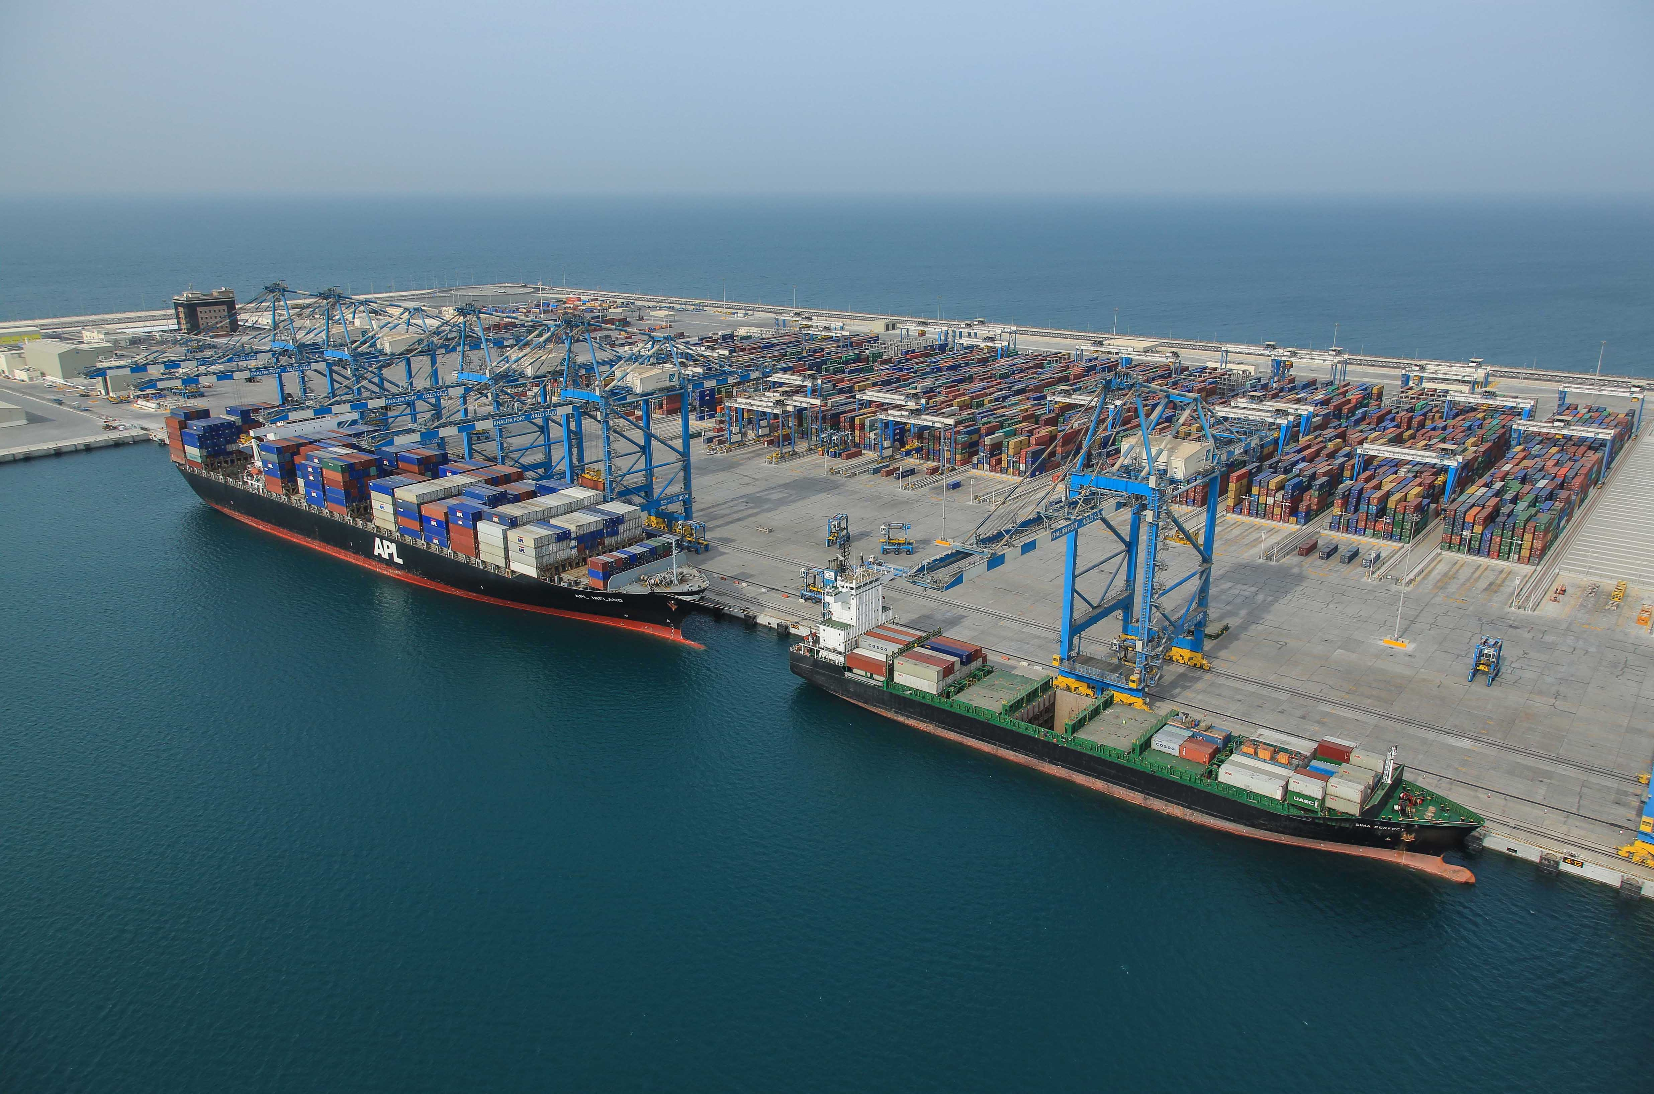
port

Slide 6
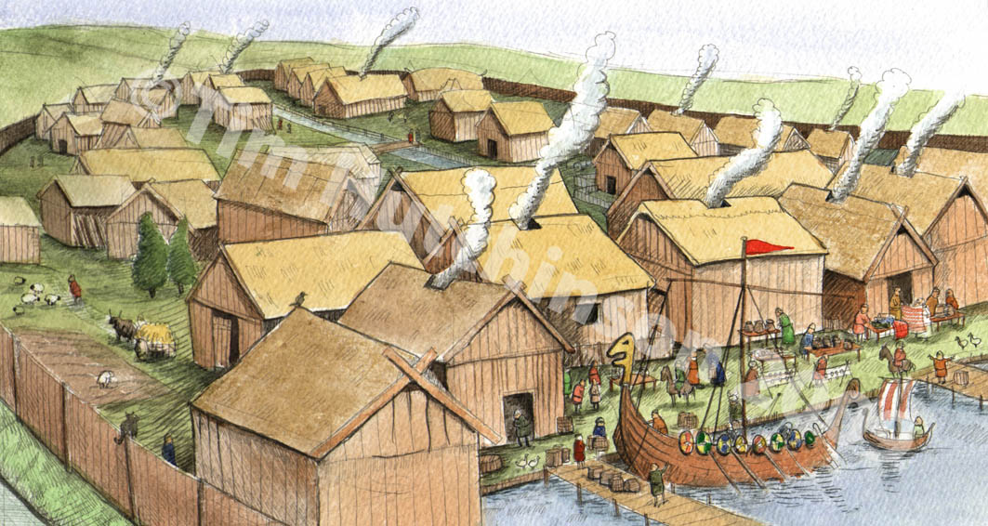
settlement

Slide 7
trade

Slide 8
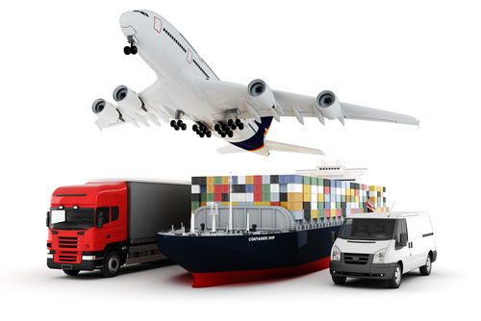
shipping

Slide 9
to light

Slide 10
top?
or
bottom?

Slide 11
gateway

Slide 12
tip

Slide 13
port

Slide 14
cargo

Slide 15
trade

Slide 16
settlement

Slide 17
to light

Slide 18
shipping

