Slide 1
Vocab!

Slide 2
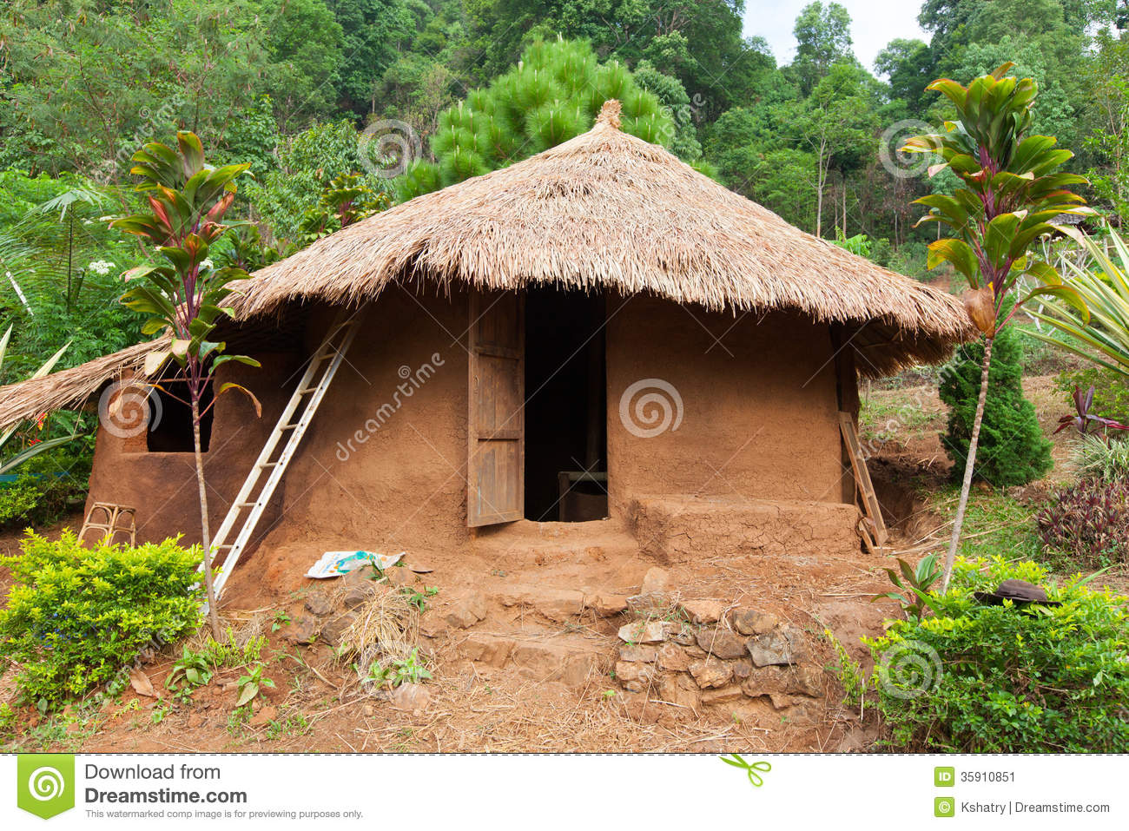
clay house

Slide 3
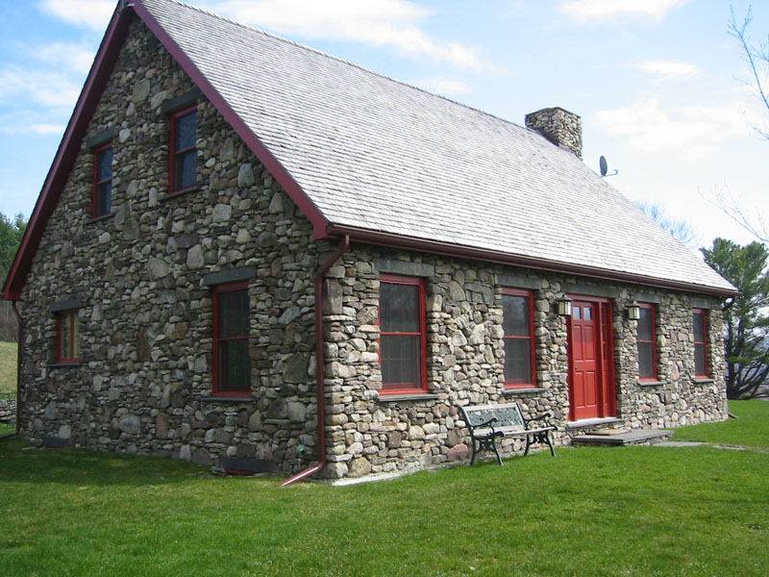
stone house

Slide 4
brick house

Slide 5
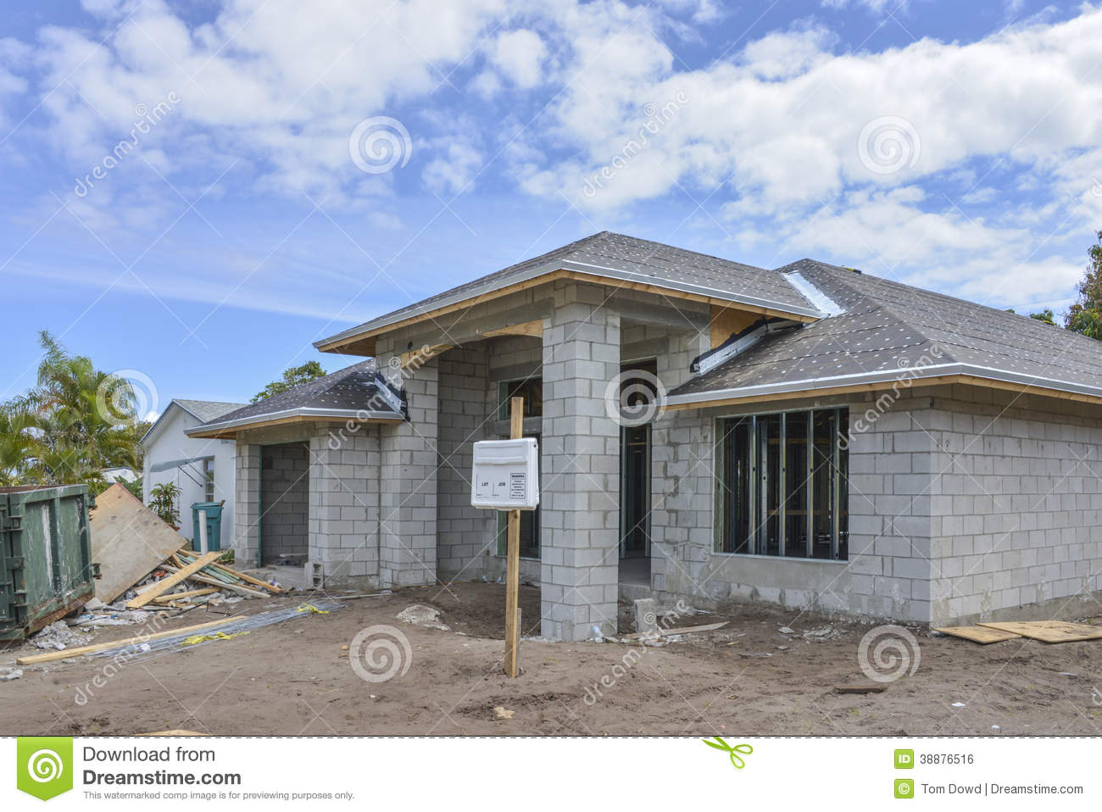
concrete house

Slide 6
wood house

Slide 7
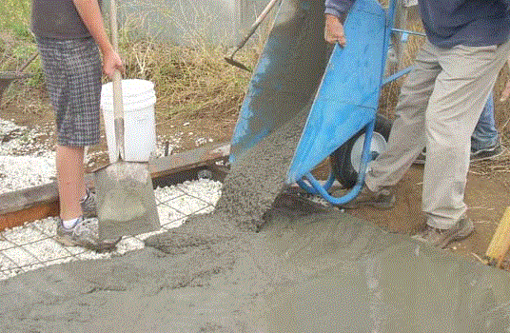
cement

Slide 8
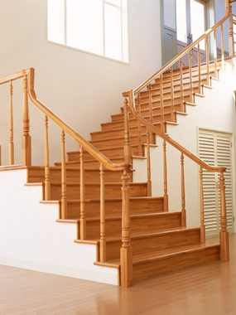
staircase

Slide 9
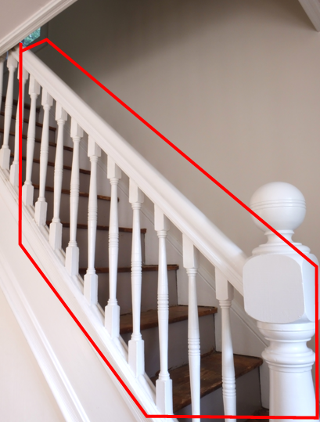
railing

Slide 10
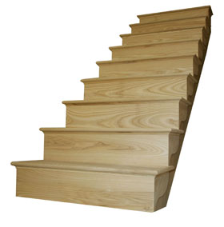
stairs

Slide 11
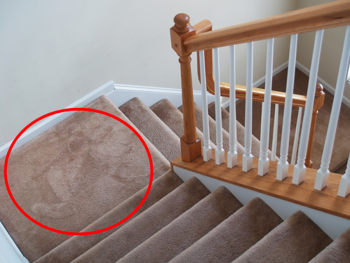
landing

Slide 12
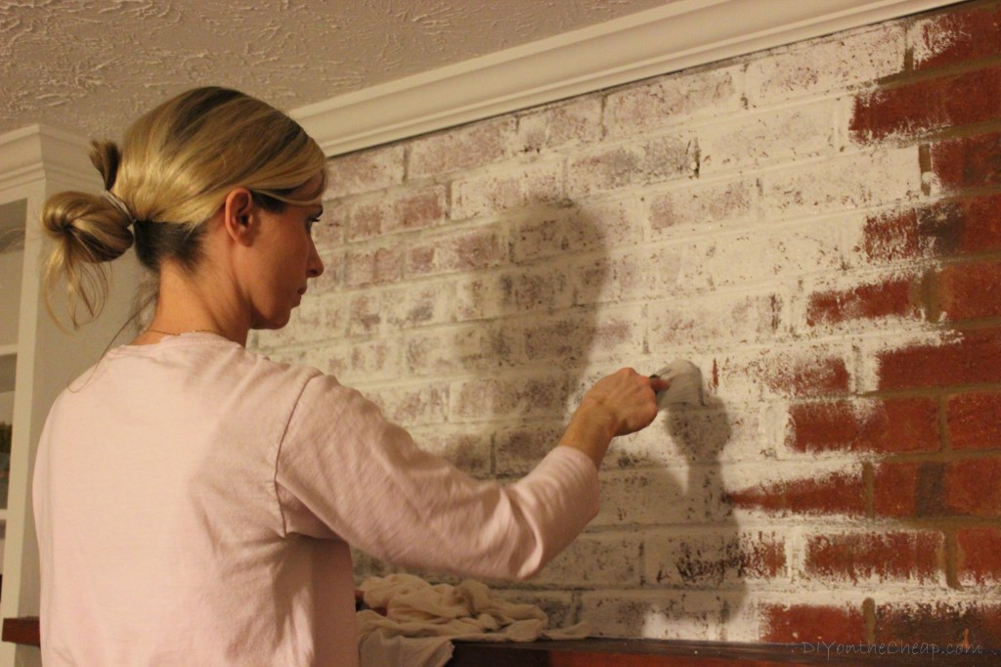
to whitewash

Slide 13
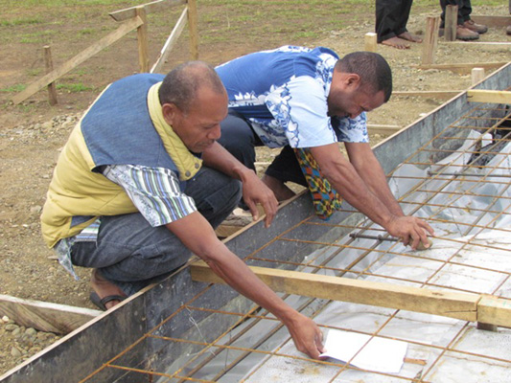
to lay the foundations

Slide 14
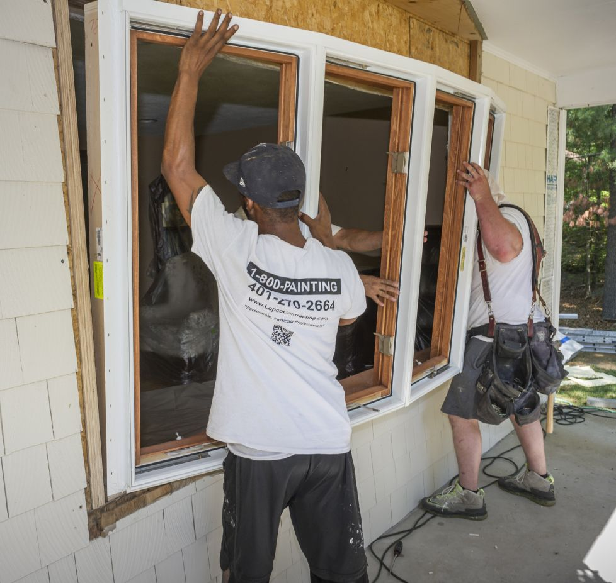
to put in doors and windows

Slide 15
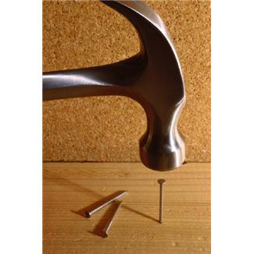
to drive/hammer nails

Slide 16
left?
right?
or

Slide 17
brick house

Slide 18
clay house

Slide 19
stone house

Slide 20
wood house

Slide 21
concrete house

Slide 22
stairs

Slide 23
cement

Slide 24
railing

Slide 25
staircase

Slide 26
to whitewash

Slide 27
landing

Slide 28
to lay the foundations

Slide 29
to put in doors and windows

Slide 30
to drive/hammer nails

