Slide 1
Vocab!

Slide 2
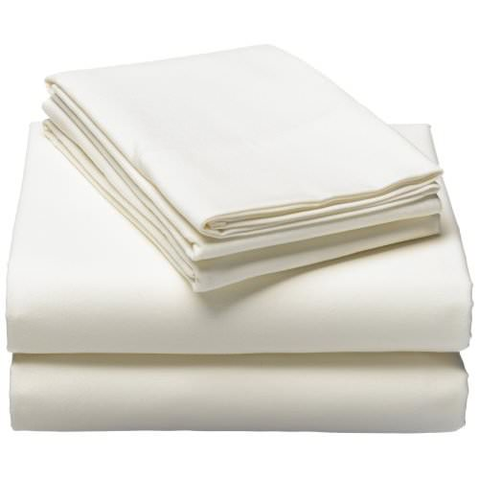
bedding

Slide 3
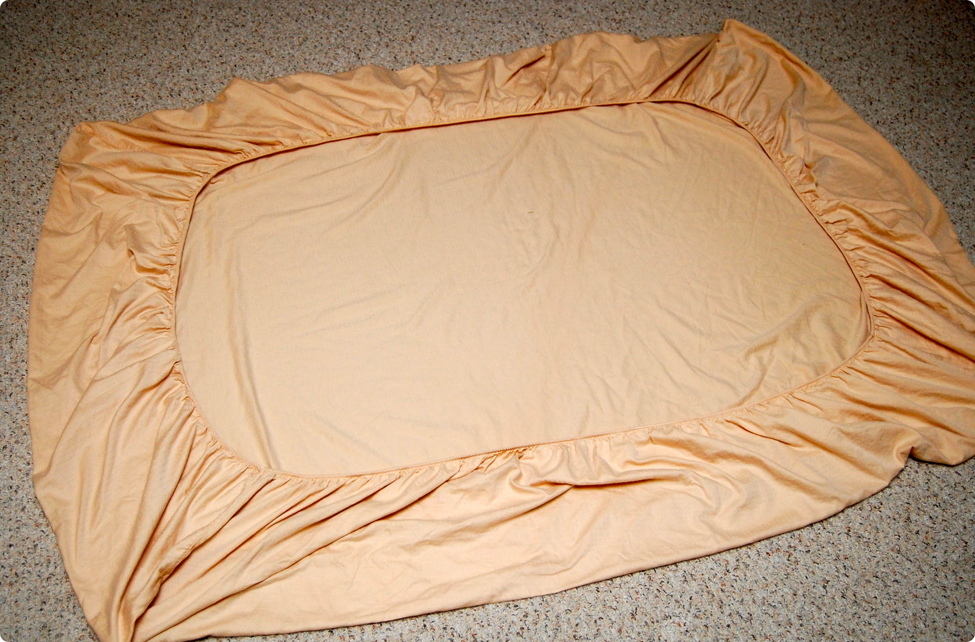
bed sheet

Slide 4
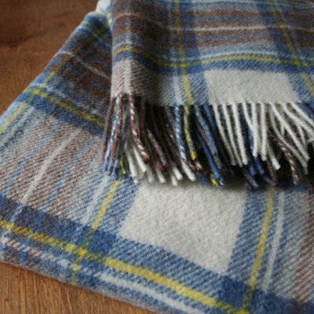
blanket

Slide 5
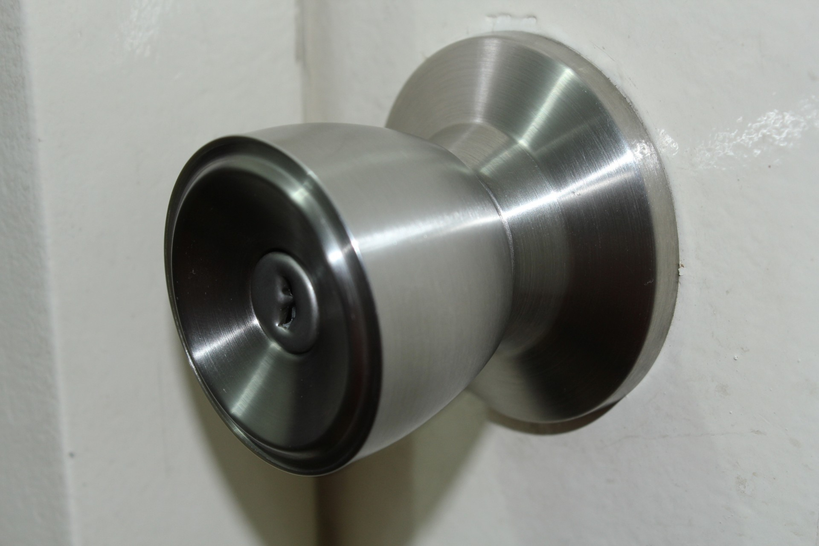
door knob/handle

Slide 6
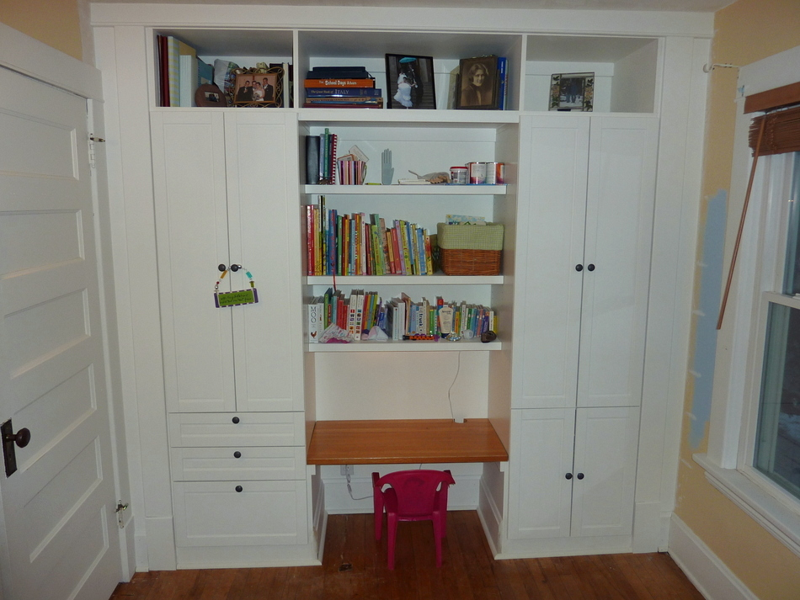
built-in wardrobe

Slide 7
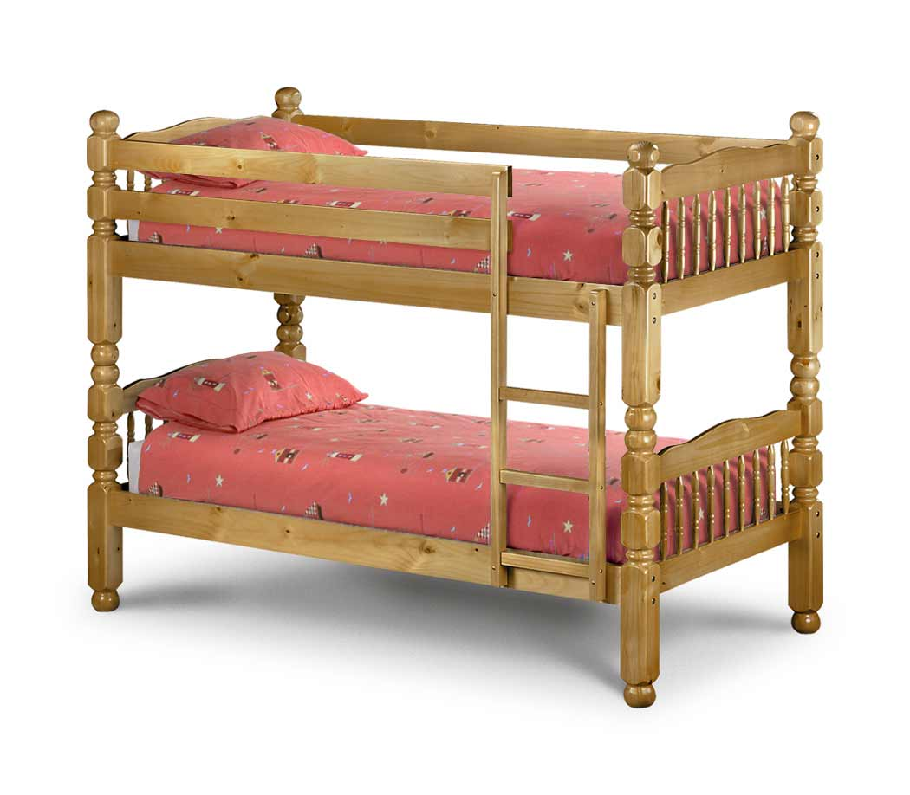
bunk bed/double-deck bed

Slide 8
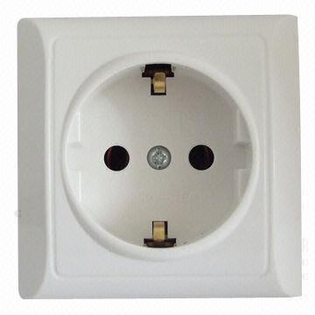
socket

Slide 9
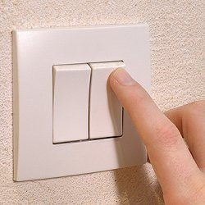
light switch

Slide 10
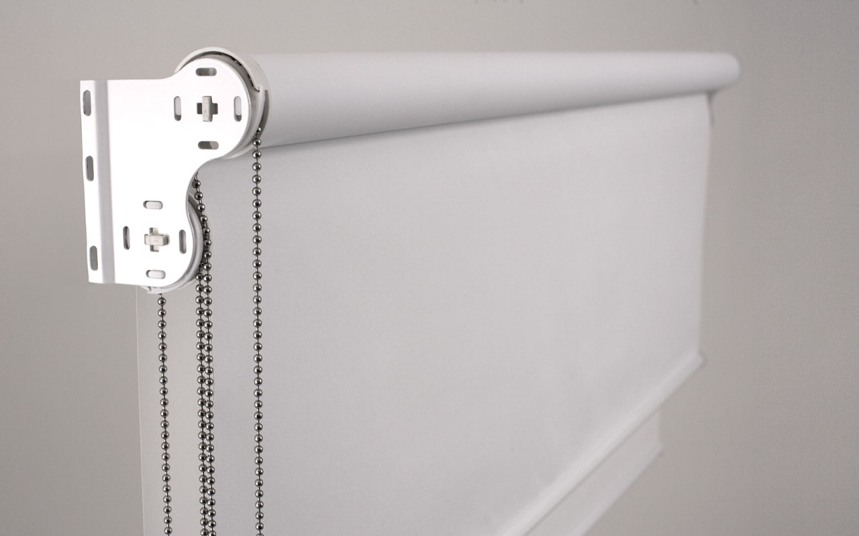
roller blind

Slide 11
left?
right?
or

Slide 12
bed sheet

Slide 13
blanket

Slide 14
bedding

Slide 15
built-in wardrobe

Slide 16
door knob/handle

Slide 17
socket

Slide 18
bunk bed/double-deck bed

Slide 19
roller blind

Slide 20
light switch

