Slide 1
Vocab!

Slide 2
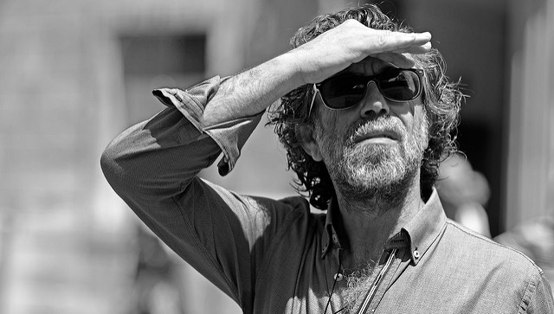
shield
(eyes)

Slide 3
habitat

Slide 4
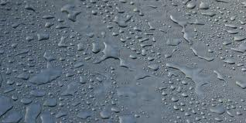
moisture

Slide 5
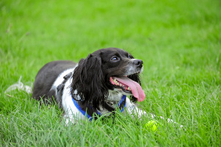
pant

Slide 6
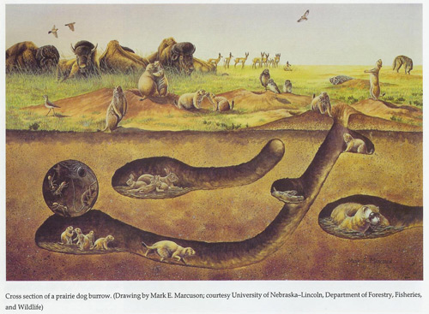
burrows

Slide 7
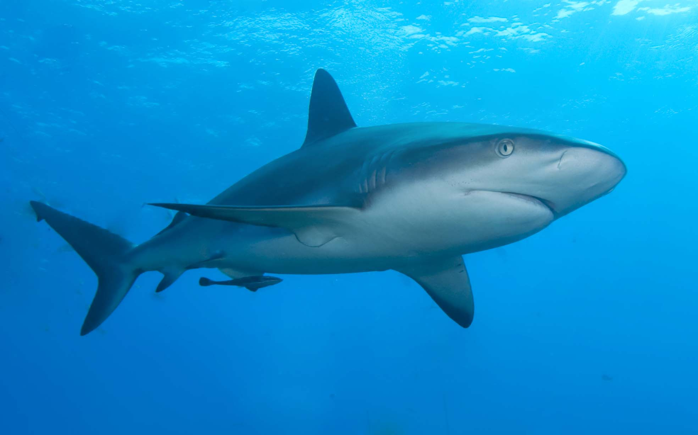
shark

Slide 8
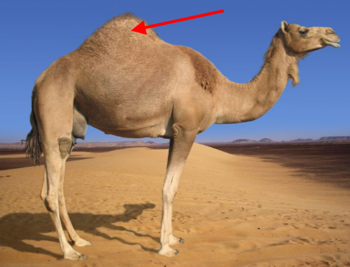
hump

Slide 9
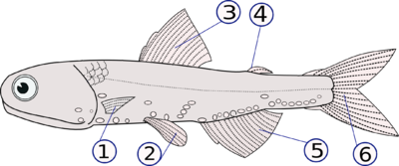
fins

Slide 10
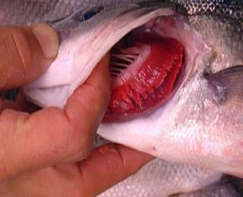
gills

Slide 11
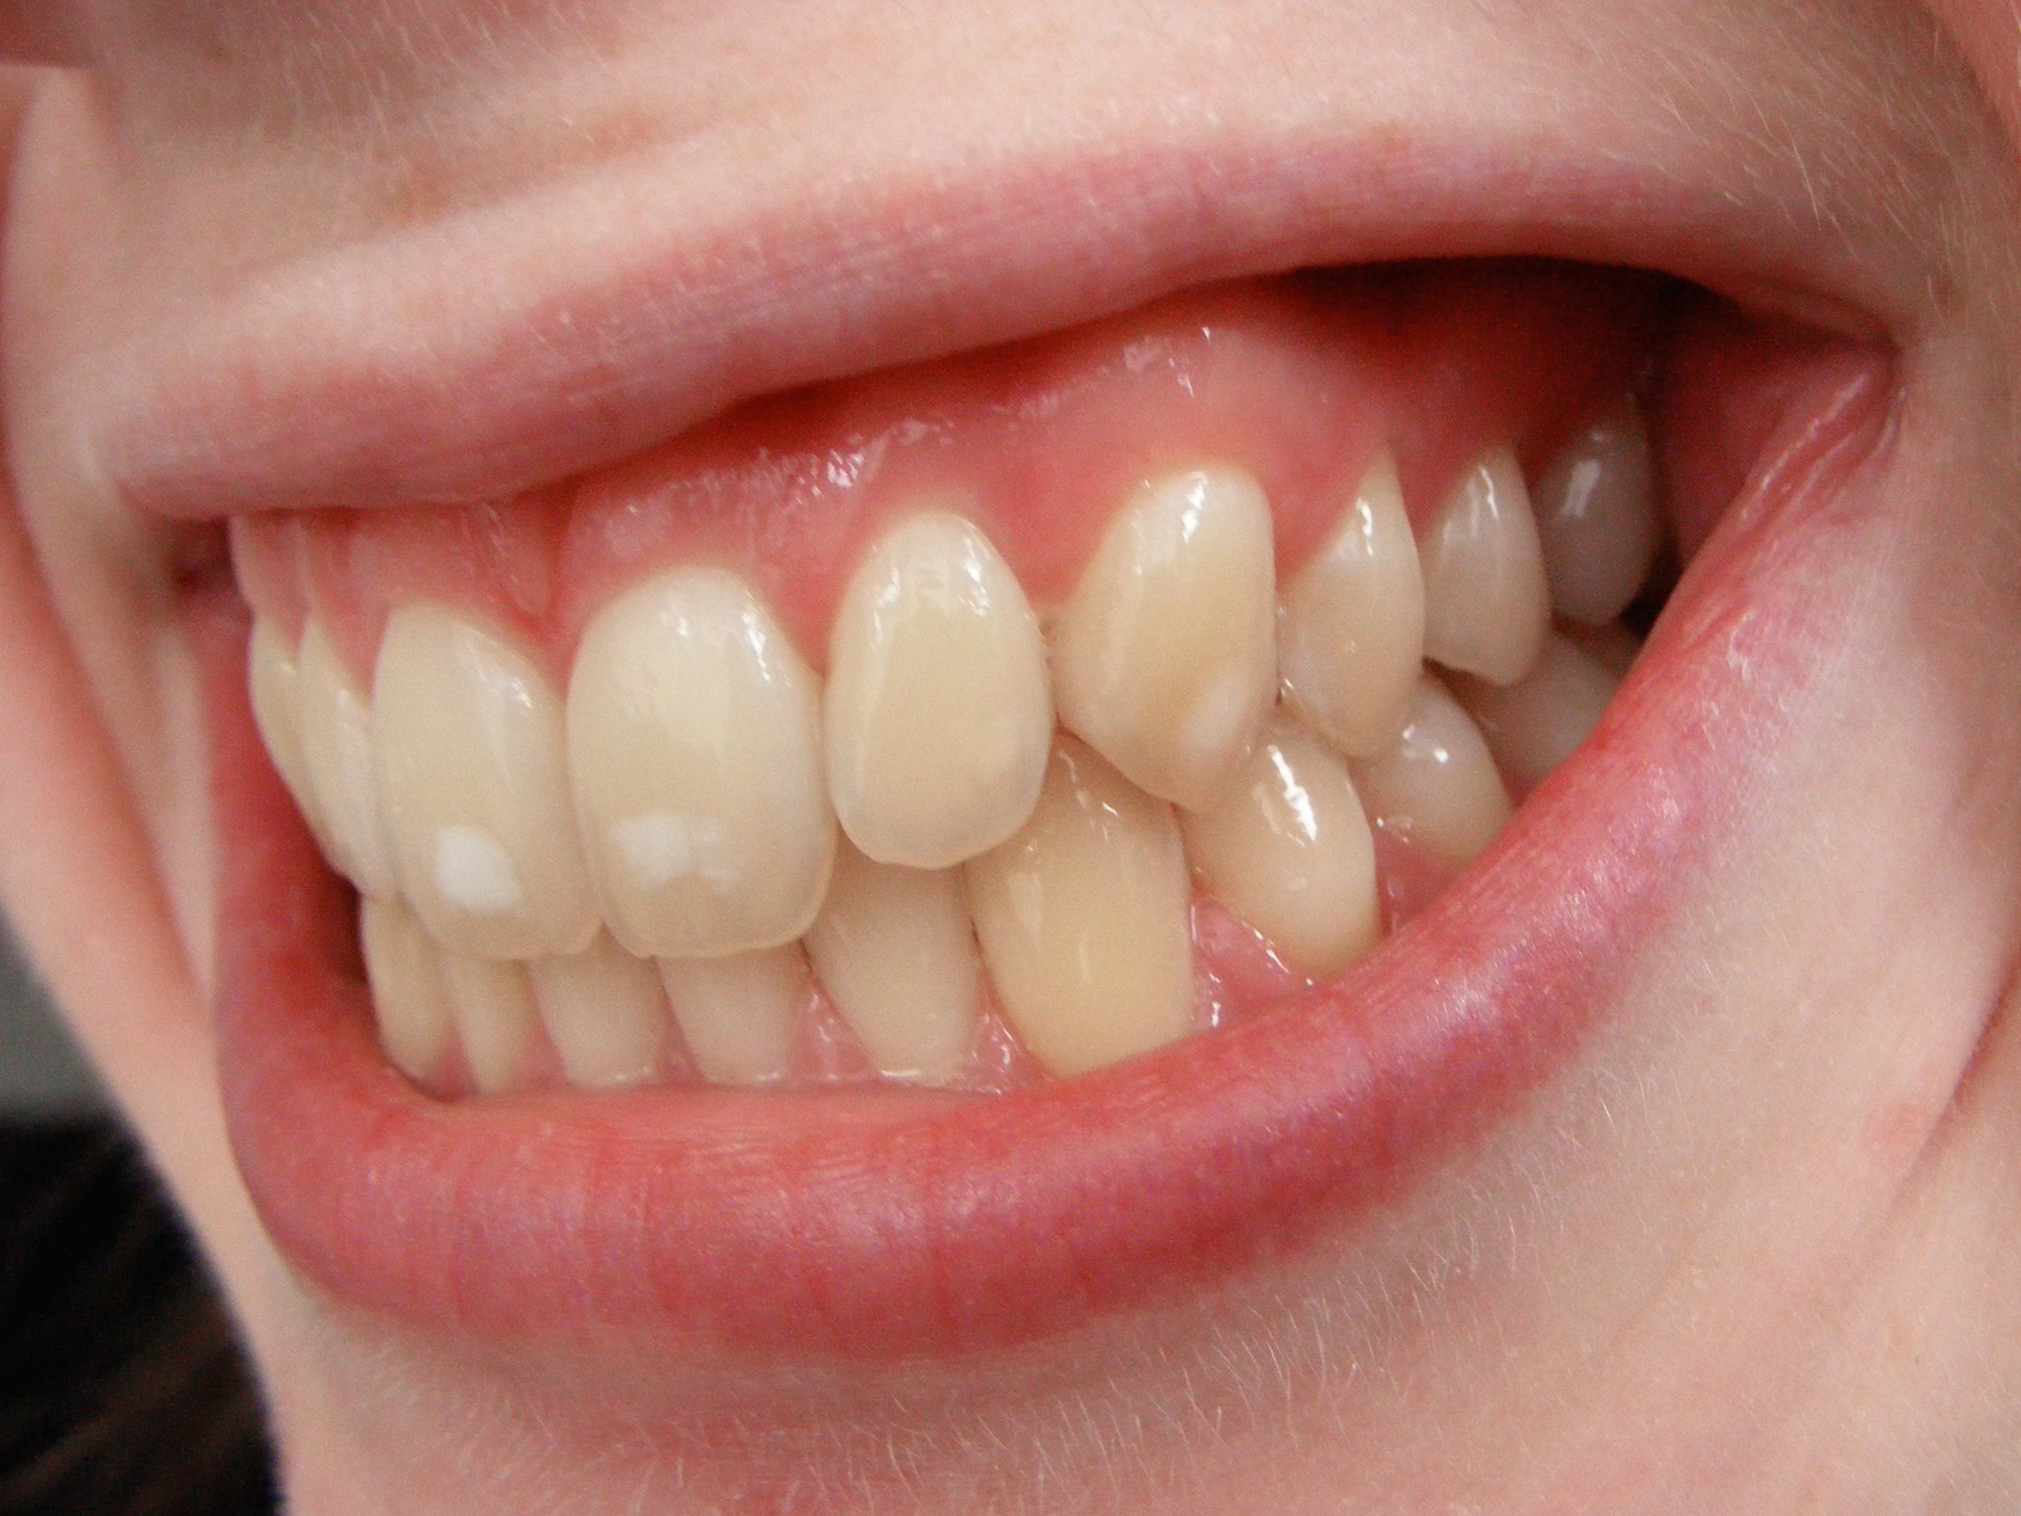
teeth

Slide 12
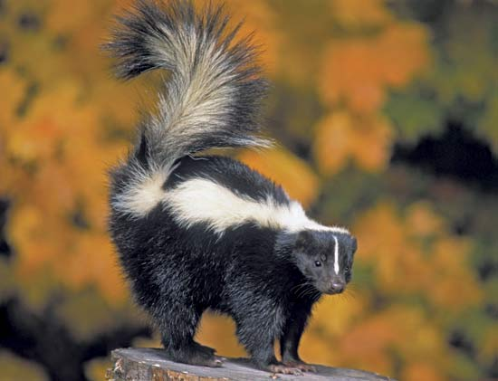
skunk

Slide 13
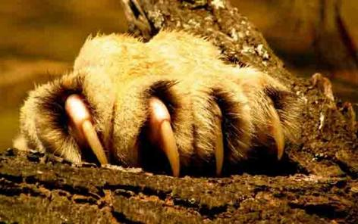
claws

Slide 14
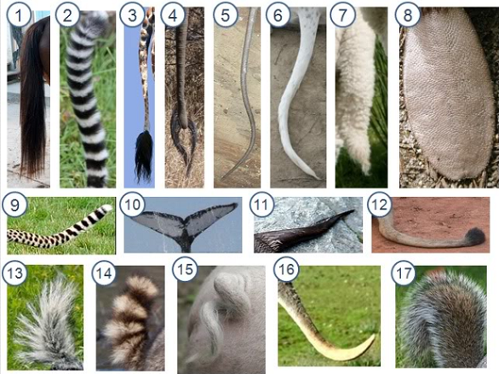
tail

Slide 15
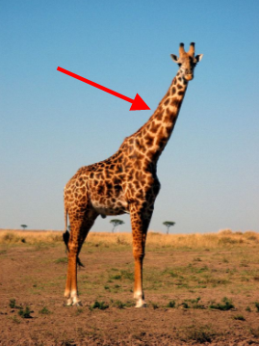
neck

Slide 16
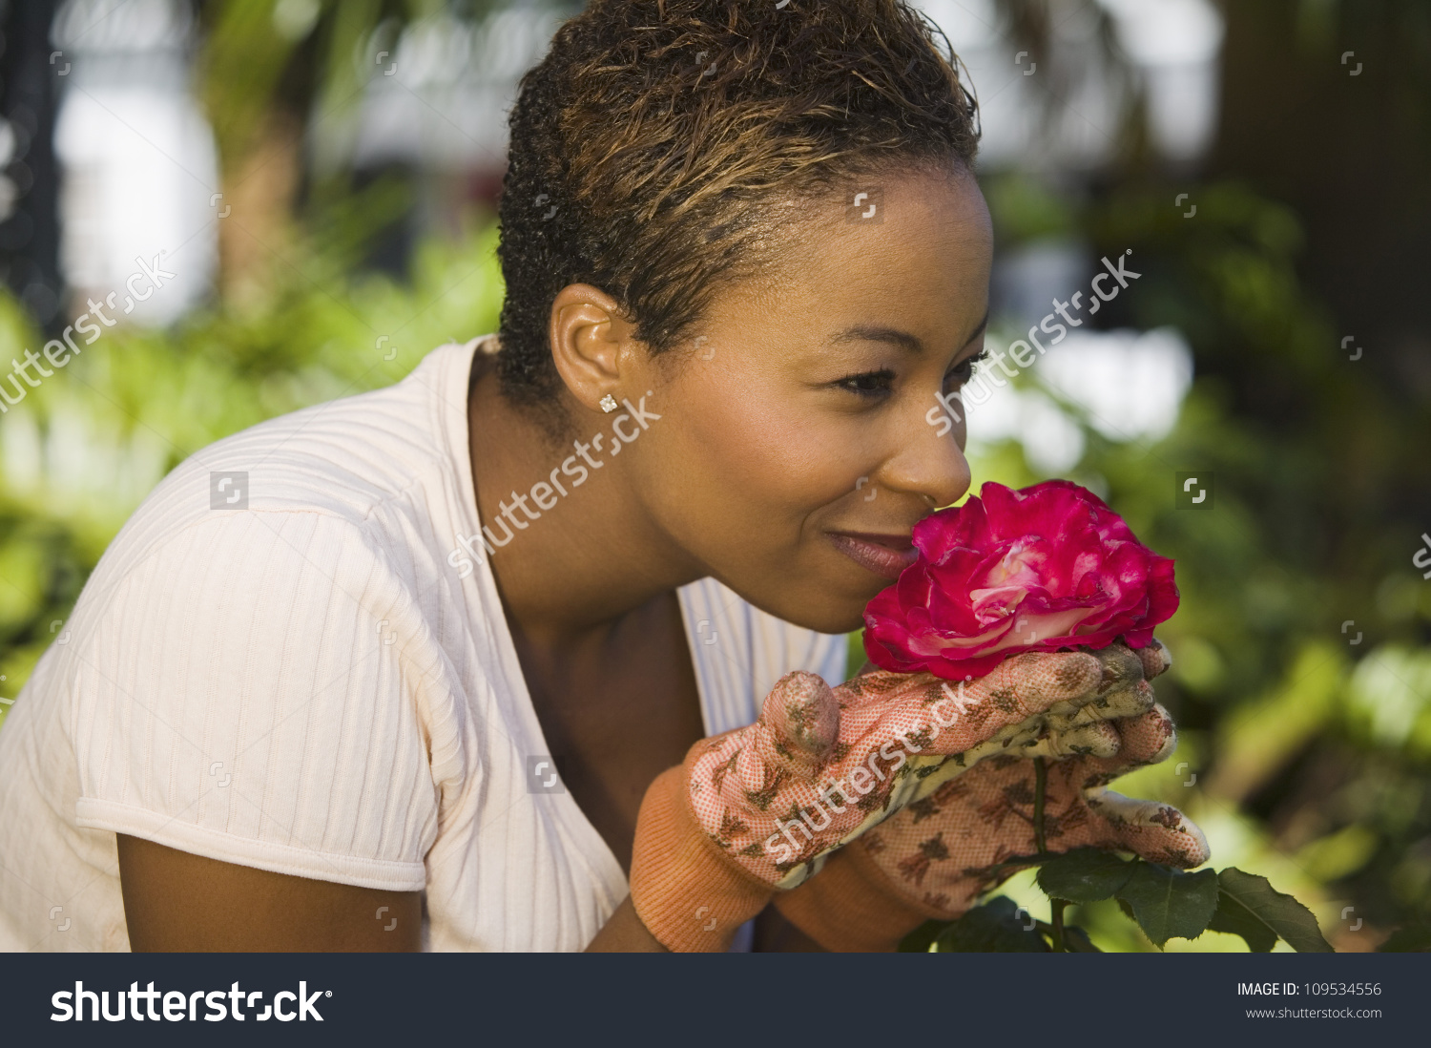
smell

Slide 17
left?
right?
or

Slide 18
habitat

Slide 19
pant

Slide 20
shield

Slide 21
skunk

Slide 22
moisture

Slide 23
burrows

Slide 24
hump

Slide 25
fins

Slide 26
tail

Slide 27
smell

Slide 28
claws

Slide 29
gills

Slide 30
neck

Slide 31
shark

Slide 32
teeth

Slide 48
