Slide 1
Vocab!

Slide 2
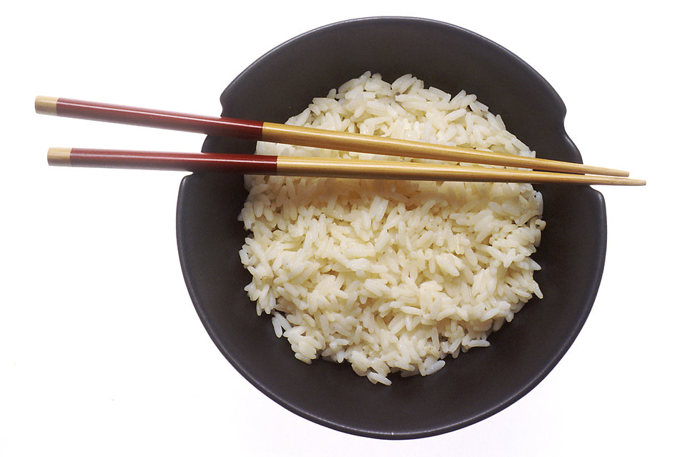
bowl of rice

Slide 3
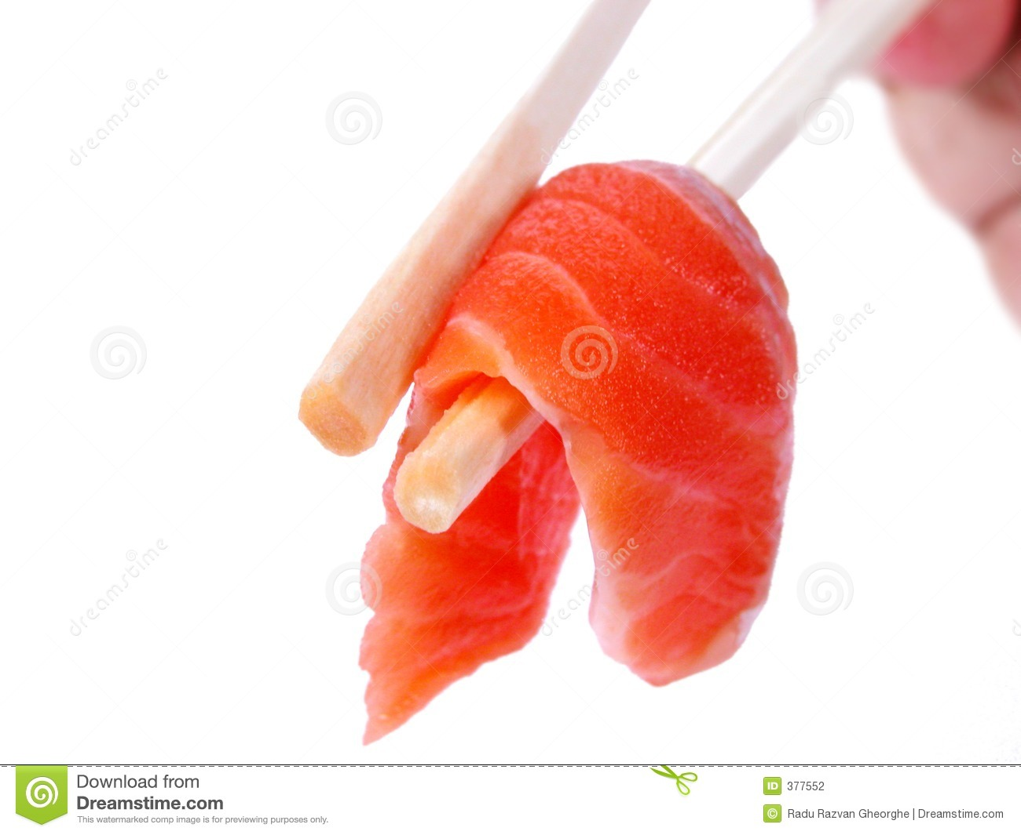
piece of fish

Slide 4
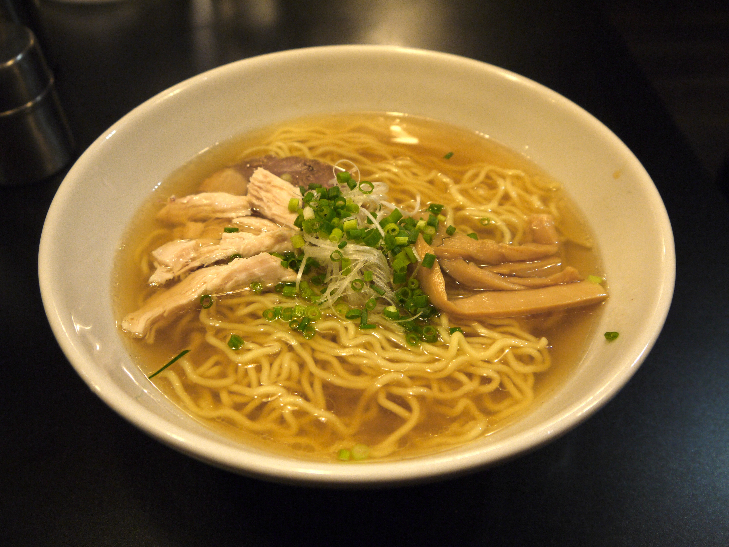
noodles

Slide 5
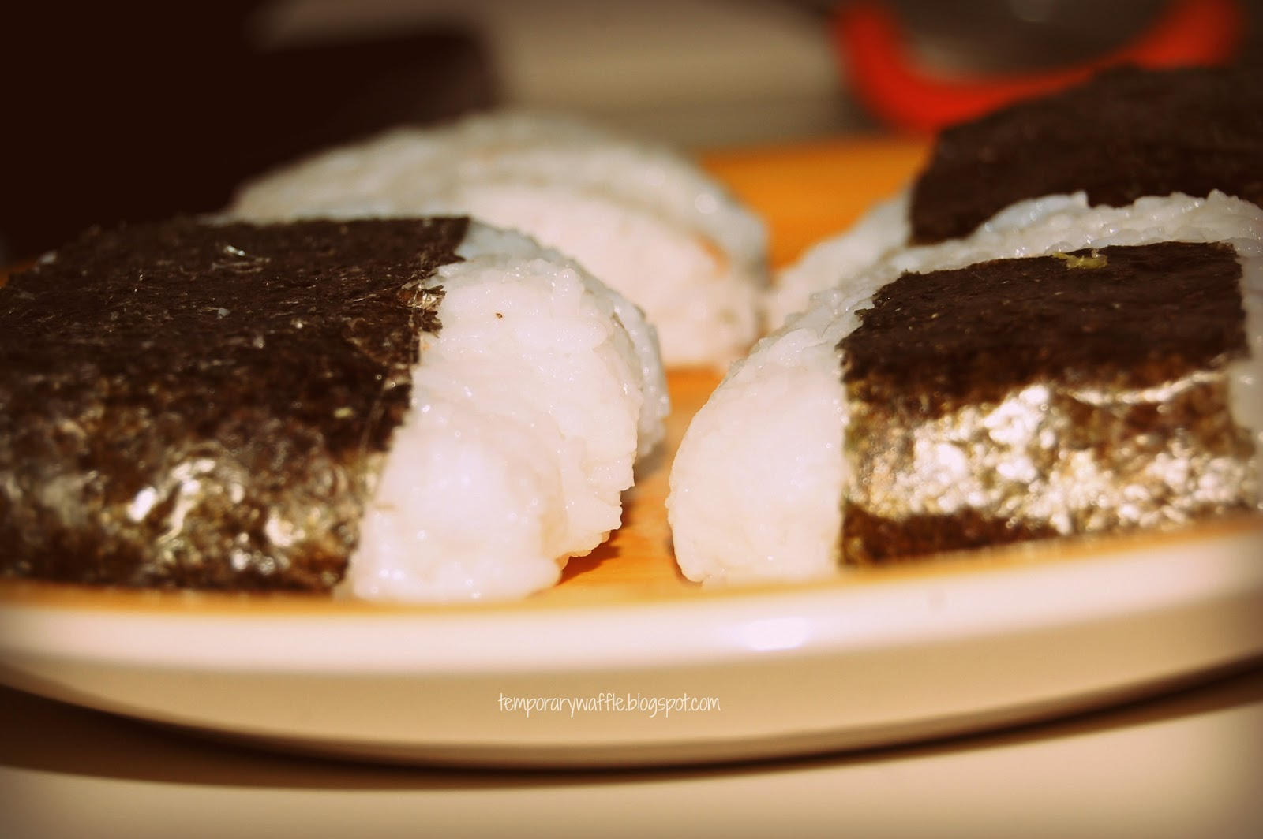
rice balls in seaweed

Slide 6
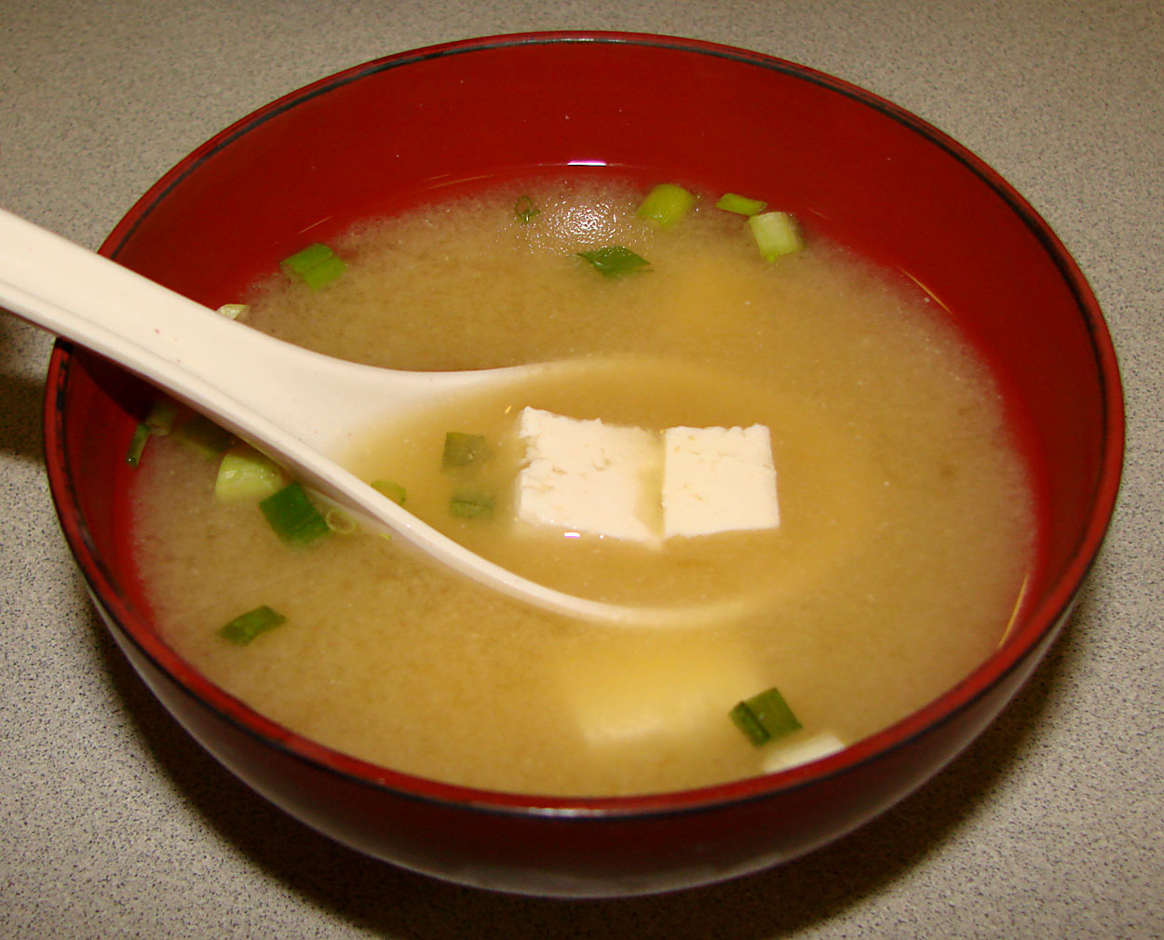
miso soup

Slide 7
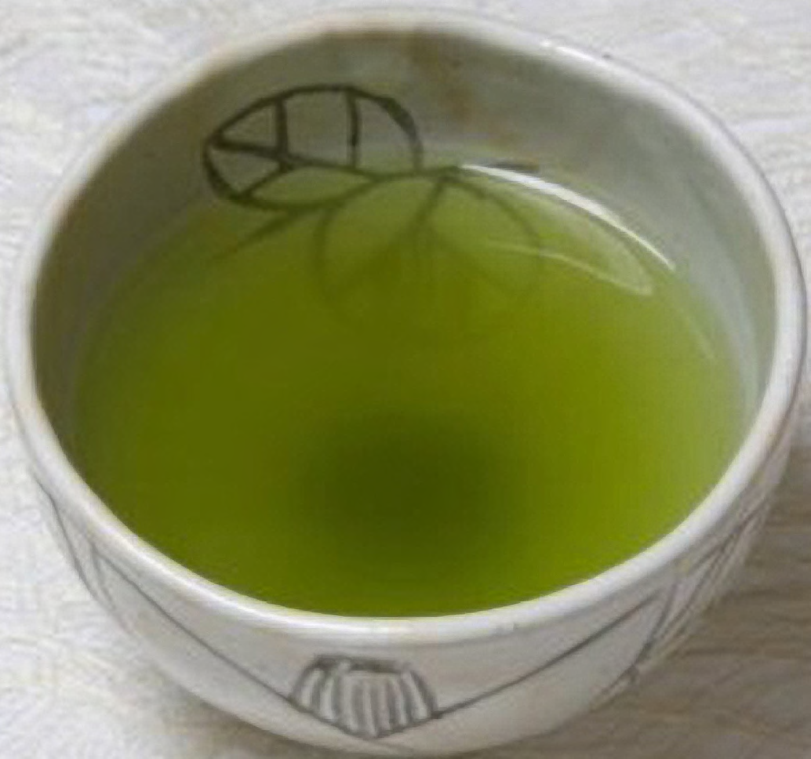
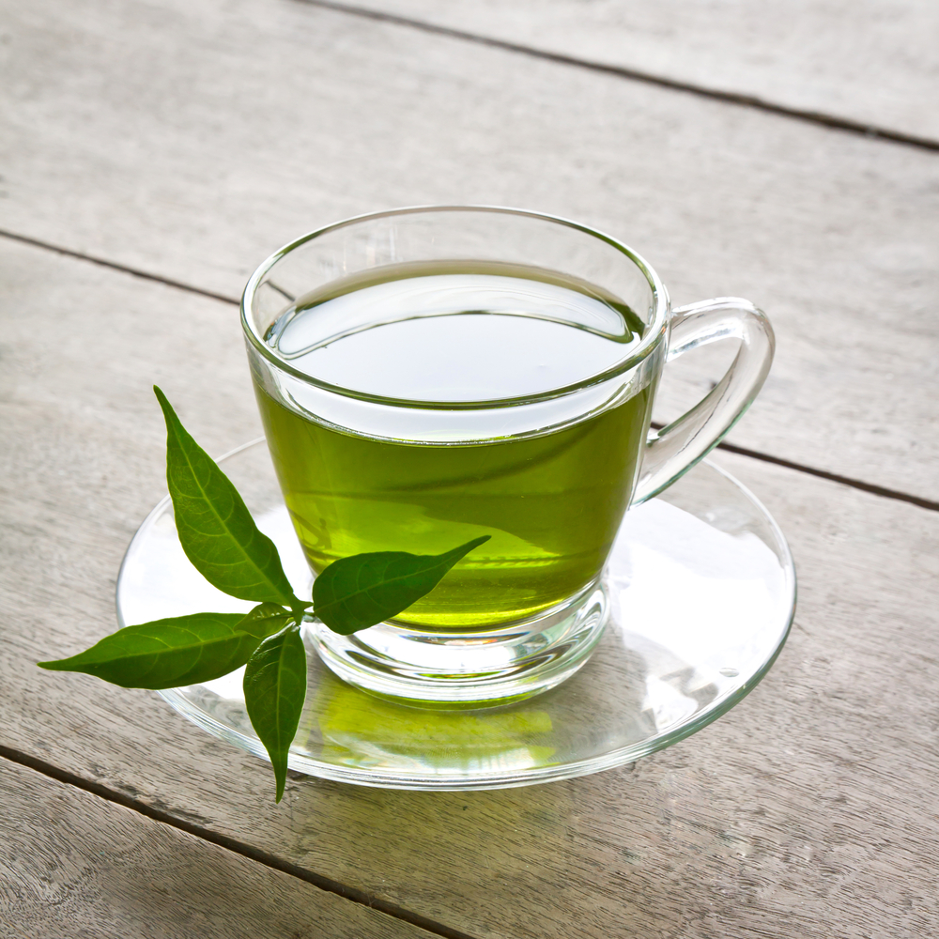
green
tea

Slide 8
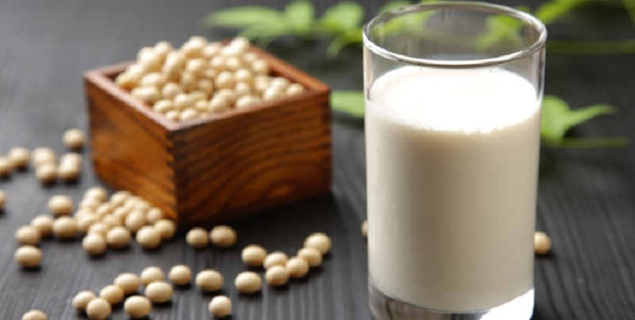
soy milk

Slide 9
left?
right?
or

Slide 10
piece of fish

Slide 11
bowl of rice

Slide 12
rice balls in seaweed

Slide 13
noodles

Slide 14
soy milk

Slide 15
green tea

Slide 16
miso soup

Slide 24
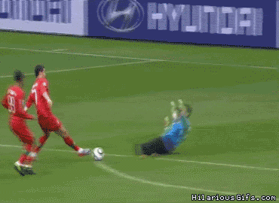
Good Job!

