Slide 1
Perfect tenses: Present Perfect, Past Perfect and Future Perfect.
Active and Passive Voice.
Teacher:
Ursu Mariana

Slide 2
Compare the verbs in the sentences, name the tenses:
I have done my homework.
I had done my homework by 8:15 pm yesterday.
I had done my homework before mother came home.
I will have done my homework by 7 pm tomorrow.
I will have done my homework before mother comes home.

Slide 3
Present Perfect
The Present Perfect is used to indicate a link between the present and the past. The time of the action is before now but not specified, and we are often more interested in the result than in the action itself.
I have done my homework.

Slide 4
More cases to use Present Perfect

Slide 5
Past Perfect
had + past participle
I had done my homework by 8:15 pm yesterday.

Slide 6
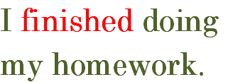
Past Perfect
had + past participle
Past Perfect is also used to make it clear that one action happened before another one both in the past.
I had done my homework before mother came home.

Slide 7
Future Perfect
I will finish doing
my homework.
Will have + past participle
6:40
7:00
I will have done my homework by 7 pm tomorrow.

Slide 8
Future Perfect
I will finish doing
my homework.
Mother will
arrive home.
Will have + past participle
6:40
7:00
I will have done my homework before mother comes home.

Slide 9
Compare the verbs in the sentences, name the tense:
They have lived in this flat since 2000.
They have lived in this flat for 17 years.
They have been living in this hotel since Tuesday.
They have been living in this hotel for 2 days.

Slide 10
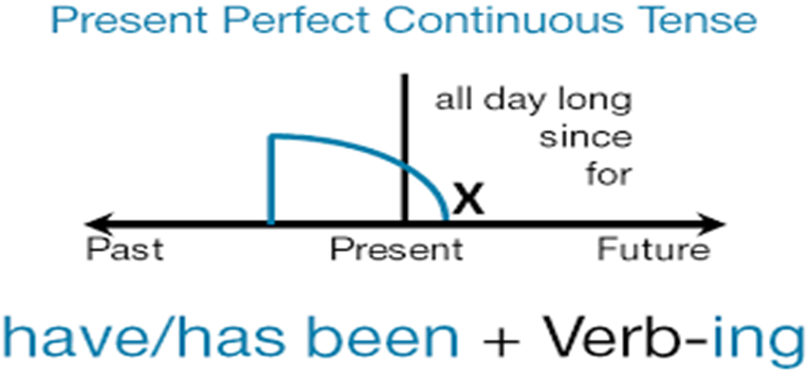
Present Perfect Progressive
They have been living in this hotel since Tuesday.
They have been living in this hotel for 2 days.

Slide 11
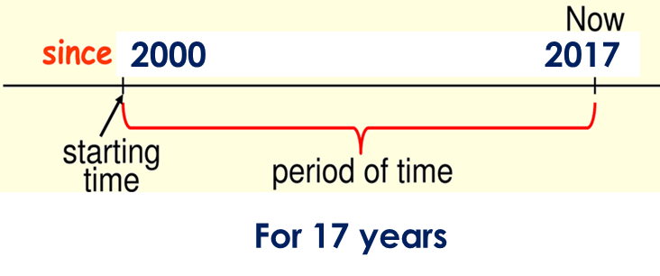
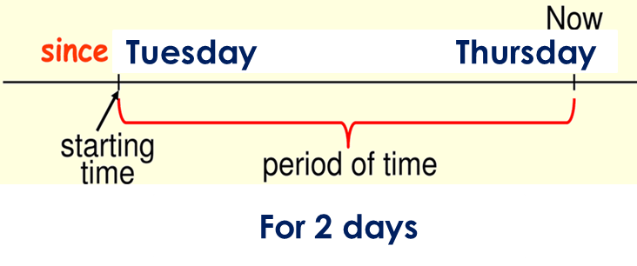
Present Perfect | Present Perfect Progressive
indicates a continuous permanent action that started in the past and continues to happen in present (for a long period) | indicates a continuous periodical action that started in the past and continues to happen in present (for a short period)
They have lived in this flat since 2000. They have lived in this flat for 17 years. | They have been living in this hotel since Tuesday. They have been living in this hotel for 2 days.

Slide 12
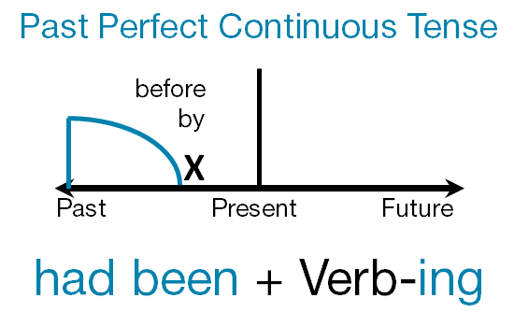
Past Perfect Progressive
We use the Past Perfect Progressive to show an action that started in the past and continued up until another time or another action in the past.
She had been reading for 2 hours by 6 pm yesterday.
They had been reading for 2 hours before her mother came home.

Slide 13
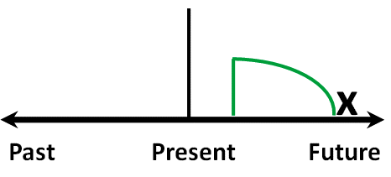
Future Perfect Progressive
will + have been + V-ing
We use the Future Perfect Progressive to show an action that will start in the future and will continue up until another time or another action in the future.
She will have been reading for 2 hours by 6 pm tomorrow.
She will have been reading for 2 hours before her mother comes home.

