Slide 1
VocabularY!

Slide 2
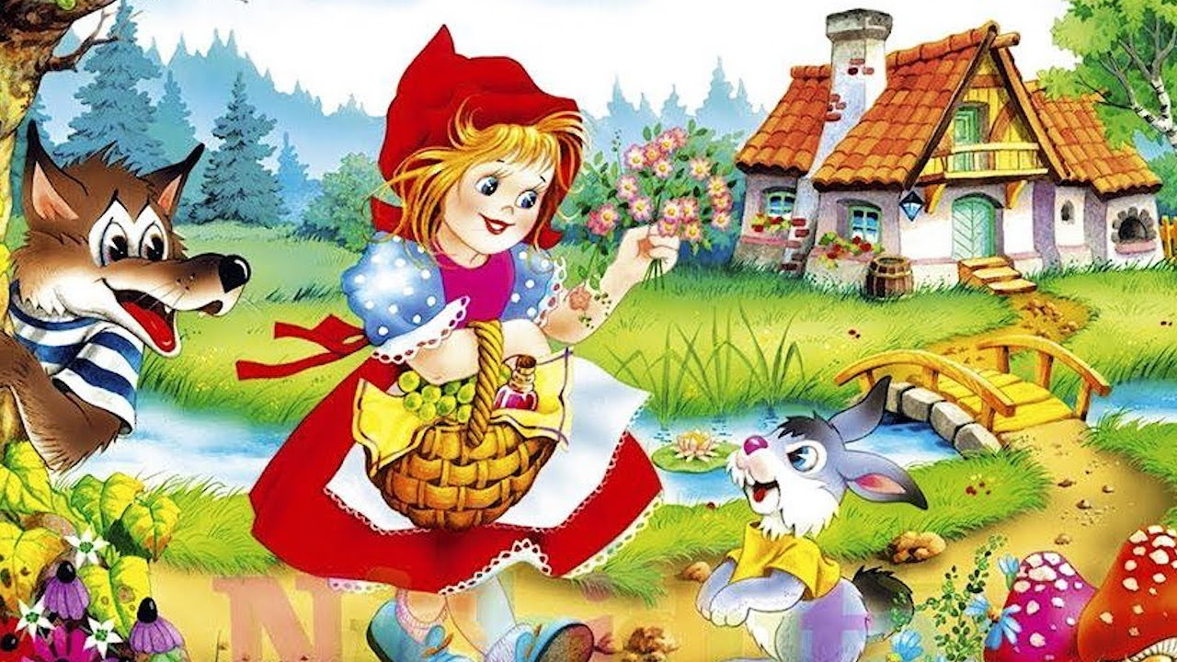
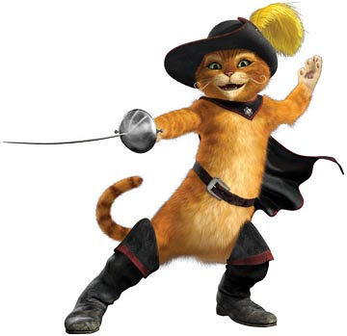
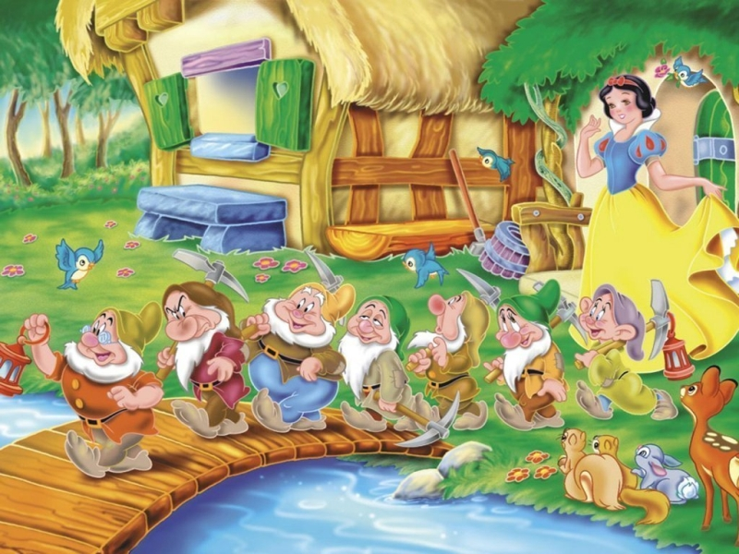

Slide 3
Tale

Slide 4
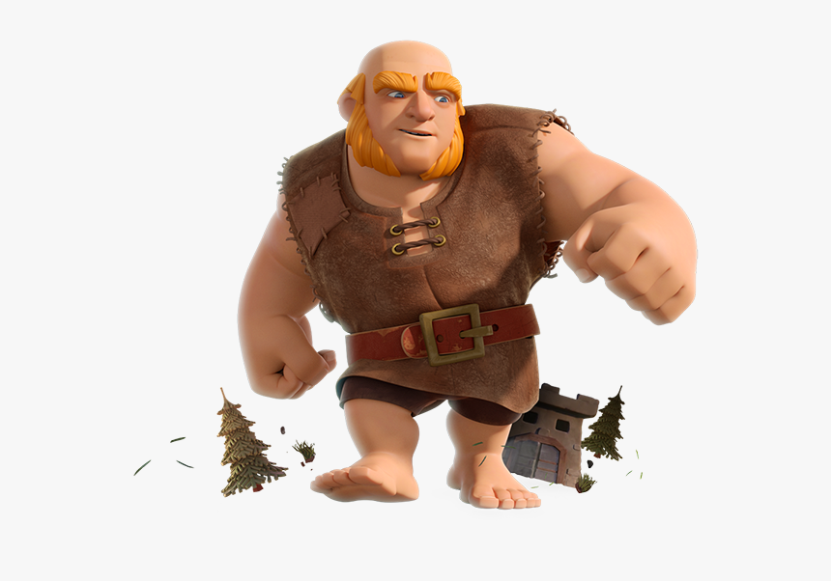
Giant

Slide 5
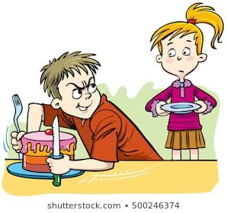
selfish

Slide 6
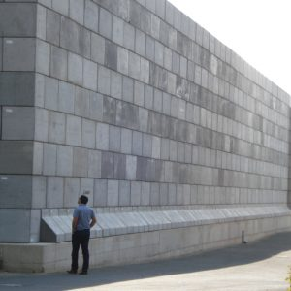
high wall

Slide 7
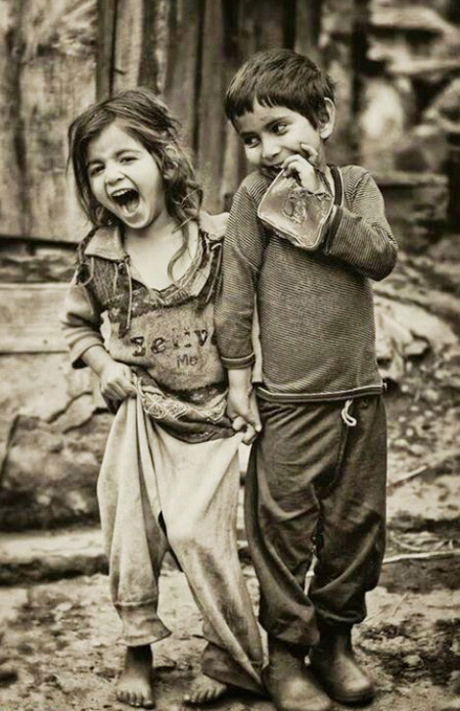
poor

Slide 8
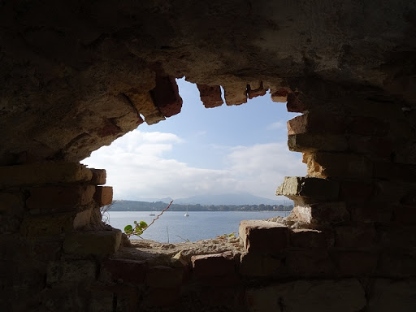
hole

Slide 9
branch

Slide 10
cover

Slide 11
blossom

Slide 12
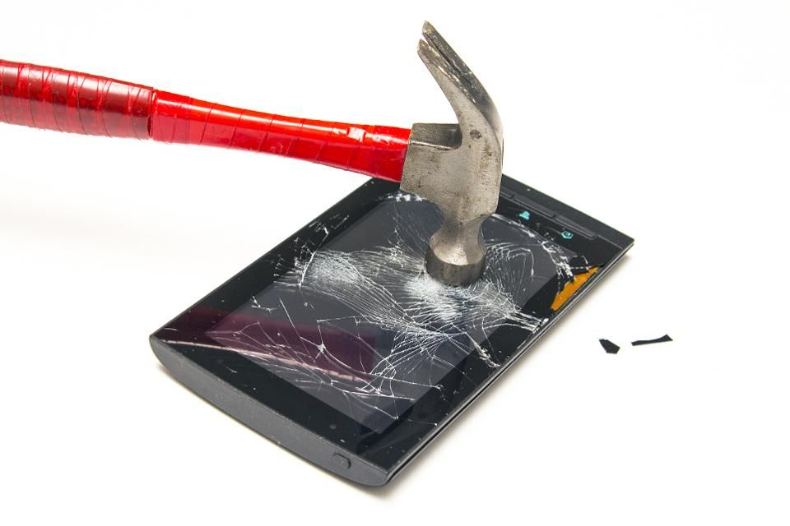
distroy

Slide 13
left?
right?
or

Slide 14
selfish

Slide 15
giant

Slide 16
Distroy

Slide 17
cover

Slide 18
poor

Slide 19
hole

Slide 20
branch

Slide 21
blossom

Slide 22
high wall

Slide 32
Good Job!!

