Slide 1
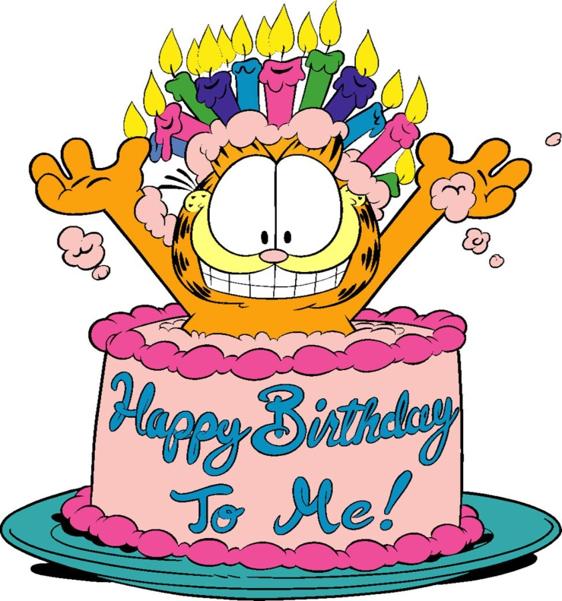
Lesson topic: Tommy’s Birthday
The 2nd form
Teacher:
Mariana Ursu

Slide 2
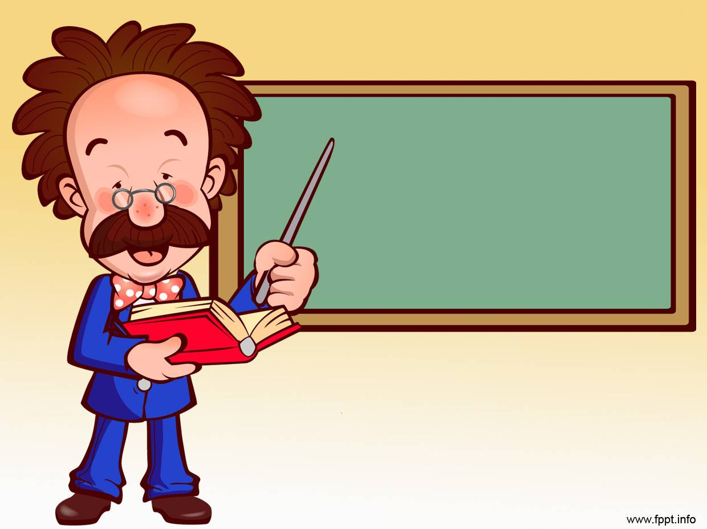
TODAY at the lesson:
- Learn new words;
- Read a text;
- Sing and have fun.

Slide 3
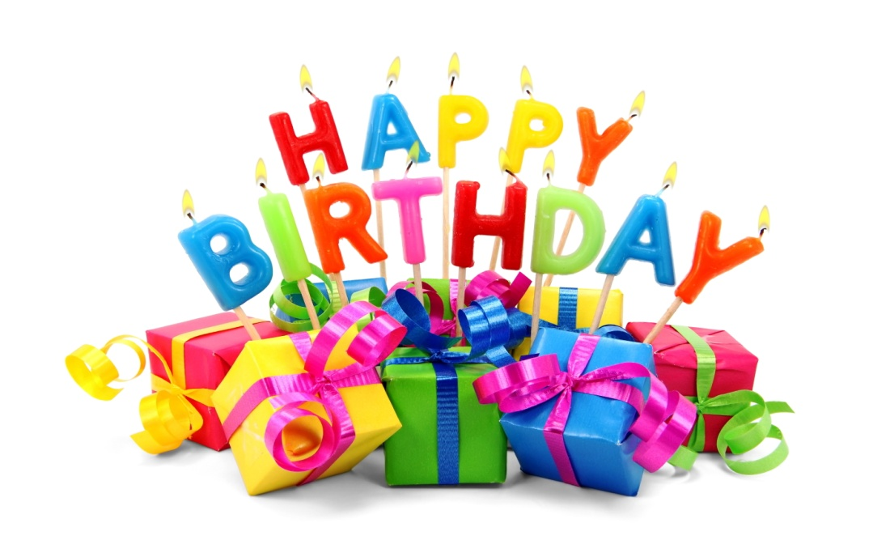
New
Vocabulary

Slide 4
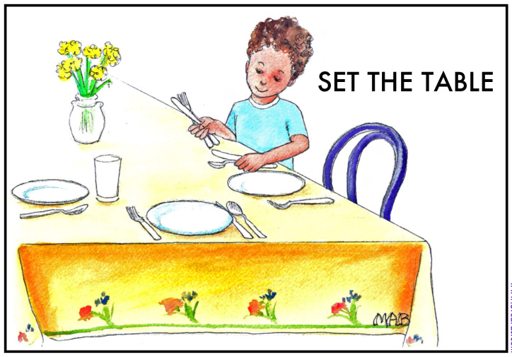
How to set the table
Form the comparison of the adjectives:

Slide 7
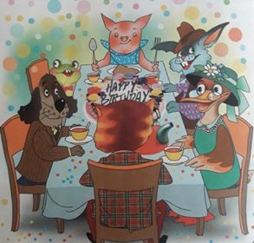
Tommy’s Birthday
This is Tommy cat’s living-room. It is large and light. There is a big table and six chairs in the room.
There are cups and saucers on the table. There are spoons, forks and plates on the table, too. There is a cake on a big plate.

Slide 8
Tommy’s Birthday
It is Tommy’s birthday. He is in the room with his friends. They are having tea and cake. They like the cake and they like the tea. They are singing Happy Birthday.

Slide 9
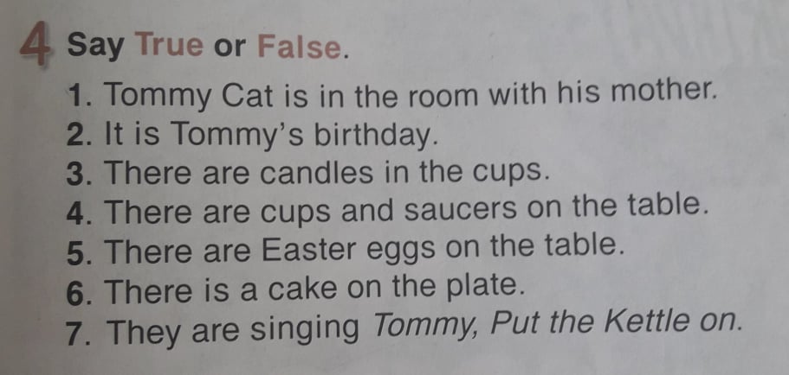
TRUE or FALSE

Slide 10
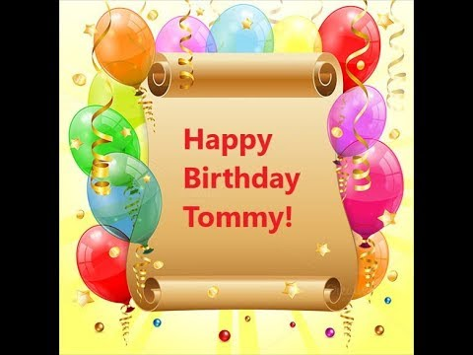
to

Slide 11
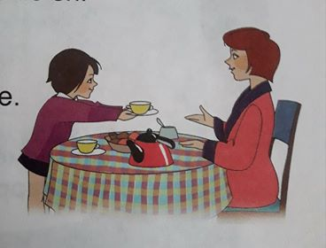
2. Here you are.
1. Pass me the cup, please.
3. Thank you.
4. You are welcome.
- Transmite-mi te rog ceașca.
Poftim.
Mulțumesc!
- Cu plăcere!

Slide 12
I can
- say the new words;
- read and translate the text;
sing HAPPY BIRTHDAY;
be polite at the table.

Slide 13
SELF-EVALUATION
I can | Independent | Guided | With more support
say the new words;
read and translate the text;
sing HAPPY BIRTHDAY;
be polite at the table.

Slide 14
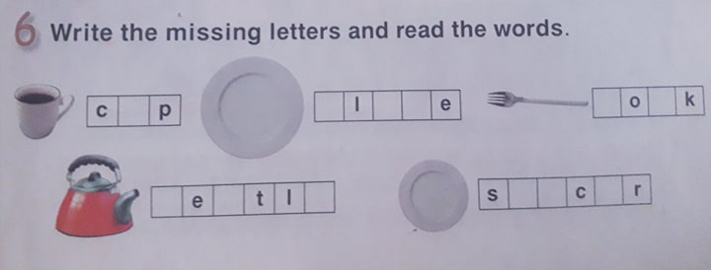
Homework: exercise 6, page 87.

Slide 15
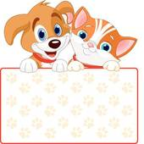
Thank you!
Goodbye!!!

