Slide 1
Prepositions!

Slide 2
in

Slide 3
on

Slide 4
in front of

Slide 5
next to

Slide 6
behind

Slide 7
under

Slide 8
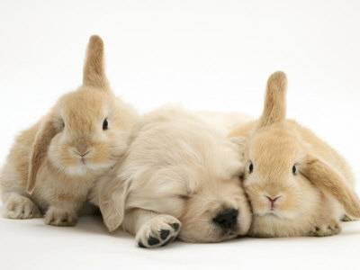
between

Slide 9
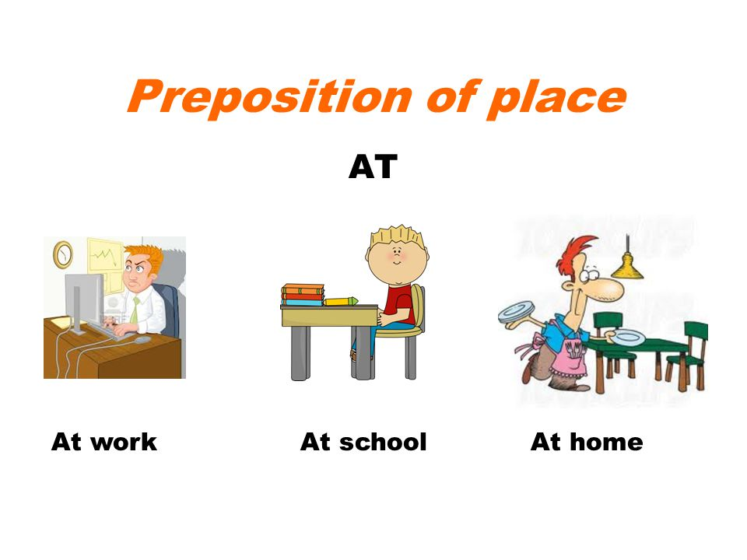

Slide 10
Where is the dog?
The dog is in the house.

Slide 11
Where is the dog?
The dog is on the house.

Slide 12
Where is the dog?
The dog is in front of the house.

Slide 13
Where is the dog?
The dog is next to the house.

Slide 14
Where is the cat?
The cat is behind the cupboard.

Slide 15
Where is the cat?
The cat is in the cupboard.

Slide 16
Where is the cat?
The cat is under the cupboard.

Slide 17
Where is the cat?
The cat is in front of the cupboard.

Slide 18
Where is the cat?
The cat is on the cupboard.

Slide 19
Where is the ball?
The ball is between the box and the bear.

Slide 20
Where is the boy?
The boy is at school.

Slide 21
Where is the girl?
The girl is behind the bed.

Slide 22
Where is the girl?
The girl is in the bed.

Slide 23
Where is the girl?
The girl is under the bed.

Slide 24
Where is the girl?
The girl is on the bed.

Slide 25
Where is the girl?
The girl is in front of the bed.

Slide 26
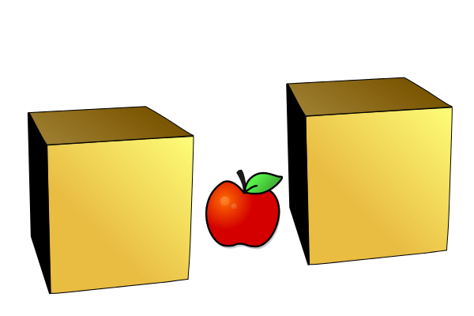
Where is the apple?
The apple is between the boxes.

Slide 27
Where is the man?
The man is at work.

Slide 28
Where is the boy?
The boy is in front of the car.

Slide 29
Where is the boy?
The boy is in the car.

Slide 30
Where is the boy?
The boy is behind the car.

Slide 31
Where is the boy?
The boy is under the car.

Slide 32
Where is the boy?
The boy is on the car.

Slide 33

Where is the girl?
The girl is at the mall.

Slide 34
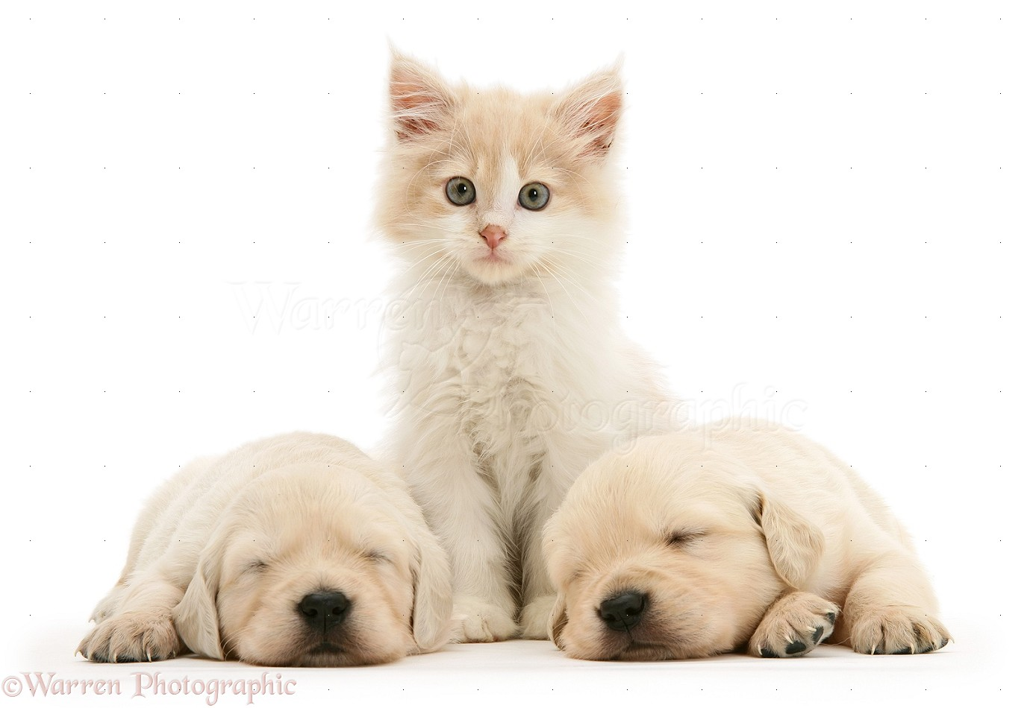
Where is the cat?
The cat is between the dogs.

